Slide 1
March 2026 primary preview
A look at the most competitive March primary elections in the fight for Congress
February 23, 2026
PRODUCER
Ryan Gest

Slide 2
Roadmap
March primary overview
Race spotlights
  Texas
  North Carolina
  Illinois

Slide 3
March primary dates and races to watch
MARCH ELECTION DATES
1 | 2 | 3 | 4 | 5 | 6 | 7
8 | 9 | 10 | 11 | 12 | 13 | 14
15 | 16 | 17 | 18 | 19 | 20 | 21
22 | 23 | 24 | 25 | 26 | 27 | 28
29 | 30 | 31
March 3: Arkansas ⦁ North Carolina ⦁ Texas
March 10: Mississippi
March 17: Illinois
KEY RACES TO WATCH
RACE (PRIMARY) | INCUMBENT | POTENTIAL CANDIDATES |  | CPR RATING
Texas Senate | John Cornyn (R) | Ken Paxton / Wesley Hunt | James Talarico / Jasmine Crockett | LIKELY R
TX-9 (R) | Open | Alex Mealer / Briscoe Cain / Dan Mims / Steve Stockman |  | SOLID R (FLIP)
TX-23 (R) | Tony Gonzales (R) | Brandon Herrera |  | SOLID R
TX-32 (R) | Open | Ryan Binkley / Paul Bondar / Jace Yarbrough |  | SOLID R (FLIP)
NC-1 (R) | Don Davis (D) | Laurie Buckhout / Asa Buck / Bobby Hanig |  | LEAN R
NC-4 (D) | Valerie Foushee (D) | Nida Allam |  | SOLID D
IL Senate (D) | Open | Raja Krishnamoorthi / Juliana Stratton / Robin Kelly |  | SOLID D
IL-2 (D) | Open | Jesse Jackson Jr. / Donna Miller / Robert Peters |  | SOLID D
IL-9 (D) | Open | Daniel Biss / Laura Fine / Kat Abughazaleh |  | SOLID D
SOURCE Rational360
PRESENTATION CENTER 2/23/26
Notes:
Sources:
“2026 Combined Congressional Calendar,” Rational360, December 23, 2025, https://rational360.com/2026-combined-congressional-calendar/

Slide 4
Roadmap
March primary overview
Race spotlights
  Texas
  North Carolina
  Illinois

Slide 5
Primaries to watch: Texas
RACE | INCUMBENT | POTENTIAL CANDIDATES | CPR RATING
Governor DEM PRIMARY | Greg Abbott (R) | Gina Hinojosa / Chris Bell / Bobby Cole | SOLID R
Senate | John Cornyn (R) | Ken Paxton / Wesley Hunt James Talarico / Jasmine Crockett | LIKELY R
TX-9 GOP PRIMARY | Open | Alex Mealer / Briscoe Cain / Dan Mims / Steve Stockman | SOLID R (FLIP)
TX-23 GOP PRIMARY | Tony Gonzales (R) | Brandon Herrera | SOLID R
TX-29 DEM PRIMARY | Sylvia Garcia (D) | Jarvis Johnson / Robert Slater | SOLID D
TX-30 DEM PRIMARY | Open | Frederick Haynes III / Rodney LaBruce | SOLID D
TX-32 GOP PRIMARY | Open | Ryan Binkley / Paul Bondar / Jace Yarbrough | SOLID R (FLIP)
SOURCE Ballotpedia, Federal Election Commission, RealClearPolitics, Decision Desk HQ, VoteHub
PRESENTATION CENTER 2/23/26

Slide 6
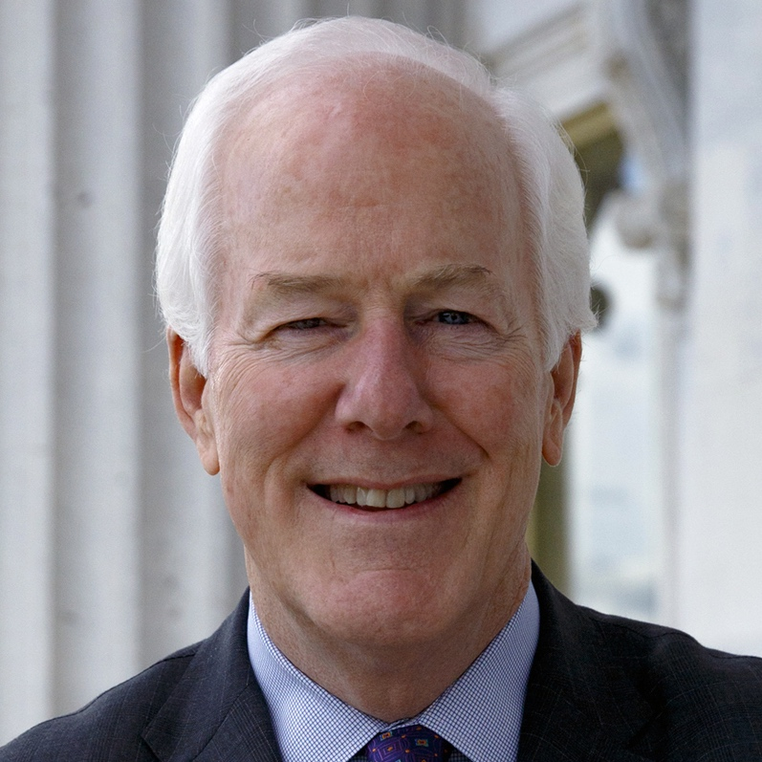
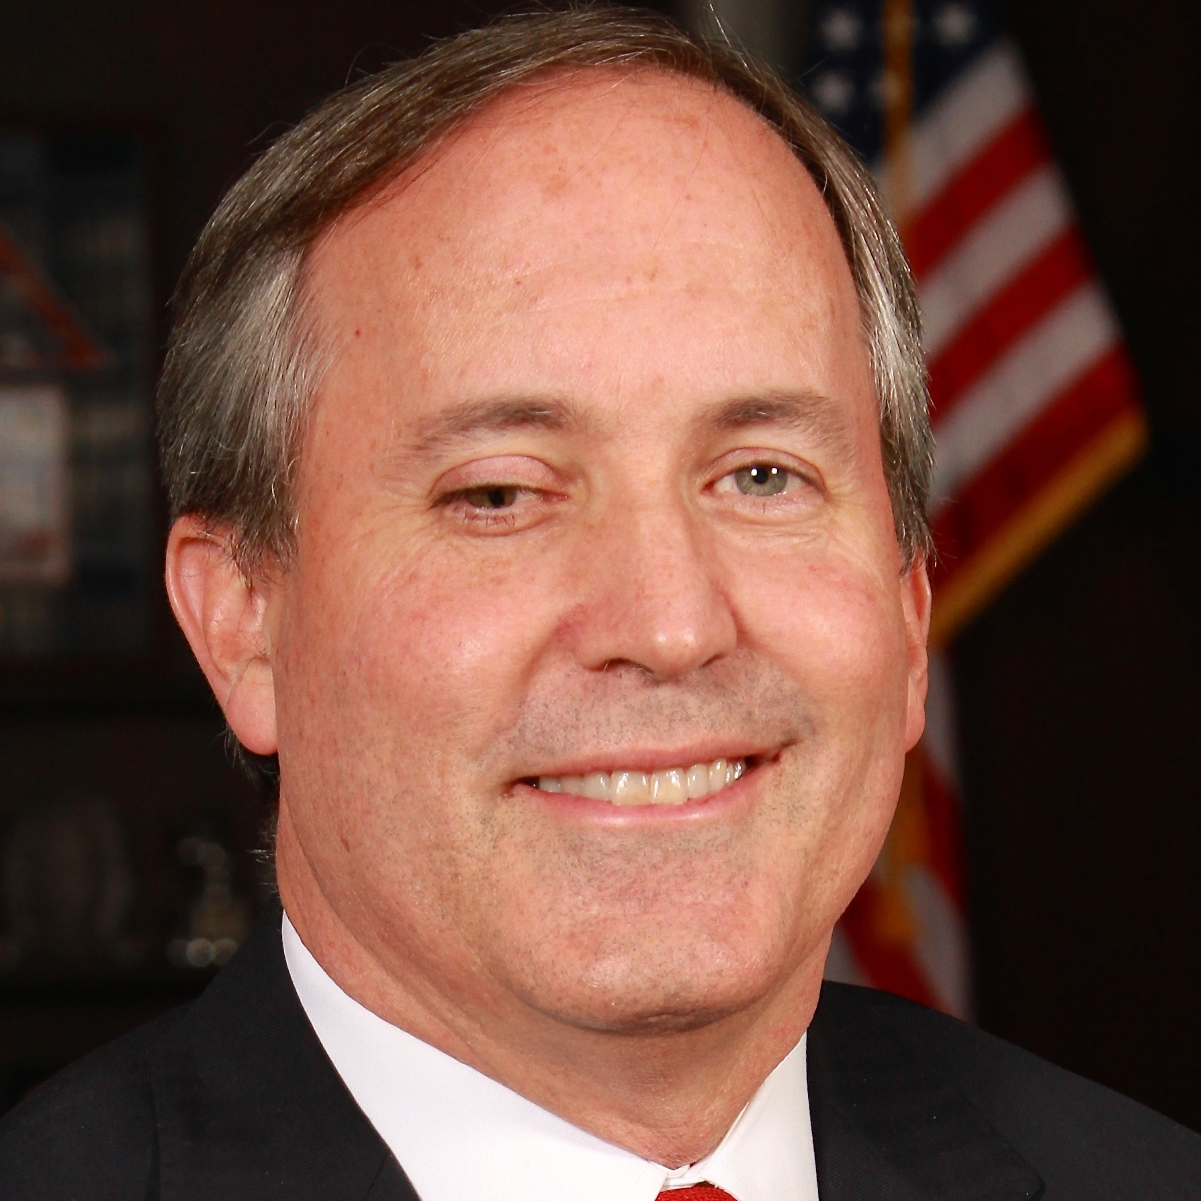
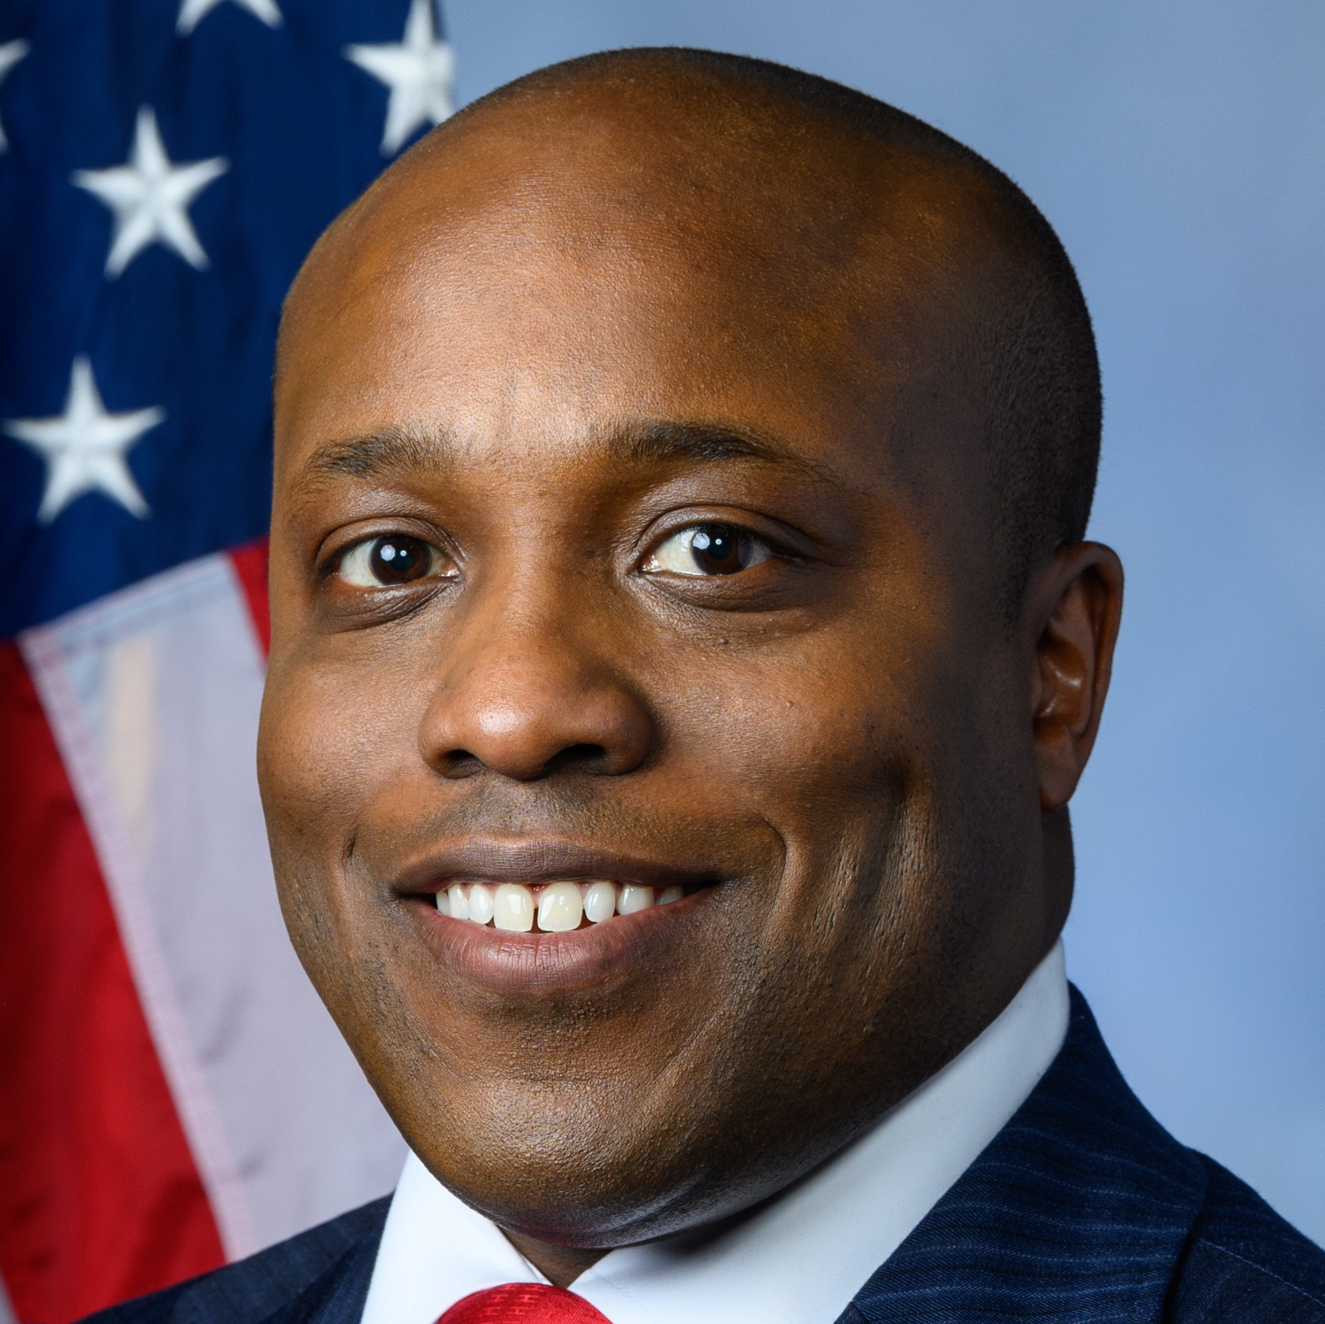
March 3: Texas Senate Republican Primary
KEY CONTENDERS | FUNDRAISED | POLL AVG. | NOTABLE ENDORSEMENTS
John Cornyn Incumbent Senator since 2002 | $10,030,736 | 27.7% | Sen. John Thune (R-SD) / Sen. John Barrasso (R-WY) / Sen. Tim Scott (R-SC) / NRSC / AIPAC
Ken Paxton Attorney General since 2015 | $5,320,191 | 31.9% | Rep. Troy Nehls (R-TX-22) / TPAction
Wesley Hunt US Representative since 2023 | $1,800,720 | 19.3% | Rep. Eli Crane (R-AZ-2)
  WHAT TO KNOW
  Attorney General Ken Paxton and Rep. Wesley Hunt are challenging incumbent Sen. John Cornyn in a high-profile clash between the GOP establishment and its hardline conservative wing
  Paxton argues Cornyn is insufficiently conservative, while Cornyn highlights Paxton’s legal troubles, including his 2023 impeachment by the GOP-led state House
  Paxton has led consistently in polling, though the race is almost certain to advance to a runoff, as no candidate is likely to clear the 50 percent threshold
  Cornyn has been endorsed by Senate leadership, but President Trump and Sen. Ted Cruz have not yet endorsed a candidate
SOURCE Ballotpedia, Federal Election Commission, RealClearPolitics, Decision Desk HQ, VoteHub
PRESENTATION CENTER 2/23/26
Notes:
2026 Election United States Senate - Texas - FEC.gov. (2024). FEC.gov. https://www.fec.gov/data/elections/senate/TX/2026/
‌
Kamisar, B., Bowman, B., & V, F. T. (2025, April 9). “Con man” vs. “anti-Trump”: Years of Republican fighting fuel a nasty Senate primary in Texas. NBC News. https://www.nbcnews.com/politics/2026-election/con-man-vs-anti-trump-years-republican-fighting-fuel-nasty-senate-prim-rcna200479
‌
Texas Senate Republican Primary Ballot Test | DDHQ. (2026). Decisiondeskhq.com. https://polls.decisiondeskhq.com/averages/primary-ballot-test/2026-tx-us-senate-gop/texas/republicans-lv-rv-adults-independents
‌
Ballotpedia. (n.d.). United States Senate election in Texas, 2026 (March 3 Republican primary). Retrieved February 11, 2026, from https://ballotpedia.org/United_States_Senate_election_in_Texas,_2026_(March_3_Republican_primary)

Slide 7
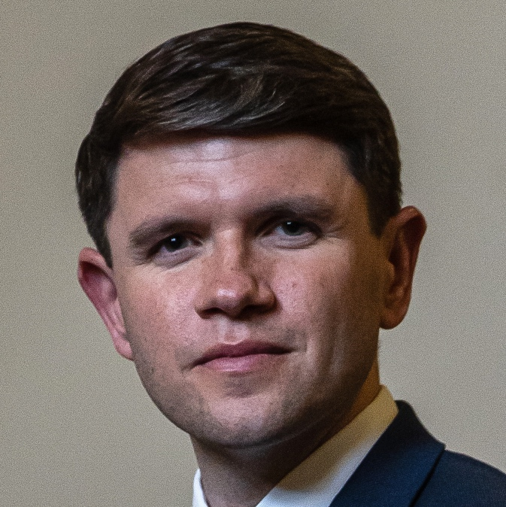
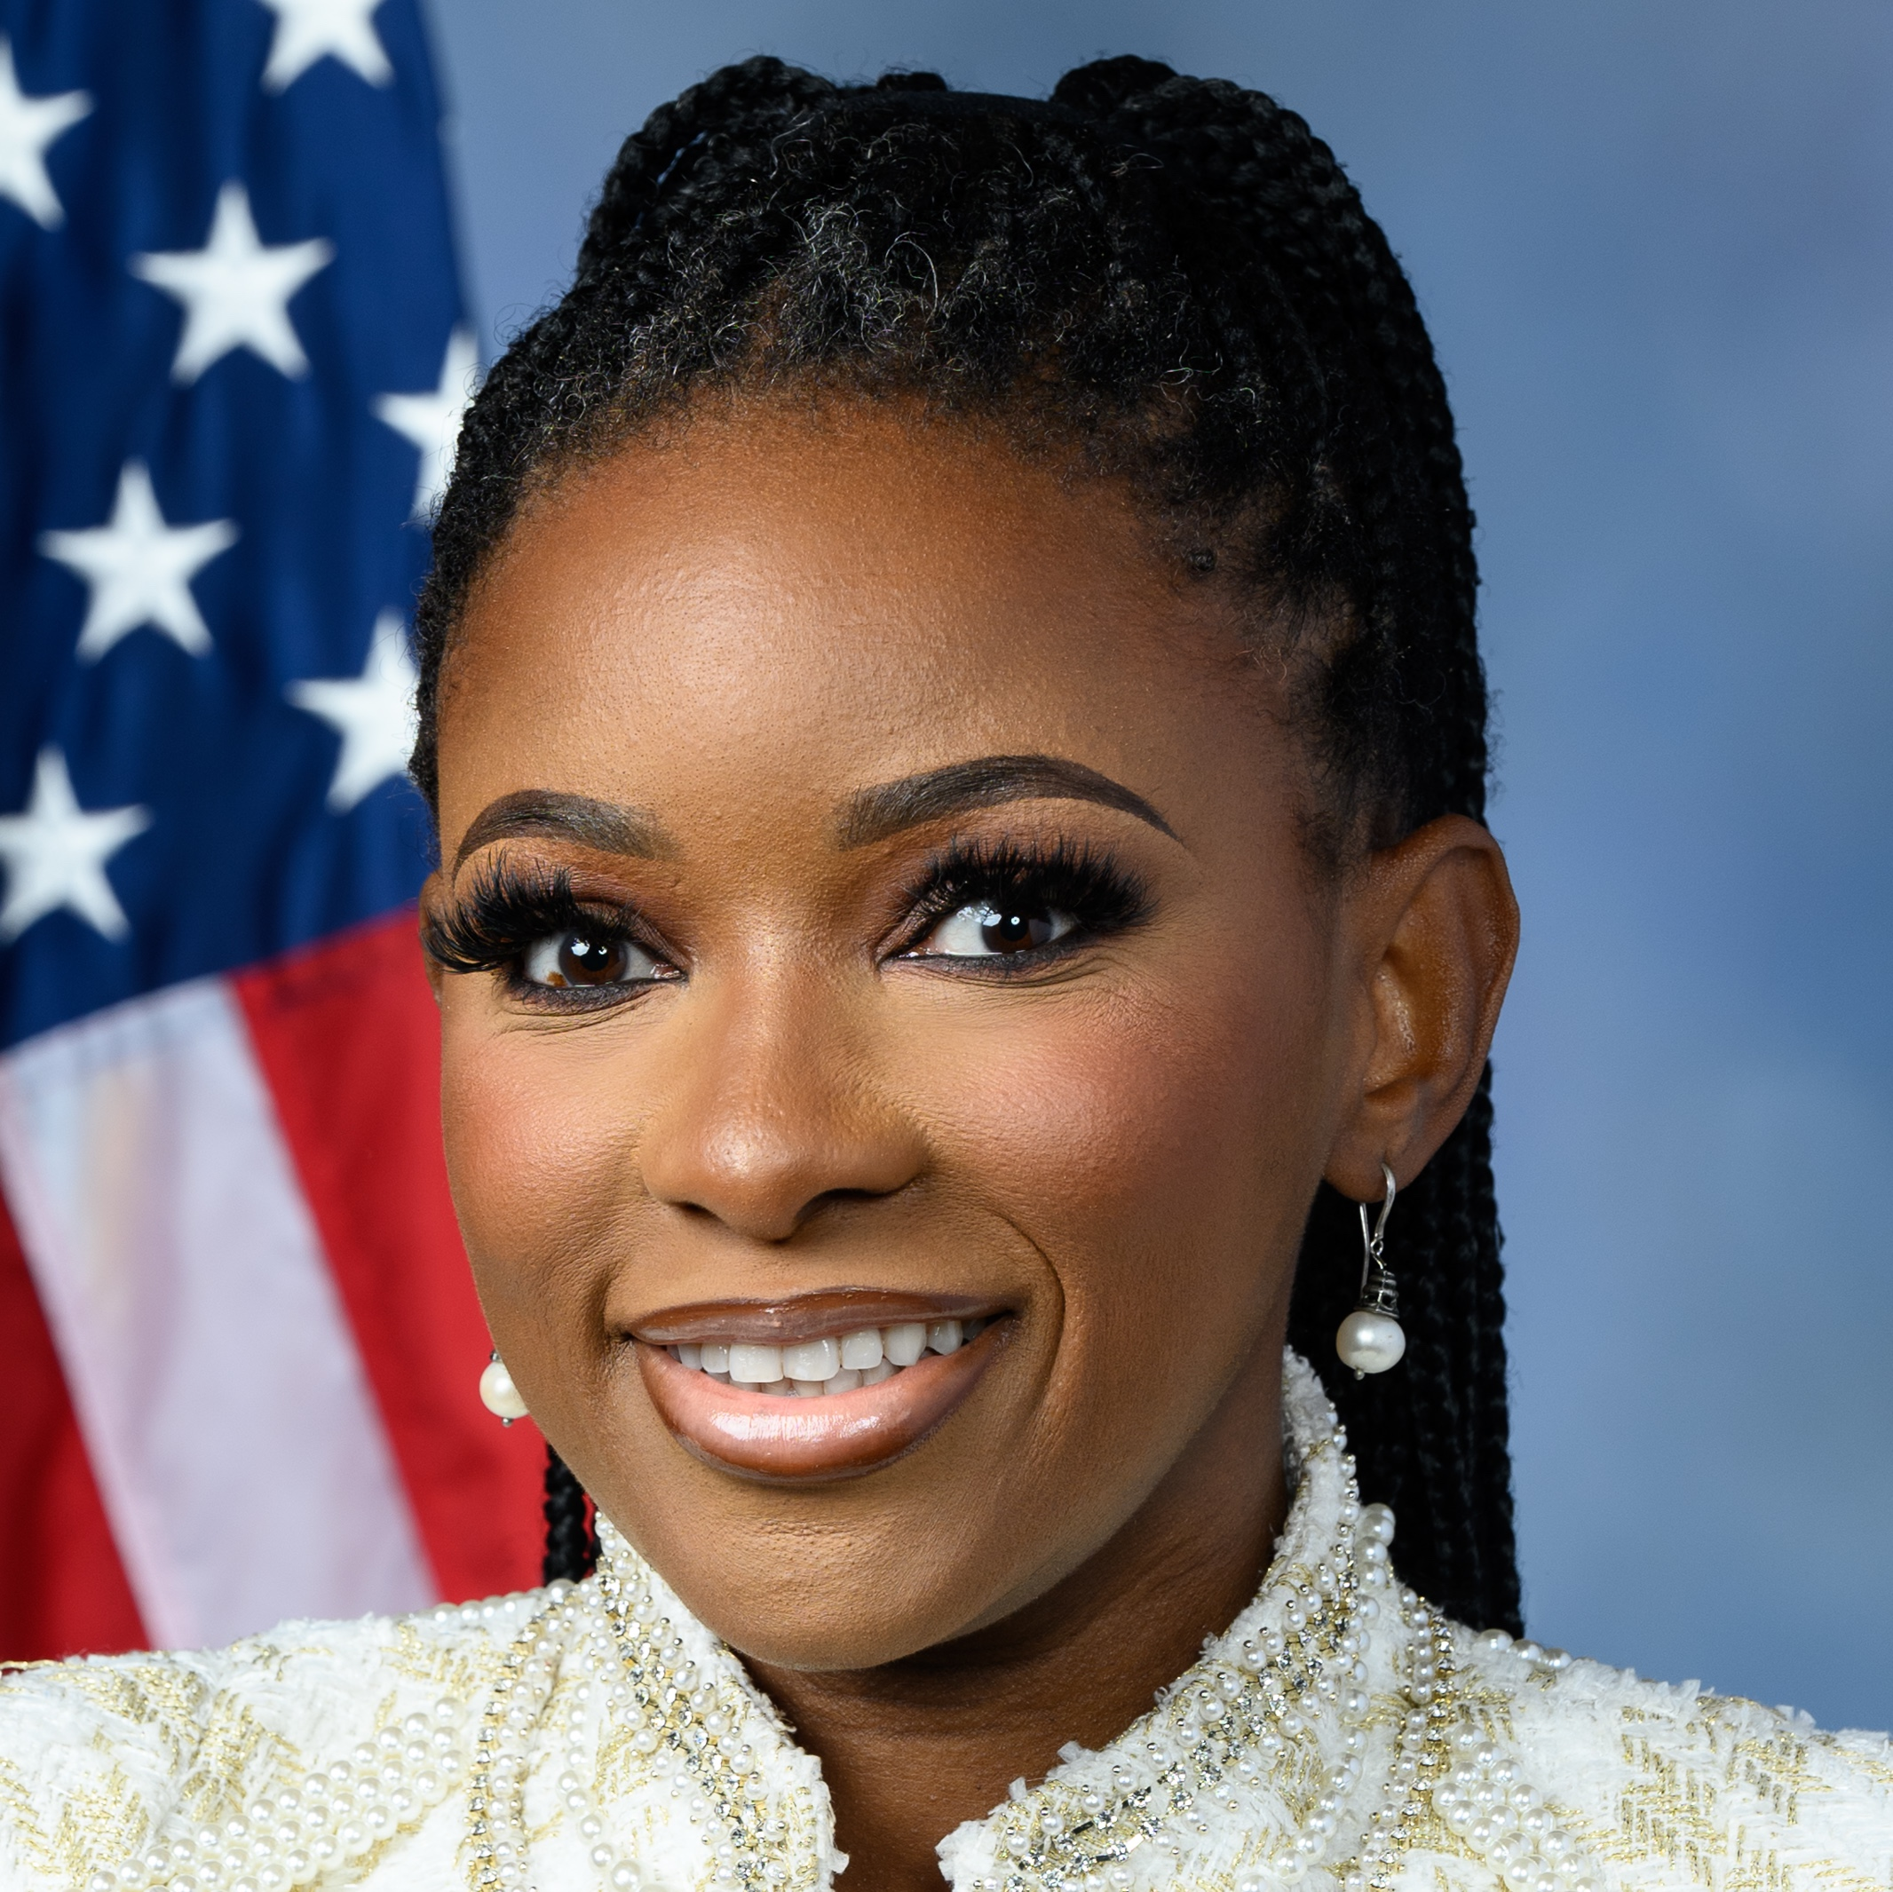
March 3: Texas Senate Democratic Primary
KEY CONTENDERS | FUNDRAISED | POLL AVG. | NOTABLE ENDORSEMENTS
James Talarico State Representative since 2018 | $13,152,583 | 39.7% | Sen. Martin Heinrich (D-NM) / Rep. Julie Johnson (D-TX-23) / Houston Chronicle
Jasmine Crockett US Representative since 2023 | $6,531,174 | 42.7% | Former Rep. Colin Allred (D-TX-32) / Rep. Ro Khanna (D-CA-17) / Rep. Ayanna Pressley (D-MA-7) / EMILYs List
  WHAT TO KNOW
  Democrats, who have not won a statewide election in Texas since 1994, see an opening due to the divisive Republican primary
  State Rep. James Talarico is favored over Rep. Jasmine Crockett, backed by stronger head-to-head polling against potential Republican opponents and a significant fundraising edge, having raised $13M to Crockett’s $6.5M in 2025
  Racial divides could ultimately determine the outcome of the race
    Talarico faced backlash from allegations made by a TikTok influencer who alleged he described former Rep. Colin Allred as a “mediocre Black man,” which he called a mischaracterization; Allred labeled the remark disqualifying and endorsed Crockett
    Crockett has built an advantage among Black voters while Talarico has shown strength among Latino voters, with Crockett arguing some Latino voters were “gaslit” over her 2024 Vanity Fair comments comparing certain Latino immigrants’ views on undocumented immigrants to a “slave mentality”
SOURCE Ballotpedia, Federal Election Commission, RealClearPolitics, Decision Desk HQ, VoteHub
PRESENTATION CENTER 2/23/26
Notes:
2026 Election United States Senate - Texas - FEC.gov. (2024). FEC.gov. https://www.fec.gov/data/elections/senate/TX/2026/
‌
2026 Texas Senate - Democratic Primary | RealClearPolling. (2025). Realclearpolling.com. https://www.realclearpolling.com/polls/senate/democratic-primary/2026/texas
‌
Bowman, B. (2026, February 5). Viral dispute over “mediocre” comment exposes racial divides in Democrats’ Texas Senate primary. NBC News. https://www.nbcnews.com/politics/2026-election/viral-dispute-mediocre-comment-exposes-racial-divides-democrats-texas-rcna257284
Ballotpedia. (n.d.). United States Senate election in Texas, 2026 (March 3 Democratic primary). Retrieved February 11, 2026, from https://ballotpedia.org/United_States_Senate_election_in_Texas,_2026_(March_3_Democratic_primary)

Slide 8
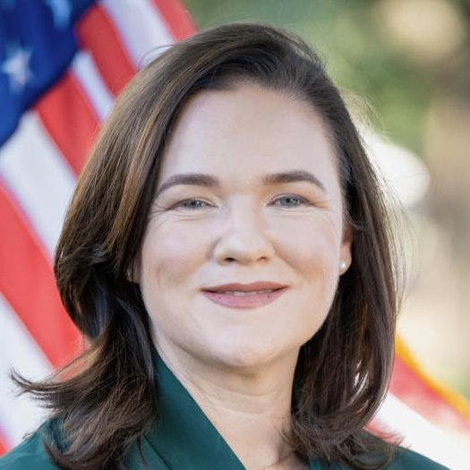
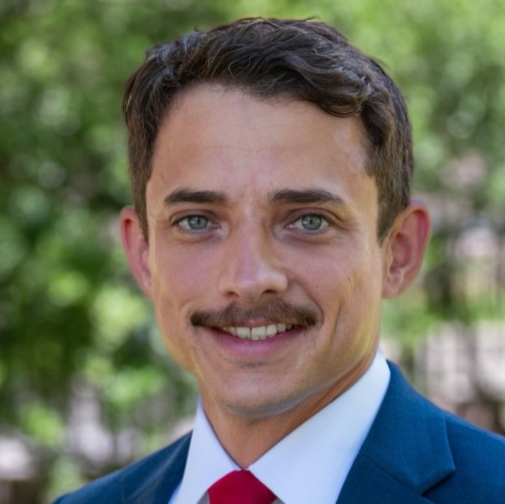
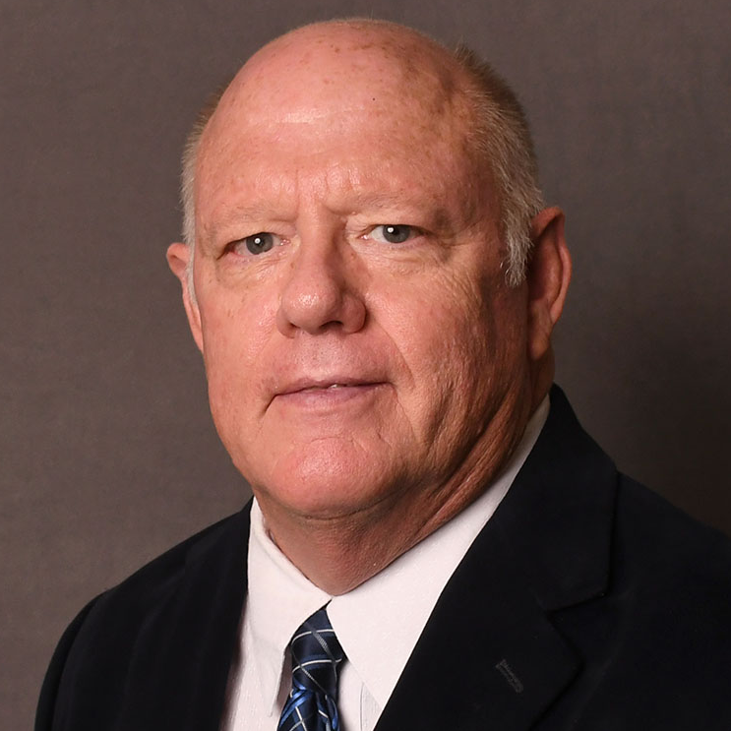
March 3: Texas 9th District Republican Primary
KEY CONTENDERS | FUNDRAISED | NOTABLE ENDORSEMENTS
Alex Mealer METRO board member and nominee for Harris County Judge in 2022 | $988,250 | President Donald Trump / Rep. Jim Jordan (R-OH-4) / Jim McIngvale
Briscoe Cain State representative since 2017 | $383,692 | Gov. Greg Abbott (R-TX) / 3 US House Reps / Former Rep. Tom DeLay (R-TX-22) / Houston Chronicle
Dan Mims State representative since 2017 | $347,089 | ---
  WHAT TO KNOW
  President Trump has endorsed Alex Mealer in the competitive Republican primary for Texas’ 9th District, which is currently held by Rep. Al Green (D) but was redrawn to favor Republicans in this year’s elections
  The 9th District, which includes southern Houston suburbs such as Missouri City, voted for Kamala Harris by 44 percentage points in the 2024 presidential election before redistricting but would have voted for Donald Trump by 20 percentage points under the new lines
  An early February University of Houston poll shows Mealer leading with 34 percent, followed by state Rep. Briscoe Cain at 26 percent, making a runoff likely since no candidate is on track to surpass 50 percent
SOURCE Ballotpedia, Federal Election Commission, RealClearPolitics, Decision Desk HQ, VoteHub
PRESENTATION CENTER 2/23/26
Notes:
2026 Election United States House - Texas - District 9 - FEC.gov. (2026). FEC.gov. https://www.fec.gov/data/elections/house/TX/09/2026/
‌
Ballotpedia. (n.d.). Texas’ 9th congressional district election, 2026 (March 3 Republican primary). Retrieved February 11, 2026, from https://ballotpedia.org/Texas%27_9th_Congressional_District_election,_2026_(March_3_Republican_primary)
Svitek, Patrick. 2026. “Some Abbott-Backed Candidates Face Political Headwinds in Republican Primaries.” The Texas Tribune. February 18, 2026. https://www.texastribune.org/2026/02/18/greg-abbott-endorsements-texas-republican-primaries-trump/.
‌
Goodman, Claire. 2026. “President Donald Trump Endorses Alex Mealer in Texas’ 9th Congressional District Race.” Yahoo News. February 17, 2026. https://www.yahoo.com/news/articles/president-donald-trump-endorses-alex-232721782.html.
“2026 Endorsement Tracker.” 2026. VoteHub. January 8, 2026. https://votehub.com/2026-endorsements.
‌
‌

Slide 9
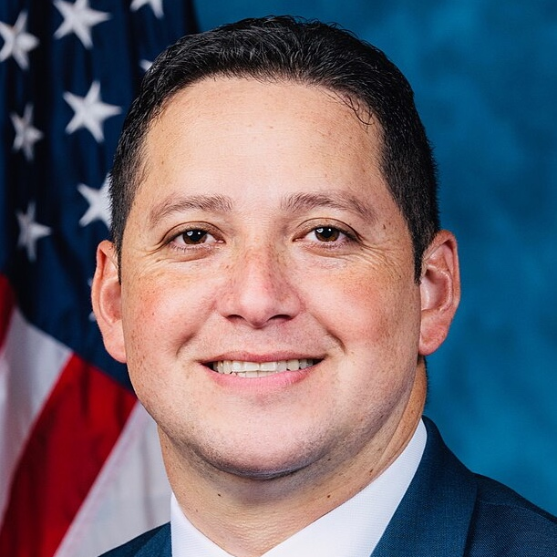

March 3: Texas 23rd District Republican Primary
KEY CONTENDERS | FUNDRAISED | NOTABLE ENDORSEMENTS
Tony Gonzales Incumbent Representative since 2021 | $1,770,982 | President Donald Trump / AIPAC
Brandon Herrera YouTuber; Firearms manufacturer | $864,186 | GOA / NAGR
  WHAT TO KNOW
  Rematch of the 2024 primary, where Gonzales defeated Herrera 50.6 percent to 49.4 percent in a runoff after neither candidate secured a majority in the initial contest
  Gonzales is considered a centrist and did not receive President Trump’s endorsement in 2022 or 2024, but has secured his backing this cycle against Herrera, who is aligned with the party’s far right and has more than 4 million YouTube subscribers focused on testing and reviewing firearms
  Texas’ 23rd Congressional District is a Hispanic majority district spanning much of southwestern Texas, including the Big Bend region, southern and western San Antonio suburbs, and southwestern El Paso suburbs, and under the new congressional map would have supported Trump by 14.8 points in the 2024 presidential election
SOURCE Ballotpedia, Federal Election Commission, RealClearPolitics, Decision Desk HQ, VoteHub
PRESENTATION CENTER 2/23/26
Notes:
2026 Election United States House - Texas - District 23 - FEC.gov. (2026). FEC.gov. https://www.fec.gov/data/elections/house/TX/23/2026/
‌
Ballotpedia. (n.d.). Texas' 23rd congressional district election, 2026 (March 3 Republican primary). Retrieved February 11, 2026, from https://ballotpedia.org/Texas%2723rd_Congressional_District_election,_2026_(March_3_Republican_primary)
Bandler, A. (2026, February 6). Texas Republican faces another close primary challenge from YouTuber who has used Nazi imagery. JNS.org. https://www.jns.org/texas-republican-faces-another-close-primary-challenge-from-youtuber-who-has-used-nazi-imagery/
‌
Brandon Herrera - YouTube. (n.d.). Www.youtube.com. https://www.youtube.com/@BrandonHerrera
‌
Census profile: Congressional District 23, TX. (n.d.). Census Reporter. https://censusreporter.org/profiles/50000US4823-congressional-district-23-tx/
‌
Astudillo, C. (2025, August 18). Texas Republicans’ redistricting maps drawn: Analysis in charts. The Texas Tribune. https://www.texastribune.org/2025/08/18/texas-redistricting-maps-charts-analysis/
Esquivel, E. (2025, December 18). Trump endorses Congressman Tony Gonzales for re-election in Texas. KFOX. https://kfoxtv.com/news/local/trump-endorses-congressman-tony-gonzales-for-re-election-in-texas

Slide 10

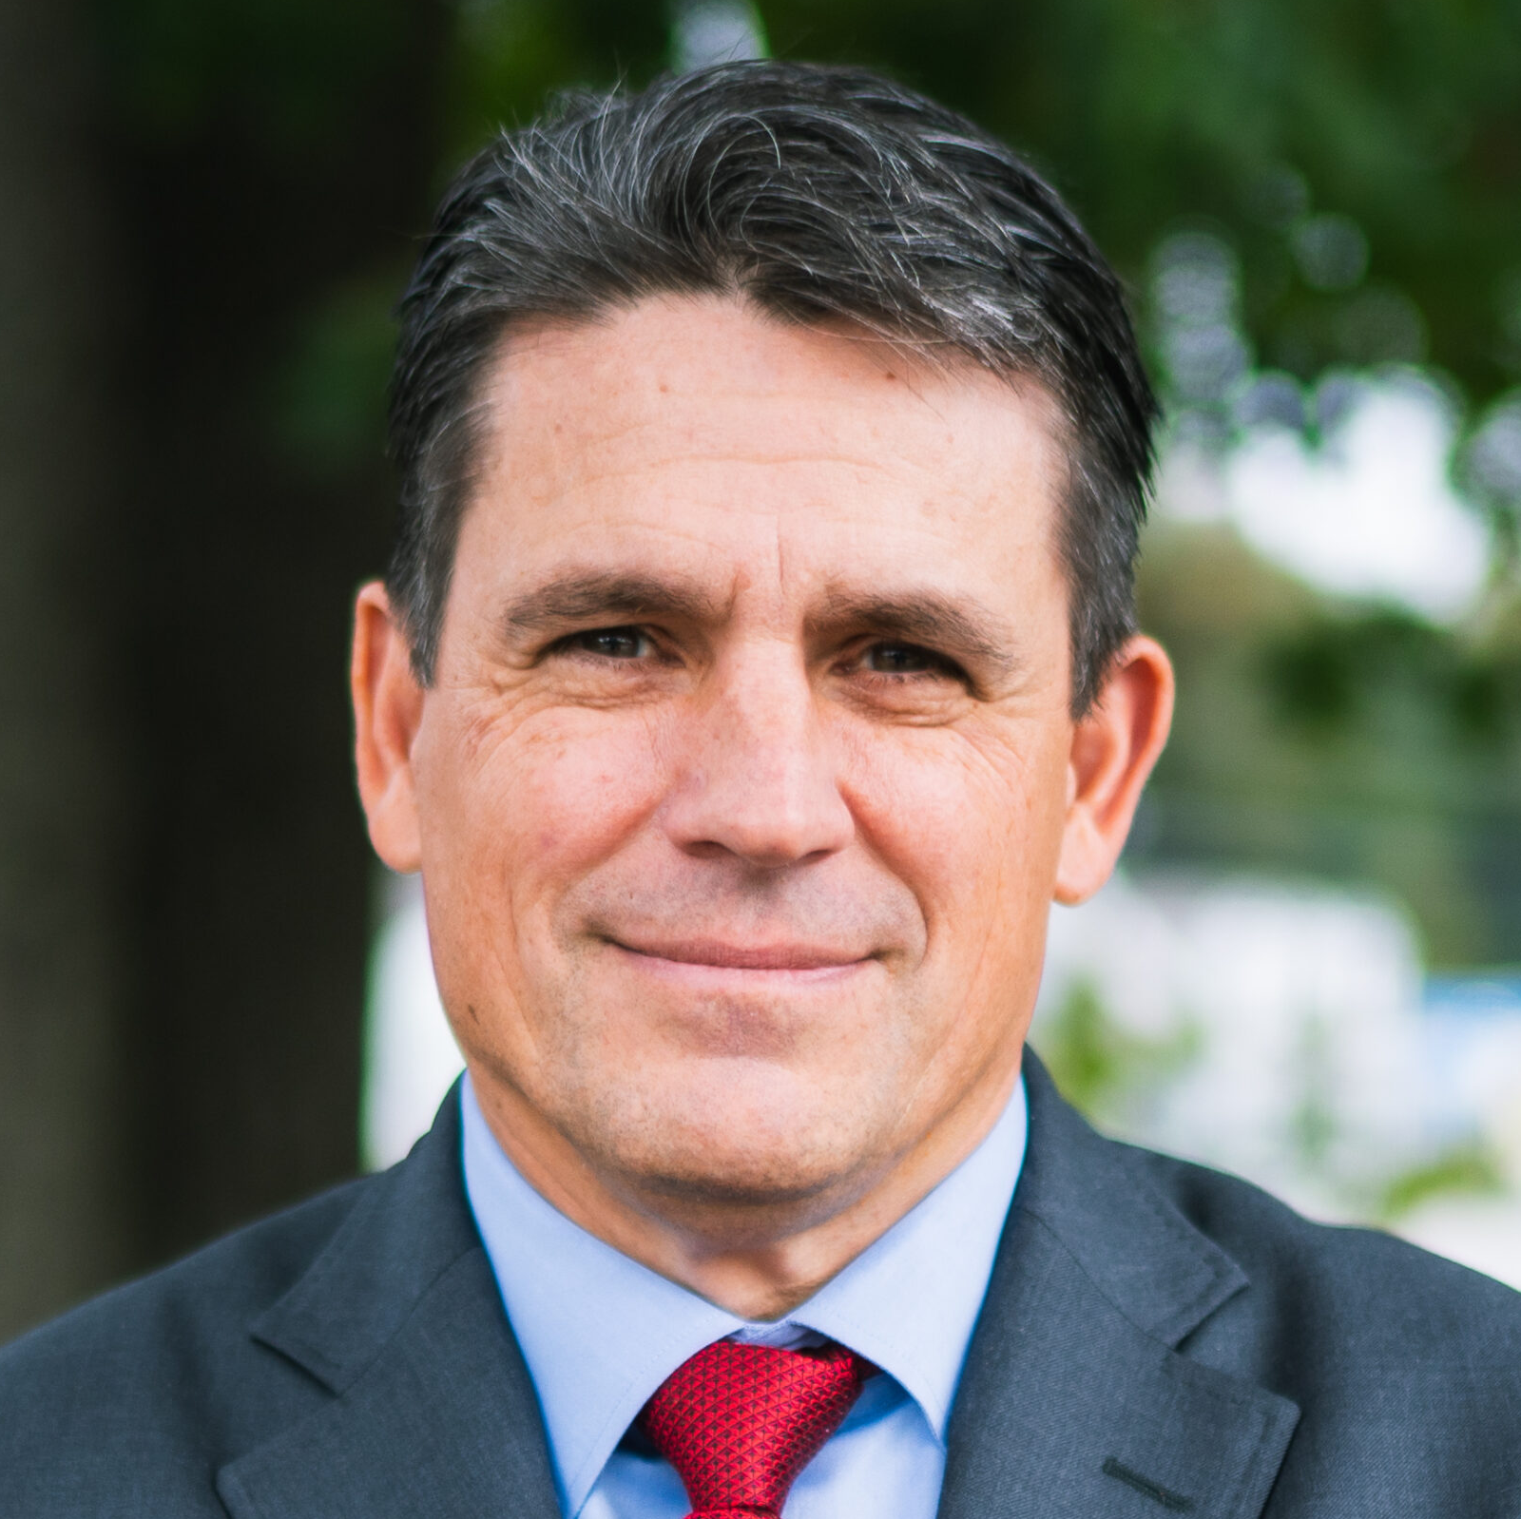
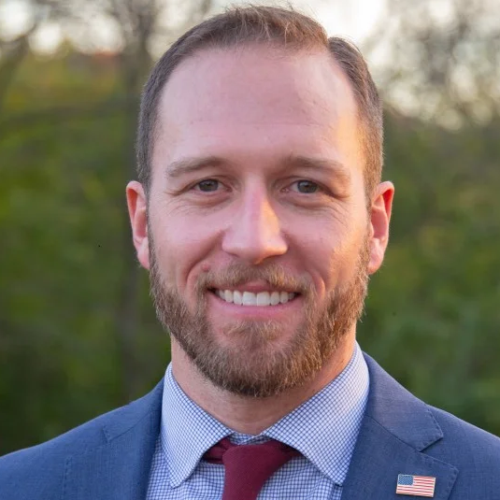
March 3: Texas 32nd District Republican Primary
KEY CONTENDERS | FUNDRAISED | NOTABLE ENDORSEMENTS
Paul Bondar Insurance agency owner | $1,905,588 | ---
Ryan Binkley Pastor | $1,258,716 | Rep. Jake Ellzey (R-TX-6)
Jace Yarbrough Attorney | $325,183 | President Donald Trump, Speaker Mike Johnson (R-LA-4) / Gov. Greg Abbott (R-TX) / House Whip Tom Emmer (R-MN-6)
  WHAT TO KNOW
  President Trump has endorsed Jace Yarbrough in the competitive Republican primary for Texas’ 32nd District, where incumbent Rep. Julie Johnson (D) was redrawn out of the district
  The 32nd District, which covers northern and eastern Dallas and its inner northern suburbs, voted in favor of Kamala Harris by 24 percentage points in the 2024 presidential election before redistricting but would have voted for Donald Trump by 18 percentage points under the new lines
  With nine candidates in the race, a runoff is possible, with Yarbrough the only candidate who has a chance of clearing 50 percent with President Trump’s endorsement
SOURCE Ballotpedia, Federal Election Commission, RealClearPolitics, Decision Desk HQ, VoteHub
PRESENTATION CENTER 2/23/26
Notes:
2026 Election United States Senate - Texas - FEC.gov. (2024). FEC.gov. https://www.fec.gov/data/elections/senate/TX/2026/
‌
Kamisar, B., Bowman, B., & V, F. T. (2025, April 9). “Con man” vs. “anti-Trump”: Years of Republican fighting fuel a nasty Senate primary in Texas. NBC News. https://www.nbcnews.com/politics/2026-election/con-man-vs-anti-trump-years-republican-fighting-fuel-nasty-senate-prim-rcna200479
‌
Texas Senate Republican Primary Ballot Test | DDHQ. (2026). Decisiondeskhq.com. https://polls.decisiondeskhq.com/averages/primary-ballot-test/2026-tx-us-senate-gop/texas/republicans-lv-rv-adults-independents
‌
Ballotpedia. (n.d.). United States Senate election in Texas, 2026 (March 3 Republican primary). Retrieved February 11, 2026, from https://ballotpedia.org/United_States_Senate_election_in_Texas,_2026_(March_3_Republican_primary)

Slide 11
Roadmap
March primary overview
Race spotlights
  Texas
  North Carolina
  Illinois

Slide 12
Primaries to watch: North Carolina
RACE | INCUMBENT | POTENTIAL CANDIDATES | CPR RATING
Senate | Open | Roy Cooper Michael Whatley / Don Brown / Michele Morrow | TOSS UP
NC-1 GOP PRIMARY | Don Davis (D) | Laurie Buckhout / Asa Buck / Bobby Hanig | LEAN R
NC-4 DEM PRIMARY | Valerie Foushee (D) | Nida Allam | SOLID D
SOURCE Ballotpedia, Federal Election Commission, RealClearPolitics, Decision Desk HQ
PRESENTATION CENTER 2/23/26

Slide 13
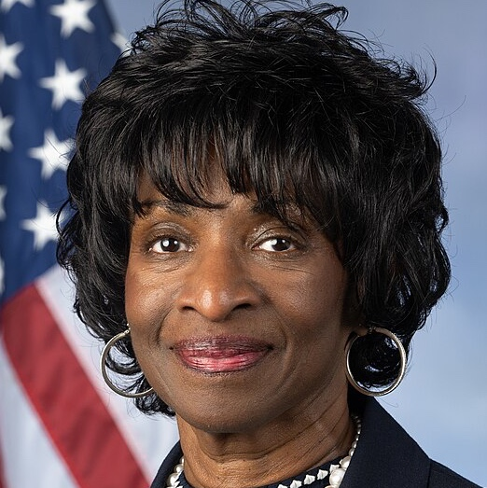

March 3: North Carolina 4th District Democratic Primary
KEY CONTENDERS | FUNDRAISED | NOTABLE ENDORSEMENTS
Valerie Foushee Incumbent representative since 2023 | $361,920 | Gov. Josh Stein (D-NC) / Former Gov. Roy Cooper (D-NC) / Rep. Maxwell Frost (D-FL-10) / Rep. Deborah Ross (D-NC-2)
Nida Allam Durham County Commissioner since 2020 | $334,740 | Sen. Bernie Sanders (I-VT) / Former DNC Vice Chair David Hogg
  WHAT TO KNOW
  Rematch between Foushee and Allam, who competed for the then-open seat in 2022, when Foushee defeated Allam 46 percent to 37 percent
  The redrawn 4th District differs from the lines used in 2022, with roughly 22 percent of Foushee’s previous voters now outside the district, compared with about 5 percent of Allam’s
  Foushee is a former Chapel Hill police administrator who served 15 years in local elected office and 10 years in the North Carolina General Assembly before winning her congressional seat, while Allam is an organizer and vice chair of the Durham County Board of Commissioners
  Foushee has secured endorsements from several high-profile North Carolina Democratic officials, while Allam has progressive support, including backing from Sen. Bernie Sanders and former DNC Vice Chair David Hogg
  From a partisan standpoint, the district remains strongly Democratic, having voted for Kamala Harris by 45 points in 2024 and projected to do so again under the new lines
SOURCE Ballotpedia, Federal Election Commission, RealClearPolitics, Decision Desk HQ, VoteHub
PRESENTATION CENTER 2/23/26
Notes:
Incumbent Valerie Foushee (D), Nida Allam (D), and Mary Patterson (D) are running in the Democratic primary for North Carolina’s 4th Congressional District on March 3, 2026 - Ballotpedia News. (2026, February 4). Ballotpedia.org. https://news.ballotpedia.org/2026/02/04/incumbent-valerie-foushee-d-nida-allam-d-and-mary-patterson-d-are-running-in-the-democratic-primary-for-north-carolinas-4th-congressional-district-on-march-3-2026/
‌
A Detailed Analysis of North Carolina’s New Congressional Map. (2025). Insideelections.com. https://www.insideelections.com/news/article/a-detailed-analysis-of-north-carolinas-new-congressional-map
‌2026 Election United States House - North Carolina - District 4 - FEC.gov. (2026). FEC.gov. https://www.fec.gov/data/elections/house/NC/4/2026/
‌
Bowman, B. (2025, December 11). Progressive groups back a new recruit in North Carolina in their push to oust House Democrats. NBC News. https://www.nbcnews.com/politics/2026-election/progressive-challenger-primaries-democrats-bernie-sanders-endorsement-rcna248387
‌
Bonner, L. (2025, December 11). Democrat Nida Allam brings major progressive backers to challenge incumbent US Rep. Foushee • NC Newsline. NC Newsline. https://ncnewsline.com/2025/12/11/democrat-nida-allam-brings-major-progressive-backers-to-challenge-incumbent-us-rep-foushee/
‌

Slide 14
Roadmap
March primary overview
Race spotlights
  Texas
  North Carolina
  Illinois

Slide 15
Primaries to watch: Illinois
RACE | INCUMBENT | POTENTIAL CANDIDATES | CPR RATING
Senate | Open | Raja Krishnamoorthi / Juliana Stratton / Robin Kelly Don Tracy | SOLID D
IL-2 DEM PRIMARY | Open | Jesse Jackson Jr. / Donna Miller / Yumeka Brown / Robert Peters / Willie Preston | SOLID D
IL-8 DEM PRIMARY | Open | Melissa Bean / Junaid Ahmed / Neil Khot / Dan Tully / Kevin Morrison / Yasmeen Bankole | SOLID D
IL-9 DEM PRIMARY | Open | Daniel Bliss / Laura Fine / Kat Abughazaleh / Mike Simmons / Bushra Amiwala / Hoan Huynh | SOLID D
SOURCE Ballotpedia, Federal Election Commission, RealClearPolitics, Decision Desk HQ, VoteHub
PRESENTATION CENTER 2/23/26

Slide 16
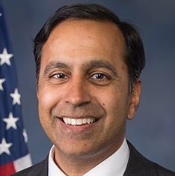
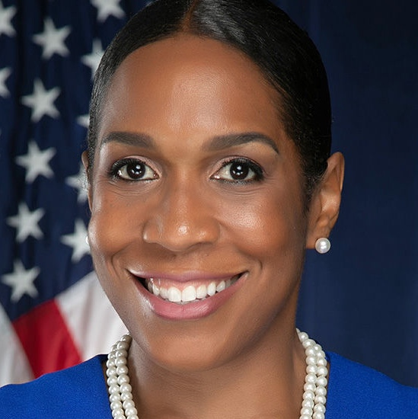
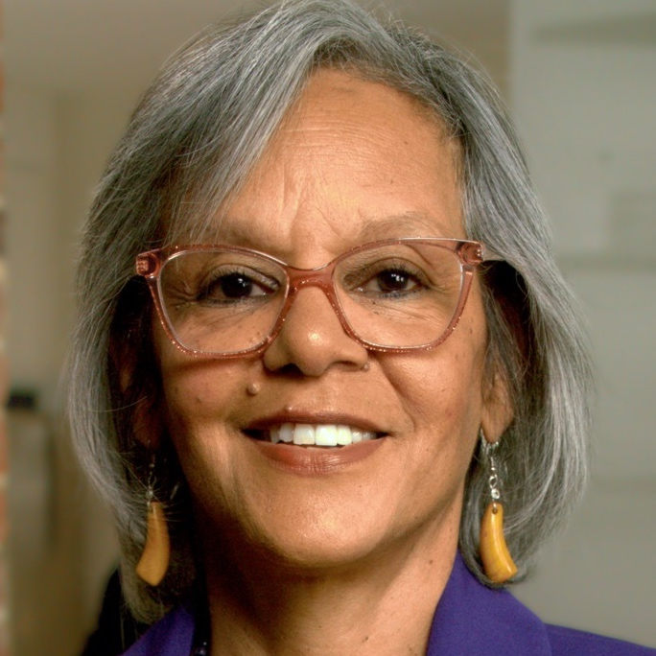
March 17: Illinois Senate Democratic Primary
KEY CONTENDERS | FUNDRAISED | POLL AVG. | NOTABLE ENDORSEMENTS
Raja Krishnamoorthi US Representative since 2017 | $28,480,748 | 35.6% | AFGE
Juliana Stratton Lieutenant Governor since 2019 | $3,199,075 | 16.3% | Gov. J.B. Pritzker (D-IL) / Sen. Elizabeth Warren (D-MA) / Sen. Tammy Duckworth (D-IL)
Robin Kelly US Representative since 2013 | $2,949,084 | 9.7% | Sen. Chris Murphy (D-CT) / 18 US Representatives
  WHAT TO KNOW
  Sen. Dick Durbin’s retirement has opened this safely Democratic seat for the first time since 1997
  Lt. Gov. Juliana Stratton entered the race first and quickly secured Gov. J.B. Pritzker’s endorsement, with reports indicating Pritzker and his allies sought to discourage other prominent Democrats from running, though US Reps. Robin Kelly and Raja Krishnamoorthi entered soon after
  Krishnamoorthi has built the largest fundraising operation of any non-incumbent Senate candidate in the country, raising more than $28 million in 2025 and beginning 2026 with over $15 million in cash on hand
  Krishnamoorthi has led in every public poll, with Stratton consistently in second and Kelly in third
SOURCE Ballotpedia, Federal Election Commission, RealClearPolitics, Decision Desk HQ, VoteHub
PRESENTATION CENTER 2/23/26
Notes:
Illinois US Senate Democratic Primary Ballot Test | DDHQ. (2026). Decisiondeskhq.com. https://polls.decisiondeskhq.com/averages/primary-ballot-test/2026-il-us-senate-dem/illinois/democrats
‌
2026 Election United States Senate - Illinois - FEC.gov. (2026). FEC.gov. https://www.fec.gov/data/elections/senate/IL/2026/
‌
Sullivan, E. (2026, February 5). Democrats have fundraising edge in key Senate races, but GOP leads in the House - OpenSecrets News. OpenSecrets News. https://www.opensecrets.org/news/2026/02/democrats-have-fundraising-edge-is-key-senate-races-but-gop-leads-in-the-house/
‌
Schutz, P. (2025, May 6). US Rep. Robin Kelly launches Senate bid to succeed Dick Durbin. FOX 32 Chicago. https://www.fox32chicago.com/news/robin-kelly-senate-dick-durbin
‌
Lesniewski, N. (2025, May 7). Krishnamoorthi joins Senate race in Illinois. Roll Call. https://rollcall.com/2025/05/07/krishnamoorthi-joins-illinois-senate-race/
‌
Ann, M. (2025, May). Sources: Pritzker team calls congresswoman “damaged goods” to stop Senate run. NBC Chicago. https://www.nbcchicago.com/news/local/chicago-politics/sources-pritzker-calls-congresswoman-damaged-goods-senate/3735712/
‌
Pecorin, A. (2025, April 23). Sen. Dick Durbin announces retirement after decades in Congress. ABC News. https://abcnews.com/Politics/sen-dick-durbin-announces-retirement-after-decades-congress/story?id=121089205

Slide 17
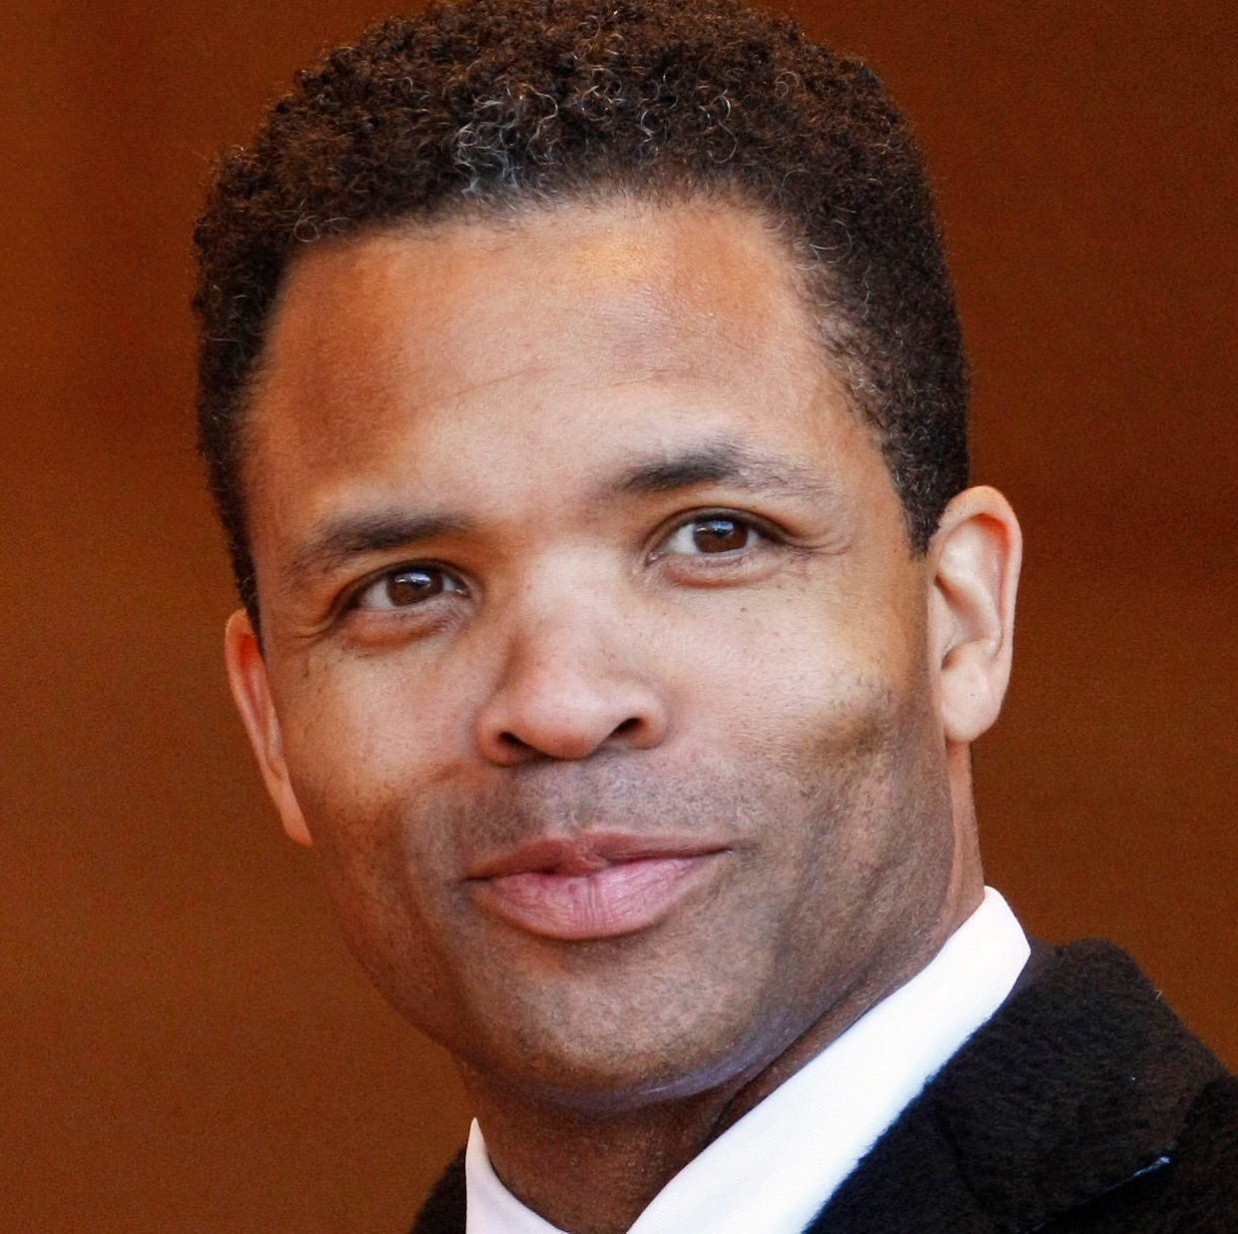
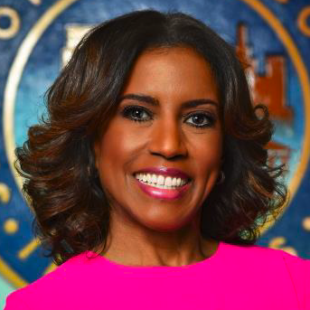
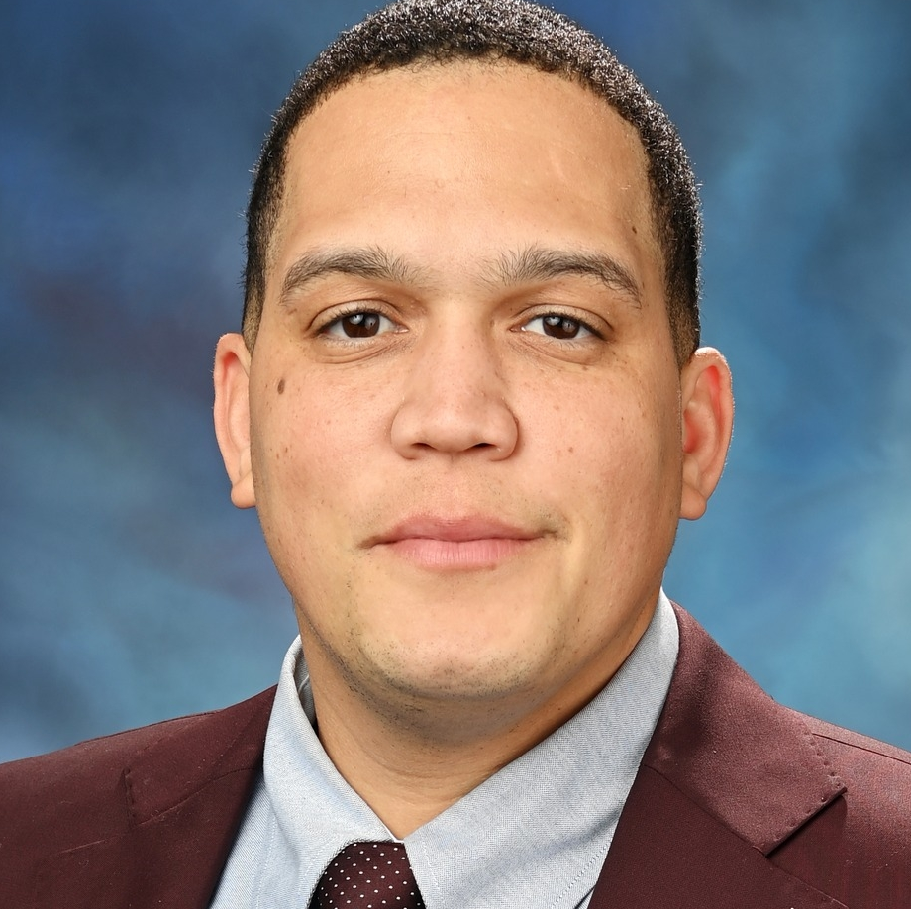
March 17: Illinois 2nd District Democratic Primary
KEY CONTENDERS | FUNDRAISED | NOTABLE ENDORSEMENTS
Jesse Jackson Jr. Former representative (1995-2012) | $206,288 | Former Rep. Bobby Rush (D-IL-1)
Donna Miller Cook County commissioner since 2018 | $1,295,068 | Five US Reps / Former Chicago Mayor Lori Lightfoot / Chicago Tribune
Robert Peters State Senator since 2019 | $903,344 | Sen. Bernie Sanders (I-VT) / Sen. Elizabeth Warren (D-MA) / Six US Reps / Former DNC Vice Chair David Hogg
  WHAT TO KNOW
  Incumbent Rep. Robin Kelly (D) is running for Senate, opening this deep blue southeast Chicago district, where nearly two thirds of residents live in densely populated Cook County and the remainder are spread across several more rural counties along the Indiana border
  The district is nearly 50 percent Black, and all four of its representatives since 1980 have been Black
  Cook County Commissioner Donna Miller leads fundraising in the crowded field, while State Sen. Robert Peters has progressive backing, including endorsements from US Sens. Bernie Sanders and Elizabeth Warren.
  Former US Rep. Jesse Jackson Jr., who left Congress amid federal charges for misusing campaign funds and ultimately served two years in federal prison, and whose brother represents the nearby 1st District, led in two polls in late 2025
SOURCE Ballotpedia, Federal Election Commission, RealClearPolitics, Decision Desk HQ, VoteHub
PRESENTATION CENTER 2/23/26
Notes:
2026 Election United States House - Illinois - District 2 - FEC.gov. (2026). FEC.gov. https://www.fec.gov/data/elections/house/IL/2/2026/
‌
Ballotpedia. (n.d.). Illinois 2nd congressional district election, 2026 (March 17 Democratic primary). Retrieved February 11, 2026, from https://ballotpedia.org/Illinois%2_2nd_Congressional_District_election,_2026_(March_17_Democratic_primary)
Kaufmann, Justin. 2026. “Robin Kelly’s Senate Run Fuels Crowded Primary in Chicago’s 2nd District.” Axios. Axios Chicago. February 12, 2026. https://www.axios.com/local/chicago/2026/02/12/robin-kelly-primary-2nd-district-jackson-jr-miller-preston-peters.
‌
Blaisdell, Max. 2025. “State Sen. Peters Launches Bid for Congress.” Hyde Park Herald. May 13, 2025. https://www.hpherald.com/evening_digest/state-sen-peters-launches-bid-for-congress/article_0f3ae7b2-0525-475d-9815-985a463a30e9.html.
‌

Slide 18
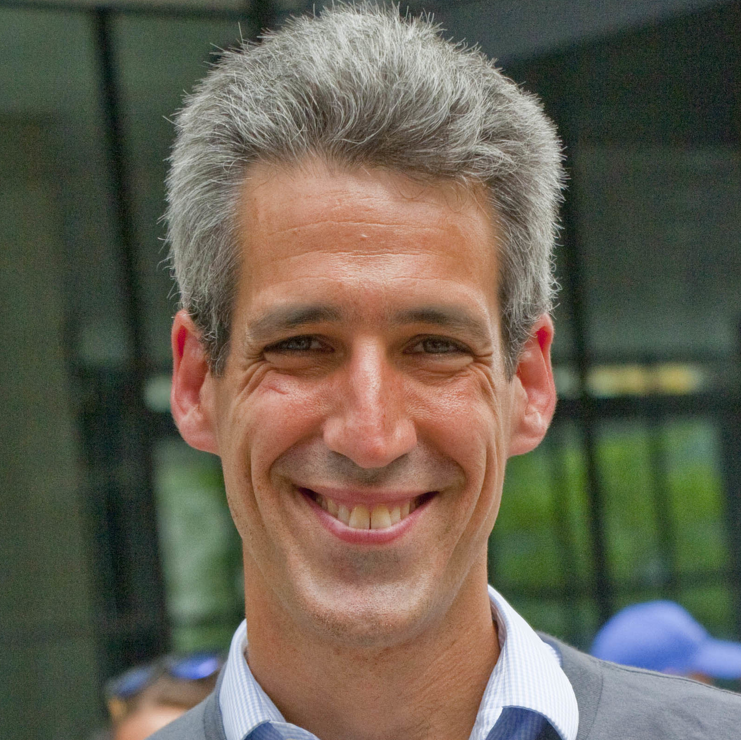
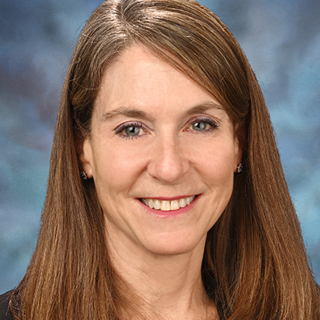

March 17: Illinois 9th District Democratic Primary
KEY CONTENDERS | FUNDRAISED | NOTABLE ENDORSEMENTS
Daniel Bliss Mayor of Evanston since 2021 | $1,984,528 | Outgoing Rep. Jan Schakowsky (D-IL-9) and 8 others / Sen. Tammy Duckworth (D-IL) / Sen. Elizabeth Warren (D-MA)
Laura Fine State senator since 2019 | $1,921,415 | 3 current US Reps. / Chicago Tribune
Kat Abughazaleh Social media influencer | $2,705,175 | US Rep. Ro Khanna / Former US Rep. Jamaal Bowman / Justice Democrats
  WHAT TO KNOW
  Rep. Jan Schakowsky’s retirement opened this deep blue northern Chicago district for the first time since 1988, drawing 15 Democrats into one of the most competitive Illinois House primaries in recent history
  Former journalist turned progressive social media creator Kat Abughazaleh, Evanston mayor Daniel Bliss, and state senator Laura Fine each raised around $2 million in 2025
  Divisions among Democrats over US support for Israel are in the spotlight: Fine and Biss are Jewish, Abughazaleh is Palestinian American; a dark-money super PAC reportedly backed by AIPAC is spending heavily in support of Fine
  An early February poll fielded by Impact Research found Bliss ahead with 31%, followed by Fine and Abughazaleh at 18%, with four other Democrats registering in the single digits and 11% still undecided
SOURCE Ballotpedia, Federal Election Commission, RealClearPolitics, Decision Desk HQ, VoteHub
PRESENTATION CENTER 2/23/26
Notes:
2026 Election United States House - Illinois - District 9 - FEC.gov. (2026). FEC.gov. https://www.fec.gov/data/elections/house/IL/9/2026/
‌
Ballotpedia. (n.d.). Illinois 9th congressional district election, 2026 (March 17 Democratic primary). Retrieved February 11, 2026, from https://ballotpedia.org/Illinois%9_9th_Congressional_District_election,_2026_(March_17_Democratic_primary)
Bradley, Tahman. 2026. “Highly Competitive Democratic Primary Unfolds for Illinois’ 9th Congressional Seat.” WGN-TV. February 10, 2026. https://wgntv.com/news/politics/wgn-the-point-politics-chicago-illinois/highly-competitive-democratic-primary-unfolds-for-illinois-9th-congressional-seat/.
‌Vakil, Caroline. 2026. “Progressive Groups Back Abughazaleh in Crowded Dem Field for Illinois House Seat.” The Hill. February 12, 2026. https://thehill.com/homenews/campaign/5735149-democratic-primary-israel-palestine-rift/.
‌

Slide 19

Ways to edit these slides
Looking to customize these slides yourself?
Looking for assistance with customization?
No problem.
The slides in this deck can be edited to suit your needs. However, if you alter text, data or images on our slides, we ask that you remove National Journal logos and branding prior to distribution or public use. Look for:
We’re here to help.
If you’d like our team of policy researchers and data visualization specialists to customize this deck with your vision in mind, contact your Dedicated Advisor or email service@nationaljournal.com.
This service is included in most membership packages.
Feel free to delete this slide before presenting.

