Slide 1
Senate races to watch
An overview of confirmed Senate matchups to watch in the 2024 election cycle
October 31, 2024
PRODUCER
Jehan Bugli
Eamonn Howerter

Slide 2
Democrats and Independents must defend 23 seats in 2024
2024 SENATE RACES IN-DEPTH
For more insight on the 2024 Senate races, visit The Cook Political Report with Amy Walter.
Senators up for election in 2024
■ Democrat ■ Democratic open seat ■ Republican
■ Republican open seat ■ Independent ■ Independent open seat
Democrats | Republicans
Murphy (CT) | Scott (FL)
Hirono (HI) | Hawley (MO)
Warren (MA) | Wicker (MS)
Klobuchar (MN) | Cramer (ND)
Menendez (NJ) | Fischer (NE)
Heinrich (NM) | Ricketts (NE)
Gillibrand (NY) | Blackburn (TN)
Whitehouse (RI) | Cruz (TX)
Kaine (VA) | Barrasso (WY)
Cantwell (WA) | OPEN (Braun) (IN)
Tester (MT) | OPEN (Romney) (UT)
Rosen (NV)
Casey Jr. (PA)
Baldwin (WI)
Brown (OH) | Independents
OPEN (Butler) (CA) | King (ME)
OPEN (Stabenow) (MI) | Sanders (VT)
OPEN (Carper) (DE) | OPEN (Sinema) (AZ)
OPEN (Cardin) (MD) | OPEN (Manchin) (WV)
AK
ME
VT
NH
WA
ID
MT
ND
MN
IL
WI
MI
NY
RI
MA
OR
NV
WY
SD
IA
IN
OH
PA
NJ
CT
CA
UT
CO
NE
MO
KY
WV
VA
MD
DE
AZ
NM
KS
AR
TN
NC
SC
OK
LA
MS
AL
GA
HI
TX
FL
SOURCE The Cook Political Report with Amy Walter.
PRESENTATION CENTER 10/31/24
Notes:
Sources:
“2024 Senate Race Ratings,” The Cook Political Report with Amy Walter, August 15, 2024, https://www.cookpolitical.com/ratings/senate-race-ratings

Slide 3
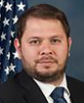
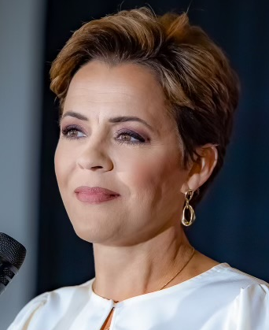
Senate Race Spotlight: Arizona
LEAN D*
CANDIDATES
PRIMARY ELECTION RESULTS
Ruben Gallego (D)
Representative of Arizona’s 3rd congressional district
DEM | GOP
Ruben Gallego Uncontested | Kari Lake 55.4%
 | Mark Lamb 39.2%
 | Elizabeth Reye 5.4%
Kari Lake (R)
News anchor for Fox10 News Phoenix, 2022 AZ Governor candidate
CAMPAIGN FINANCE
PREVIOUS AZ RESULTS
CAMPAIGN FINANCE DATA AS OF OCT. 29, 2024
■ Total receipts ■ Total disbursements
Election | Winner | Runner-Up | Margin
2018 Senate | Sinema (D) 50.0% | McSally (R) 47.6% | D + 2.4%
2020 Presidential | Biden (D) 49.4% | Trump (R) 49.1% | D + 0.3%
Gallego
Lake
*COOK POLITICAL REPORT RATINGS
SOURCE Cook Political Report with Amy Walter, Ballotpedia, FEC.
PRESENTATION CENTER 10/31/24
Notes:
Sources:
“2024 CPR House Race Ratings,” Cook Political Report, January 23, 2024, https://www.cookpolitical.com/ratings/house-race-ratings
“New York's 3rd Congressional District special election, 2024,” Ballotpedia, accessed January 31, 2024, https://ballotpedia.org/New_York%27s_3rd_Congressional_District_special_election,_2024
“New York 3rd Special Election - Forecast & Predictions,” Race to the White House, accessed January 31, 2024, https://www.racetothewh.com/house/ny3
“SUOZZI, THOMAS,” Federal Election Commission, Accessed February 6, 2024, https://www.fec.gov/data/candidate/H6NY03247/?cycle=2024&election_full=false
“PILIP, MAZI MELESA,” Federal Election Commission, Accessed February 6, 2024, https://www.fec.gov/data/candidate/H4NY03283/?cycle=2024&election_full=false
“New York Third Congressional District Special Election Results,” New York Times, February 14, 2024, https://www.nytimes.com/interactive/2024/02/13/us/elections/results-new-york-us-house-3-special.html

Slide 4
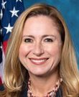
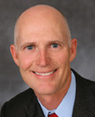
Senate Race Spotlight: Florida
LIKELY R*
CANDIDATES
PRIMARY ELECTION RESULTS
Debbie Mucarsel-Powell (D)
Representative, United States House of Representatives, Florida, District 26, 2019-2021
DEM | GOP
Debbie Mucarsel-Powell 68.6% | Rick Scott 84.4%
Stanley Campbell 19.5% | Keith Gross 9.3%
Brian Rush 6.7% | John Columbus 6.3%
Rick Scott (R)
Incumbent
CAMPAIGN FINANCE
PREVIOUS FL RESULTS
CAMPAIGN FINANCE DATA AS OF OCT. 29, 2024
■ Total receipts ■ Total disbursements
Election | Winner | Runner-Up | Margin
2018 Senate | Scott (R) 50.1% | Nelson (D) 49.9% | R + 0.2%
2020 Presidential | Trump (R) 51.2% | Biden (D) 47.9% | R + 3.3%
Mucarsel-Powell
Scott
*COOK POLITICAL REPORT RATINGS
SOURCE Cook Political Report with Amy Walter, Ballotpedia, FEC.
PRESENTATION CENTER 10/31/24
Notes:
Sources:
“2024 CPR House Race Ratings,” Cook Political Report, January 23, 2024, https://www.cookpolitical.com/ratings/house-race-ratings
“New York's 3rd Congressional District special election, 2024,” Ballotpedia, accessed January 31, 2024, https://ballotpedia.org/New_York%27s_3rd_Congressional_District_special_election,_2024
“New York 3rd Special Election - Forecast & Predictions,” Race to the White House, accessed January 31, 2024, https://www.racetothewh.com/house/ny3
“SUOZZI, THOMAS,” Federal Election Commission, Accessed February 6, 2024, https://www.fec.gov/data/candidate/H6NY03247/?cycle=2024&election_full=false
“PILIP, MAZI MELESA,” Federal Election Commission, Accessed February 6, 2024, https://www.fec.gov/data/candidate/H4NY03283/?cycle=2024&election_full=false
“New York Third Congressional District Special Election Results,” New York Times, February 14, 2024, https://www.nytimes.com/interactive/2024/02/13/us/elections/results-new-york-us-house-3-special.html

Slide 5
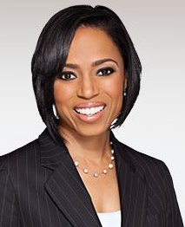
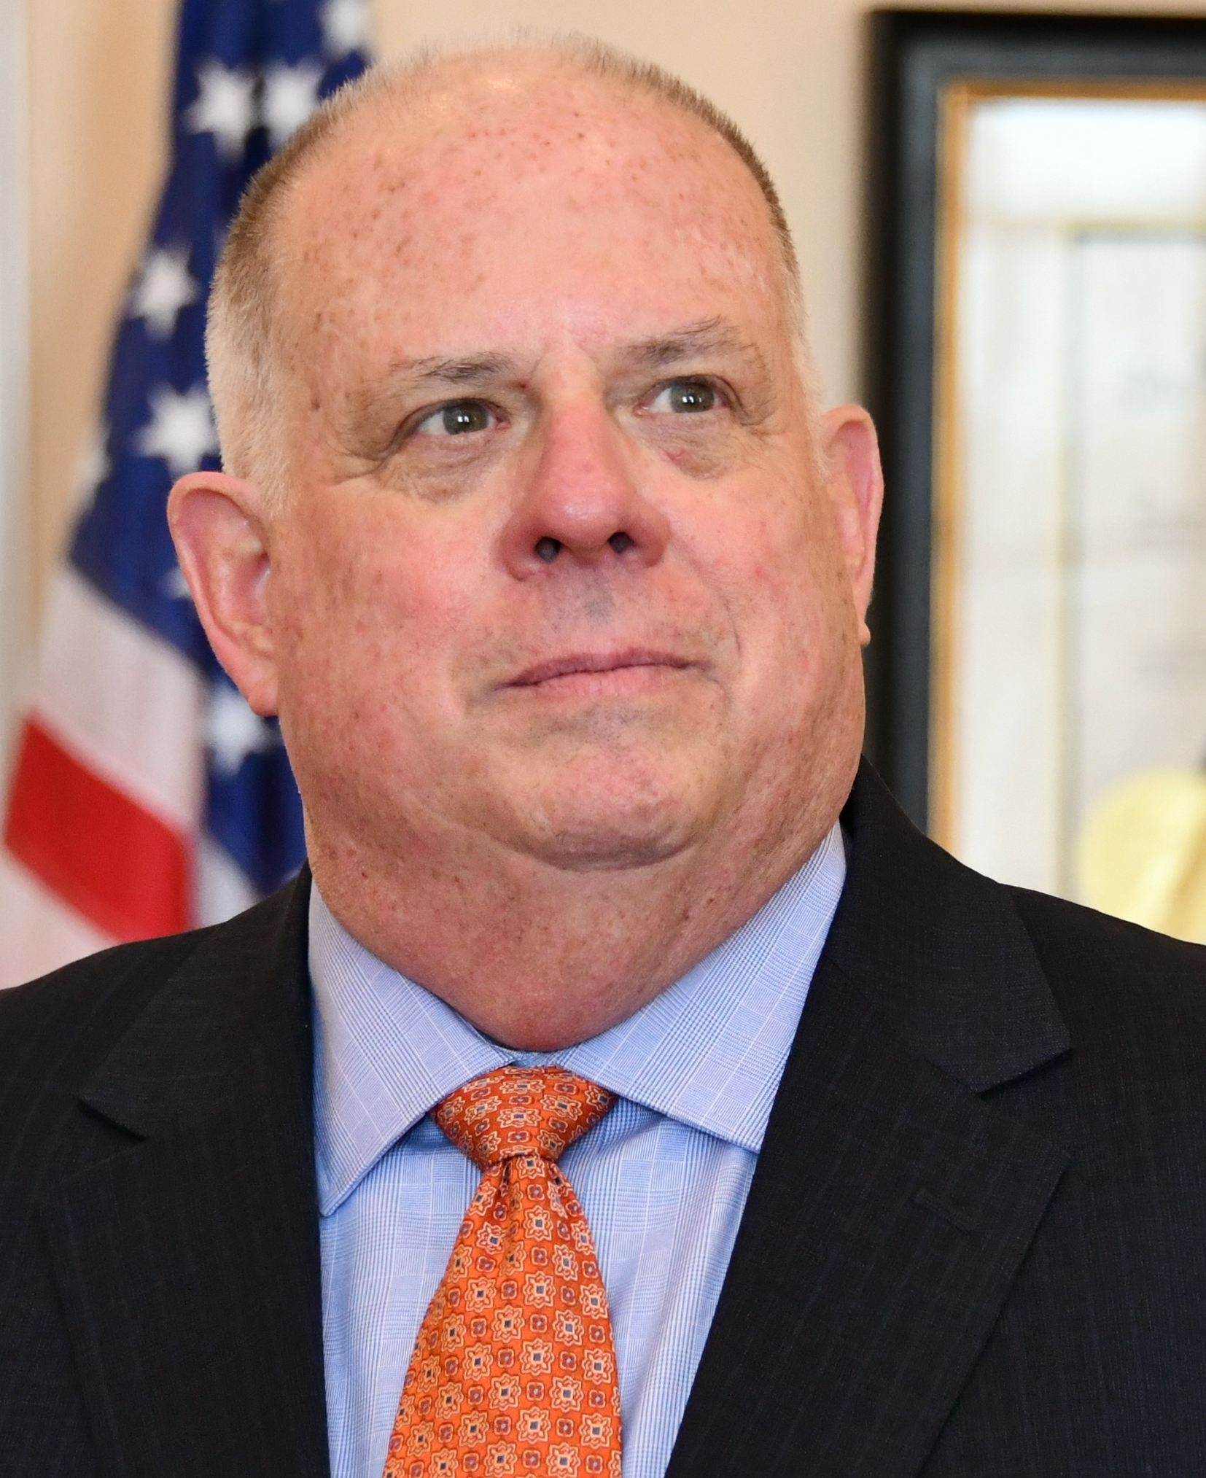
Senate Race Spotlight: Maryland
LIKELY D*
CANDIDATES
PRIMARY ELECTION RESULTS
Angela Alsobrooks (D)
County Executive, Prince George's County, 2018-present
DEM | GOP
Angela Alsobrooks 53.8% | Larry Hogan 61.9%
David Trone 42.0% | Robin Ficker 30.1%
Michael Cobb 0.8% | Chris Chaffee 3.3%
Larry Hogan (R)
Governor, State of Maryland, 2014-2023
CAMPAIGN FINANCE
PREVIOUS MD RESULTS
CAMPAIGN FINANCE DATA AS OF OCT. 29, 2024
■ Total receipts ■ Total disbursements
Election | Winner | Runner-Up | Margin
2022 Senate | Van Hollen (D) 65.8% | Chaffee (R) 34.1% | D + 31.7%
2020 Presidential | Biden (D) 65.6% | Trump (R) 32.1% | D + 33.5%
Alsobrooks
Hogan
*COOK POLITICAL REPORT RATINGS
SOURCE Cook Political Report with Amy Walter, Ballotpedia, FEC.
PRESENTATION CENTER 10/31/24
Notes:
Sources:
“2024 CPR House Race Ratings,” Cook Political Report, January 23, 2024, https://www.cookpolitical.com/ratings/house-race-ratings
“New York's 3rd Congressional District special election, 2024,” Ballotpedia, accessed January 31, 2024, https://ballotpedia.org/New_York%27s_3rd_Congressional_District_special_election,_2024
“New York 3rd Special Election - Forecast & Predictions,” Race to the White House, accessed January 31, 2024, https://www.racetothewh.com/house/ny3
“SUOZZI, THOMAS,” Federal Election Commission, Accessed February 6, 2024, https://www.fec.gov/data/candidate/H6NY03247/?cycle=2024&election_full=false
“PILIP, MAZI MELESA,” Federal Election Commission, Accessed February 6, 2024, https://www.fec.gov/data/candidate/H4NY03283/?cycle=2024&election_full=false
“New York Third Congressional District Special Election Results,” New York Times, February 14, 2024, https://www.nytimes.com/interactive/2024/02/13/us/elections/results-new-york-us-house-3-special.html

Slide 6
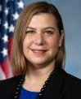
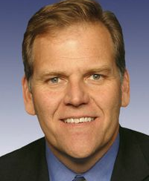
Senate Race Spotlight: Michigan
TOSS UP*
CANDIDATES
PRIMARY ELECTION RESULTS
Elissa Slotkin (D)
Representative of Michigan’s 7th District, 2023-Present; 8th District, 2019-2023
DEM | GOP
Elissa Slotkin 80.5% | Mike Rogers 62.8%
Hill Harper 19.5% | Justin Amash 16.1%
 | Sherry O’Donnell 12.4%
Mike Rogers (R)
Former Representative of Michigan’s 8th District, 2001-2015
CAMPAIGN FINANCE
PREVIOUS MI RESULTS
CAMPAIGN FINANCE DATA AS OF OCT. 29, 2024
■ Total receipts ■ Total disbursements
Election | Winner | Runner-Up | Margin
2018 Senate | Stabenow (D) 52.3% | James (R) 45.8% | D + 6.5%
2020 Presidential | Biden (D) 50.6% | Trump (R) 47.8% | D + 2.8%
Slotkin
Rogers
*COOK POLITICAL REPORT RATINGS
SOURCE Cook Political Report with Amy Walter, Ballotpedia, FEC.
PRESENTATION CENTER 10/31/24
Notes:
Sources:
“2024 CPR House Race Ratings,” Cook Political Report, January 23, 2024, https://www.cookpolitical.com/ratings/house-race-ratings
“New York's 3rd Congressional District special election, 2024,” Ballotpedia, accessed January 31, 2024, https://ballotpedia.org/New_York%27s_3rd_Congressional_District_special_election,_2024
“New York 3rd Special Election - Forecast & Predictions,” Race to the White House, accessed January 31, 2024, https://www.racetothewh.com/house/ny3
“SUOZZI, THOMAS,” Federal Election Commission, Accessed February 6, 2024, https://www.fec.gov/data/candidate/H6NY03247/?cycle=2024&election_full=false
“PILIP, MAZI MELESA,” Federal Election Commission, Accessed February 6, 2024, https://www.fec.gov/data/candidate/H4NY03283/?cycle=2024&election_full=false
“New York Third Congressional District Special Election Results,” New York Times, February 14, 2024, https://www.nytimes.com/interactive/2024/02/13/us/elections/results-new-york-us-house-3-special.html

Slide 7
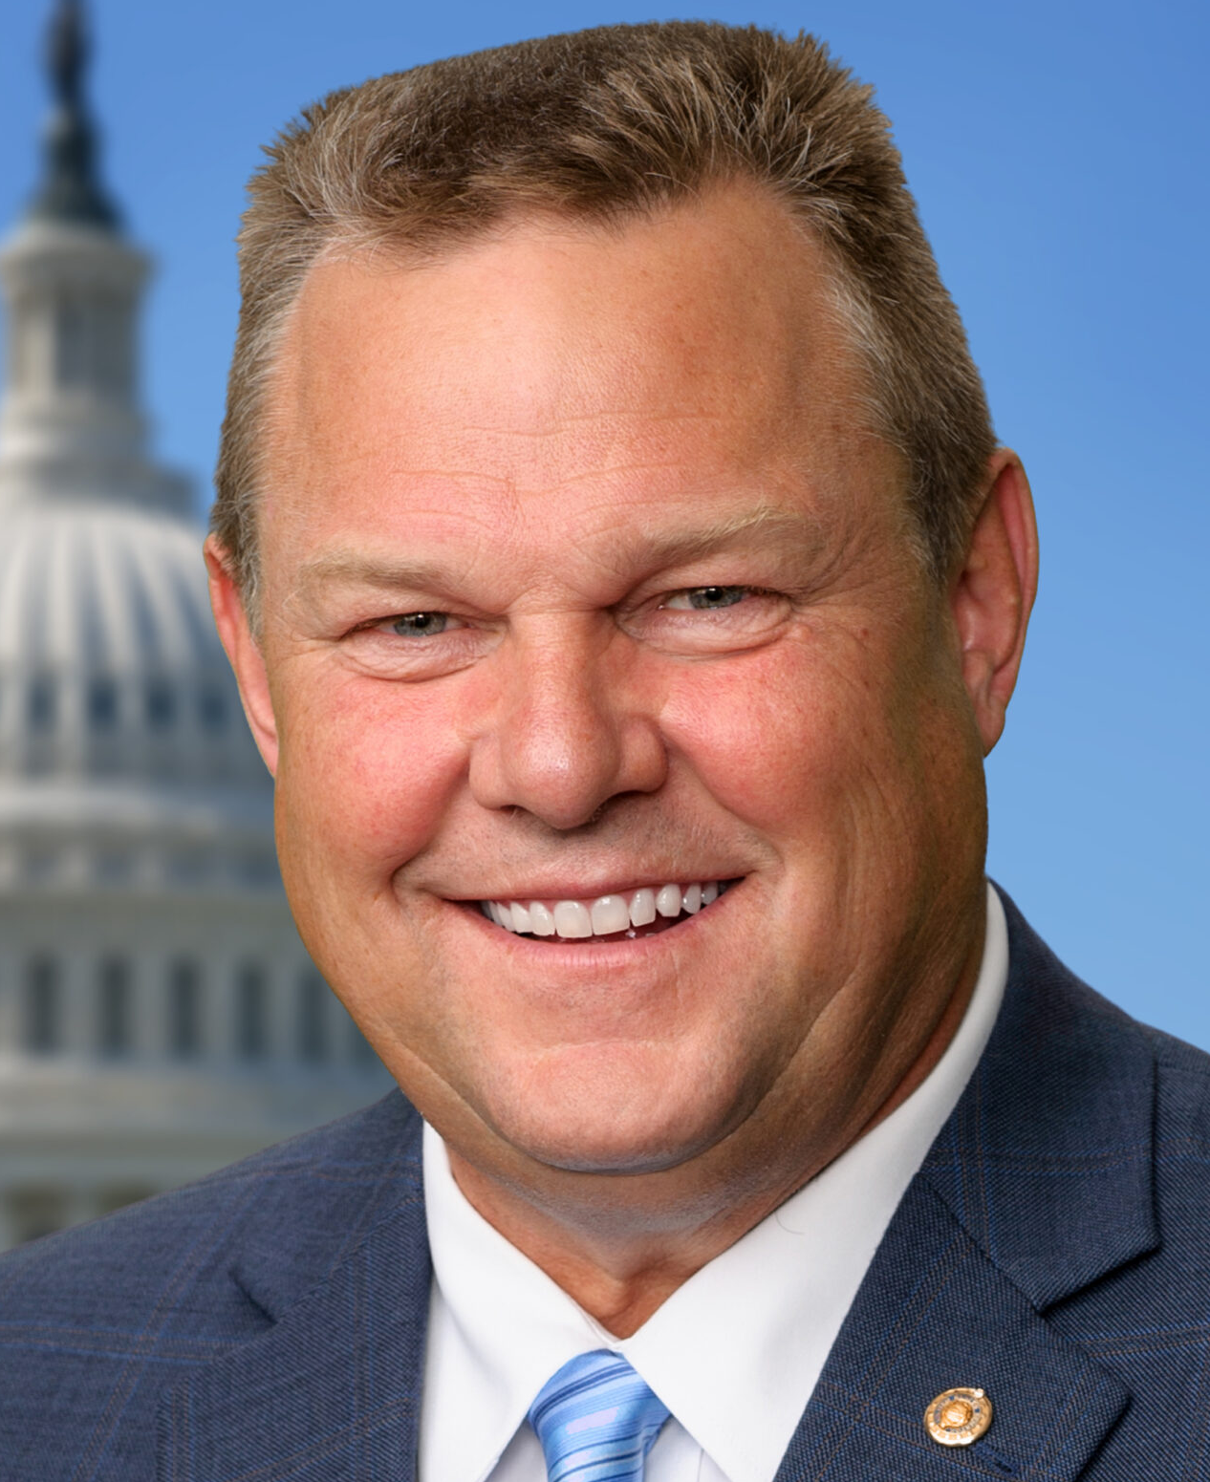

Senate Race Spotlight: Montana
LEAN R*
CANDIDATES
PRIMARY ELECTION RESULTS
Jon Tester (D)
Incumbent
DEM | GOP
Jon Tester 97.1% | Tim Sheehy 73.8%
Michael Hummert 2.9% | Brad Johnson 18.7%
 | Charles Walking Child 7.5%
Tim Sheehy (R)
Retired Navy SEAL and entrepreneur
CAMPAIGN FINANCE
PREVIOUS MT RESULTS
CAMPAIGN FINANCE DATA AS OF OCT. 29, 2024
■ Total receipts ■ Total disbursements
Election | Winner | Runner-Up | Margin
2018 Senate | Tester (D) 50.3% | Rosendale (R) 46.8% | D + 3.5%
2020 Presidential | Trump (R) 56.8% | Biden (D) 40.4% | R + 16.4%
Tester
Sheehy
*COOK POLITICAL REPORT RATINGS
SOURCE Cook Political Report with Amy Walter, Ballotpedia, FEC.
PRESENTATION CENTER 10/31/24
Notes:
Sources:
“2024 CPR House Race Ratings,” Cook Political Report, January 23, 2024, https://www.cookpolitical.com/ratings/house-race-ratings
“New York's 3rd Congressional District special election, 2024,” Ballotpedia, accessed January 31, 2024, https://ballotpedia.org/New_York%27s_3rd_Congressional_District_special_election,_2024
“New York 3rd Special Election - Forecast & Predictions,” Race to the White House, accessed January 31, 2024, https://www.racetothewh.com/house/ny3
“SUOZZI, THOMAS,” Federal Election Commission, Accessed February 6, 2024, https://www.fec.gov/data/candidate/H6NY03247/?cycle=2024&election_full=false
“PILIP, MAZI MELESA,” Federal Election Commission, Accessed February 6, 2024, https://www.fec.gov/data/candidate/H4NY03283/?cycle=2024&election_full=false
“New York Third Congressional District Special Election Results,” New York Times, February 14, 2024, https://www.nytimes.com/interactive/2024/02/13/us/elections/results-new-york-us-house-3-special.html

Slide 8
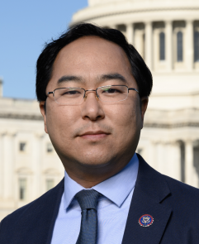
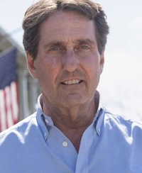
Senate Race Spotlight: New Jersey
SOLID D*
CANDIDATES
PRIMARY ELECTION RESULTS
Andy Kim (D)
Representative, United States House of Representatives, New Jersey, District 3, 2019-present
DEM | GOP
Andy Kim 75.4% | Curtis Bashaw 48.0%
Patricia Campos-Medina 15.8% | Christine Serrano-Glassner 37.1%
Lawrence Hamm 8.8% | Justin Murphy 10.7%
Curtis Bashaw (R)
Co-Founder/Co-Managing Partner, Cape Advisors, Inc., 1994-2019
CAMPAIGN FINANCE
PREVIOUS NJ RESULTS
CAMPAIGN FINANCE DATA AS OF OCT. 29, 2024
■ Total receipts ■ Total disbursements
Election | Winner | Runner-Up | Margin
2018 Senate | Menendez (D) 54.0% | Hugin (R) 42.8% | D + 11.2%
2020 Presidential | Biden (D) 57.3% | Trump (R) 41.4% | D + 15.9%
Kim
Bashaw
*COOK POLITICAL REPORT RATINGS
SOURCE Cook Political Report with Amy Walter, Ballotpedia, FEC.
PRESENTATION CENTER 10/31/24
Notes:
Sources:
“2024 CPR House Race Ratings,” Cook Political Report, January 23, 2024, https://www.cookpolitical.com/ratings/house-race-ratings
“New York's 3rd Congressional District special election, 2024,” Ballotpedia, accessed January 31, 2024, https://ballotpedia.org/New_York%27s_3rd_Congressional_District_special_election,_2024
“New York 3rd Special Election - Forecast & Predictions,” Race to the White House, accessed January 31, 2024, https://www.racetothewh.com/house/ny3
“SUOZZI, THOMAS,” Federal Election Commission, Accessed February 6, 2024, https://www.fec.gov/data/candidate/H6NY03247/?cycle=2024&election_full=false
“PILIP, MAZI MELESA,” Federal Election Commission, Accessed February 6, 2024, https://www.fec.gov/data/candidate/H4NY03283/?cycle=2024&election_full=false
“New York Third Congressional District Special Election Results,” New York Times, February 14, 2024, https://www.nytimes.com/interactive/2024/02/13/us/elections/results-new-york-us-house-3-special.html

Slide 9
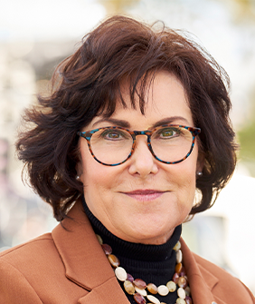
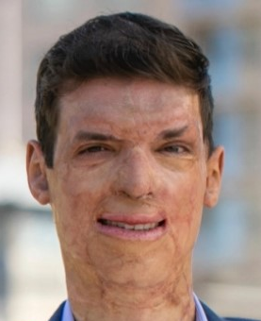
Senate Race Spotlight: Nevada
Lean D*
CANDIDATES
PRIMARY ELECTION RESULTS
Jacky Rosen (D)
Incumbent
DEM | GOP
Jacky Rosen 92.3% | Sam Brown 60.8%
Troy Walker 3.8% | Jeff Gunter 14.7%
Mike Schaefer 2.3% | Jim Marchant 6.6%
Sam Brown (R)
Retired Army Captain
CAMPAIGN FINANCE
PREVIOUS NV RESULTS
CAMPAIGN FINANCE DATA AS OF OCT. 29, 2024
■ Total receipts ■ Total disbursements
Election | Winner | Runner-Up | Margin
2018 Senate | Rosen (D) 50.4% | Heller (R) 45.4% | D + 5.0%
2020 Presidential | Biden (D) 50.1% | Trump (R) 47.7% | D + 2.4%
Rosen
Brown
*COOK POLITICAL REPORT RATINGS
SOURCE Cook Political Report with Amy Walter, Ballotpedia, FEC.
PRESENTATION CENTER 10/31/24
Notes:
Sources:
“2024 CPR House Race Ratings,” Cook Political Report, January 23, 2024, https://www.cookpolitical.com/ratings/house-race-ratings
“New York's 3rd Congressional District special election, 2024,” Ballotpedia, accessed January 31, 2024, https://ballotpedia.org/New_York%27s_3rd_Congressional_District_special_election,_2024
“New York 3rd Special Election - Forecast & Predictions,” Race to the White House, accessed January 31, 2024, https://www.racetothewh.com/house/ny3
“SUOZZI, THOMAS,” Federal Election Commission, Accessed February 6, 2024, https://www.fec.gov/data/candidate/H6NY03247/?cycle=2024&election_full=false
“PILIP, MAZI MELESA,” Federal Election Commission, Accessed February 6, 2024, https://www.fec.gov/data/candidate/H4NY03283/?cycle=2024&election_full=false
“New York Third Congressional District Special Election Results,” New York Times, February 14, 2024, https://www.nytimes.com/interactive/2024/02/13/us/elections/results-new-york-us-house-3-special.html

Slide 10


Senate Race Spotlight: Ohio
TOSS UP*
CANDIDATES
PRIMARY ELECTION RESULTS
Sherrod Brown (D)
Incumbent
DEM | GOP
Sherrod Brown Uncontested | Bernie Moreno 50.5%
 | Matt Dolan 32.9%
 | Frank LaRose 16.7%
Bernie Moreno (R)
Chairman, CHAMPtitles, 2018-2023
CAMPAIGN FINANCE
PREVIOUS OH RESULTS
CAMPAIGN FINANCE DATA AS OF OCT. 29, 2024
■ Total receipts ■ Total disbursements
Election | Winner | Runner-Up | Margin
2018 Senate | Brown (D) 53.4% | Renacci (R) 46.6% | D + 6.8%
2020 Presidential | Trump (R) 53.3% | Biden (D) 45.3% | R + 8.0%
Brown
Moreno
*COOK POLITICAL REPORT RATINGS
SOURCE Cook Political Report with Amy Walter, Ballotpedia, FEC.
PRESENTATION CENTER 10/31/24
Notes:
Sources:
“2024 CPR House Race Ratings,” Cook Political Report, January 23, 2024, https://www.cookpolitical.com/ratings/house-race-ratings
“New York's 3rd Congressional District special election, 2024,” Ballotpedia, accessed January 31, 2024, https://ballotpedia.org/New_York%27s_3rd_Congressional_District_special_election,_2024
“New York 3rd Special Election - Forecast & Predictions,” Race to the White House, accessed January 31, 2024, https://www.racetothewh.com/house/ny3
“SUOZZI, THOMAS,” Federal Election Commission, Accessed February 6, 2024, https://www.fec.gov/data/candidate/H6NY03247/?cycle=2024&election_full=false
“PILIP, MAZI MELESA,” Federal Election Commission, Accessed February 6, 2024, https://www.fec.gov/data/candidate/H4NY03283/?cycle=2024&election_full=false
“New York Third Congressional District Special Election Results,” New York Times, February 14, 2024, https://www.nytimes.com/interactive/2024/02/13/us/elections/results-new-york-us-house-3-special.html

Slide 11
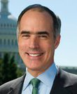

Senate Race Spotlight: Pennsylvania
TOSS UP*
CANDIDATES
PRIMARY ELECTION RESULTS
Bob Casey (D)
Incumbent
DEM | GOP
Bob Casey Uncontested | Dave McCormick Uncontested
David McCormick (R)
Chief Executive Officer, Bridgewater Associates, 2020-2022
CAMPAIGN FINANCE
PREVIOUS PA RESULTS
CAMPAIGN FINANCE DATA AS OF OCT. 29, 2024
■ Total receipts ■ Total disbursements
Election | Winner | Runner-Up | Margin
2018 Senate | Casey (D) 55.7% | Barletta (R) 42.6% | D + 13.1%
2020 Presidential | Biden (D) 49.9% | Trump (R) 48.7% | D + 1.2%
Casey
McCormick
*COOK POLITICAL REPORT RATINGS
SOURCE Cook Political Report with Amy Walter, Ballotpedia, FEC.
PRESENTATION CENTER 10/31/24
Notes:
Sources:
“2024 CPR House Race Ratings,” Cook Political Report, January 23, 2024, https://www.cookpolitical.com/ratings/house-race-ratings
“New York's 3rd Congressional District special election, 2024,” Ballotpedia, accessed January 31, 2024, https://ballotpedia.org/New_York%27s_3rd_Congressional_District_special_election,_2024
“New York 3rd Special Election - Forecast & Predictions,” Race to the White House, accessed January 31, 2024, https://www.racetothewh.com/house/ny3
“SUOZZI, THOMAS,” Federal Election Commission, Accessed February 6, 2024, https://www.fec.gov/data/candidate/H6NY03247/?cycle=2024&election_full=false
“PILIP, MAZI MELESA,” Federal Election Commission, Accessed February 6, 2024, https://www.fec.gov/data/candidate/H4NY03283/?cycle=2024&election_full=false
“New York Third Congressional District Special Election Results,” New York Times, February 14, 2024, https://www.nytimes.com/interactive/2024/02/13/us/elections/results-new-york-us-house-3-special.html

Slide 12
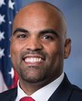
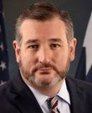
Senate Race Spotlight: Texas
LEAN R*
CANDIDATES
PRIMARY ELECTION RESULTS
Colin Allred (D)
Representative, United States House of Representatives, District 32, 2019-present
DEM | GOP
Colin Allred 58.9% | Ted Cruz 88.3%
Roland Gutierrez 16.6% | Redd Gibson 6.0%
Mark Gonzalez 8.8% | Rufus Lopez 5.7%
Ted Cruz (R)
Incumbent
CAMPAIGN FINANCE
PREVIOUS TX RESULTS
CAMPAIGN FINANCE DATA AS OF OCT. 29, 2024
■ Total receipts ■ Total disbursements
Election | Winner | Runner-Up | Margin
2018 Senate | Cruz (R) 50.9% | O'Rourke (D) 48.3% | R + 2.6%
2020 Presidential | Trump (R) 52.0% | Biden (D) 46.5% | R + 5.5%
Allred
Cruz
*COOK POLITICAL REPORT RATINGS
SOURCE Cook Political Report with Amy Walter, Ballotpedia, FEC.
PRESENTATION CENTER 10/31/24
Notes:
Sources:
“2024 CPR House Race Ratings,” Cook Political Report, January 23, 2024, https://www.cookpolitical.com/ratings/house-race-ratings
“New York's 3rd Congressional District special election, 2024,” Ballotpedia, accessed January 31, 2024, https://ballotpedia.org/New_York%27s_3rd_Congressional_District_special_election,_2024
“New York 3rd Special Election - Forecast & Predictions,” Race to the White House, accessed January 31, 2024, https://www.racetothewh.com/house/ny3
“SUOZZI, THOMAS,” Federal Election Commission, Accessed February 6, 2024, https://www.fec.gov/data/candidate/H6NY03247/?cycle=2024&election_full=false
“PILIP, MAZI MELESA,” Federal Election Commission, Accessed February 6, 2024, https://www.fec.gov/data/candidate/H4NY03283/?cycle=2024&election_full=false
“New York Third Congressional District Special Election Results,” New York Times, February 14, 2024, https://www.nytimes.com/interactive/2024/02/13/us/elections/results-new-york-us-house-3-special.html

Slide 13
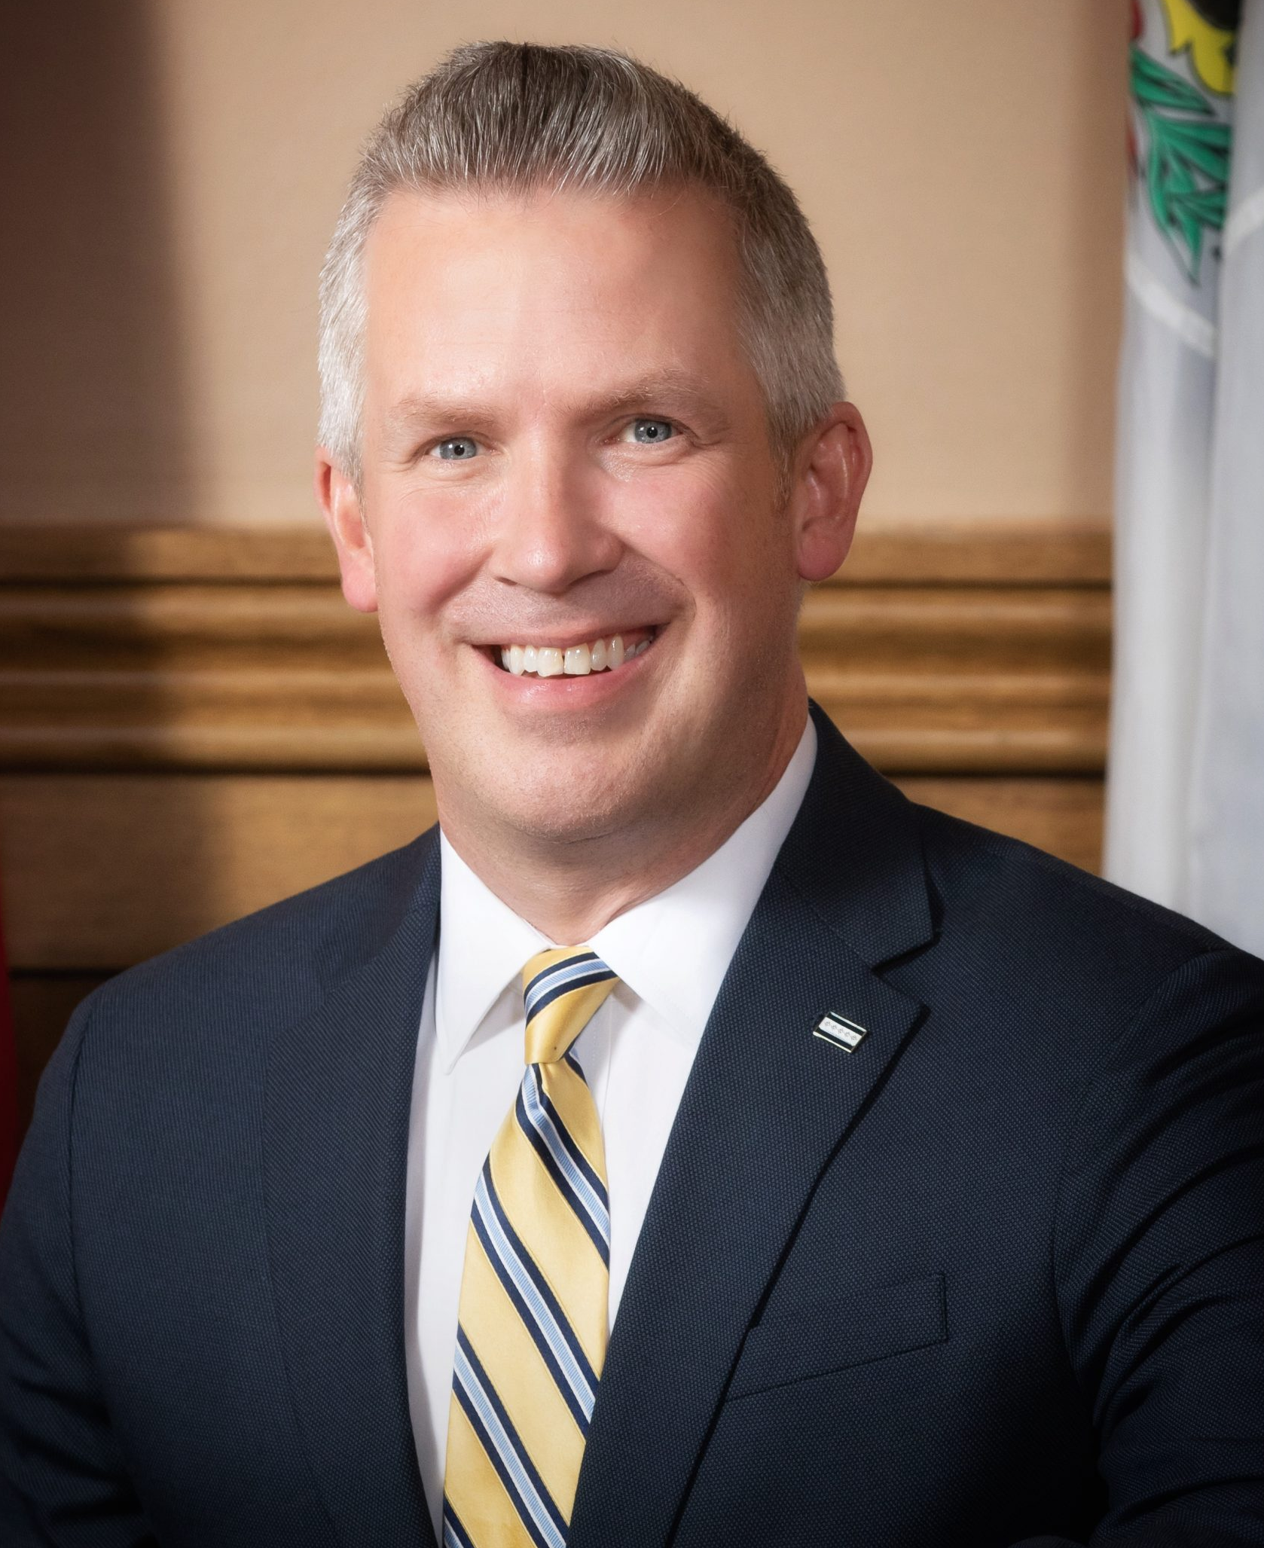

Senate Race Spotlight: West Virginia
SOLID R*
CANDIDATES
PRIMARY ELECTION RESULTS
Glenn Elliott (D)
Mayor, City of Wheeling, 2016-2024
DEM | GOP
Glenn Elliott 45.4% | Jim Justice 61.8%
Zachary Shrewsbury 36.1% | Alex Mooney 26.6%
Don Blankenship 18.4% | Bryan Bird 3.1%
Jim Justice (R)
Owner, The Greenbrier Resort, 2009-present
CAMPAIGN FINANCE
PREVIOUS WV RESULTS
CAMPAIGN FINANCE DATA AS OF OCT. 29, 2024
■ Total receipts ■ Total disbursements
Election | Winner | Runner-Up | Margin
2020 Senate | Capito (R) 70.3% | Swearengin (D) 27.0% | R + 43.3%
2020 Presidential | Trump (R) 68.6% | Biden (D) 29.7% | R + 38.9%
Elliott
Justice
*COOK POLITICAL REPORT RATINGS
SOURCE Cook Political Report with Amy Walter, Ballotpedia, FEC.
PRESENTATION CENTER 10/31/24
Notes:
Sources:
“2024 CPR House Race Ratings,” Cook Political Report, January 23, 2024, https://www.cookpolitical.com/ratings/house-race-ratings
“New York's 3rd Congressional District special election, 2024,” Ballotpedia, accessed January 31, 2024, https://ballotpedia.org/New_York%27s_3rd_Congressional_District_special_election,_2024
“New York 3rd Special Election - Forecast & Predictions,” Race to the White House, accessed January 31, 2024, https://www.racetothewh.com/house/ny3
“SUOZZI, THOMAS,” Federal Election Commission, Accessed February 6, 2024, https://www.fec.gov/data/candidate/H6NY03247/?cycle=2024&election_full=false
“PILIP, MAZI MELESA,” Federal Election Commission, Accessed February 6, 2024, https://www.fec.gov/data/candidate/H4NY03283/?cycle=2024&election_full=false
“New York Third Congressional District Special Election Results,” New York Times, February 14, 2024, https://www.nytimes.com/interactive/2024/02/13/us/elections/results-new-york-us-house-3-special.html

Slide 14
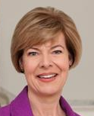

Senate Race Spotlight: Wisconsin
TOSS UP*
CANDIDATES
PRIMARY ELECTION RESULTS
Tammy Baldwin (D)
Incumbent
DEM | GOP
Tammy Baldwin Unopposed | Eric Hovde 86.3%
 | Charles Barman 7.4%
 | Rejani Raveendran 6.3%
Eric Hovde (R)
CEO, Hovde Properties, H Bancorp, Sunwest Bank
CAMPAIGN FINANCE
PREVIOUS WI RESULTS
CAMPAIGN FINANCE DATA AS OF OCT. 29, 2024
■ Total receipts ■ Total disbursements
Election | Winner | Runner-Up | Margin
2018 Senate | Baldwin (D) 55.4% | Vukmir (R) 44.6% | D + 10.8%
2020 Presidential | Biden (D) 49.5% | Trump (R) 48.8% | D + 0.7%
Baldwin
Hovde
*COOK POLITICAL REPORT RATINGS
SOURCE Cook Political Report with Amy Walter, Ballotpedia, FEC.
PRESENTATION CENTER 10/31/24
Notes:
Sources:
“2024 CPR House Race Ratings,” Cook Political Report, January 23, 2024, https://www.cookpolitical.com/ratings/house-race-ratings
“New York's 3rd Congressional District special election, 2024,” Ballotpedia, accessed January 31, 2024, https://ballotpedia.org/New_York%27s_3rd_Congressional_District_special_election,_2024
“New York 3rd Special Election - Forecast & Predictions,” Race to the White House, accessed January 31, 2024, https://www.racetothewh.com/house/ny3
“SUOZZI, THOMAS,” Federal Election Commission, Accessed February 6, 2024, https://www.fec.gov/data/candidate/H6NY03247/?cycle=2024&election_full=false
“PILIP, MAZI MELESA,” Federal Election Commission, Accessed February 6, 2024, https://www.fec.gov/data/candidate/H4NY03283/?cycle=2024&election_full=false
“New York Third Congressional District Special Election Results,” New York Times, February 14, 2024, https://www.nytimes.com/interactive/2024/02/13/us/elections/results-new-york-us-house-3-special.html

Slide 15

Ways to edit these slides
Looking to customize these slides yourself?
Looking for assistance with customization?
No problem.
The slides in this deck can be edited to suit your needs. However, if you alter text, data or images on our slides, we ask that you remove National Journal logos and branding prior to distribution or public use. Look for:
We’re here to help.
If you’d like our team of policy researchers and data visualization specialists to customize this deck with your vision in mind, contact your Dedicated Advisor or email service@nationaljournal.com.
This service is included in most membership packages.
Feel free to delete this slide before presenting.

