Slide 1
Competitive House races
An overview of confirmed House matchups to watch in the 2024 election cycle
May 15, 2024
PRODUCER
Jehan Bugli
&
Eamonn Howerter

Slide 2
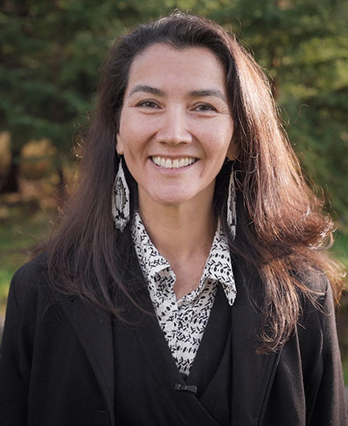

House Race Spotlight: AK-AL
TOSS UP*
CANDIDATES
ALL-PARTY PRIMARY RESULTS
Mary Peltola (D)
Incumbent
Mary Peltola (D) 50.4%
Nicholas Begich (R) 27.0%
Nancy Dahlstrom (R) 20.0%
Nicholas Begich (R)
Chair of FarShore Partners
CAMPAIGN FINANCE
PREVIOUS CA-22 RESULTS
CAMPAIGN FINANCE DATA AS OF OCT. 16, 2024
■ Total receipts ■ Total disbursements
Election | Winner | Runner-Up | Margin
2022 House | Peltola (D) 55.0% | Palin (R) 45.0% | D + 10.0%
2020 House | Young (R) 54.4% | Galvin (I) 45.3% | R + 9.1%
2020 Presidential | Biden (D) 43.0% | Trump (R) 53.1% | R + 10.1%
Peltola
Begich
*COOK POLITICAL REPORT RATINGS
SOURCE Cook Political Report with Amy Walter, Ballotpedia, FEC.
PRESENTATION CENTER 10/29/24

Slide 3
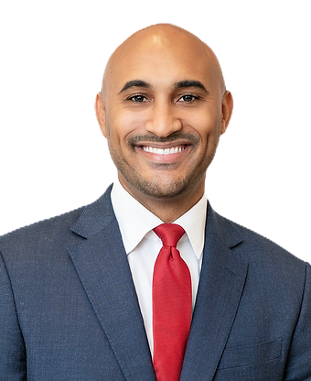
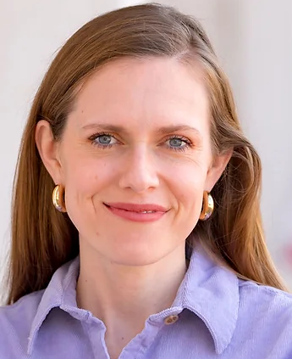
House Race Spotlight: AL-2
LIKELY D*
CANDIDATES
PRIMARY ELECTION RESULTS
Shomari Figures (D)
Deputy Chief of Staff & Counselor to the Attorney General, U.S. Department of Justice, 2021-2023
DEM | GOP
Shomari Figures 61.0% | Caroleene Dobson 58.4%
Anthony Daniels 39.0% | Dick Brewbaker 41.6%
Caroleene Dobson (R)
Shareholder, Maynard Cooper & Gale, 2019-present
CAMPAIGN FINANCE
PREVIOUS AL-2 RESULTS
CAMPAIGN FINANCE DATA AS OF OCT. 16, 2024*
■ Total receipts ■ Total disbursements
Election | Winner | Runner-Up | Margin
2022 House | Moore (R) 69.1% | Harvey-Hall (D) 29.2% | R + 39.9%
2020 House | Moore (R) 65.2% | Harvey-Hall (D) 34.7% | R + 30.5%
2020 Presidential | Biden (D) 55.7% | Trump (R) 43.3% | D + 12.4%
Figures
Dobson
*COOK POLITICAL REPORT RATINGS
SOURCE Cook Political Report with Amy Walter, Ballotpedia, FEC.
*DEMOCRATIC TOTALS REFLECT FILINGS UP TO MAR. 31, 2024
PRESENTATION CENTER 10/29/24
Notes:
Sources:
“2024 CPR House Race Ratings,” Cook Political Report, January 23, 2024, https://www.cookpolitical.com/ratings/house-race-ratings
“New York's 3rd Congressional District special election, 2024,” Ballotpedia, accessed January 31, 2024, https://ballotpedia.org/New_York%27s_3rd_Congressional_District_special_election,_2024
“New York 3rd Special Election - Forecast & Predictions,” Race to the White House, accessed January 31, 2024, https://www.racetothewh.com/house/ny3
“SUOZZI, THOMAS,” Federal Election Commission, Accessed February 6, 2024, https://www.fec.gov/data/candidate/H6NY03247/?cycle=2024&election_full=false
“PILIP, MAZI MELESA,” Federal Election Commission, Accessed February 6, 2024, https://www.fec.gov/data/candidate/H4NY03283/?cycle=2024&election_full=false
“New York Third Congressional District Special Election Results,” New York Times, February 14, 2024, https://www.nytimes.com/interactive/2024/02/13/us/elections/results-new-york-us-house-3-special.html

Slide 4

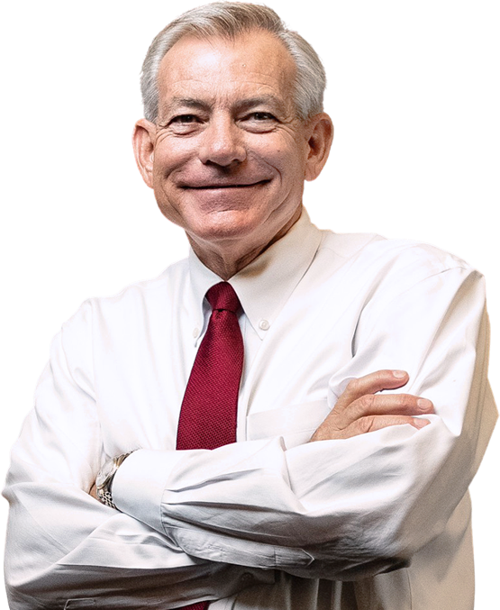
House Race Spotlight: AZ-1
TOSS UP*
CANDIDATES
PRIMARY ELECTION RESULTS
Amish Shah (D)
Representative, Arizona State House of Representatives, District 5, 2023-2024, District 24, 2019-2023
DEM | GOP
Amish Shah 23.5% | David Schweikert 62.7%
Andrei Cherny 21.3% | Kim George 27.5%
Marlene Galan-Woods 21.2% | Robert Backie 9.8%
David Schweikert (R)
Incumbent
CAMPAIGN FINANCE
PREVIOUS AZ-1 RESULTS
CAMPAIGN FINANCE DATA AS OF OCT. 16, 2024
■ Total receipts ■ Total disbursements
Election | Winner | Runner-Up | Margin
2022 House | Schweikert (R) 50.4% | Hodge (D) 49.6% | R + 0.9%
2020 House | O'Halleran (D) 51.6% | Shedd (R) 48.4% | D + 3.2%
2020 Presidential | Biden (D) 50.1% | Trump (R) 48.6% | D + 1.5%
Shah
Schweikert
*COOK POLITICAL REPORT RATINGS
SOURCE Cook Political Report with Amy Walter, Ballotpedia, FEC.
PRESENTATION CENTER 10/29/24
Notes:
Sources:
“2024 CPR House Race Ratings,” Cook Political Report, January 23, 2024, https://www.cookpolitical.com/ratings/house-race-ratings
“New York's 3rd Congressional District special election, 2024,” Ballotpedia, accessed January 31, 2024, https://ballotpedia.org/New_York%27s_3rd_Congressional_District_special_election,_2024
“New York 3rd Special Election - Forecast & Predictions,” Race to the White House, accessed January 31, 2024, https://www.racetothewh.com/house/ny3
“SUOZZI, THOMAS,” Federal Election Commission, Accessed February 6, 2024, https://www.fec.gov/data/candidate/H6NY03247/?cycle=2024&election_full=false
“PILIP, MAZI MELESA,” Federal Election Commission, Accessed February 6, 2024, https://www.fec.gov/data/candidate/H4NY03283/?cycle=2024&election_full=false
“New York Third Congressional District Special Election Results,” New York Times, February 14, 2024, https://www.nytimes.com/interactive/2024/02/13/us/elections/results-new-york-us-house-3-special.html

Slide 5

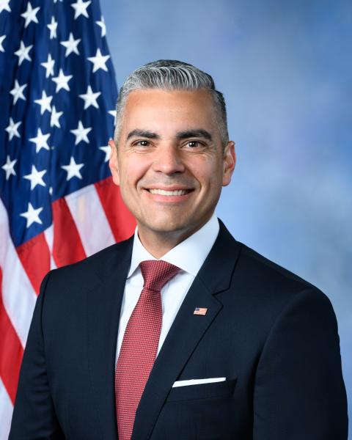
House Race Spotlight: AZ-6
TOSS UP*
CANDIDATES
PRIMARY ELECTION RESULTS
Kirsten Engel (D)
Representative, Arizona State House of Representatives, District 10, 2017-2021
DEM | GOP
Kirsten Engel Uncontested | Juan Ciscomani 61.0%
 | Kathleen Winn 39.0%
Juan Ciscomani (R)
Incumbent
CAMPAIGN FINANCE
PREVIOUS AZ-6 RESULTS
CAMPAIGN FINANCE DATA AS OF OCT. 16, 2024
■ Total receipts ■ Total disbursements
Election | Winner | Runner-Up | Margin
2022 House | Ciscomani (R) 50.7% | Engel (D) 49.2% | R + 1.5%
2020 House | Schweikert (R) 52.2% | Tipirneni (D) 47.8% | R + 4.3%
2020 Presidential | Biden (D) 49.3% | Trump (R) 49.2% | D + 0.1%
Engel
Ciscomani
*COOK POLITICAL REPORT RATINGS
SOURCE Cook Political Report with Amy Walter, Ballotpedia, FEC.
PRESENTATION CENTER 8/8/24
Notes:
Sources:
“2024 CPR House Race Ratings,” Cook Political Report, January 23, 2024, https://www.cookpolitical.com/ratings/house-race-ratings
“New York's 3rd Congressional District special election, 2024,” Ballotpedia, accessed January 31, 2024, https://ballotpedia.org/New_York%27s_3rd_Congressional_District_special_election,_2024
“New York 3rd Special Election - Forecast & Predictions,” Race to the White House, accessed January 31, 2024, https://www.racetothewh.com/house/ny3
“SUOZZI, THOMAS,” Federal Election Commission, Accessed February 6, 2024, https://www.fec.gov/data/candidate/H6NY03247/?cycle=2024&election_full=false
“PILIP, MAZI MELESA,” Federal Election Commission, Accessed February 6, 2024, https://www.fec.gov/data/candidate/H4NY03283/?cycle=2024&election_full=false
“New York Third Congressional District Special Election Results,” New York Times, February 14, 2024, https://www.nytimes.com/interactive/2024/02/13/us/elections/results-new-york-us-house-3-special.html

Slide 6

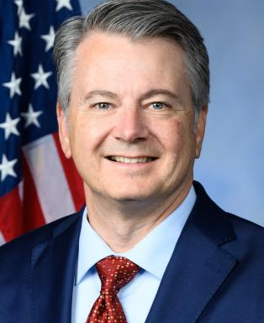
House Race Spotlight: CA-13
TOSS UP*
CANDIDATES
ALL-PARTY PRIMARY RESULTS
Adam Gray (D)
Assembly Member, California State Assembly, District 21, 2012-2022
John Duarte (R) 54.9%
Adam Gary (D) 45.1%
John Duarte (R)
Incumbent
CAMPAIGN FINANCE
PREVIOUS CA-13 RESULTS
CAMPAIGN FINANCE DATA AS OF OCT. 16, 2024
■ Total receipts ■ Total disbursements
Election | Winner | Runner-Up | Margin
2022 House | Duarte (R) 50.2% | Gray (D) 49.8% | R + 0.4%
2020 House | Lee (D) 90.4% | Piterman (R) 9.6% | D + 80.8%
2020 Presidential | Biden (D) 54.3% | Trump (R) 43.4% | D + 10.9%
Gray
Duarte
*COOK POLITICAL REPORT RATINGS
SOURCE Cook Political Report with Amy Walter, Ballotpedia, FEC.
PRESENTATION CENTER 8/8/24

Slide 7
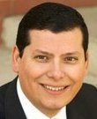

House Race Spotlight: CA-22
TOSS UP*
CANDIDATES
ALL-PARTY PRIMARY RESULTS
Rudy Salas (D)
Assembly Member, California State Assembly, District 32, 2012-2022
David Valadao (R) 32.7%
Rudy Salas (D) 31.3%
Chris Mathys (R) 22.0%
Melissa Hurtado (D) 14.0%
David Valadao (R)
Incumbent
CAMPAIGN FINANCE
PREVIOUS CA-22 RESULTS
CAMPAIGN FINANCE DATA AS OF OCT. 16, 2024
■ Total receipts ■ Total disbursements
Election | Winner | Runner-Up | Margin
2022 House | Valadao (R) 51.5% | Salas (D) 48.5% | R + 3.0%
2020 House | Nunes (R) 54.2% | Arballo (D) 45.8% | R + 8.4%
2020 Presidential | Biden (D) 55.3% | Trump (R) 42.3% | D + 13.0%
Salas
Valadao
*COOK POLITICAL REPORT RATINGS
SOURCE Cook Political Report with Amy Walter, Ballotpedia, FEC.
PRESENTATION CENTER 10/29/24

Slide 8

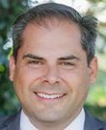
House Race Spotlight: CA-27
TOSS UP*
CANDIDATES
ALL-PARTY PRIMARY RESULTS
George Whitesides (D)
Chief Executive Officer/Chairman, Virgin Galactic, 2010-2023
Mike Garcia (R) 54.9%
George Whitesides (D) 32.8%
Steve Hill (D) 12.2%
Mike Garcia (R)
Incumbent
CAMPAIGN FINANCE
PREVIOUS CA-27 RESULTS
CAMPAIGN FINANCE DATA AS OF OCT. 16, 2024
■ Total receipts ■ Total disbursements
Election | Winner | Runner-Up | Margin
2022 House | Garcia (R) 53.2% | Smith (D) 46.8% | R + 6.4%
2020 House | Chu (D) 69.8% | Nalbandian (R) 30.2% | D + 39.6%
2020 Presidential | Biden (D) 55.1% | Trump (R) 42.7% | D + 12.4%
Whitesides
Garcia
*COOK POLITICAL REPORT RATINGS
SOURCE Cook Political Report with Amy Walter, Ballotpedia, FEC.
PRESENTATION CENTER 10/29/24

Slide 9
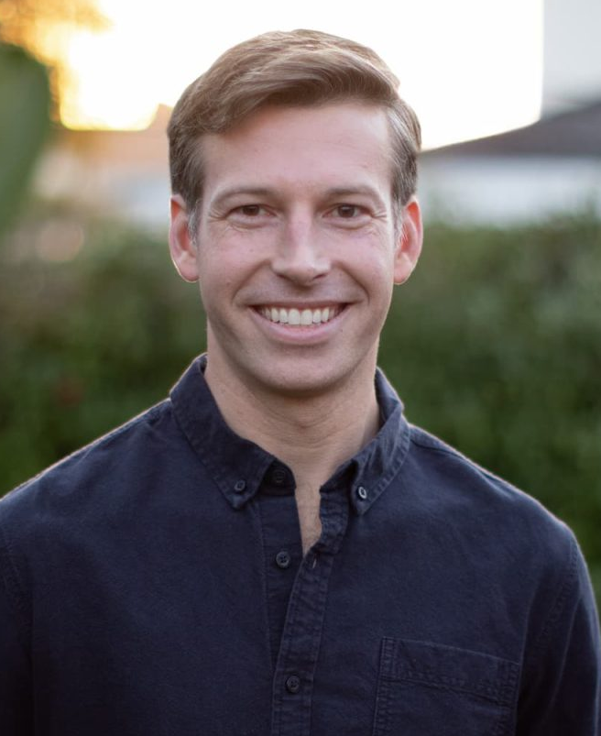
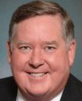
House Race Spotlight: CA-41
TOSS UP*
CANDIDATES
ALL-PARTY PRIMARY RESULTS
Will Rollins (D)
Assistant United States Attorney, United States Department of Justice, 2016-2021
Ken Calvert (R) 53.0%
Will Rollins (D) 38.4%
Anna Nevenic (D) 8.6%
Ken Calvert (R)
Incumbent
CAMPAIGN FINANCE
PREVIOUS CA-41 RESULTS
CAMPAIGN FINANCE DATA AS OF OCT. 16, 2024
■ Total receipts ■ Total disbursements
Election | Winner | Runner-Up | Margin
2022 House | Calvert (R) 52.3% | Rollins (D) 47.7% | R + 4.6%
2020 House | Takano (D) 64.0% | Smith (R) 36.0% | D + 28.0%
2020 Presidential | Trump (R) 49.7% | Biden (D) 48.6% | R + 1.1%
Rollins
Calvert
*COOK POLITICAL REPORT RATINGS
SOURCE Cook Political Report with Amy Walter, Ballotpedia, FEC.
PRESENTATION CENTER 8/8/24

Slide 10
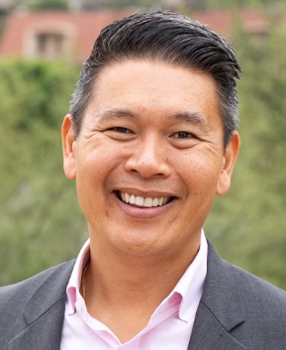

House Race Spotlight: CA-45
TOSS UP*
CANDIDATES
ALL-PARTY PRIMARY RESULTS
Derek Tran (D)
Managing Attorney, Feher Law, Professional Corporation, 2023-present
Michelle Steel (R) 54.9%
Derek Tran (D) 15.9%
Kim Nguyen-Penaloza (D) 15.6%
Cheyenne Hunt (D) 8.4
Aditya Pai (D) 5.2%
Michelle Steel (R)
Incumbent
CAMPAIGN FINANCE
PREVIOUS CA-45 RESULTS
CAMPAIGN FINANCE DATA AS OF OCT. 16, 2024
■ Total receipts ■ Total disbursements
Election | Winner | Runner-Up | Margin
2022 House | Steel (R) 52.4% | Chen (D) 47.6% | R + 4.8%
2020 House | Porter (D) 53.5% | Raths (R) 46.5% | D + 7.0%
2020 Presidential | Biden (D) 52.1% | Trump (R) 46.0% | D + 6.1%
Tran
Steel
*COOK POLITICAL REPORT RATINGS
SOURCE Cook Political Report with Amy Walter, Ballotpedia, FEC.
PRESENTATION CENTER 10/29/24

Slide 11
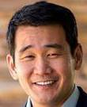
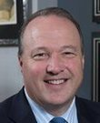
House Race Spotlight: CA-47
LEAN D*
CANDIDATES
ALL-PARTY PRIMARY RESULTS
Dave Min (D)
Senator, California State Senate, District 37, 2020-present
Scott Baugh (R) 32.1%
Dave Min (D) 25.9%
Joanna Weiss (D) 19.4%
Max Ukropina (R) 14.8%
Scott Baugh (R)
Owner, Scott Baugh & Associates, 2000-present
CAMPAIGN FINANCE
PREVIOUS CA-47 RESULTS
CAMPAIGN FINANCE DATA AS OF OCT. 16, 2024
■ Total receipts ■ Total disbursements
Election | Winner | Runner-Up | Margin
2022 House | Porter (D) 51.7% | Baugh (R) 48.3% | D + 3.4%
2020 House | Lowenthal (D) 63.3% | Briscoe (R) 36.7% | D + 26.5%
2020 Presidential | Biden (D) 54.5% | Trump (R) 43.4% | D + 11.1%
Min
Baugh
*COOK POLITICAL REPORT RATINGS
SOURCE Cook Political Report with Amy Walter, Ballotpedia, FEC.
PRESENTATION CENTER 2/14/24
Notes:
Sources:
“2024 CPR House Race Ratings,” Cook Political Report, January 23, 2024, https://www.cookpolitical.com/ratings/house-race-ratings
“New York's 3rd Congressional District special election, 2024,” Ballotpedia, accessed January 31, 2024, https://ballotpedia.org/New_York%27s_3rd_Congressional_District_special_election,_2024
“New York 3rd Special Election - Forecast & Predictions,” Race to the White House, accessed January 31, 2024, https://www.racetothewh.com/house/ny3
“SUOZZI, THOMAS,” Federal Election Commission, Accessed February 6, 2024, https://www.fec.gov/data/candidate/H6NY03247/?cycle=2024&election_full=false
“PILIP, MAZI MELESA,” Federal Election Commission, Accessed February 6, 2024, https://www.fec.gov/data/candidate/H4NY03283/?cycle=2024&election_full=false
“New York Third Congressional District Special Election Results,” New York Times, February 14, 2024, https://www.nytimes.com/interactive/2024/02/13/us/elections/results-new-york-us-house-3-special.html

Slide 12


House Race Spotlight: CO-3
LEAN R*
CANDIDATES
PRIMARY ELECTION RESULTS
Adam Frisch (D)
Substitute Teacher, Aspen School District, 2021-present
DEM | GOP
Adam Frisch Uncontested | Jeff Hurd 42.0%
 | Ron Hanks 27.7%
 | Stephen Varela 9.7%
Jeff Hurd (R)
Director, Ireland Stapleton Pryor & Pascoe, PC, 2017-present
CAMPAIGN FINANCE
PREVIOUS CO-3 RESULTS
CAMPAIGN FINANCE DATA AS OF OCT. 16, 2024
■ Total receipts ■ Total disbursements
Election | Winner | Runner-Up | Margin
2022 House | Boebert (R) 50.1% | Frisch (D) 49.9% | R + 0.2%
2020 House | Boebert (R) 51.4% | Mitsch Bush (D) 45.2% | R + 6.2%
2020 Presidential | Trump (R) 52.9% | Biden (D) 44.7% | R + 8.2%
Frisch
Hurd
*COOK POLITICAL REPORT RATINGS
SOURCE Cook Political Report with Amy Walter, Ballotpedia, FEC.
PRESENTATION CENTER 10/29/24
Notes:
Sources:
“2024 CPR House Race Ratings,” Cook Political Report, January 23, 2024, https://www.cookpolitical.com/ratings/house-race-ratings
“New York's 3rd Congressional District special election, 2024,” Ballotpedia, accessed January 31, 2024, https://ballotpedia.org/New_York%27s_3rd_Congressional_District_special_election,_2024
“New York 3rd Special Election - Forecast & Predictions,” Race to the White House, accessed January 31, 2024, https://www.racetothewh.com/house/ny3
“SUOZZI, THOMAS,” Federal Election Commission, Accessed February 6, 2024, https://www.fec.gov/data/candidate/H6NY03247/?cycle=2024&election_full=false
“PILIP, MAZI MELESA,” Federal Election Commission, Accessed February 6, 2024, https://www.fec.gov/data/candidate/H4NY03283/?cycle=2024&election_full=false
“New York Third Congressional District Special Election Results,” New York Times, February 14, 2024, https://www.nytimes.com/interactive/2024/02/13/us/elections/results-new-york-us-house-3-special.html

Slide 13


House Race Spotlight: CO-8
TOSS UP*
CANDIDATES
PRIMARY ELECTION RESULTS
Yadira Caraveo (D)
Incumbent
DEM | GOP
Yadira Caraveo Uncontested | Gabe Evans 78%
 | Janak Joshi 22%
Gabe Evans (R)
Instructor, Makhaira Group, 2022-present
CAMPAIGN FINANCE
PREVIOUS CO-8 RESULTS
CAMPAIGN FINANCE DATA AS OF OCT. 16, 2024
■ Total receipts ■ Total disbursements
Election | Winner | Runner-Up | Margin
2022 House | Caraveo (D) 48.4% | Kirkmeyer (R) 47.7% | D + 0.7%
2020 Presidential | Biden (D) 50.8% | Trump (R) 46.3% | D + 4.5%
Caraveo
Evans
*COOK POLITICAL REPORT RATINGS
SOURCE Cook Political Report with Amy Walter, Ballotpedia, FEC.
PRESENTATION CENTER 10/29/24
Notes:
Sources:
“2024 CPR House Race Ratings,” Cook Political Report, January 23, 2024, https://www.cookpolitical.com/ratings/house-race-ratings
“New York's 3rd Congressional District special election, 2024,” Ballotpedia, accessed January 31, 2024, https://ballotpedia.org/New_York%27s_3rd_Congressional_District_special_election,_2024
“New York 3rd Special Election - Forecast & Predictions,” Race to the White House, accessed January 31, 2024, https://www.racetothewh.com/house/ny3
“SUOZZI, THOMAS,” Federal Election Commission, Accessed February 6, 2024, https://www.fec.gov/data/candidate/H6NY03247/?cycle=2024&election_full=false
“PILIP, MAZI MELESA,” Federal Election Commission, Accessed February 6, 2024, https://www.fec.gov/data/candidate/H4NY03283/?cycle=2024&election_full=false
“New York Third Congressional District Special Election Results,” New York Times, February 14, 2024, https://www.nytimes.com/interactive/2024/02/13/us/elections/results-new-york-us-house-3-special.html

Slide 14


House Race Spotlight: FL-27
LIKELY R*
CANDIDATES
PRIMARY ELECTION RESULTS
Lucia Baez-Geller (D)
Board Member, Miami-Dade County School Board, 2020-present
DEM | GOP
Lucia Baez-Geller 54.2% | Maria Elvira Salazar 88.7%
Mike Davey 45.8% | Royland Lara 11.3%
Maria Salazar (R)
Incumbent
CAMPAIGN FINANCE
PREVIOUS FL-27 RESULTS
CAMPAIGN FINANCE DATA AS OF OCT. 16, 2024
■ Total receipts ■ Total disbursements
Election | Winner | Runner-Up | Margin
2022 House | Salazar (R) 57.3% | Taddeo (D) 42.7% | R + 14.6%
2020 House | Salazar (R) 51.4% | Shalala (D) 48.6% | R + 2.8%
2020 Presidential | Trump (R) 49.9% | Biden (D) 49.6% | R + 0.3%
Baez-Geller
Salazar
*COOK POLITICAL REPORT RATINGS
SOURCE Cook Political Report with Amy Walter, Ballotpedia, FEC.
PRESENTATION CENTER 10/29/24
Notes:
Sources:
“2024 CPR House Race Ratings,” Cook Political Report, January 23, 2024, https://www.cookpolitical.com/ratings/house-race-ratings
“New York's 3rd Congressional District special election, 2024,” Ballotpedia, accessed January 31, 2024, https://ballotpedia.org/New_York%27s_3rd_Congressional_District_special_election,_2024
“New York 3rd Special Election - Forecast & Predictions,” Race to the White House, accessed January 31, 2024, https://www.racetothewh.com/house/ny3
“SUOZZI, THOMAS,” Federal Election Commission, Accessed February 6, 2024, https://www.fec.gov/data/candidate/H6NY03247/?cycle=2024&election_full=false
“PILIP, MAZI MELESA,” Federal Election Commission, Accessed February 6, 2024, https://www.fec.gov/data/candidate/H4NY03283/?cycle=2024&election_full=false
“New York Third Congressional District Special Election Results,” New York Times, February 14, 2024, https://www.nytimes.com/interactive/2024/02/13/us/elections/results-new-york-us-house-3-special.html

Slide 15
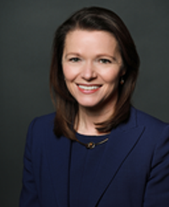
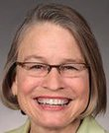
House Race Spotlight: IA-1
TOSS UP*
CANDIDATES
PRIMARY ELECTION RESULTS
Christina Bohannan (D)
Former Clerk, 11th Circuit Court of Appeals, Montgomery, Alabama
DEM | GOP
No election | Mariannette Miller-Meeks 56.0%
 | David Pautsch 44.0%
Mariannette Miller-Meeks (R)
Incumbent
CAMPAIGN FINANCE
PREVIOUS IA-1 RESULTS
CAMPAIGN FINANCE DATA AS OF OCT. 16, 2024
■ Total receipts ■ Total disbursements
Election | Winner | Runner-Up | Margin
2022 House | Miller-Meeks (R) 53.4% | Bohannan (D) 46.6% | R + 6.8%
2020 House | Hinson (R) 51.3% | Finkenauer (D) 48.7% | R + 2.6%
2020 Presidential | Trump (R) 50.5% | Biden (D) 47.6% | R + 2.9%
Bohannan
Miller-Meeks
*COOK POLITICAL REPORT RATINGS
SOURCE Cook Political Report with Amy Walter, Ballotpedia, FEC.
PRESENTATION CENTER 2/14/24
Notes:
Sources:
“2024 CPR House Race Ratings,” Cook Political Report, January 23, 2024, https://www.cookpolitical.com/ratings/house-race-ratings
“New York's 3rd Congressional District special election, 2024,” Ballotpedia, accessed January 31, 2024, https://ballotpedia.org/New_York%27s_3rd_Congressional_District_special_election,_2024
“New York 3rd Special Election - Forecast & Predictions,” Race to the White House, accessed January 31, 2024, https://www.racetothewh.com/house/ny3
“SUOZZI, THOMAS,” Federal Election Commission, Accessed February 6, 2024, https://www.fec.gov/data/candidate/H6NY03247/?cycle=2024&election_full=false
“PILIP, MAZI MELESA,” Federal Election Commission, Accessed February 6, 2024, https://www.fec.gov/data/candidate/H4NY03283/?cycle=2024&election_full=false
“New York Third Congressional District Special Election Results,” New York Times, February 14, 2024, https://www.nytimes.com/interactive/2024/02/13/us/elections/results-new-york-us-house-3-special.html

Slide 16
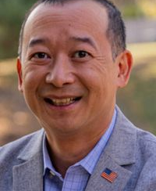

House Race Spotlight: IA-3
TOSS UP*
CANDIDATES
PRIMARY ELECTION RESULTS
Lanon Baccam (D)
Retired National Guard
DEM | GOP
Lanon Baccam 84.2% | Zach Nunn 98.3%
Melissa Vine 15.8% | Write-in votes 1.7%
Zach Nunn (R)
Incumbent
CAMPAIGN FINANCE
PREVIOUS IA-3 RESULTS
CAMPAIGN FINANCE DATA AS OF JUN. 30, 2024
■ Total receipts ■ Total disbursements
Election | Winner | Runner-Up | Margin
2022 House | Nunn (R) 50.3% | Axne (D) 49.6% | R + 0.7%
2020 House | Axne (D) 48.9% | Young (R) 47.5% | D + 1.4%
2020 Presidential | Trump (R) 49.3% | Biden (D) 48.9% | R + 0.4%
Baccam
Nunn
*COOK POLITICAL REPORT RATINGS
SOURCE Cook Political Report with Amy Walter, Ballotpedia, FEC.
PRESENTATION CENTER 10/29/24
Notes:
Sources:
“2024 CPR House Race Ratings,” Cook Political Report, January 23, 2024, https://www.cookpolitical.com/ratings/house-race-ratings
“New York's 3rd Congressional District special election, 2024,” Ballotpedia, accessed January 31, 2024, https://ballotpedia.org/New_York%27s_3rd_Congressional_District_special_election,_2024
“New York 3rd Special Election - Forecast & Predictions,” Race to the White House, accessed January 31, 2024, https://www.racetothewh.com/house/ny3
“SUOZZI, THOMAS,” Federal Election Commission, Accessed February 6, 2024, https://www.fec.gov/data/candidate/H6NY03247/?cycle=2024&election_full=false
“PILIP, MAZI MELESA,” Federal Election Commission, Accessed February 6, 2024, https://www.fec.gov/data/candidate/H4NY03283/?cycle=2024&election_full=false
“New York Third Congressional District Special Election Results,” New York Times, February 14, 2024, https://www.nytimes.com/interactive/2024/02/13/us/elections/results-new-york-us-house-3-special.html

Slide 17
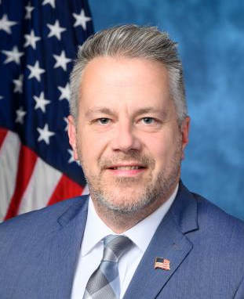

House Race Spotlight: IL-17
LIKELY D*
CANDIDATES
PRIMARY ELECTION RESULTS
Eric Sorensen (D)
Incumbent
DEM | GOP
Eric Sorensen Uncontested | Joe McGraw 67.8%
 | Scott Crowl 32.2%
Joe McGraw (R)
CAMPAIGN FINANCE
PREVIOUS IL-17 RESULTS
CAMPAIGN FINANCE DATA AS OF OCT. 16, 2024
■ Total receipts ■ Total disbursements
Election | Winner | Runner-Up | Margin
2022 House | Sorensen (D) 52.0% | King (R) 48.0% | D + 4.0%
2020 House | Bustos (D) 52.0% | King (R) 48.0% | D + 4.0%
2020 Presidential | Biden (D) 52.7% | Trump (R) 44.9% | D + 7.8%
Sorensen
McGraw
*COOK POLITICAL REPORT RATINGS
SOURCE Cook Political Report with Amy Walter, Ballotpedia, FEC.
PRESENTATION CENTER 10/29/24
Notes:
Sources:
“2024 CPR House Race Ratings,” Cook Political Report, January 23, 2024, https://www.cookpolitical.com/ratings/house-race-ratings
“New York's 3rd Congressional District special election, 2024,” Ballotpedia, accessed January 31, 2024, https://ballotpedia.org/New_York%27s_3rd_Congressional_District_special_election,_2024
“New York 3rd Special Election - Forecast & Predictions,” Race to the White House, accessed January 31, 2024, https://www.racetothewh.com/house/ny3
“SUOZZI, THOMAS,” Federal Election Commission, Accessed February 6, 2024, https://www.fec.gov/data/candidate/H6NY03247/?cycle=2024&election_full=false
“PILIP, MAZI MELESA,” Federal Election Commission, Accessed February 6, 2024, https://www.fec.gov/data/candidate/H4NY03283/?cycle=2024&election_full=false
“New York Third Congressional District Special Election Results,” New York Times, February 14, 2024, https://www.nytimes.com/interactive/2024/02/13/us/elections/results-new-york-us-house-3-special.html

Slide 18
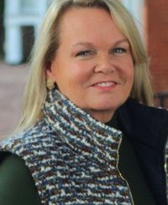

House Race Spotlight: MD-6
LEAN D*
CANDIDATES
PRIMARY ELECTION RESULTS
April Delaney (D)
DEM | GOP
April Delaney 40.4% | Neil Parrott 45.9%
Joe Vogel 26.2% | Dan Cox 30.1%
Ashwani Jain 8.3% | Mariela Roca 12.3%
Neil Parrott (R)
Assistant Minority Whip, Maryland State House of Delegates, 2015-2023
CAMPAIGN FINANCE
PREVIOUS MD-6 RESULTS
CAMPAIGN FINANCE DATA AS OF OCT. 16, 2024
■ Total receipts ■ Total disbursements
Election | Winner | Runner-Up | Margin
2022 House | Trone (D) 54.7% | Parrott (R) 45.2% | D + 9.5%
2020 House | Trone (D) 58.8% | Parrott (R) 39.2% | D + 19.6%
2020 Presidential | Biden (D) 53.9% | Trump (R) 44.1% | D + 9.8%
Delaney
Parrott
*COOK POLITICAL REPORT RATINGS
SOURCE Cook Political Report with Amy Walter, Ballotpedia, FEC.
PRESENTATION CENTER 10/29/24
Notes:
Sources:
“2024 CPR House Race Ratings,” Cook Political Report, January 23, 2024, https://www.cookpolitical.com/ratings/house-race-ratings
“New York's 3rd Congressional District special election, 2024,” Ballotpedia, accessed January 31, 2024, https://ballotpedia.org/New_York%27s_3rd_Congressional_District_special_election,_2024
“New York 3rd Special Election - Forecast & Predictions,” Race to the White House, accessed January 31, 2024, https://www.racetothewh.com/house/ny3
“SUOZZI, THOMAS,” Federal Election Commission, Accessed February 6, 2024, https://www.fec.gov/data/candidate/H6NY03247/?cycle=2024&election_full=false
“PILIP, MAZI MELESA,” Federal Election Commission, Accessed February 6, 2024, https://www.fec.gov/data/candidate/H4NY03283/?cycle=2024&election_full=false
“New York Third Congressional District Special Election Results,” New York Times, February 14, 2024, https://www.nytimes.com/interactive/2024/02/13/us/elections/results-new-york-us-house-3-special.html

Slide 19
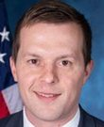
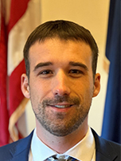
House Race Spotlight: ME-2
TOSS UP*
CANDIDATES
PRIMARY ELECTION RESULTS
Jared Golden (D)
Incumbent
DEM | GOP
Jared Golden Uncontested | Austin Theriault 66.9%
 | Michael Soboleski 33.1%
Austin Theriault (R)
Racer, National Association for Stock Car Auto Racing (NASCAR), 2014-2023
CAMPAIGN FINANCE
PREVIOUS ME-2 RESULTS
CAMPAIGN FINANCE DATA AS OF OCT. 16, 2024
■ Total receipts ■ Total disbursements
Election | Winner | Runner-Up | Margin
2022 House | Golden (D) 53.1 | Poliquin (R) 46.9% | D + 6.2%
2020 House | Golden (D) 53.0% | Crafts (R) 47.0% | D + 6.0%
2020 Presidential | Trump (R) 51.6% | Biden (D) 45.5% | R + 6.1%
Golden
Theriault
*COOK POLITICAL REPORT RATINGS
SOURCE Cook Political Report with Amy Walter, Ballotpedia, FEC.
PRESENTATION CENTER 10/29/24
Notes:
Sources:
“2024 CPR House Race Ratings,” Cook Political Report, January 23, 2024, https://www.cookpolitical.com/ratings/house-race-ratings
“New York's 3rd Congressional District special election, 2024,” Ballotpedia, accessed January 31, 2024, https://ballotpedia.org/New_York%27s_3rd_Congressional_District_special_election,_2024
“New York 3rd Special Election - Forecast & Predictions,” Race to the White House, accessed January 31, 2024, https://www.racetothewh.com/house/ny3
“SUOZZI, THOMAS,” Federal Election Commission, Accessed February 6, 2024, https://www.fec.gov/data/candidate/H6NY03247/?cycle=2024&election_full=false
“PILIP, MAZI MELESA,” Federal Election Commission, Accessed February 6, 2024, https://www.fec.gov/data/candidate/H4NY03283/?cycle=2024&election_full=false
“New York Third Congressional District Special Election Results,” New York Times, February 14, 2024, https://www.nytimes.com/interactive/2024/02/13/us/elections/results-new-york-us-house-3-special.html

Slide 20
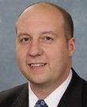
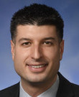
House Race Spotlight: MI-7
LEAN R*
CANDIDATES
PRIMARY ELECTION RESULTS
Curtis Hertel (D)
Senator, Michigan State Senate, District 23, 2015-2022
DEM | GOP
Curtis Hertel Uncontested | Tom Barrett Uncontested
Tom Barrett (R)
Helicopter Pilot, Michigan Army National Guard, present
CAMPAIGN FINANCE
PREVIOUS MI-7 RESULTS
CAMPAIGN FINANCE DATA AS OF OCT. 16, 2024
■ Total receipts ■ Total disbursements
Election | Winner | Runner-Up | Margin
2022 House | Slotkin (D) 51.7% | Barrett (R) 46.3% | D + 5.4%
2020 House | Walberg (R) 58.8% | Driskell (D) 41.2% | R + 17.6%
2020 Presidential | Biden (D) 49.4% | Trump (R) 48.9% | D + 0.5%
Hertel
Barrett
*COOK POLITICAL REPORT RATINGS
SOURCE Cook Political Report with Amy Walter, Ballotpedia, FEC.
PRESENTATION CENTER 10/29/24
Notes:
Sources:
“2024 CPR House Race Ratings,” Cook Political Report, January 23, 2024, https://www.cookpolitical.com/ratings/house-race-ratings
“New York's 3rd Congressional District special election, 2024,” Ballotpedia, accessed January 31, 2024, https://ballotpedia.org/New_York%27s_3rd_Congressional_District_special_election,_2024
“New York 3rd Special Election - Forecast & Predictions,” Race to the White House, accessed January 31, 2024, https://www.racetothewh.com/house/ny3
“SUOZZI, THOMAS,” Federal Election Commission, Accessed February 6, 2024, https://www.fec.gov/data/candidate/H6NY03247/?cycle=2024&election_full=false
“PILIP, MAZI MELESA,” Federal Election Commission, Accessed February 6, 2024, https://www.fec.gov/data/candidate/H4NY03283/?cycle=2024&election_full=false
“New York Third Congressional District Special Election Results,” New York Times, February 14, 2024, https://www.nytimes.com/interactive/2024/02/13/us/elections/results-new-york-us-house-3-special.html

Slide 21
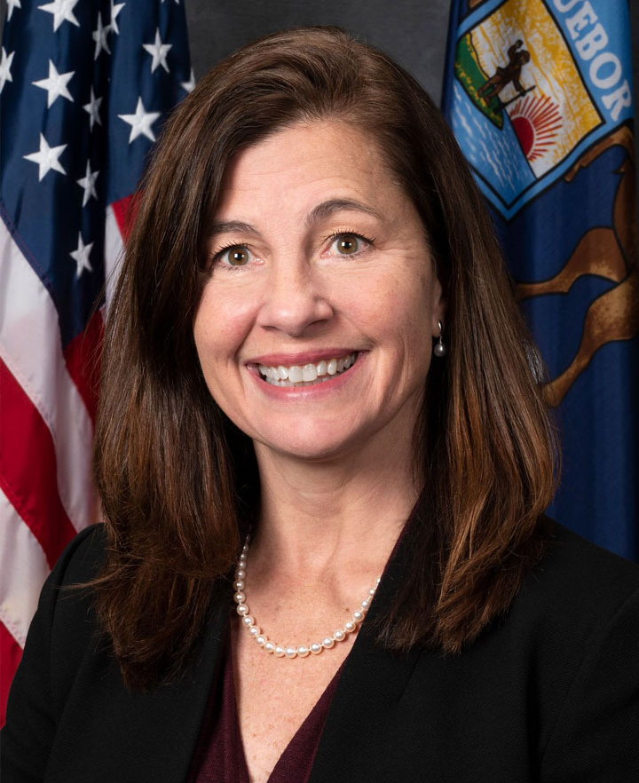

House Race Spotlight: MI-8
TOSS UP*
CANDIDATES
PRIMARY ELECTION RESULTS
Kristen McDonald Rivet (D)
Vice President, Michigan Future, Incorporated, 2021-present
DEM | GOP
Kristen McDonald Rivet 55.9% | Paul Junge 73.6%
Matt Collier 28.7% | Mary Draves 15.8%
Pamela Pugh 15.4% | Anthony Hudson 10.6%
Paul Junge (R)
External Affairs, United States Citizenship and Immigration Services, 2018
CAMPAIGN FINANCE
PREVIOUS MI-8 RESULTS
CAMPAIGN FINANCE DATA AS OF OCT. 16, 2024
■ Total receipts ■ Total disbursements
Election | Winner | Runner-Up | Margin
2022 House | Kildee (D) 53.1% | Junge (R) 42.8% | D + 10.3%
2020 House | Slotkin (D) 50.9% | Junge (R) 47.3% | D + 3.6%
2020 Presidential | Biden (D) 50.3% | Trump (R) 48.2% | D + 2.1%
Rivet
Junge
*COOK POLITICAL REPORT RATINGS
SOURCE Cook Political Report with Amy Walter, Ballotpedia, FEC.
PRESENTATION CENTER 10/29/24
Notes:
Sources:
“2024 CPR House Race Ratings,” Cook Political Report, January 23, 2024, https://www.cookpolitical.com/ratings/house-race-ratings
“New York's 3rd Congressional District special election, 2024,” Ballotpedia, accessed January 31, 2024, https://ballotpedia.org/New_York%27s_3rd_Congressional_District_special_election,_2024
“New York 3rd Special Election - Forecast & Predictions,” Race to the White House, accessed January 31, 2024, https://www.racetothewh.com/house/ny3
“SUOZZI, THOMAS,” Federal Election Commission, Accessed February 6, 2024, https://www.fec.gov/data/candidate/H6NY03247/?cycle=2024&election_full=false
“PILIP, MAZI MELESA,” Federal Election Commission, Accessed February 6, 2024, https://www.fec.gov/data/candidate/H4NY03283/?cycle=2024&election_full=false
“New York Third Congressional District Special Election Results,” New York Times, February 14, 2024, https://www.nytimes.com/interactive/2024/02/13/us/elections/results-new-york-us-house-3-special.html

Slide 22
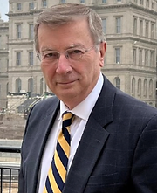
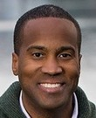
House Race Spotlight: MI-10
LEAN R*
CANDIDATES
PRIMARY ELECTION RESULTS
Carl Marlinga (D)
Arbitrator and Mediator, Carl Marlinga Alternative Dispute Resolution, 2022-present
DEM | GOP
Carl Marlinga 47.2% | John James Uncontested
Diane Young 25.5%
Tiffany Tilley 13.7%
John James (R)
Incumbent
CAMPAIGN FINANCE
PREVIOUS MI-10 RESULTS
CAMPAIGN FINANCE DATA AS OF OCT. 16, 2024
■ Total receipts ■ Total disbursements
Election | Winner | Runner-Up | Margin
2022 House | James (R) 48.8% | Marlinga (D) 48.3% | R + 0.5%
2020 House | McClain (R) 66.3% | Bizon (D) 33.7% | R + 32.6%
2020 Presidential | Trump (R) 49.8% | Biden (D) 48.8% | R + 1.0%
Marlinga
James
*COOK POLITICAL REPORT RATINGS
SOURCE Cook Political Report with Amy Walter, Ballotpedia, FEC.
PRESENTATION CENTER 10/29/24
Notes:
Sources:
“2024 CPR House Race Ratings,” Cook Political Report, January 23, 2024, https://www.cookpolitical.com/ratings/house-race-ratings
“New York's 3rd Congressional District special election, 2024,” Ballotpedia, accessed January 31, 2024, https://ballotpedia.org/New_York%27s_3rd_Congressional_District_special_election,_2024
“New York 3rd Special Election - Forecast & Predictions,” Race to the White House, accessed January 31, 2024, https://www.racetothewh.com/house/ny3
“SUOZZI, THOMAS,” Federal Election Commission, Accessed February 6, 2024, https://www.fec.gov/data/candidate/H6NY03247/?cycle=2024&election_full=false
“PILIP, MAZI MELESA,” Federal Election Commission, Accessed February 6, 2024, https://www.fec.gov/data/candidate/H4NY03283/?cycle=2024&election_full=false
“New York Third Congressional District Special Election Results,” New York Times, February 14, 2024, https://www.nytimes.com/interactive/2024/02/13/us/elections/results-new-york-us-house-3-special.html

Slide 23
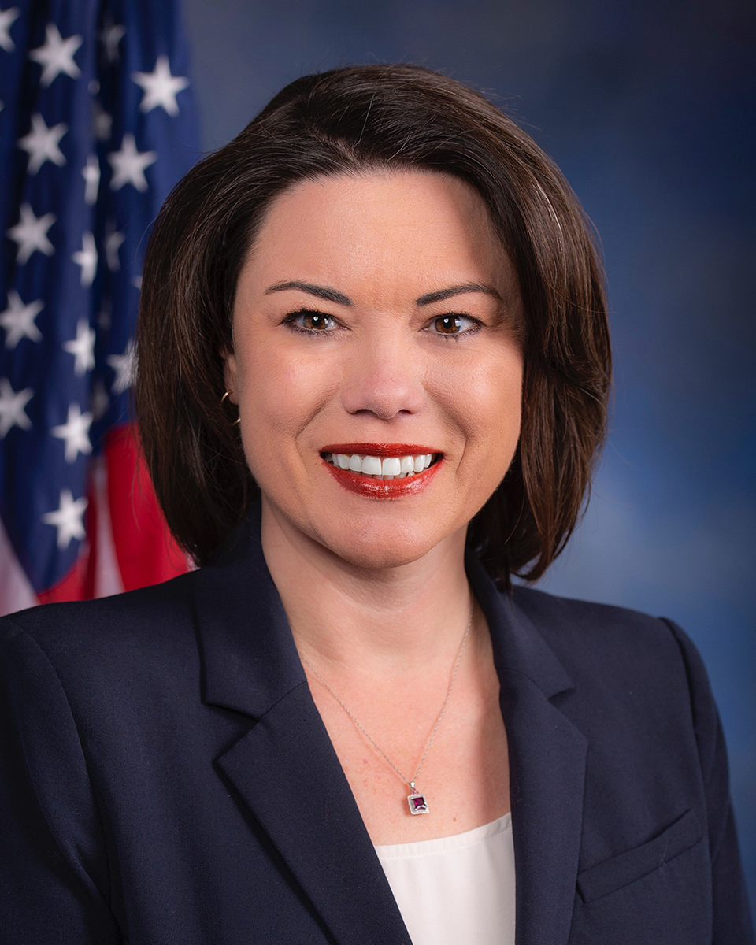
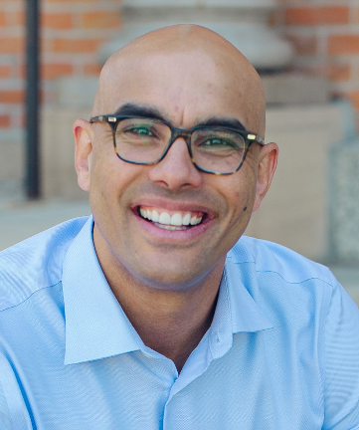
House Race Spotlight: MN-2
LIKELY D*
CANDIDATES
PRIMARY ELECTION RESULTS
Angie Craig (D)
Incumbent
DEM | GOP
Angie Craig 91.0% | Joe Teirab 76.0%
Marc Ives 9.0% | Tayler Rahm 24.0%
Joe Teirab (R)
Assistant United States Attorney, United States Attorneys'​ Offices, 2019-2023
CAMPAIGN FINANCE
PREVIOUS MN-2 RESULTS
CAMPAIGN FINANCE DATA AS OF OCT. 16, 2024
■ Total receipts ■ Total disbursements
Election | Winner | Runner-Up | Margin
2022 House | Craig (D) 50.9% | Kistner (R) 45.6% | D + 5.3%
2020 House | Craig (D) 48.2% | Kistner (R) 45.9% | D + 2.3%
2020 Presidential | Biden (D) 52.5% | Trump (R) 45.4% | D + 7.1%
Craig
Teirab
*COOK POLITICAL REPORT RATINGS
SOURCE Cook Political Report with Amy Walter, Ballotpedia, FEC.
PRESENTATION CENTER 10/29/24
Notes:
Sources:
“2024 CPR House Race Ratings,” Cook Political Report, January 23, 2024, https://www.cookpolitical.com/ratings/house-race-ratings
“New York's 3rd Congressional District special election, 2024,” Ballotpedia, accessed January 31, 2024, https://ballotpedia.org/New_York%27s_3rd_Congressional_District_special_election,_2024
“New York 3rd Special Election - Forecast & Predictions,” Race to the White House, accessed January 31, 2024, https://www.racetothewh.com/house/ny3
“SUOZZI, THOMAS,” Federal Election Commission, Accessed February 6, 2024, https://www.fec.gov/data/candidate/H6NY03247/?cycle=2024&election_full=false
“PILIP, MAZI MELESA,” Federal Election Commission, Accessed February 6, 2024, https://www.fec.gov/data/candidate/H4NY03283/?cycle=2024&election_full=false
“New York Third Congressional District Special Election Results,” New York Times, February 14, 2024, https://www.nytimes.com/interactive/2024/02/13/us/elections/results-new-york-us-house-3-special.html

Slide 24
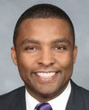

House Race Spotlight: NC-1
TOSS UP*
CANDIDATES
PRIMARY ELECTION RESULTS
Don Davis (D)
Incumbent
DEM | GOP
Don Davis Uncontested | Laurie Buckhout 53.5%
 | Sandy Smith 46.5%
Laurie Buckhout (R)
Independent Consultant, Self-Employed, 2023-present
CAMPAIGN FINANCE
PREVIOUS NC-1 RESULTS
CAMPAIGN FINANCE DATA AS OF OCT. 16, 2024
■ Total receipts ■ Total disbursements
Election | Winner | Runner-Up | Margin
2022 House | Davis (D) 52.4% | Smith (R) 47.6% | D + 4.8%
2020 House | Butterfield (D) 54.2% | Smith (R) 45.8% | D + 8.4%
2020 Presidential | Biden (D) 50.4% | Trump (R) 48.8% | D + 1.6%
Davis
Buckhout
*COOK POLITICAL REPORT RATINGS
SOURCE Cook Political Report with Amy Walter, Ballotpedia, FEC.
PRESENTATION CENTER 10/29/24
Notes:
Sources:
“2024 CPR House Race Ratings,” Cook Political Report, January 23, 2024, https://www.cookpolitical.com/ratings/house-race-ratings
“New York's 3rd Congressional District special election, 2024,” Ballotpedia, accessed January 31, 2024, https://ballotpedia.org/New_York%27s_3rd_Congressional_District_special_election,_2024
“New York 3rd Special Election - Forecast & Predictions,” Race to the White House, accessed January 31, 2024, https://www.racetothewh.com/house/ny3
“SUOZZI, THOMAS,” Federal Election Commission, Accessed February 6, 2024, https://www.fec.gov/data/candidate/H6NY03247/?cycle=2024&election_full=false
“PILIP, MAZI MELESA,” Federal Election Commission, Accessed February 6, 2024, https://www.fec.gov/data/candidate/H4NY03283/?cycle=2024&election_full=false
“New York Third Congressional District Special Election Results,” New York Times, February 14, 2024, https://www.nytimes.com/interactive/2024/02/13/us/elections/results-new-york-us-house-3-special.html

Slide 25
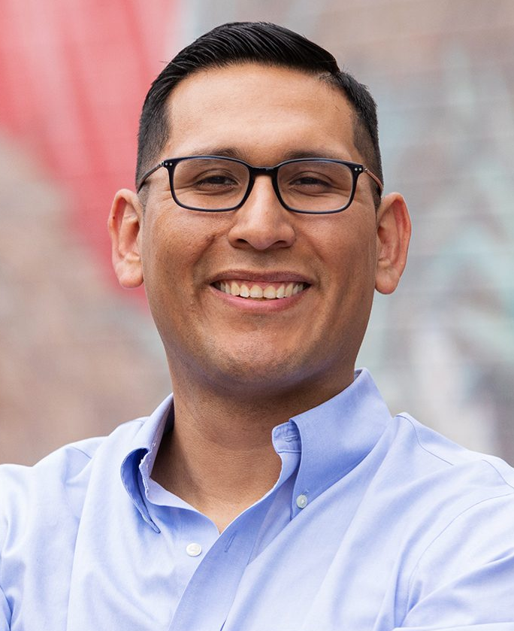
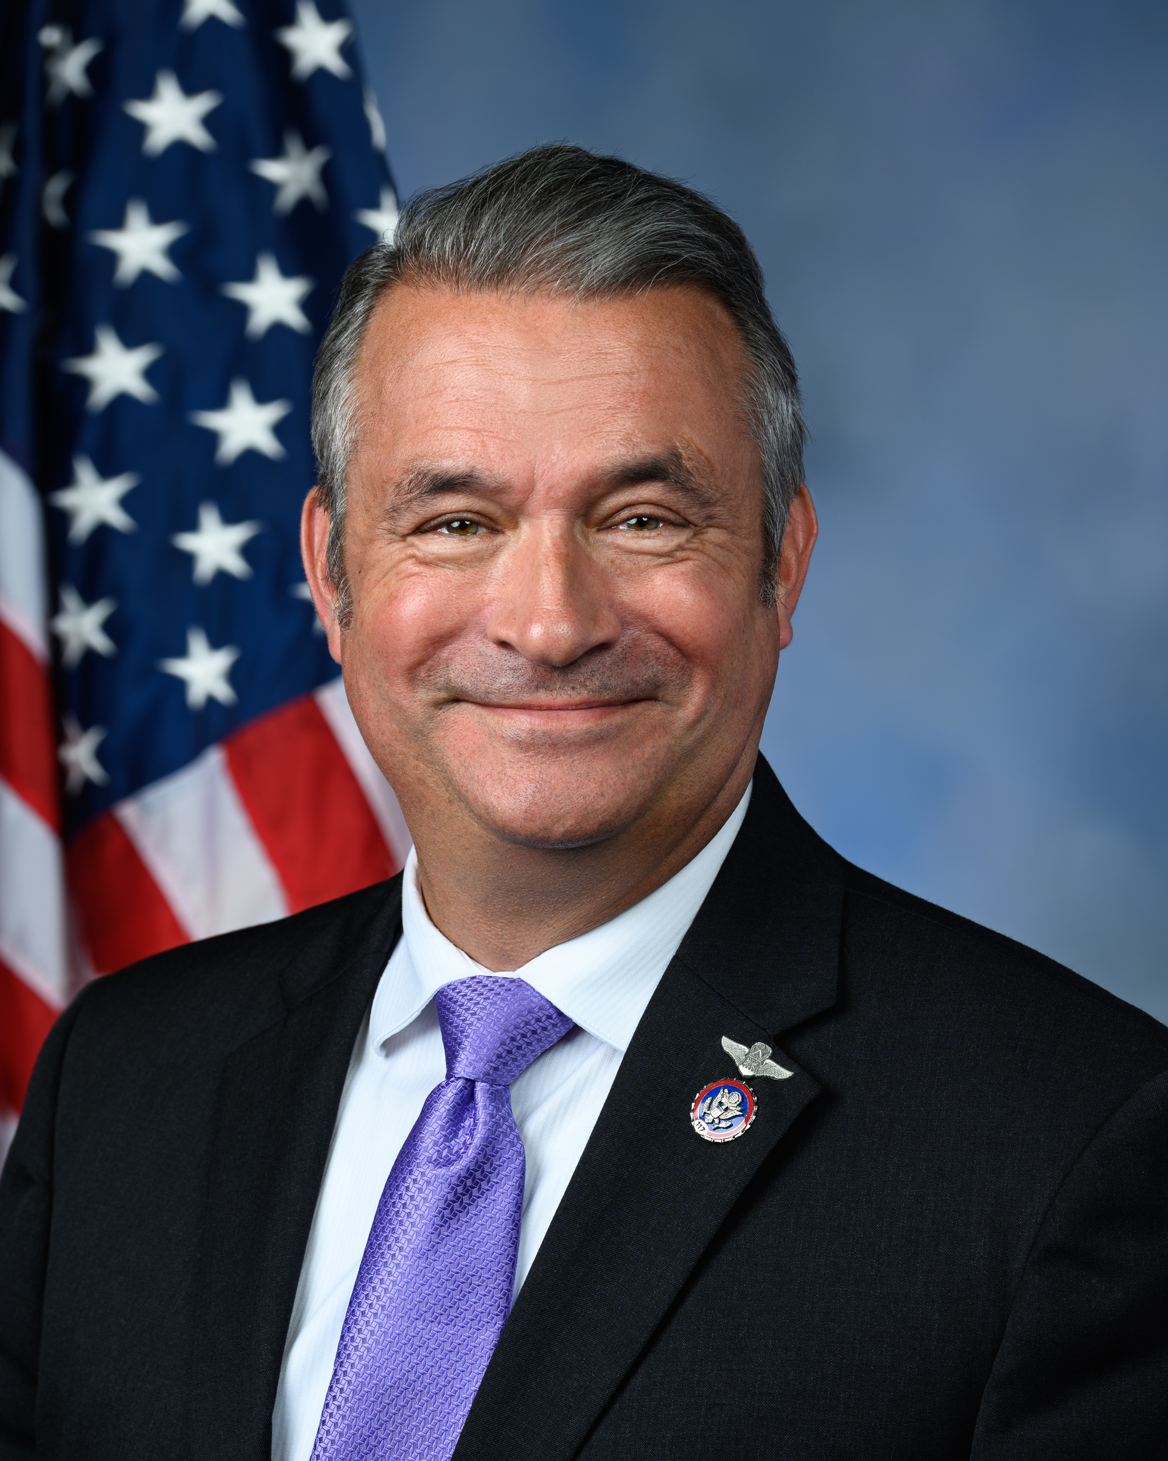
House Race Spotlight: NE-02
LEAN D*
CANDIDATES
PRIMARY ELECTION RESULTS
Tony Vargas (D)
State Senator for Nebraska’s 7th District
DEM | GOP
Tony Vargas Uncontested | Don Bacon 62.1%
 | Dan Frei 37.9%
Don Bacon(R)
Incumbent
CAMPAIGN FINANCE
PREVIOUS CA-45 RESULTS
CAMPAIGN FINANCE DATA AS OF OCT. 16, 2024
■ Total receipts ■ Total disbursements
Election | Winner | Runner-Up | Margin
2022 House | Bacon (R) 51.3% | Vargas (D) 48.7% | R + 2.6%
2020 House | Bacon (R) 50.8% | Eastman (D) 46.2% | D + 4.6%
2020 Presidential | Biden (D) 52.2% | Trump (R) 45.8% | D + 6.4%
Vargas
Bacon
*COOK POLITICAL REPORT RATINGS
SOURCE Cook Political Report with Amy Walter, Ballotpedia, FEC.
PRESENTATION CENTER 10/29/24

Slide 26

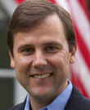
House Race Spotlight: NJ-7
LEAN R*
CANDIDATES
PRIMARY ELECTION RESULTS
Sue Altman (D)
Executive Director, New Jersey Working Families Alliance, 2019-2023
DEM | GOP
Sue Altman Uncontested | Thomas Kean Jr. 79.9%
 | Roger Bacon 20.1%
Tom Kean (R)
Incumbent
CAMPAIGN FINANCE
PREVIOUS NJ-7 RESULTS
CAMPAIGN FINANCE DATA AS OF OCT. 16, 2024
■ Total receipts ■ Total disbursements
Election | Winner | Runner-Up | Margin
2022 House | Kean Jr. (R) 51.4% | Malinowski (D) 48.6% | R + 2.8%
2020 House | Malinowski (D) 50.6% | Kean Jr. (R) 49.4% | D + 1.2%
2020 Presidential | Biden (D) 51.1% | Trump (R) 47.3% | D + 3.8%
Altman
Kean
*COOK POLITICAL REPORT RATINGS
SOURCE Cook Political Report with Amy Walter, Ballotpedia, FEC.
PRESENTATION CENTER 10/29/24
Notes:
Sources:
“2024 CPR House Race Ratings,” Cook Political Report, January 23, 2024, https://www.cookpolitical.com/ratings/house-race-ratings
“New York's 3rd Congressional District special election, 2024,” Ballotpedia, accessed January 31, 2024, https://ballotpedia.org/New_York%27s_3rd_Congressional_District_special_election,_2024
“New York 3rd Special Election - Forecast & Predictions,” Race to the White House, accessed January 31, 2024, https://www.racetothewh.com/house/ny3
“SUOZZI, THOMAS,” Federal Election Commission, Accessed February 6, 2024, https://www.fec.gov/data/candidate/H6NY03247/?cycle=2024&election_full=false
“PILIP, MAZI MELESA,” Federal Election Commission, Accessed February 6, 2024, https://www.fec.gov/data/candidate/H4NY03283/?cycle=2024&election_full=false
“New York Third Congressional District Special Election Results,” New York Times, February 14, 2024, https://www.nytimes.com/interactive/2024/02/13/us/elections/results-new-york-us-house-3-special.html

Slide 27
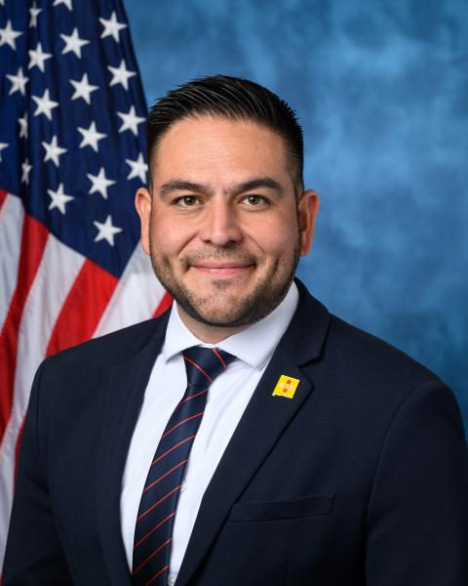

House Race Spotlight: NM-2
TOSS UP*
CANDIDATES
PRIMARY ELECTION RESULTS
Gabe Vasquez (D)
Incumbent
DEM | GOP
Gabriel Vasquez Uncontested | Yvette Herrell Uncontested
Yvette Herrell (R)
Former Rep., United States House of Representatives, New Mexico, District 2, 2021-2023
CAMPAIGN FINANCE
PREVIOUS NM-2 RESULTS
CAMPAIGN FINANCE DATA AS OF OCT. 16, 2024
■ Total receipts ■ Total disbursements
Election | Winner | Runner-Up | Margin
2022 House | Vasquez (D) 50.3% | Herrell (R) 49.6% | D + 0.7%
2020 House | Herrell (R) 53.7% | Small (D) 46.3% | R + 7.4%
2020 Presidential | Biden (D) 51.9% | Trump (R) 46.1% | D + 5.8%
Vasquez
Herrell
*COOK POLITICAL REPORT RATINGS
SOURCE Cook Political Report with Amy Walter, Ballotpedia, FEC.
PRESENTATION CENTER 10/29/24
Notes:
Sources:
“2024 CPR House Race Ratings,” Cook Political Report, January 23, 2024, https://www.cookpolitical.com/ratings/house-race-ratings
“New York's 3rd Congressional District special election, 2024,” Ballotpedia, accessed January 31, 2024, https://ballotpedia.org/New_York%27s_3rd_Congressional_District_special_election,_2024
“New York 3rd Special Election - Forecast & Predictions,” Race to the White House, accessed January 31, 2024, https://www.racetothewh.com/house/ny3
“SUOZZI, THOMAS,” Federal Election Commission, Accessed February 6, 2024, https://www.fec.gov/data/candidate/H6NY03247/?cycle=2024&election_full=false
“PILIP, MAZI MELESA,” Federal Election Commission, Accessed February 6, 2024, https://www.fec.gov/data/candidate/H4NY03283/?cycle=2024&election_full=false
“New York Third Congressional District Special Election Results,” New York Times, February 14, 2024, https://www.nytimes.com/interactive/2024/02/13/us/elections/results-new-york-us-house-3-special.html

Slide 28
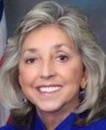
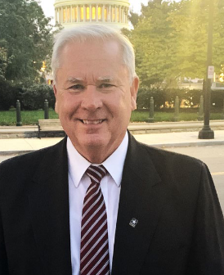
House Race Spotlight: NV-1
LIKELY D*
CANDIDATES
PRIMARY ELECTION RESULTS
Dina Titus (D)
Incumbent
DEM | GOP
Dina Titus Uncontested | Mark Robertson 48.4%
 | Flemming Larsen 39.0%
 | Jim Blockey 5.0%
Mark Robertson (R)
Owner/ Managing Partner, RDJ Financial Architects, 2001-2020
CAMPAIGN FINANCE
PREVIOUS NV-1 RESULTS
CAMPAIGN FINANCE DATA AS OF OCT. 16, 2024
■ Total receipts ■ Total disbursements
Election | Winner | Runner-Up | Margin
2022 House | Titus (D) 51.6% | Robertson (R) 46.0% | D + 5.6%
2020 House | Titus (D) 61.8% | Bentley (R) 33.4% | D + 28.4%
2020 Presidential | Biden (D) 53.2% | Trump (R) 44.7% | D + 8.5%
Titus
Robertson
*COOK POLITICAL REPORT RATINGS
SOURCE Cook Political Report with Amy Walter, Ballotpedia, FEC.
PRESENTATION CENTER 10/29/24
Notes:
Sources:
“2024 CPR House Race Ratings,” Cook Political Report, January 23, 2024, https://www.cookpolitical.com/ratings/house-race-ratings
“New York's 3rd Congressional District special election, 2024,” Ballotpedia, accessed January 31, 2024, https://ballotpedia.org/New_York%27s_3rd_Congressional_District_special_election,_2024
“New York 3rd Special Election - Forecast & Predictions,” Race to the White House, accessed January 31, 2024, https://www.racetothewh.com/house/ny3
“SUOZZI, THOMAS,” Federal Election Commission, Accessed February 6, 2024, https://www.fec.gov/data/candidate/H6NY03247/?cycle=2024&election_full=false
“PILIP, MAZI MELESA,” Federal Election Commission, Accessed February 6, 2024, https://www.fec.gov/data/candidate/H4NY03283/?cycle=2024&election_full=false
“New York Third Congressional District Special Election Results,” New York Times, February 14, 2024, https://www.nytimes.com/interactive/2024/02/13/us/elections/results-new-york-us-house-3-special.html

Slide 29
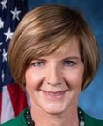

House Race Spotlight: NV-3
LEAN D*
CANDIDATES
PRIMARY ELECTION RESULTS
Susie Lee (D)
Incumbent
DEM | GOP
Susie Lee 92.7% | Drew Johnson 32.0%
RockAthena Brittain 7.3% | Dan Schwartz 22.6%
 | Elizabeth Helgelien 20.5%
Drew Johnson (R)
CAMPAIGN FINANCE
PREVIOUS NV-3 RESULTS
CAMPAIGN FINANCE DATA AS OF OCT. 16, 2024
■ Total receipts ■ Total disbursements
Election | Winner | Runner-Up | Margin
2022 House | Lee (D) 52.0% | Becker (R) 48.0% | D + 4.0%
2020 House | Lee (D) 48.8% | Rodimer (R) 45.8% | D + 3.0%
2020 Presidential | Biden (D) 52.4% | Trump (R) 45.7% | D + 6.7%
Lee
Johnson
*COOK POLITICAL REPORT RATINGS
SOURCE Cook Political Report with Amy Walter, Ballotpedia, FEC.
PRESENTATION CENTER 10/29/24
Notes:
Sources:
“2024 CPR House Race Ratings,” Cook Political Report, January 23, 2024, https://www.cookpolitical.com/ratings/house-race-ratings
“New York's 3rd Congressional District special election, 2024,” Ballotpedia, accessed January 31, 2024, https://ballotpedia.org/New_York%27s_3rd_Congressional_District_special_election,_2024
“New York 3rd Special Election - Forecast & Predictions,” Race to the White House, accessed January 31, 2024, https://www.racetothewh.com/house/ny3
“SUOZZI, THOMAS,” Federal Election Commission, Accessed February 6, 2024, https://www.fec.gov/data/candidate/H6NY03247/?cycle=2024&election_full=false
“PILIP, MAZI MELESA,” Federal Election Commission, Accessed February 6, 2024, https://www.fec.gov/data/candidate/H4NY03283/?cycle=2024&election_full=false
“New York Third Congressional District Special Election Results,” New York Times, February 14, 2024, https://www.nytimes.com/interactive/2024/02/13/us/elections/results-new-york-us-house-3-special.html

Slide 30
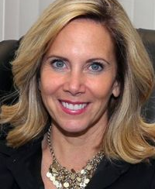
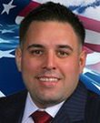
House Race Spotlight: NY-4
TOSS UP*
CANDIDATES
PRIMARY ELECTION RESULTS
Laura Gillen (D)
Supervisor, Town of Hempstead, New York, 2018-2019
DEM | GOP
Laura Gillen Uncontested | Anthony D'Esposito Uncontested
Anthony D'Esposito (R)
Retired, Detective, New York City Police Department, 2006-2020
CAMPAIGN FINANCE
PREVIOUS NY-4 RESULTS
CAMPAIGN FINANCE DATA AS OF OCT. 16, 2024
■ Total receipts ■ Total disbursements
Election | Winner | Runner-Up | Margin
2022 House | D'Esposito (R) 51.8% | Gillen (D) 48.2% | R + 3.6%
2020 House | Rice (D) 56.1% | Tuman (R) 43.0% | D + 13.1%
2020 Presidential | Biden (D) 56.8% | Trump (R) 42.2% | D + 14.6%
Gillen
D'Esposito
*COOK POLITICAL REPORT RATINGS
SOURCE Cook Political Report with Amy Walter, Ballotpedia, FEC.
PRESENTATION CENTER 10/29/24
Notes:
Sources:
“2024 CPR House Race Ratings,” Cook Political Report, January 23, 2024, https://www.cookpolitical.com/ratings/house-race-ratings
“New York's 3rd Congressional District special election, 2024,” Ballotpedia, accessed January 31, 2024, https://ballotpedia.org/New_York%27s_3rd_Congressional_District_special_election,_2024
“New York 3rd Special Election - Forecast & Predictions,” Race to the White House, accessed January 31, 2024, https://www.racetothewh.com/house/ny3
“SUOZZI, THOMAS,” Federal Election Commission, Accessed February 6, 2024, https://www.fec.gov/data/candidate/H6NY03247/?cycle=2024&election_full=false
“PILIP, MAZI MELESA,” Federal Election Commission, Accessed February 6, 2024, https://www.fec.gov/data/candidate/H4NY03283/?cycle=2024&election_full=false
“New York Third Congressional District Special Election Results,” New York Times, February 14, 2024, https://www.nytimes.com/interactive/2024/02/13/us/elections/results-new-york-us-house-3-special.html

Slide 31
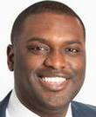
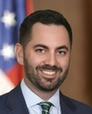
House Race Spotlight: NY-17
LEAN R*
CANDIDATES
PRIMARY ELECTION RESULTS
Mondaire Jones (D)
Representative, United States House of Representatives, New York, District 17, 2021-2023
DEM | GOP
Mondaire Jones Uncontested | Mike Lawler Uncontested
Mike Lawler (R)
Incumbent
CAMPAIGN FINANCE
PREVIOUS NY-17 RESULTS
CAMPAIGN FINANCE DATA AS OF OCT. 16, 2024
■ Total receipts ■ Total disbursements
Election | Winner | Runner-Up | Margin
2022 House | Lawler (R) 50.3% | Maloney (D) 49.7% | R + 0.8%
2020 House | Jones (D) 59.3% | McArdle Schulman (R) 35.2% | D + 24.1%
2020 Presidential | Biden (D) 54.5% | Trump (R) 44.4% | D + 10.1%
Jones
Lawler
*COOK POLITICAL REPORT RATINGS
SOURCE Cook Political Report with Amy Walter, Ballotpedia, FEC.
PRESENTATION CENTER 10/29/24
Notes:
Sources:
“2024 CPR House Race Ratings,” Cook Political Report, January 23, 2024, https://www.cookpolitical.com/ratings/house-race-ratings
“New York's 3rd Congressional District special election, 2024,” Ballotpedia, accessed January 31, 2024, https://ballotpedia.org/New_York%27s_3rd_Congressional_District_special_election,_2024
“New York 3rd Special Election - Forecast & Predictions,” Race to the White House, accessed January 31, 2024, https://www.racetothewh.com/house/ny3
“SUOZZI, THOMAS,” Federal Election Commission, Accessed February 6, 2024, https://www.fec.gov/data/candidate/H6NY03247/?cycle=2024&election_full=false
“PILIP, MAZI MELESA,” Federal Election Commission, Accessed February 6, 2024, https://www.fec.gov/data/candidate/H4NY03283/?cycle=2024&election_full=false
“New York Third Congressional District Special Election Results,” New York Times, February 14, 2024, https://www.nytimes.com/interactive/2024/02/13/us/elections/results-new-york-us-house-3-special.html

Slide 32

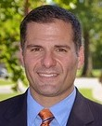
House Race Spotlight: NY-19
TOSS UP*
CANDIDATES
PRIMARY ELECTION RESULTS
Joshua Riley (D)
Partner, Jenner & Block, 2021
DEM | GOP
Josh Riley Uncontested | Marcus Molinaro Uncontested
Marcus Molinaro (R)
Incumbent
CAMPAIGN FINANCE
PREVIOUS NY-19 RESULTS
CAMPAIGN FINANCE DATA AS OF OCT. 16, 2024
■ Total receipts ■ Total disbursements
Election | Winner | Runner-Up | Margin
2022 House | Molinaro (R) 50.8% | Riley (D) 49.2% | R + 1.6%
2020 House | Delgado (D) 54.5% | Van De Water (R) 42.9% | D + 11.6%
2020 Presidential | Biden (D) 51.3% | Trump (R) 46.7% | D + 4.6%
Riley
Molinaro
*COOK POLITICAL REPORT RATINGS
SOURCE Cook Political Report with Amy Walter, Ballotpedia, FEC.
PRESENTATION CENTER 10/29/24
Notes:
Sources:
“2024 CPR House Race Ratings,” Cook Political Report, January 23, 2024, https://www.cookpolitical.com/ratings/house-race-ratings
“New York's 3rd Congressional District special election, 2024,” Ballotpedia, accessed January 31, 2024, https://ballotpedia.org/New_York%27s_3rd_Congressional_District_special_election,_2024
“New York 3rd Special Election - Forecast & Predictions,” Race to the White House, accessed January 31, 2024, https://www.racetothewh.com/house/ny3
“SUOZZI, THOMAS,” Federal Election Commission, Accessed February 6, 2024, https://www.fec.gov/data/candidate/H6NY03247/?cycle=2024&election_full=false
“PILIP, MAZI MELESA,” Federal Election Commission, Accessed February 6, 2024, https://www.fec.gov/data/candidate/H4NY03283/?cycle=2024&election_full=false
“New York Third Congressional District Special Election Results,” New York Times, February 14, 2024, https://www.nytimes.com/interactive/2024/02/13/us/elections/results-new-york-us-house-3-special.html

Slide 33


House Race Spotlight: NY-22
LEAN D*
CANDIDATES
PRIMARY ELECTION RESULTS
John Mannion (D)
Senator, New York State Senate, District 50, 2021-present
DEM | GOP
John Mannion 61.5% | Brandon Williams Uncontested
Sarah Hood 38.3%
Brandon Williams (R)
Incumbent
CAMPAIGN FINANCE
PREVIOUS NY-22 RESULTS
CAMPAIGN FINANCE DATA AS OF OCT. 16, 2024
■ Total receipts ■ Total disbursements
Election | Winner | Runner-Up | Margin
2022 House | Williams (R) 50.5% | Conole (D) 49.5% | R + 1.0%
2020 House | Tenney (R) 49.0% | Brindisi (D) 48.9% | R + 0.0%
2020 Presidential | Biden (D) 54.6% | Trump (R) 43.2% | D + 11.4%
Mannion
Williams
*COOK POLITICAL REPORT RATINGS
SOURCE Cook Political Report with Amy Walter, Ballotpedia, FEC.
PRESENTATION CENTER 2/14/24
Notes:
Sources:
“2024 CPR House Race Ratings,” Cook Political Report, January 23, 2024, https://www.cookpolitical.com/ratings/house-race-ratings
“New York's 3rd Congressional District special election, 2024,” Ballotpedia, accessed January 31, 2024, https://ballotpedia.org/New_York%27s_3rd_Congressional_District_special_election,_2024
“New York 3rd Special Election - Forecast & Predictions,” Race to the White House, accessed January 31, 2024, https://www.racetothewh.com/house/ny3
“SUOZZI, THOMAS,” Federal Election Commission, Accessed February 6, 2024, https://www.fec.gov/data/candidate/H6NY03247/?cycle=2024&election_full=false
“PILIP, MAZI MELESA,” Federal Election Commission, Accessed February 6, 2024, https://www.fec.gov/data/candidate/H4NY03283/?cycle=2024&election_full=false
“New York Third Congressional District Special Election Results,” New York Times, February 14, 2024, https://www.nytimes.com/interactive/2024/02/13/us/elections/results-new-york-us-house-3-special.html

Slide 34
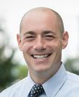

House Race Spotlight: OH-1
LIKELY D*
CANDIDATES
PRIMARY ELECTION RESULTS
Greg Landsman (D)
Incumbent
DEM | GOP
Greg Landsman Uncontested | Orlando Sonza Uncontested
Orlando Sonza (R)
Assistant Prosecutor, Hamilton County Prosecutor's Office, present
CAMPAIGN FINANCE
PREVIOUS OH-1 RESULTS
CAMPAIGN FINANCE DATA AS OF OCT. 16, 2024
■ Total receipts ■ Total disbursements
Election | Winner | Runner-Up | Margin
2022 House | Landsman (D) 52.5% | Chabot (R) 47.2% | D + 5.3%
2020 House | Chabot (R) 51.8% | Schroder (D) 44.6% | R + 7.2%
2020 Presidential | Biden (D) 53.5% | Trump (R) 45.0% | D + 8.5%
Landsman
Sonza
*COOK POLITICAL REPORT RATINGS
SOURCE Cook Political Report with Amy Walter, Ballotpedia, FEC.
PRESENTATION CENTER 10/29/24
Notes:
Sources:
“2024 CPR House Race Ratings,” Cook Political Report, January 23, 2024, https://www.cookpolitical.com/ratings/house-race-ratings
“New York's 3rd Congressional District special election, 2024,” Ballotpedia, accessed January 31, 2024, https://ballotpedia.org/New_York%27s_3rd_Congressional_District_special_election,_2024
“New York 3rd Special Election - Forecast & Predictions,” Race to the White House, accessed January 31, 2024, https://www.racetothewh.com/house/ny3
“SUOZZI, THOMAS,” Federal Election Commission, Accessed February 6, 2024, https://www.fec.gov/data/candidate/H6NY03247/?cycle=2024&election_full=false
“PILIP, MAZI MELESA,” Federal Election Commission, Accessed February 6, 2024, https://www.fec.gov/data/candidate/H4NY03283/?cycle=2024&election_full=false
“New York Third Congressional District Special Election Results,” New York Times, February 14, 2024, https://www.nytimes.com/interactive/2024/02/13/us/elections/results-new-york-us-house-3-special.html

Slide 35
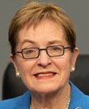

House Race Spotlight: OH-9
LEAN D*
CANDIDATES
PRIMARY ELECTION RESULTS
Marcy Kaptur (D)
Incumbent
DEM | GOP
Marcy Kaptur Uncontested | Derek Merrin 52.5%
 | Craig Riedel 34.4%
 | Steve Lankenau 13.2%
Derek Merrin (R)
Realtor, Key Realty, Limited, 2013-2017
CAMPAIGN FINANCE
PREVIOUS OH-9 RESULTS
CAMPAIGN FINANCE DATA AS OF OCT. 16, 2024
■ Total receipts ■ Total disbursements
Election | Winner | Runner-Up | Margin
2022 House | Kaptur (D) 56.6% | Majewski (R) 43.4% | D + 13.2%
2020 House | Kaptur (D) 63.1% | Weber (R) 36.9% | D + 26.2%
2020 Presidential | Trump (R) 50.6% | Biden (D) 47.7% | R + 2.9%
Kaptur
Merrin
*COOK POLITICAL REPORT RATINGS
SOURCE Cook Political Report with Amy Walter, Ballotpedia, FEC.
PRESENTATION CENTER 10/29/24
Notes:
Sources:
“2024 CPR House Race Ratings,” Cook Political Report, January 23, 2024, https://www.cookpolitical.com/ratings/house-race-ratings
“New York's 3rd Congressional District special election, 2024,” Ballotpedia, accessed January 31, 2024, https://ballotpedia.org/New_York%27s_3rd_Congressional_District_special_election,_2024
“New York 3rd Special Election - Forecast & Predictions,” Race to the White House, accessed January 31, 2024, https://www.racetothewh.com/house/ny3
“SUOZZI, THOMAS,” Federal Election Commission, Accessed February 6, 2024, https://www.fec.gov/data/candidate/H6NY03247/?cycle=2024&election_full=false
“PILIP, MAZI MELESA,” Federal Election Commission, Accessed February 6, 2024, https://www.fec.gov/data/candidate/H4NY03283/?cycle=2024&election_full=false
“New York Third Congressional District Special Election Results,” New York Times, February 14, 2024, https://www.nytimes.com/interactive/2024/02/13/us/elections/results-new-york-us-house-3-special.html

Slide 36


House Race Spotlight: OH-13
LEAN D*
CANDIDATES
PRIMARY ELECTION RESULTS
Emilia Sykes (D)
Incumbent
DEM | GOP
Emilia Sykes Uncontested | Kevin Coughlin 64.7%
 | Chris Banweg 27.7%
 | Richard Morckel 7.7%
Kevin Coughlin (R)
Clerk of Courts, Stow Municipal Court, 2013-2015
CAMPAIGN FINANCE
PREVIOUS OH-13 RESULTS
CAMPAIGN FINANCE DATA AS OF OCT. 16, 2024
■ Total receipts ■ Total disbursements
Election | Winner | Runner-Up | Margin
2022 House | Sykes (D) 52.7% | Madison Gilbert (R) 47.3% | D + 5.4%
2020 House | Ryan (D) 52.5% | Hagan (R) 44.9% | D + 7.6%
2020 Presidential | Biden (D) 50.7% | Trump (R) 47.9% | D + 2.8%
Sykes
Coughlin
*COOK POLITICAL REPORT RATINGS
SOURCE Cook Political Report with Amy Walter, Ballotpedia, FEC.
PRESENTATION CENTER 10/29/24
Notes:
Sources:
“2024 CPR House Race Ratings,” Cook Political Report, January 23, 2024, https://www.cookpolitical.com/ratings/house-race-ratings
“New York's 3rd Congressional District special election, 2024,” Ballotpedia, accessed January 31, 2024, https://ballotpedia.org/New_York%27s_3rd_Congressional_District_special_election,_2024
“New York 3rd Special Election - Forecast & Predictions,” Race to the White House, accessed January 31, 2024, https://www.racetothewh.com/house/ny3
“SUOZZI, THOMAS,” Federal Election Commission, Accessed February 6, 2024, https://www.fec.gov/data/candidate/H6NY03247/?cycle=2024&election_full=false
“PILIP, MAZI MELESA,” Federal Election Commission, Accessed February 6, 2024, https://www.fec.gov/data/candidate/H4NY03283/?cycle=2024&election_full=false
“New York Third Congressional District Special Election Results,” New York Times, February 14, 2024, https://www.nytimes.com/interactive/2024/02/13/us/elections/results-new-york-us-house-3-special.html

Slide 37

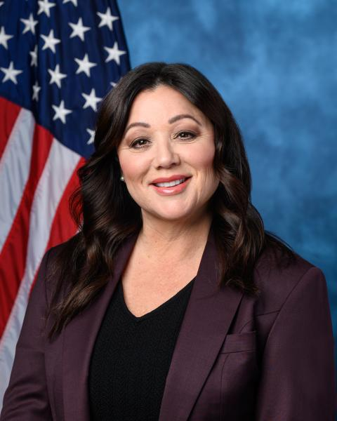
House Race Spotlight: OR-5
TOSS UP*
CANDIDATES
PRIMARY ELECTION RESULTS
Janelle Bynum (D)
Representative, Oregon State House of Representatives, District 39, 2023-present
DEM | GOP
Janelle Bynum 70.0% | Lori Chavez-DeRemer Uncontested
Jamie McLeod-Skinner 30.0%
Lori Chavez-DeRemer (R)
Incumbent
CAMPAIGN FINANCE
PREVIOUS OR-5 RESULTS
CAMPAIGN FINANCE DATA AS OF OCT. 16, 2024
■ Total receipts ■ Total disbursements
Election | Winner | Runner-Up | Margin
2022 House | Chavez-DeRemer (R) 50.9% | McLeod-Skinner (D) 48.8% | R + 2.1%
2020 House | Schrader (D) 51.9% | Ryan Courser (R) 45.2% | D + 6.7%
2020 Presidential | Biden (D) 53.2% | Trump (R) 44.4% | D + 8.8%
Bynum
Chavez-DeRemer
*COOK POLITICAL REPORT RATINGS
SOURCE Cook Political Report with Amy Walter, Ballotpedia, FEC.
PRESENTATION CENTER 10/29/24
Notes:
Sources:
“2024 CPR House Race Ratings,” Cook Political Report, January 23, 2024, https://www.cookpolitical.com/ratings/house-race-ratings
“New York's 3rd Congressional District special election, 2024,” Ballotpedia, accessed January 31, 2024, https://ballotpedia.org/New_York%27s_3rd_Congressional_District_special_election,_2024
“New York 3rd Special Election - Forecast & Predictions,” Race to the White House, accessed January 31, 2024, https://www.racetothewh.com/house/ny3
“SUOZZI, THOMAS,” Federal Election Commission, Accessed February 6, 2024, https://www.fec.gov/data/candidate/H6NY03247/?cycle=2024&election_full=false
“PILIP, MAZI MELESA,” Federal Election Commission, Accessed February 6, 2024, https://www.fec.gov/data/candidate/H4NY03283/?cycle=2024&election_full=false
“New York Third Congressional District Special Election Results,” New York Times, February 14, 2024, https://www.nytimes.com/interactive/2024/02/13/us/elections/results-new-york-us-house-3-special.html

Slide 38
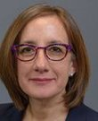
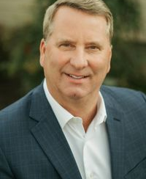
House Race Spotlight: OR-6
LIKELY D*
CANDIDATES
PRIMARY ELECTION RESULTS
Andrea Salinas (D)
Incumbent
DEM | GOP
Andrea Salinas 87.6% | Mike Erickson 74.6%
Cody Reynolds 12.0% | David Russ 20.5%
 | David Burch 3.0%
Mike Erickson (R)
Founder, CEO, AFMS - Logistics Management Group, Limited Liability Company, 1992-Present
CAMPAIGN FINANCE
PREVIOUS OR-6 RESULTS
CAMPAIGN FINANCE DATA AS OF OCT. 16, 2024
■ Total receipts ■ Total disbursements
Election | Winner | Runner-Up | Margin
2022 House | Salinas (D) 50.1% | Erickson (R) 47.7% | D + 2.4%
No 6th District prior to 2022
2020 Presidential | Biden (D) 55.2% | Trump (R) 42.1% | D + 13.1%
Salinas
Erickson
*COOK POLITICAL REPORT RATINGS
SOURCE Cook Political Report with Amy Walter, Ballotpedia, FEC.
PRESENTATION CENTER 10/29/24
Notes:
Sources:
“2024 CPR House Race Ratings,” Cook Political Report, January 23, 2024, https://www.cookpolitical.com/ratings/house-race-ratings
“New York's 3rd Congressional District special election, 2024,” Ballotpedia, accessed January 31, 2024, https://ballotpedia.org/New_York%27s_3rd_Congressional_District_special_election,_2024
“New York 3rd Special Election - Forecast & Predictions,” Race to the White House, accessed January 31, 2024, https://www.racetothewh.com/house/ny3
“SUOZZI, THOMAS,” Federal Election Commission, Accessed February 6, 2024, https://www.fec.gov/data/candidate/H6NY03247/?cycle=2024&election_full=false
“PILIP, MAZI MELESA,” Federal Election Commission, Accessed February 6, 2024, https://www.fec.gov/data/candidate/H4NY03283/?cycle=2024&election_full=false
“New York Third Congressional District Special Election Results,” New York Times, February 14, 2024, https://www.nytimes.com/interactive/2024/02/13/us/elections/results-new-york-us-house-3-special.html

Slide 39

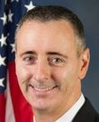
House Race Spotlight: PA-1
LIKELY R*
CANDIDATES
PRIMARY ELECTION RESULTS
Ashley Ehasz (D)
Government and Public Services Senior Consultant, Deloitte, 2021-present
DEM | GOP
Ashley Ehasz Uncontested | Brian Fitzpatrick 61.5%
 | Mark Houck 38.5%
Brian Fitzpatrick (R)
Incumbent
CAMPAIGN FINANCE
PREVIOUS PA-1 RESULTS
CAMPAIGN FINANCE DATA AS OF OCT. 16, 2024
■ Total receipts ■ Total disbursements
Election | Winner | Runner-Up | Margin
2022 House | Fitzpatrick (R) 54.9% | Ehasz (D) 45.1% | R + 9.8%
2020 House | Fitzpatrick (R) 56.6% | Finello (D) 43.4% | R + 13.2%
2020 Presidential | Biden (D) 51.8% | Trump (R) 47.2% | D + 4.6%
Ehasz
Fitzpatrick
*COOK POLITICAL REPORT RATINGS
SOURCE Cook Political Report with Amy Walter, Ballotpedia, FEC.
PRESENTATION CENTER 10/29/24
Notes:
Sources:
“2024 CPR House Race Ratings,” Cook Political Report, January 23, 2024, https://www.cookpolitical.com/ratings/house-race-ratings
“New York's 3rd Congressional District special election, 2024,” Ballotpedia, accessed January 31, 2024, https://ballotpedia.org/New_York%27s_3rd_Congressional_District_special_election,_2024
“New York 3rd Special Election - Forecast & Predictions,” Race to the White House, accessed January 31, 2024, https://www.racetothewh.com/house/ny3
“SUOZZI, THOMAS,” Federal Election Commission, Accessed February 6, 2024, https://www.fec.gov/data/candidate/H6NY03247/?cycle=2024&election_full=false
“PILIP, MAZI MELESA,” Federal Election Commission, Accessed February 6, 2024, https://www.fec.gov/data/candidate/H4NY03283/?cycle=2024&election_full=false
“New York Third Congressional District Special Election Results,” New York Times, February 14, 2024, https://www.nytimes.com/interactive/2024/02/13/us/elections/results-new-york-us-house-3-special.html

Slide 40
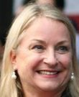
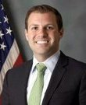
House Race Spotlight: PA-7
TOSS UP*
CANDIDATES
PRIMARY ELECTION RESULTS
Susan Wild (D)
Incumbent
DEM | GOP
Susan Wild Uncontested | Ryan Mackenzie 42.6%
 | Kevin Dellicker 34.0%
 | Maria Montero 23.4%
Ryan Mackenzie (R)
Television Host, Legislative Report with Ryan Mackenzie, 2012-present
CAMPAIGN FINANCE
PREVIOUS PA-7 RESULTS
CAMPAIGN FINANCE DATA AS OF OCT. 16, 2024
■ Total receipts ■ Total disbursements
Election | Winner | Runner-Up | Margin
2022 House | Wild (D) 51.0% | Scheller (R) 49.0% | D + 2.0%
2020 House | Wild (D) 51.9% | Scheller (R) 48.1% | D + 3.8%
2020 Presidential | Biden (D) 49.7% | Trump (R) 49.1% | D + 0.6%
Wild
Mackenzie
*COOK POLITICAL REPORT RATINGS
SOURCE Cook Political Report with Amy Walter, Ballotpedia, FEC.
PRESENTATION CENTER 10/29/24
Notes:
Sources:
“2024 CPR House Race Ratings,” Cook Political Report, January 23, 2024, https://www.cookpolitical.com/ratings/house-race-ratings
“New York's 3rd Congressional District special election, 2024,” Ballotpedia, accessed January 31, 2024, https://ballotpedia.org/New_York%27s_3rd_Congressional_District_special_election,_2024
“New York 3rd Special Election - Forecast & Predictions,” Race to the White House, accessed January 31, 2024, https://www.racetothewh.com/house/ny3
“SUOZZI, THOMAS,” Federal Election Commission, Accessed February 6, 2024, https://www.fec.gov/data/candidate/H6NY03247/?cycle=2024&election_full=false
“PILIP, MAZI MELESA,” Federal Election Commission, Accessed February 6, 2024, https://www.fec.gov/data/candidate/H4NY03283/?cycle=2024&election_full=false
“New York Third Congressional District Special Election Results,” New York Times, February 14, 2024, https://www.nytimes.com/interactive/2024/02/13/us/elections/results-new-york-us-house-3-special.html

Slide 41
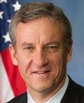

House Race Spotlight: PA-8
TOSS UP*
CANDIDATES
PRIMARY ELECTION RESULTS
Matt Cartwright (D)
Incumbent
DEM | GOP
Matt Cartwright Uncontested | Robert Bresnahan Uncontested
Robert Bresnahan (R)
President, RPB Ventures LLC, 2016-present
CAMPAIGN FINANCE
PREVIOUS PA-8 RESULTS
CAMPAIGN FINANCE DATA AS OF OCT. 16, 2024
■ Total receipts ■ Total disbursements
Election | Winner | Runner-Up | Margin
2022 House | Cartwright (D) 51.2% | Bognet (R) 48.8% | D + 2.4%
2020 House | Cartwright (D) 51.8% | Bognet (R) 48.2% | D + 3.6%
2020 Presidential | Trump (R) 50.9% | Biden (D) 48.0% | R + 2.9%
Cartwright
Bresnahan
*COOK POLITICAL REPORT RATINGS
SOURCE Cook Political Report with Amy Walter, Ballotpedia, FEC.
PRESENTATION CENTER 10/29/24
Notes:
Sources:
“2024 CPR House Race Ratings,” Cook Political Report, January 23, 2024, https://www.cookpolitical.com/ratings/house-race-ratings
“New York's 3rd Congressional District special election, 2024,” Ballotpedia, accessed January 31, 2024, https://ballotpedia.org/New_York%27s_3rd_Congressional_District_special_election,_2024
“New York 3rd Special Election - Forecast & Predictions,” Race to the White House, accessed January 31, 2024, https://www.racetothewh.com/house/ny3
“SUOZZI, THOMAS,” Federal Election Commission, Accessed February 6, 2024, https://www.fec.gov/data/candidate/H6NY03247/?cycle=2024&election_full=false
“PILIP, MAZI MELESA,” Federal Election Commission, Accessed February 6, 2024, https://www.fec.gov/data/candidate/H4NY03283/?cycle=2024&election_full=false
“New York Third Congressional District Special Election Results,” New York Times, February 14, 2024, https://www.nytimes.com/interactive/2024/02/13/us/elections/results-new-york-us-house-3-special.html

Slide 42
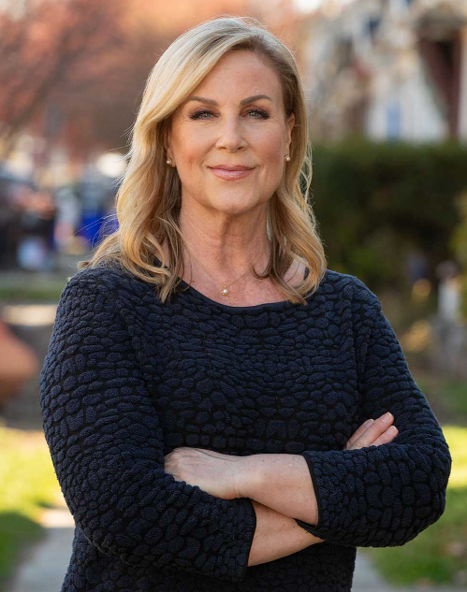

House Race Spotlight: PA-10
TOSS UP*
CANDIDATES
PRIMARY ELECTION RESULTS
Janelle Stelson (D)
News Anchor, WGAL-TV 8, 1997-2017
DEM | GOP
Janelle Stelson 43.7% | Scott Perry Uncontested
Mike O'Brien 23.2%
Shamaine Daniels 14.5%
Scott Perry (R)
Incumbent
CAMPAIGN FINANCE
PREVIOUS PA-10 RESULTS
CAMPAIGN FINANCE DATA AS OF OCT. 16, 2024
■ Total receipts ■ Total disbursements
Election | Winner | Runner-Up | Margin
2022 House | Perry (R) 53.9% | Daniels (D) 46.1% | R + 7.9%
2020 House | Perry (R) 53.3% | DePasquale (D) 46.7% | R + 6.6%
2020 Presidential | Trump (R) 51.3% | Biden (D) 47.2% | R + 4.1%
Stelson
Perry
*COOK POLITICAL REPORT RATINGS
SOURCE Cook Political Report with Amy Walter, Ballotpedia, FEC.
PRESENTATION CENTER 2/14/24
Notes:
Sources:
“2024 CPR House Race Ratings,” Cook Political Report, January 23, 2024, https://www.cookpolitical.com/ratings/house-race-ratings
“New York's 3rd Congressional District special election, 2024,” Ballotpedia, accessed January 31, 2024, https://ballotpedia.org/New_York%27s_3rd_Congressional_District_special_election,_2024
“New York 3rd Special Election - Forecast & Predictions,” Race to the White House, accessed January 31, 2024, https://www.racetothewh.com/house/ny3
“SUOZZI, THOMAS,” Federal Election Commission, Accessed February 6, 2024, https://www.fec.gov/data/candidate/H6NY03247/?cycle=2024&election_full=false
“PILIP, MAZI MELESA,” Federal Election Commission, Accessed February 6, 2024, https://www.fec.gov/data/candidate/H4NY03283/?cycle=2024&election_full=false
“New York Third Congressional District Special Election Results,” New York Times, February 14, 2024, https://www.nytimes.com/interactive/2024/02/13/us/elections/results-new-york-us-house-3-special.html

Slide 43


House Race Spotlight: PA-17
LEAN D*
CANDIDATES
PRIMARY ELECTION RESULTS
Chris Deluzio (D)
Incumbent
DEM | GOP
Chris Deluzio Uncontested | Rob Mercuri Uncontested
Robert Mercuri (R)
Manager, PriceWaterhouseCoopers (PwC), 2011-2013
CAMPAIGN FINANCE
PREVIOUS PA-17 RESULTS
CAMPAIGN FINANCE DATA AS OF OCT. 16, 2024
■ Total receipts ■ Total disbursements
Election | Winner | Runner-Up | Margin
2022 House | Deluzio (D) 53.4% | Shaffer (R) 46.6% | D + 6.8%
2020 House | Lamb (D) 51.1% | Parnell (R) 48.9% | D + 2.2%
2020 Presidential | Biden (D) 52.3% | Trump (R) 46.5% | D + 5.8%
Deluzio
Mercuri
*COOK POLITICAL REPORT RATINGS
SOURCE Cook Political Report with Amy Walter, Ballotpedia, FEC.
PRESENTATION CENTER 10/29/24
Notes:
Sources:
“2024 CPR House Race Ratings,” Cook Political Report, January 23, 2024, https://www.cookpolitical.com/ratings/house-race-ratings
“New York's 3rd Congressional District special election, 2024,” Ballotpedia, accessed January 31, 2024, https://ballotpedia.org/New_York%27s_3rd_Congressional_District_special_election,_2024
“New York 3rd Special Election - Forecast & Predictions,” Race to the White House, accessed January 31, 2024, https://www.racetothewh.com/house/ny3
“SUOZZI, THOMAS,” Federal Election Commission, Accessed February 6, 2024, https://www.fec.gov/data/candidate/H6NY03247/?cycle=2024&election_full=false
“PILIP, MAZI MELESA,” Federal Election Commission, Accessed February 6, 2024, https://www.fec.gov/data/candidate/H4NY03283/?cycle=2024&election_full=false
“New York Third Congressional District Special Election Results,” New York Times, February 14, 2024, https://www.nytimes.com/interactive/2024/02/13/us/elections/results-new-york-us-house-3-special.html

Slide 44


House Race Spotlight: TX-15
LIKELY R*
CANDIDATES
PRIMARY ELECTION RESULTS
Michelle Vallejo (D)
Co-Founder, Hustle + Socialize, 2018-present
DEM | GOP
Michelle Vallejo 74.7% | Monica De La Cruz 88.2%
John Rigney 25.3% | Vangela Churchill 11.8%
Monica De La Cruz (R)
Incumbent
CAMPAIGN FINANCE
PREVIOUS TX-15 RESULTS
CAMPAIGN FINANCE DATA AS OF OCT. 16, 2024
■ Total receipts ■ Total disbursements
Election | Winner | Runner-Up | Margin
2022 House | De La Cruz (R) 53.3% | Vallejo (D) 44.8% | R + 8.5%
2020 House | Gonzalez (D) 50.5% | De La Cruz-Hernandez (R) 47.6% | D + 2.9%
2020 Presidential | Trump (R) 51.0% | Biden (D) 48.1% | R + 2.9%
Vallejo
Cruz
*COOK POLITICAL REPORT RATINGS
SOURCE Cook Political Report with Amy Walter, Ballotpedia, FEC.
PRESENTATION CENTER 10/29/24
Notes:
Sources:
“2024 CPR House Race Ratings,” Cook Political Report, January 23, 2024, https://www.cookpolitical.com/ratings/house-race-ratings
“New York's 3rd Congressional District special election, 2024,” Ballotpedia, accessed January 31, 2024, https://ballotpedia.org/New_York%27s_3rd_Congressional_District_special_election,_2024
“New York 3rd Special Election - Forecast & Predictions,” Race to the White House, accessed January 31, 2024, https://www.racetothewh.com/house/ny3
“SUOZZI, THOMAS,” Federal Election Commission, Accessed February 6, 2024, https://www.fec.gov/data/candidate/H6NY03247/?cycle=2024&election_full=false
“PILIP, MAZI MELESA,” Federal Election Commission, Accessed February 6, 2024, https://www.fec.gov/data/candidate/H4NY03283/?cycle=2024&election_full=false
“New York Third Congressional District Special Election Results,” New York Times, February 14, 2024, https://www.nytimes.com/interactive/2024/02/13/us/elections/results-new-york-us-house-3-special.html

Slide 45


House Race Spotlight: TX-28
LIKELY D*
CANDIDATES
PRIMARY ELECTION RESULTS
Henry Cuellar (D)
Incumbent
DEM | GOP runoff
Henry Cuellar Uncontested | Jay Furman 65.6%
 | Lazaro Garza 34.4%
Jay Furman (R)
Founder, CEO, AFMS - Logistics Management Group, Limited Liability Company, 1992-Present
CAMPAIGN FINANCE
PREVIOUS TX-28 RESULTS
CAMPAIGN FINANCE DATA AS OF OCT.16, 2024
■ Total receipts ■ Total disbursements
Election | Winner | Runner-Up | Margin
2022 House | Cuellar (D) 56.7% | Garcia (R) 43.3% | D + 13.4%
2020 House | Cuellar (D) 58.3% | Whitten (R) 39.0% | D + 19.3%
2020 Presidential | Biden (D) 52.9% | Trump (R) 45.9% | D + 7.0%
Cuellar
Furman
*COOK POLITICAL REPORT RATINGS
SOURCE Cook Political Report with Amy Walter, Ballotpedia, FEC.
PRESENTATION CENTER 10/29/24
Notes:
Sources:
“2024 CPR House Race Ratings,” Cook Political Report, January 23, 2024, https://www.cookpolitical.com/ratings/house-race-ratings
“New York's 3rd Congressional District special election, 2024,” Ballotpedia, accessed January 31, 2024, https://ballotpedia.org/New_York%27s_3rd_Congressional_District_special_election,_2024
“New York 3rd Special Election - Forecast & Predictions,” Race to the White House, accessed January 31, 2024, https://www.racetothewh.com/house/ny3
“SUOZZI, THOMAS,” Federal Election Commission, Accessed February 6, 2024, https://www.fec.gov/data/candidate/H6NY03247/?cycle=2024&election_full=false
“PILIP, MAZI MELESA,” Federal Election Commission, Accessed February 6, 2024, https://www.fec.gov/data/candidate/H4NY03283/?cycle=2024&election_full=false
“New York Third Congressional District Special Election Results,” New York Times, February 14, 2024, https://www.nytimes.com/interactive/2024/02/13/us/elections/results-new-york-us-house-3-special.html

Slide 46


House Race Spotlight: TX-34
LEAN D*
CANDIDATES
PRIMARY ELECTION RESULTS
Vicente Gonzalez (D)
Incumbent
DEM | GOP
Vicente Gonzalez Uncontested | Mayra Flores 81.2%
 | Laura Cisneros 8.8%
 | Mauro Garza 6.2%
Mayra Flores (R)
Respiratory Nurse Practitioner, Elderly and Disabled Care Facility, present
CAMPAIGN FINANCE
PREVIOUS TX-34 RESULTS
CAMPAIGN FINANCE DATA AS OF OCT. 16, 2024
■ Total receipts ■ Total disbursements
Election | Winner | Runner-Up | Margin
2022 House | Gonzalez (D) 52.7% | Flores (R) 44.2% | D + 8.5%
2020 House | Vela (D) 55.4% | Gonzalez (R) 41.8% | D + 13.6%
2020 Presidential | Biden (D) 57.3% | Trump (R) 41.8% | D + 15.5%
Gonzalez
Flores
*COOK POLITICAL REPORT RATINGS
SOURCE Cook Political Report with Amy Walter, Ballotpedia, FEC.
PRESENTATION CENTER 10/29/24
Notes:
Sources:
“2024 CPR House Race Ratings,” Cook Political Report, January 23, 2024, https://www.cookpolitical.com/ratings/house-race-ratings
“New York's 3rd Congressional District special election, 2024,” Ballotpedia, accessed January 31, 2024, https://ballotpedia.org/New_York%27s_3rd_Congressional_District_special_election,_2024
“New York 3rd Special Election - Forecast & Predictions,” Race to the White House, accessed January 31, 2024, https://www.racetothewh.com/house/ny3
“SUOZZI, THOMAS,” Federal Election Commission, Accessed February 6, 2024, https://www.fec.gov/data/candidate/H6NY03247/?cycle=2024&election_full=false
“PILIP, MAZI MELESA,” Federal Election Commission, Accessed February 6, 2024, https://www.fec.gov/data/candidate/H4NY03283/?cycle=2024&election_full=false
“New York Third Congressional District Special Election Results,” New York Times, February 14, 2024, https://www.nytimes.com/interactive/2024/02/13/us/elections/results-new-york-us-house-3-special.html

Slide 47


House Race Spotlight: VA-2
LEAN R*
CANDIDATES
PRIMARY ELECTION RESULTS
Missy Cotter Smasal (D)
Officer, United States Navy
DEM | GOP
Missy Smasal 69.8% | No election
Jeremiah Denton 30.2%
Jennifer Kiggans (R)
Incumbent
CAMPAIGN FINANCE
PREVIOUS VA-2 RESULTS
CAMPAIGN FINANCE DATA AS OF OCT. 16 2024
■ Total receipts ■ Total disbursements
Election | Winner | Runner-Up | Margin
2022 House | Kiggans (R) 51.6% | Luria (D) 48.2% | R + 3.4%
2020 House | Luria (D) 51.6% | Taylor (R) 45.8% | D + 5.8%
2020 Presidential | Biden (D) 50.1% | Trump (R) 48.2% | D + 1.9%
Smasal
Kiggans
*COOK POLITICAL REPORT RATINGS
SOURCE Cook Political Report with Amy Walter, Ballotpedia, FEC.
PRESENTATION CENTER 10/29/24
Notes:
Sources:
“2024 CPR House Race Ratings,” Cook Political Report, January 23, 2024, https://www.cookpolitical.com/ratings/house-race-ratings
“New York's 3rd Congressional District special election, 2024,” Ballotpedia, accessed January 31, 2024, https://ballotpedia.org/New_York%27s_3rd_Congressional_District_special_election,_2024
“New York 3rd Special Election - Forecast & Predictions,” Race to the White House, accessed January 31, 2024, https://www.racetothewh.com/house/ny3
“SUOZZI, THOMAS,” Federal Election Commission, Accessed February 6, 2024, https://www.fec.gov/data/candidate/H6NY03247/?cycle=2024&election_full=false
“PILIP, MAZI MELESA,” Federal Election Commission, Accessed February 6, 2024, https://www.fec.gov/data/candidate/H4NY03283/?cycle=2024&election_full=false
“New York Third Congressional District Special Election Results,” New York Times, February 14, 2024, https://www.nytimes.com/interactive/2024/02/13/us/elections/results-new-york-us-house-3-special.html

Slide 48


House Race Spotlight: VA-7
TOSS UP*
CANDIDATES
PRIMARY ELECTION RESULTS
Eugene Vindman (D)
DEM | GOP
Eugene Vindman 49.2% | Derrick Anderson 45.3%
Elizabeth Guzman 15.0% | Cameron Hamilton 37.2%
Briana Sewell 13.4% | Jon Myers 12.8%
Derrick Anderson (R)
Judicial Law Clerk, The Honorable Anthony J. Trenga United States District Court, 2020-2021
CAMPAIGN FINANCE
PREVIOUS VA-7 RESULTS
CAMPAIGN FINANCE DATA AS OF OCT. 16, 2024
■ Total receipts ■ Total disbursements
Election | Winner | Runner-Up | Margin
2022 House | Spanberger (D) 52.2% | Vega (R) 47.6% | D + 4.6%
2020 House | Spanberger (D) 50.8% | Freitas (R) 49.0% | D + 1.8%
2020 Presidential | Biden (D) 52.6% | Trump (R) 45.8% | D + 6.8%
Vindman
Anderson
*COOK POLITICAL REPORT RATINGS
SOURCE Cook Political Report with Amy Walter, Ballotpedia, FEC.
PRESENTATION CENTER 10/29/24
Notes:
Sources:
“2024 CPR House Race Ratings,” Cook Political Report, January 23, 2024, https://www.cookpolitical.com/ratings/house-race-ratings
“New York's 3rd Congressional District special election, 2024,” Ballotpedia, accessed January 31, 2024, https://ballotpedia.org/New_York%27s_3rd_Congressional_District_special_election,_2024
“New York 3rd Special Election - Forecast & Predictions,” Race to the White House, accessed January 31, 2024, https://www.racetothewh.com/house/ny3
“SUOZZI, THOMAS,” Federal Election Commission, Accessed February 6, 2024, https://www.fec.gov/data/candidate/H6NY03247/?cycle=2024&election_full=false
“PILIP, MAZI MELESA,” Federal Election Commission, Accessed February 6, 2024, https://www.fec.gov/data/candidate/H4NY03283/?cycle=2024&election_full=false
“New York Third Congressional District Special Election Results,” New York Times, February 14, 2024, https://www.nytimes.com/interactive/2024/02/13/us/elections/results-new-york-us-house-3-special.html

Slide 49


House Race Spotlight: WA-3
TOSS UP*
CANDIDATES
ALL-PARTY PRIMARY RESULTS
Marie Gluesenkamp Perez (D)
Incumbent
Marie Gluesenkamp Perez 46.9%
Joe Kent 38.4%
Leslie Lewallen 12.4%
John Saulie-Rohman 2.3%
Joe Kent (R)
Project Manager, Technology Startup, 2019-present
CAMPAIGN FINANCE
PREVIOUS WA-3 RESULTS
CAMPAIGN FINANCE DATA AS OF OCT. 16, 2024
■ Total receipts ■ Total disbursements
Election | Winner | Runner-Up | Margin
2022 House | Gluesenkamp Perez (D) 50.4% | Kent (R) 49.6% | D + 0.8%
2020 House | Herrera Beutler (R) 56.5% | Long (D) 43.5% | R + 13.0%
2020 Presidential | Trump (R) 50.8% | Biden (D) 46.6% | R + 4.2%
Perez
Kent
*COOK POLITICAL REPORT RATINGS
SOURCE Cook Political Report with Amy Walter, Ballotpedia, FEC.
PRESENTATION CENTER 10/29/24
Notes:
Sources:
“2024 CPR House Race Ratings,” Cook Political Report, January 23, 2024, https://www.cookpolitical.com/ratings/house-race-ratings
“New York's 3rd Congressional District special election, 2024,” Ballotpedia, accessed January 31, 2024, https://ballotpedia.org/New_York%27s_3rd_Congressional_District_special_election,_2024
“New York 3rd Special Election - Forecast & Predictions,” Race to the White House, accessed January 31, 2024, https://www.racetothewh.com/house/ny3
“SUOZZI, THOMAS,” Federal Election Commission, Accessed February 6, 2024, https://www.fec.gov/data/candidate/H6NY03247/?cycle=2024&election_full=false
“PILIP, MAZI MELESA,” Federal Election Commission, Accessed February 6, 2024, https://www.fec.gov/data/candidate/H4NY03283/?cycle=2024&election_full=false
“New York Third Congressional District Special Election Results,” New York Times, February 14, 2024, https://www.nytimes.com/interactive/2024/02/13/us/elections/results-new-york-us-house-3-special.html

Slide 50


House Race Spotlight: WI-3
LEAN R*
CANDIDATES
PRIMARY ELECTION RESULTS
Rebecca Cooke (D)
Owner, Red’s Mercantile, 2015-2022
DEM | GOP
Rebecca Cooke 50.5% | Derrick Van Orden Uncontested
Katrina Shankland 41.6%
Eric Wilson 7.9%
Derrick Van Orden (R)
Incumbent
CAMPAIGN FINANCE
PREVIOUS WI-3 RESULTS
CAMPAIGN FINANCE DATA AS OF OCT. 16, 2024
■ Total receipts ■ Total disbursements
Election | Winner | Runner-Up | Margin
2022 House | Van Orden (R) 51.8% | Pfaff (D) 48.1% | R + 3.7%
2020 House | Kind (D) 51.3% | Van Orden (R) 48.6% | D + 2.7%
2020 Presidential | Trump (R) 51.5% | Biden (D) 46.8% | R + 4.7%
Cooke
Orden
*COOK POLITICAL REPORT RATINGS
SOURCE Cook Political Report with Amy Walter, Ballotpedia, FEC.
PRESENTATION CENTER 10/29/24
Notes:
Sources:
“2024 CPR House Race Ratings,” Cook Political Report, January 23, 2024, https://www.cookpolitical.com/ratings/house-race-ratings
“New York's 3rd Congressional District special election, 2024,” Ballotpedia, accessed January 31, 2024, https://ballotpedia.org/New_York%27s_3rd_Congressional_District_special_election,_2024
“New York 3rd Special Election - Forecast & Predictions,” Race to the White House, accessed January 31, 2024, https://www.racetothewh.com/house/ny3
“SUOZZI, THOMAS,” Federal Election Commission, Accessed February 6, 2024, https://www.fec.gov/data/candidate/H6NY03247/?cycle=2024&election_full=false
“PILIP, MAZI MELESA,” Federal Election Commission, Accessed February 6, 2024, https://www.fec.gov/data/candidate/H4NY03283/?cycle=2024&election_full=false
“New York Third Congressional District Special Election Results,” New York Times, February 14, 2024, https://www.nytimes.com/interactive/2024/02/13/us/elections/results-new-york-us-house-3-special.html

Slide 51

Ways to edit these slides
Looking to customize these slides yourself?
Looking for assistance with customization?
No problem.
The slides in this deck can be edited to suit your needs. However, if you alter text, data or images on our slides, we ask that you remove National Journal logos and branding prior to distribution or public use. Look for:
We’re here to help.
If you’d like our team of policy researchers and data visualization specialists to customize this deck with your vision in mind, contact your Dedicated Advisor or email service@nationaljournal.com.
This service is included in most membership packages.
Feel free to delete this slide before presenting.

