Slide 1
2023 congressional recap
A recap of legislation passed in 2023, and key moments from the 118th Congress
January 1, 2024
PRODUCER
Eamonn Howerter

Slide 2
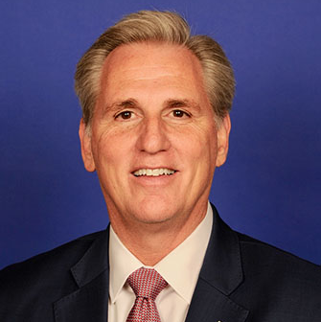
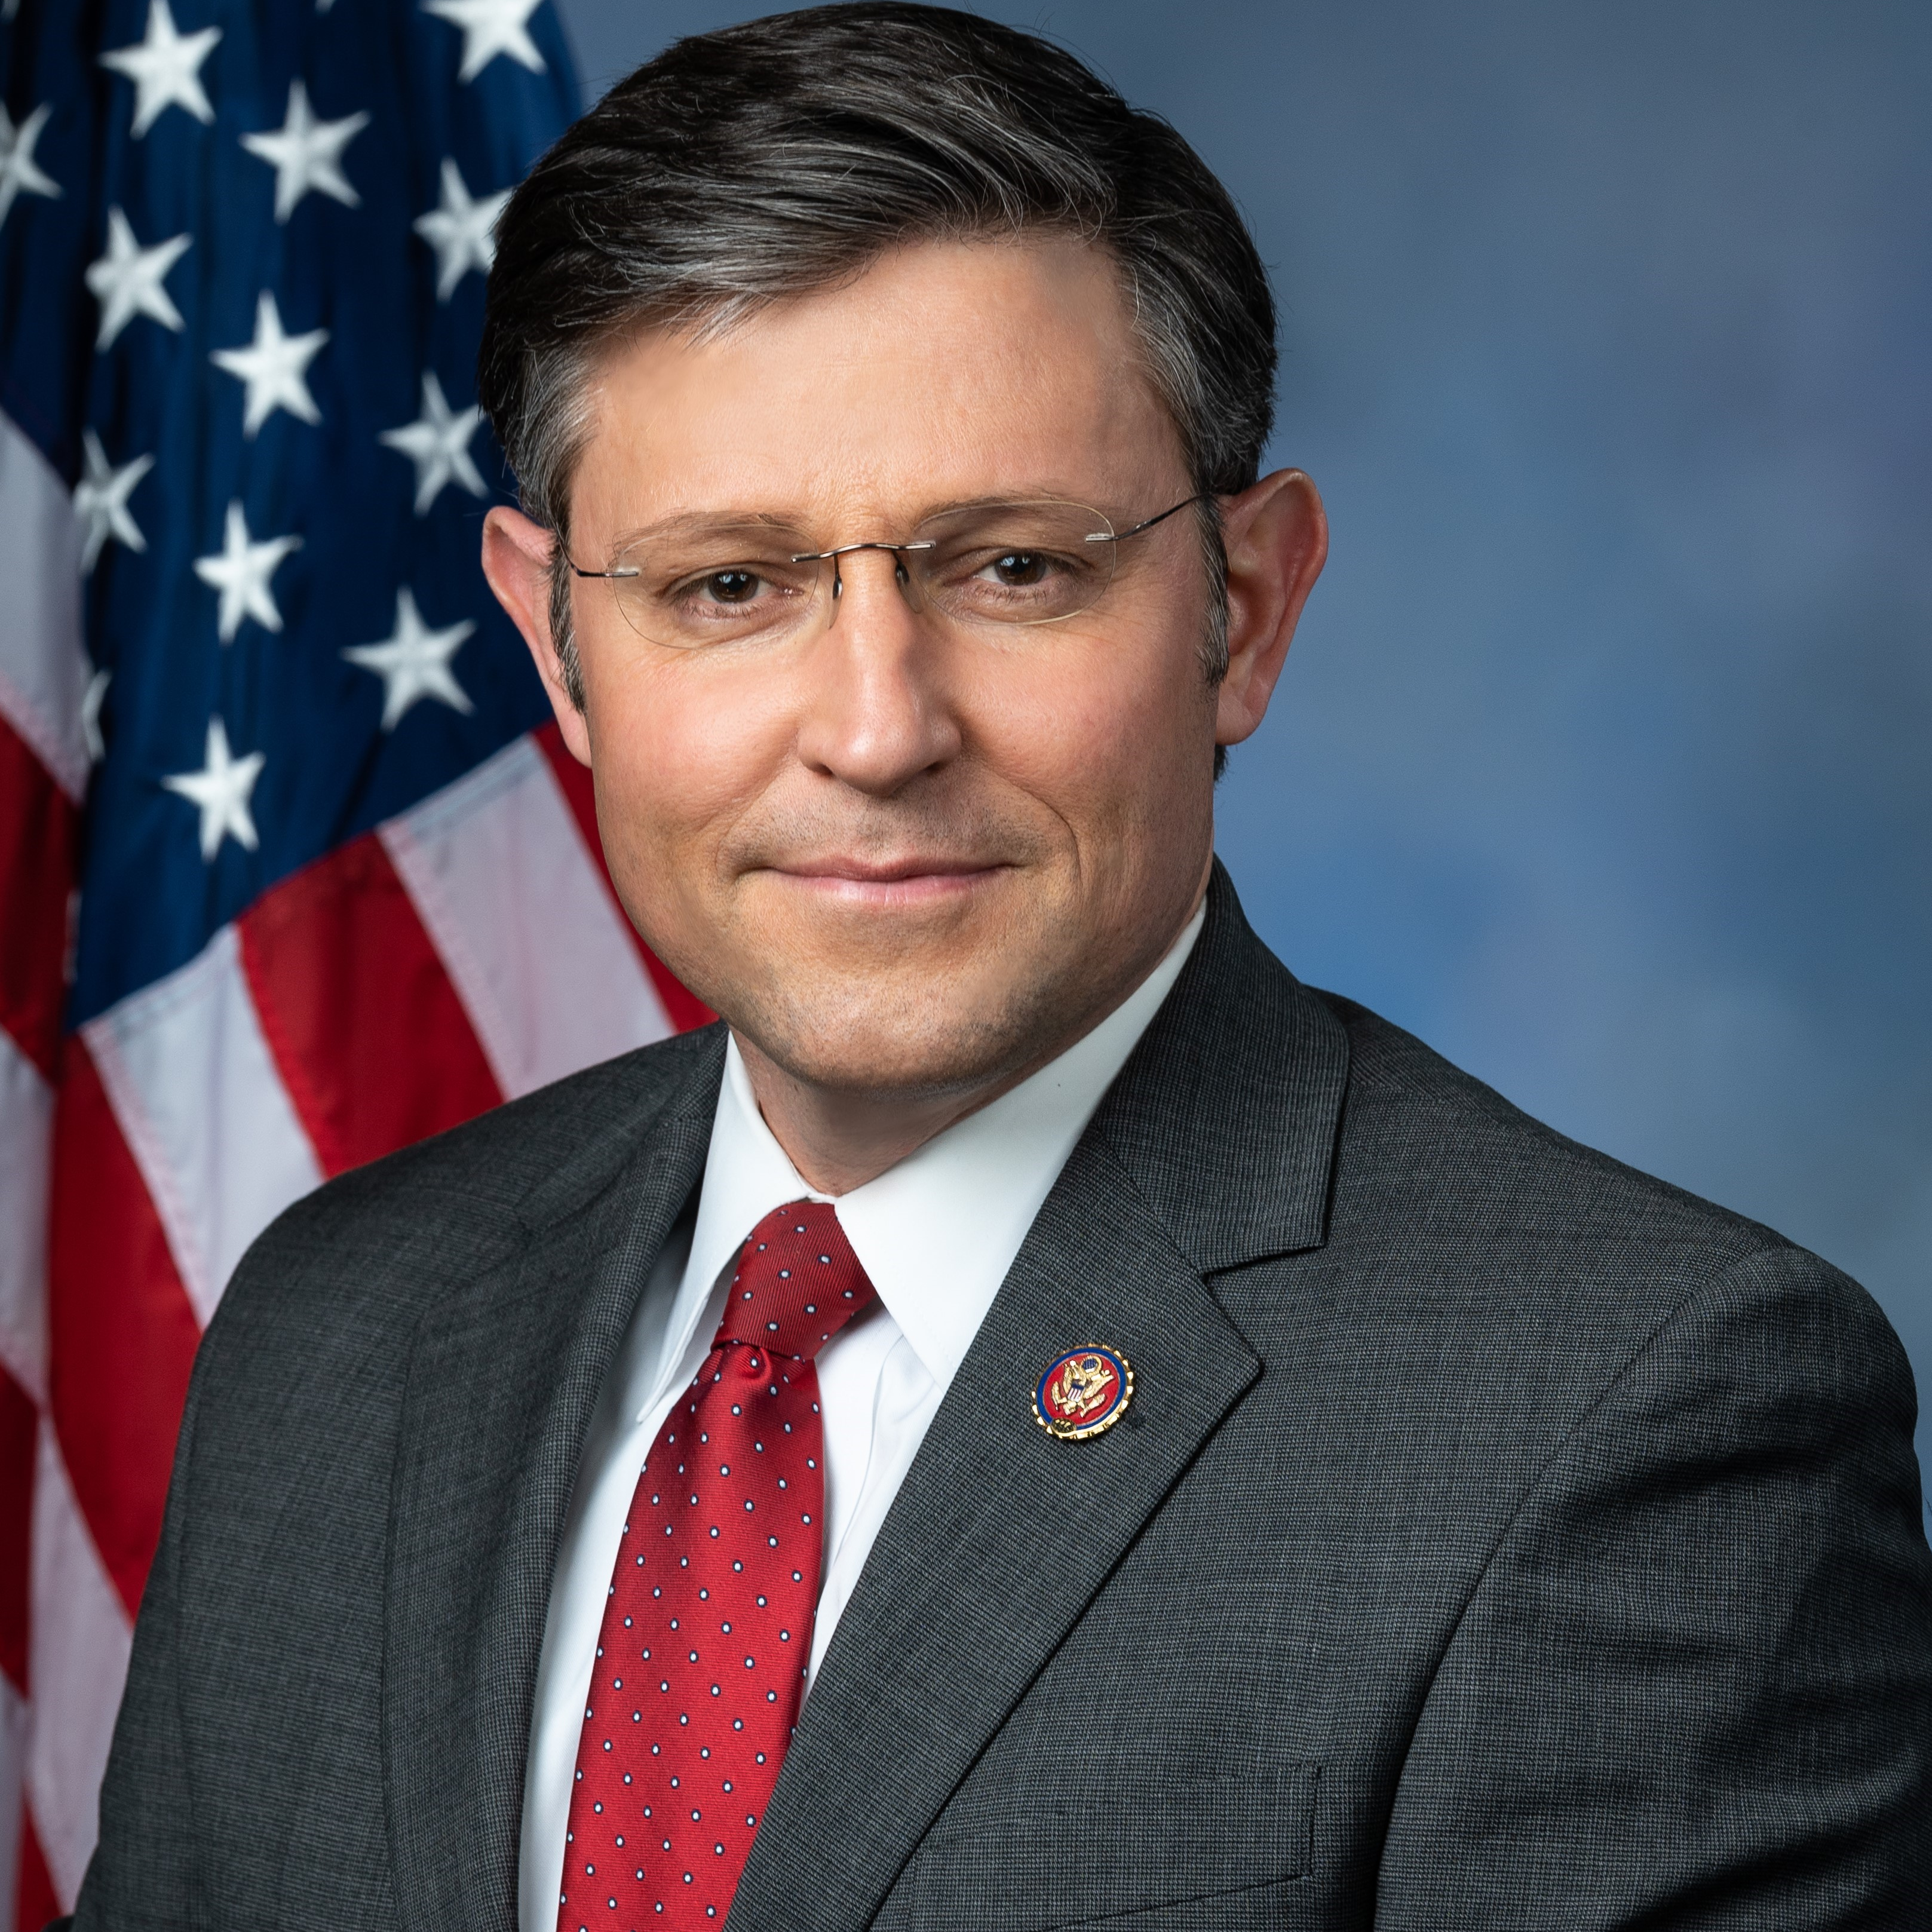
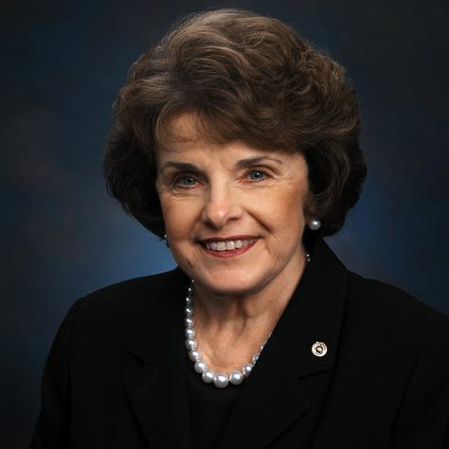
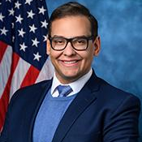
2023 legislative record and key events for the 118th Congress
Total for 118th Congress
NOTABLE CONGRESSIONAL EVENTS IN 2023
INTRODUCED
PASSED HOUSE
Kevin McCarthy (R-CA-20) was elected as House Speaker after 15 ballots; later became the first Speaker to be ousted
After four rounds and three GOP candidates, Mike Johnson (R-LA-4) was elected House Speaker
10,762
172
PASSED SENATE
PASSED HOUSE + SENATE
Congress suspended the debt ceiling through Jan. 1, 2025, and passed two CRs to fund the government
One Senator and four Reps. voluntarily left office, including former House Speaker Kevin McCarthy
76
9
ENACTED*
VETOED
Longtime California Sen. Dianne Feinstein passed away
Freshman Rep. George Santos was expelled from the House of Representatives district NY-3
34
9
*Does not include bills enacted as part of other legislation
SOURCE GovTrack.
PRESENTATION CENTER 1/1/24

Slide 3
Key legislation passed in 2023
Title | Signed into law | Description
H.R. 3746: Fiscal Responsibility Act of 2023 | June 3, 2023 | Suspended the debt ceiling through January 1, 2025; cuts spending by 1% if all 12 appropriations bills for FY2024 are not passed by the end of 2023, and caps discretionary spending for FY2024 and FY2025
S. 777: Veterans’ Compensation Cost-of-Living Adjustment (COLA) Act of 2023 | June 14, 2023 | Requires the Dept. of Veterans Affairs to increase the rate of veterans’ disability compensation by the same percentage that beneficiaries of Social Security receive adjusted cost-of-living increases
H.R. 4004: United States-Taiwan Initiative on 21st Century Trade First Agreement Implementation Act | August 7, 2023 | Approves the June 1 US-Taiwan trade agreement, allowing implementation after Taiwan takes steps to ensure compliance, and requires the US Trade Representative to share US negotiating texts with Congress before Taiwan or parties outside of the executive branch
H.R. 5860: Continuing Appropriations Act, 2024 and Other Extensions Act | September 30, 2023 | Continues FY2024 appropriations to federal agencies through November 17, 2023; provides emergency funding for disaster relief; extends programs such as FAA and National Flood Insurance
H.R. 6363: Further Continuing Appropriations and Other Extensions Act, 2024 | November 16, 2023 | Continues FY2024 appropriations for federal agencies through January 19, 2024, and February 2, 2024, for varying agencies; extends the 2018 Farm Bill.
H.R. 2670: National Defense Authorization Act for Fiscal Year 2024 | December 22, 2023 | Authorizes FY2024 appropriations and establishes policies for Department of Defense programs and activities, and national security programs of the Department of Energy
SOURCE Congress.gov.
PRESENTATION CENTER 1/1/24

Slide 4
All enacted laws in 2023 (1/4)
Title | Sponsor | Cosponsor #
S.619: COVID-19 Origin Act of 2023 | Hawley, Josh (Sen.-R-MO) | 4 (4R)
H.J. Res. 26: Disapproving the action of the District of Columbia Council in approving the Revised Criminal Code Act of 2022. | Clyde, Andrew S. (Rep.-R-GA-9) | 46 (46R)
H.J. Res. 7: Relating to a national emergency declared by the President on March 13, 2020. | Gosar, Paul A. (Rep.-R-AZ-9) | 68 (68R)
H.R. 346: NOTAM Improvement Act of 2023 | Stauber, Pete (Rep.-R-MN-8) | 11 (10R, 1D)
H.R. 3746: Fiscal Responsibility Act of 2023 | McHenry, Patrick T. (Rep.-R-NC-10) | 0
S. 777: Veterans' COLA Act of 2023 | Tester, Jon (Sen.-D-MT) | 12 (6R, 5D, 1I)
S. 467: CADETS Act | Peters, Gary C. (Sen.-D-MI) | 6 (3R, 3D)
S. 30: Fiscal Year 2023 Veterans Affairs Major Medical Facility Authorization Act | Tester, Jon (Sen.-D-MT) | 1 (1R)
S. 111: Providing Accountability Through Transparency Act of 2023 | Lankford, James (Sen.-R-OK) | 5 (3R, 1D, 1I)
H.R. 1096: 250th Anniversary of the United States Marine Corps Commemorative Coin Act | Moulton, Seth (Rep.-D-MA-6) | 301 (205R, 96D)
H.R. 423: Pala Band of Mission Indians Land Transfer Act of 2023 | Issa, Darrell E. (Rep.-R-CA-48) | 1 (1D)
SOURCE Congress.gov.
PRESENTATION CENTER 1/1/24

Slide 5
All enacted laws in 2023 (2/4)
Title | Sponsor | Cosponsor #
H.R. 3672: To designate the clinic of the Department of Veterans Affairs in Indian River, Michigan, as the "Pfc. Justin T. Paton Department of Veterans Affairs Clinic". | Bergman, Jack (Rep.-R-MI-1) | 12 (7D, 5R)
H.R. 4004: United States-Taiwan Initiative on 21st-Century Trade First Agreement Implementation Act | Smith, Jason (Rep.-R-MO-8) | 43 (22R, 21D)
H.R. 2544: Securing the U.S. Organ Procurement and Transplantation Network Act | Bucshon, Larry (Rep.-R-IN-8) | 10 (6D, 4R)
H.R. 5860: Continuing Appropriations Act, 2024 and Other Extensions Act | Granger, Kay (Rep.-R-TX-12) | 0
S. 475: A bill to designate the clinic of the Department of Veterans Affairs in Gallup, New Mexico, as the Hiroshi "Hershey" Miyamura VA Clinic. | Heinrich, Martin (Sen.-D-NM) | 1 (1D)
S. 112: A bill to amend title 38, United States Code, to strengthen benefits for children of Vietnam veterans born with spina bifida, and for other purposes. | Braun, Mike (Sen.-R-IN) | 8 (4R, 4D)
S. 2795: A bill to amend title 38, United States Code, to extend and modify certain authorities and requirements relating to the Department of Veterans Affairs, and for other purposes. | Tester, Jon (Sen.-D-MT) | 1 (1R)
H.R. 5110: Protecting Hunting Heritage and Education Act | Green, Mark E. (Rep.-R-TN-7) | 71 (68 R, 3D)
H.R. 366: Korean American VALOR Act | Takano, Mark (Rep.-D-CA-39) | 15 (9D, 6R)
H.R. 1226: Wounded Warrior Access Act | Aguilar, Pete (Rep.-D-CA-33) | 2 (2R)
SOURCE Congress.gov.
PRESENTATION CENTER 1/1/24

Slide 6
All enacted laws in 2023 (3/4)
Title | Sponsor | Cosponsor #
H.R. 6363: Further Continuing Appropriations and Other Extensions Act, 2024 | Granger, Kay (Rep.-R-TX-12) | 0
S. 788: Duck Stamp Modernization Act of 2023 | Boozman, John (Sen.-R-AR) | 6 (3R, 2D, 1I)
S. 2747: A bill to amend the Federal Election Campaign Act of 1971 to extend the Administrative Fine Program for certain reporting violations. | Klobuchar, Amy (Sen.-D-MN) | 1 (1R)
S. 2787: 5G SALE Act | Kennedy, John (Sen.-R-LA) | 0
H.R. 1734: TRANQ Research Act of 2023 | Collins, Mike (Rep.-R-GA-10) | 25 (13D, 12R)
H.R. 3315: National Guard and Reservists Debt Relief Extension Act of 2023 | Cohen, Steve (Rep.-D-TN-9) | 3 (2R, 1D)
H.J.Res. 62: Providing for the reappointment of Michael Govan as a citizen regent of the Board of Regents of the Smithsonian Institution. | Smith, Adrian (Rep.-R-NE-3) | 2 (1R, 1D)
H.J.Res. 63: Providing for the appointment of Antoinette Bush as a citizen regent of the Board of Regents of the Smithsonian Institution. | Smith, Adrian (Rep.-R-NE-3) | 2 (1R, 1D)
H.J.Res. 64: Providing for the reappointment of Roger W. Ferguson as a citizen regent of the Board of Regents of the Smithsonian Institution. | Smith, Adrian (Rep.-R-NE-3) | 2 (1R, 1D)
H.R. 2670: National Defense Authorization Act for Fiscal Year 2024 | Rogers, Mike D. (Rep.-R-AL-3) | 1 (1D)
SOURCE Congress.gov.
PRESENTATION CENTER 1/1/24

Slide 7
All enacted laws in 2023 (4/4)
Title | Sponsor | Cosponsor #
H.R. 1722: Grand Ronde Reservation Act Amendment of 2023 | Salinas, Andrea (Rep.-D-OR-6) | 5 (3D, 2R)
H.R. 2839: To amend the Siletz Reservation Act to address the hunting, fishing, trapping, and animal gathering rights of the Confederated Tribes of Siletz Indians, and for other purposes. | Hoyle, Val T. (Rep.-D-OR-4) | 4 (3D, 1R)
H.R. 6503: Airport and Airway Extension Act of 2023, Part II | Graves, Sam (Rep.-R-MO-6) | 1 (1D)
SOURCE Congress.gov.
PRESENTATION CENTER 1/1/24

Slide 8
Ways to edit these slides
Looking to customize these slides yourself?
Looking for assistance with customization?
No problem.
The slides in this deck can be edited to suit your needs. However, if you alter text, data or images on our slides, we ask that you remove National Journal logos and branding prior to distribution or public use. Look for:
We’re here to help.
If you’d like our team of policy researchers and data visualization specialists to customize this deck with your vision in mind, contact your Dedicated Advisor or email service@nationaljournal.com.
This service is included in most membership packages.
Feel free to delete this slide before presenting.

