Slide 1
Party leadership in the 118th Congress
A look at party leadership in the new Congress, including an overview of McCarthy’s concessions to the House Freedom Caucus in his bid to become Speaker
January 10, 2023
PRODUCER
National Journal Presentation Center

Slide 2
Congressional leadership hierarchy
Congress
The Vice President is the official leader of the Senate. However, the Senate elects a President Pro Tempore to act in their stead. They hold far less power than the Senate majority leader.
House
Senate
Speaker
President Pro Tempore
Majority leader
Minority leader
Majority leader
Minority leader
Majority whip
Minority whip
Majority whip
Minority whip
Committee chairs
Ranking members
Committee chairs
Ranking members
SOURCE Gibson Dunn, Ballotpedia
PRESENTATION CENTER11/21/2022
Notes:
Sources:
“118th CONGRESS: OUTLOOK FOR CONGRESSIONAL AND COMMITTEE LEADERSHIP SELECTIONS.” Gibson Dunn, November 9, 2022. gibsondunn.com/wp-content/uploads/2022/11/118th-congress-outlook-for-congressional-and-committee-leadership-selections.pdf
“United States Senate.” Ballotpedia, accessed November 21, 2022. https://ballotpedia.org/United_States_Senate
“United States House of Representatives.” Ballotpedia, accessed November 21, 2022. https://ballotpedia.org/United_States_House_of_Representatives

Slide 3
Party leadership elections overview
Each party uses the same method to decide who presides over each chamber, majority/minority leaders in each chamber, and whips in each chamber.
House
Senate
Speaker of the House
President Pro Tempore
The Speaker of the House is determined by a chamber-wide secret ballot vote
The Speaker serves as the de facto leader of the House and is second in line to succeed the President after the Vice President
In lieu of the VP, the Senate elects a President Pro Tempore (usually the most senior member) to preside over the chamber
The President Pro Tempore is third in the line of presidential succession after the Speaker of the House
Majority/minority leader
Majority/minority leader
The majority/minority leaders are elected by each party’s caucus in a secret ballot
The House majority leader is distinct from the Speaker; the former is not in the presidential line of succession and deals with more quotidian operations management than does the latter
The Senate majority leader holds a role analogous to the Speaker of the House, while the minority leader holds a role similar to the House minority leader
Leaders are elected by a majority vote of all members in their party
Majority/minority whip
Majority/minority whip
Party whips are elected by each party’s caucus in a secret ballot
Whips are responsible for ensuring that congresspeople vote along party lines
As in the House, the Senate whips are responsible for ensuring party members toe the party line
Whips are elected by a majority vote of all members in their party
SOURCE Gibson Dunn, Ballotpedia, VOA, Senate.gov, ,
PRESENTATION CENTER 11/21/2022
Notes:
Sources:
“President of the US Senate.” Ballotpedia, accessed November 21, 2022. https://ballotpedia.org/President_of_the_U.S._Senate
“House of Representatives Hierarchy.” VOA, accessed November 21, 2022. https://www.voanews.com/a/house-of-representatives-hierarchy/4674319.html
“118th CONGRESS: OUTLOOK FOR CONGRESSIONAL AND COMMITTEE LEADERSHIP SELECTIONS.” Gibson Dunn, November 9, 2022. gibsondunn.com/wp-content/uploads/2022/11/118th-congress-outlook-for-congressional-and-committee-leadership-selections.pdf
“About Parties and Leadership.” Majority and Minority Leaders.” United States Senate, accessed November 21, 2022. https://www.senate.gov/about/origins-foundations/parties-leadership/majority-minority-leaders.htm#:~:text=Working%20with%20the%20committee%20chairs,about%20the%20daily%20legislative%20program.
“About Parties and Leadership. Party Whips.” United States Senate, accessed November 21, 2022. https://www.senate.gov/about/origins-foundations/parties-leadership/party-whips.htm#:~:text=Traditionally%20serving%20as%20assistant%20leaders,minority%20leaders%20in%20their%20absence.

Slide 4








Kevin McCarthy (R-CA-20) became Speaker of the House, offering rules concessions to far-right colleagues
McCarthy prevailed after 14 failed votes, allowing the 118th Congress to commence.
Why the process was lengthy
House Freedom Caucus demands
20 members of the House Freedom Caucus, the GOP’s furthest-right caucus, had refused to vote for McCarthy unless he conceded to their demands. McCarthy failed 14 consecutive ballots before winning the support necessary to assume the Speaker role.
Reinstitute the “Motion to vacate” rule, allowing any member to bring forward an immediate motion to remove the Speaker
Simplify bills and enforce a deadline by which to have final text ready to read before a vote
What roadblocks this caused
Eliminate party leadership involvement in GOP primaries
1
The House could not be sworn in on time
Increase conservative representation on committees, especially the Rules Committee
2
Delays in New House rules debate
3
Committee assignments could not officially begin
Institute an actionable plan to cut government spending
4
Other party leaders including majority/minority leaders, whips, conference chairs, etc. could not officially begin their roles
Use must-pass legislation like the NDAA to battle Biden’s legislative agenda
Form a “Church Commission”-style committee to target “weaponized” government
SOURCE Congressional Research Service, House Freedom Caucus, Washington Post
PRESENTATION CENTER 1/10/2023
Notes:
Sources:
“The First Day of a New Congress: A guide to Proceedings on the House Floor.” Congressional Research Service, December 15, 2022. https://sgp.fas.org/crs/misc/RL30725.pdf
“Speaker Dear Colleague (FINAL) 12.8.22.” Scott Perry et. al., accessed January 3, 2023. https://www.documentcloud.org/documents/23400811-speaker-dear-colleague-final-12822
JM. Rieger and Aaron Blake. “These Republicans voted against Kevin McCarthy for House speaker.” The Washington Post, January 3, 2023. https://www.washingtonpost.com/politics/2023/01/03/kevin-mccarthy-house-speaker-vote/

Slide 5
Overview of McCarthy’s concessions in the House rules package
The House adopted a final set of rules the evening of January 9.
Concessions status
House Freedom Caucus demand | Adopted?
Motion to vacate
Simplify bills and enforce text-ready deadline
Eliminate party leadership involvement in GOP primaries*°
Increase conservative representation on committees*
Cut government spending:
Reinstitute “Holman rule” Cut spending before raising debt ceiling Eliminate omnibus spending
Target Biden’s legislative agenda
Investigate “weaponized” federal government
Key concessions overview
1
Reinstituting the motion to vacate
✓
YES
  New rules allow any one member to bring forward a motion to remove the Speaker from their role at any time
  McCarthy had previously floated an amended version of the rule allowing any five members to bring forward such a motion to no avail
✓
YES
PARTIAL
-
✓
YES
2
Investigating “weaponized” government
✓
YES
  New rules establish a “Select Subcommittee on Weaponization of the Federal Government” under the Judiciary Committee
  Committee objectives will be investigating the work of the Jan. 6 Committee, the withdrawal from Afghanistan, and the work of the FBI
3
Cutting government spending
✓
YES
  New rules reinstate the “Holman rule,” which can be used to reduce the salary of federal officials
  Spending cuts must accompany efforts to raise the debt ceiling
✓
YES
*Not specifically in rules package; agreed to on other terms.
°One McCarthy-aligned super PAC agreed to stay out of open Republican seats in safe districts.
SOURCE Axios, Washington Post, CNN, New York Times, House.gov
PRESENTATION CENTER 1/10/2023
Notes:
Sources:
Erin Doherty. “What we know about Kevin McCarthy’s concessions to become speaker.” Axios, January 8, 2023. https://www.axios.com/2023/01/08/kevin-mccarthy-house-speaker-vote-republicans
“Adopting the Rules of the House of Representatives for the One Hundred Eighteenth Congress, and for other purposes.” House of Representatives, accessed January 9, 2023. https://rules.house.gov/sites/republicans.rules118.house.gov/files/BILLS-118hresPIH-118th-rules-of-the-house-of-reps-V3.pdf
Clare Foran, Manu RaJu, Annie Grayer, and Melanie Zanona. “McCarthy elected House speaker after days of painstaking negotiations and failed votes.” CNN, January 7, 2023. https://www.cnn.com/2023/01/06/politics/mccarthy-speaker-fight-friday/index.html
Aaron Blake. “McCarthy’s big concession – and how it could hamstring a GOP speaker.” Washington Post, January 3, 2023. https://www.washingtonpost.com/politics/2023/01/03/motion-vacate-house-speaker/
Charlie Savage and Luke Broadwater. “House Republicans preparing broad inquiry into FBI and security agencies.” New York Times, January 8, 2023. https://www.nytimes.com/2023/01/08/us/politics/house-republicans-fbi-investigation.html
Carl Hulse and Luke Broadwater. “New House rules make it easier to dump Speaker, and harder to spend or raise taxes.” The New York Times, January 9, 2023. https://www.nytimes.com/2023/01/05/us/politics/house-rules-package.html

Slide 6
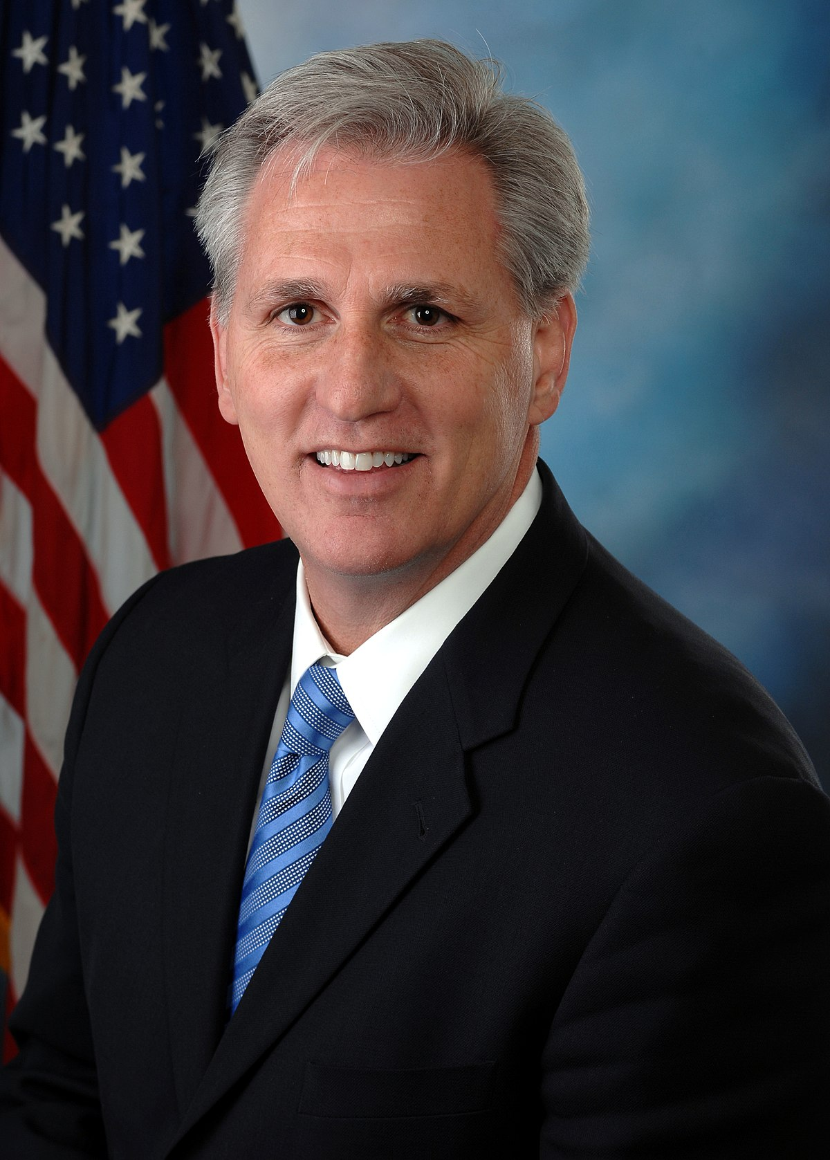
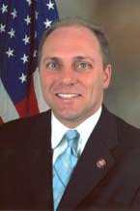
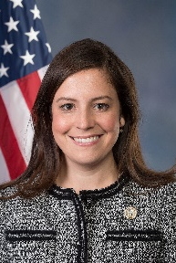
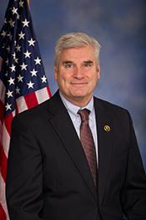
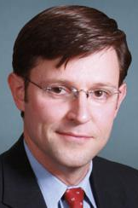
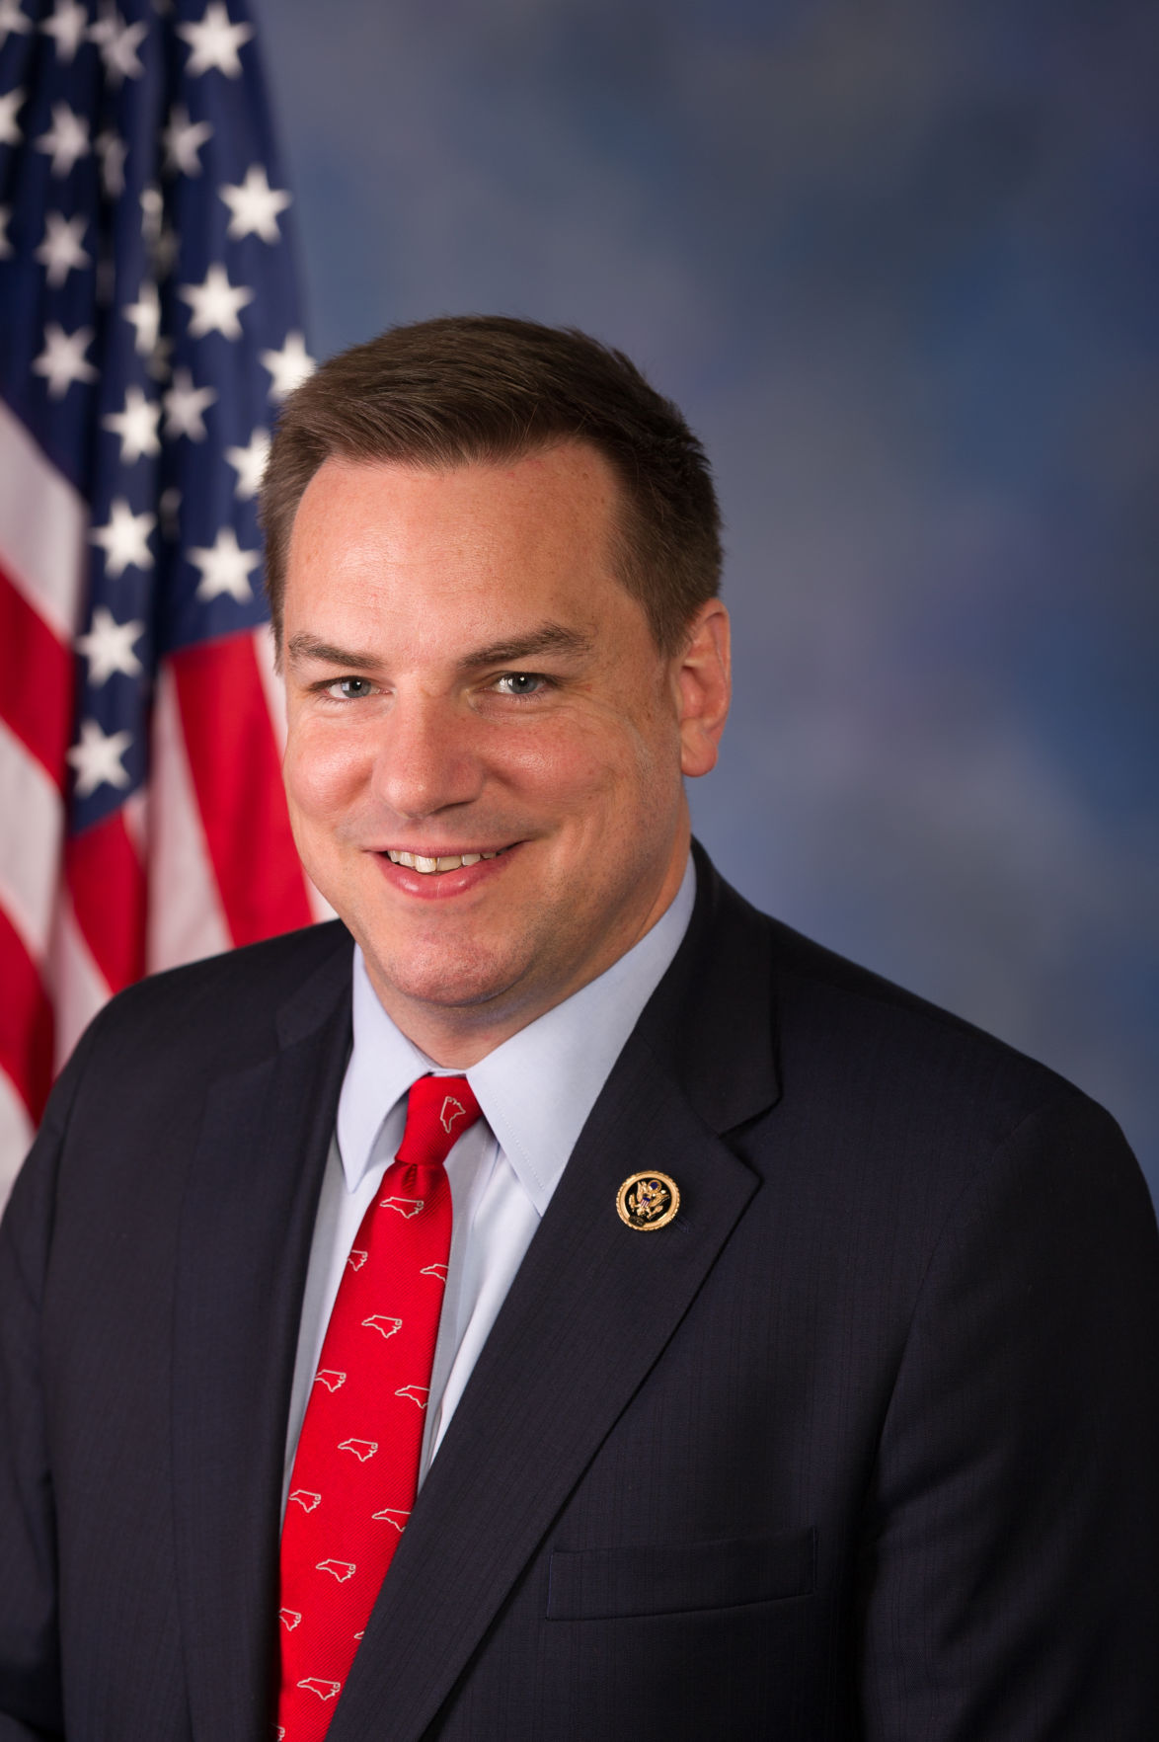
House Republican leadership
Kevin McCarthy (CA-20)
Speaker of the House
Represents the Republican Party on the House floor
Elected after 15 ballots; conceded to certain demands of the House Freedom Caucus to win support
Steve Scalise (LA-01)
Majority Leader
Elected as House majority leader
Assists Republican leadership in managing the party’s legislative program
Elise Stefanik (NY-21)
Republican Conference Chair
Reelected as Republican Conference Chair
Leads organization efforts of all Republican Party members in the House
Tom Emmer (MN-06)
House Majority Whip
Elected as House majority whip (last Republican whip was Steve Scalise LA-01)
Leads Republican Conference on policy development
Mike Johnson (LA-04)
Republican Conference Vice-Chair
Re-elected as Vice Chairman
Serves alongside the Chair of the Republican Conference
Richard Hudson (NC-09)
National Republican Congressional Committee Chair
Previously held by Tom Emmer (MN-06)
Organizes and manages Republican House campaign efforts
SOURCE CNN, Mike Johnson, Carolina Journal
PRESENTATION CENTER 1/09/2023
Notes:
Sources:
Melanie Zanona, Alex Rogers, and Manu RaJu.” Kevin McCarthy Beats Far-Right Challenger 188-31 to Lead House GOP.” CNN, November 15, 2022. https://www.cnn.com/2022/11/15/politics/house-republican-vote-kevin-mccarthy/index.html
“Congressman Mike Johnson Reelected as Vice Chairman of the House Republican Conference.” US Congressman Mike Johnson, accessed November 21, 2022. https://mikejohnson.house.gov/news/documentsingle.aspx?DocumentID=1219
“NC’s Hudson Elected to Chair National Republican Congressional Committee.” The Carolina Journal, November 16, 2022. https://www.carolinajournal.com/ncs-hudson-elected-to-chair-national-republican-congressional-committee/

Slide 7
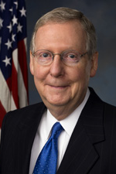
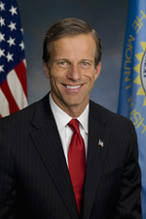
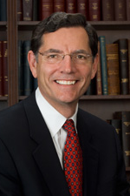
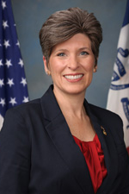
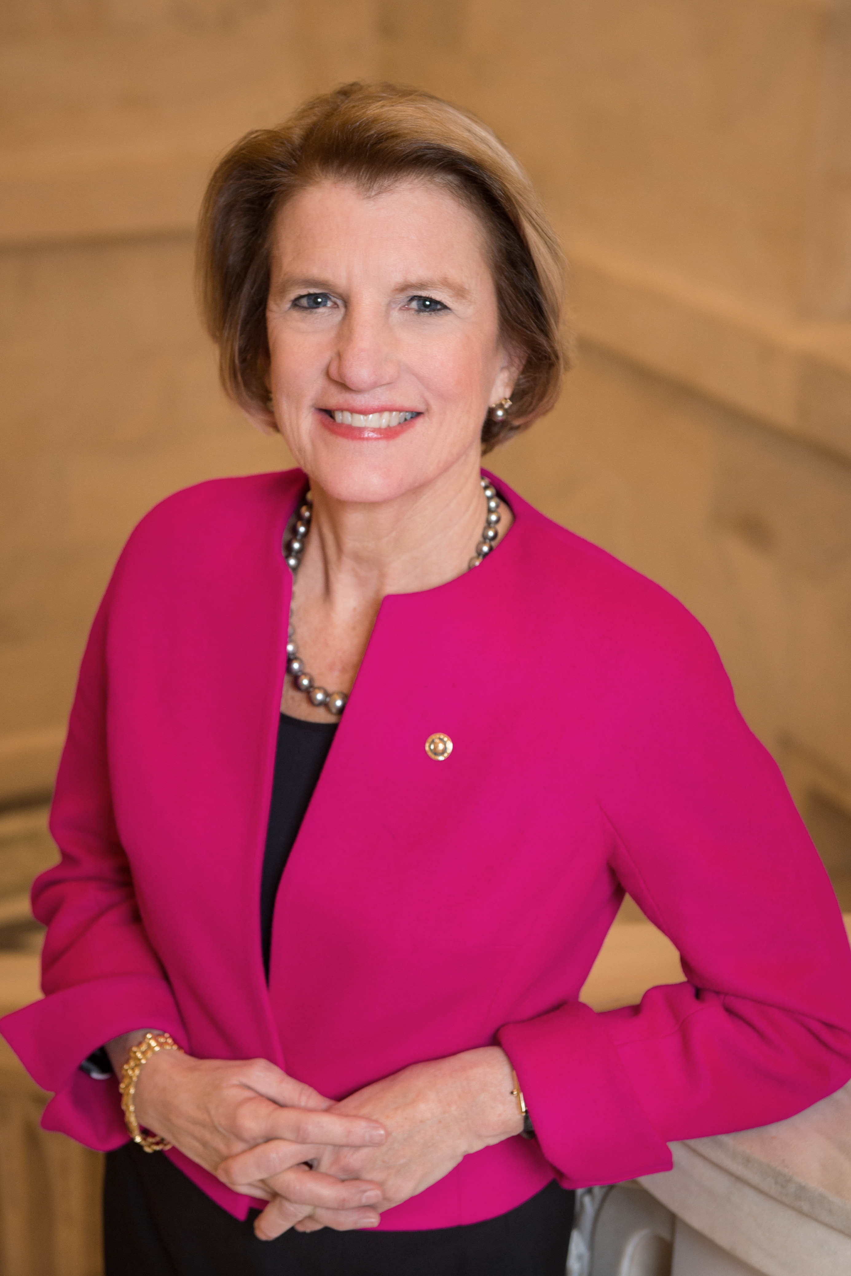
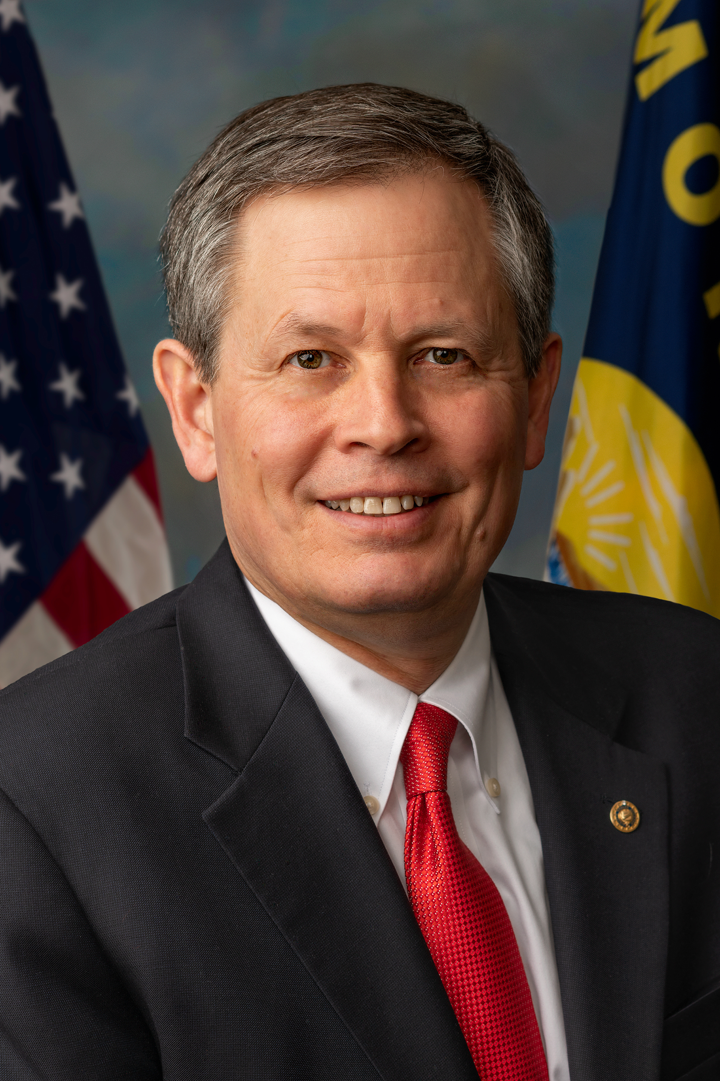
Senate Republican leadership
Mitch McConnell (KY)
Republican Leader
Re-elected as Senate Minority Leader
Head representative of the Republican Party on the Senate floor
John Thune (SD)
Republican Whip
Previously served as Senate Majority Whip
Assistant leader, responsible for counting and securing party votes
John Barrasso (WY)
Republican Conference Chair
Reelected as Republican Conference Chair
Responsible for intraparty committee assignments and leadership elections
Joni Ernst (IA)
Republican Policy Committee Chair
Previously Vice Conference Chair
Responsible for Senate Republican policy development
Shelley Moore Capito (WV)
Vice Chair of the Senate Republican Conference
Previously held by Joni Ernst (IA)
Responsible for taking minutes of the party conferences
Steve Daines (MT)
National Republican Senatorial Committee Chair
Previously held by Rick Scott (FL)
Responsible for strengthening the Republican conference through recruiting and fundraising
SOURCE Axios
PRESENTATION CENTER 11/21/2022
Notes:
Sources:
Andrew Solender, Alayna Treene. “McConnell Reelected as Senate GOP Leader.” Axios, November 16, 2022. https://www.axios.com/2022/11/16/mitch-mconnell-reelected-republican-senate-leader

Slide 8
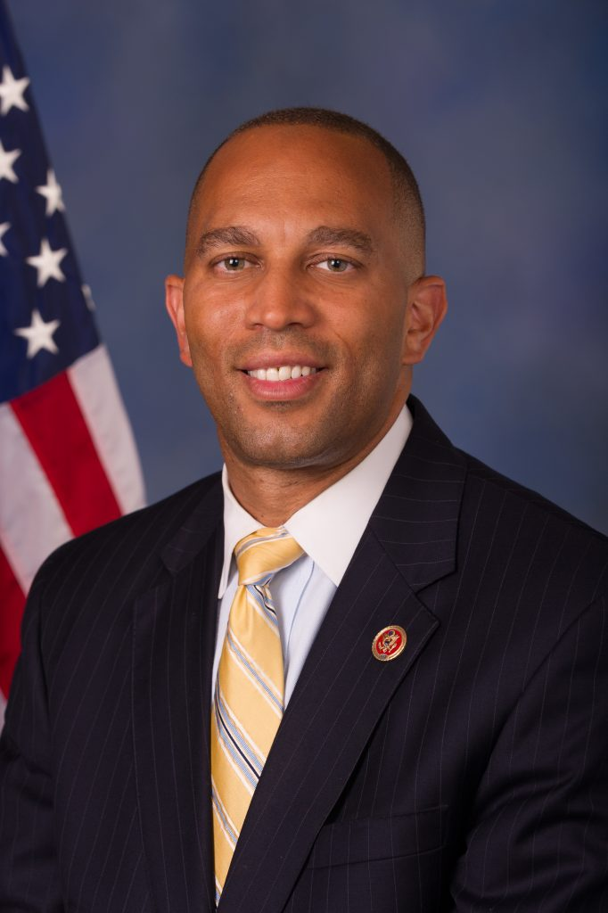
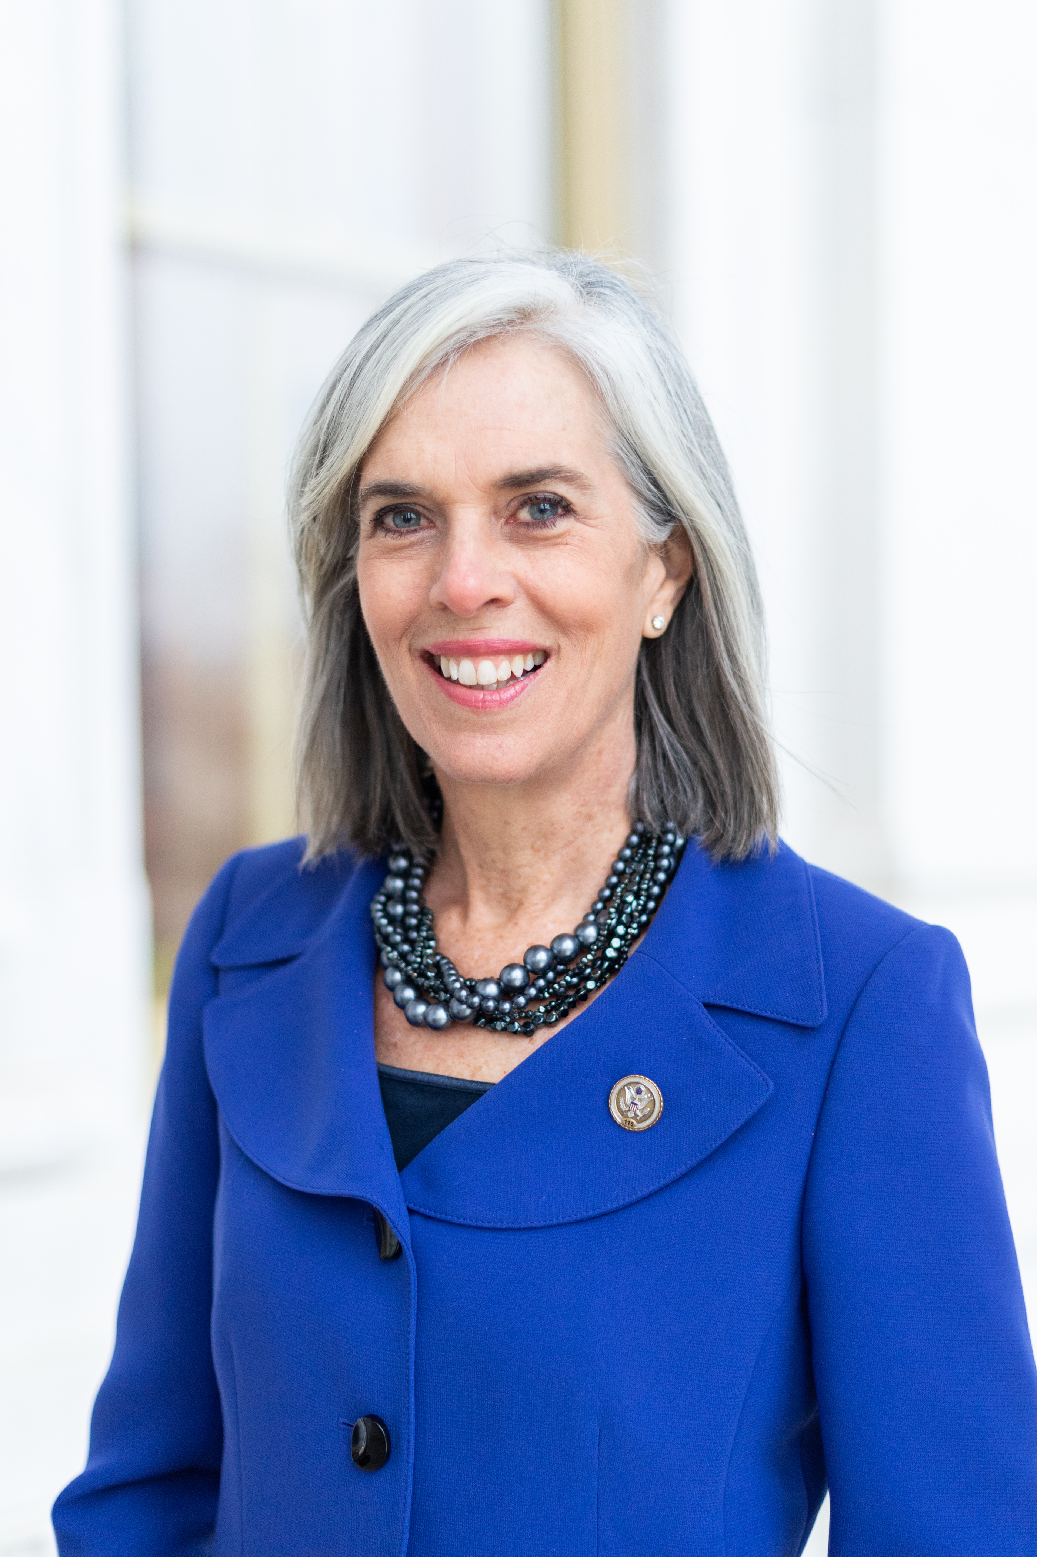
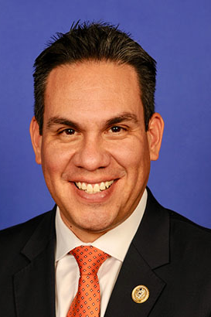
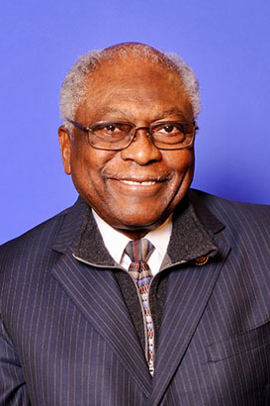
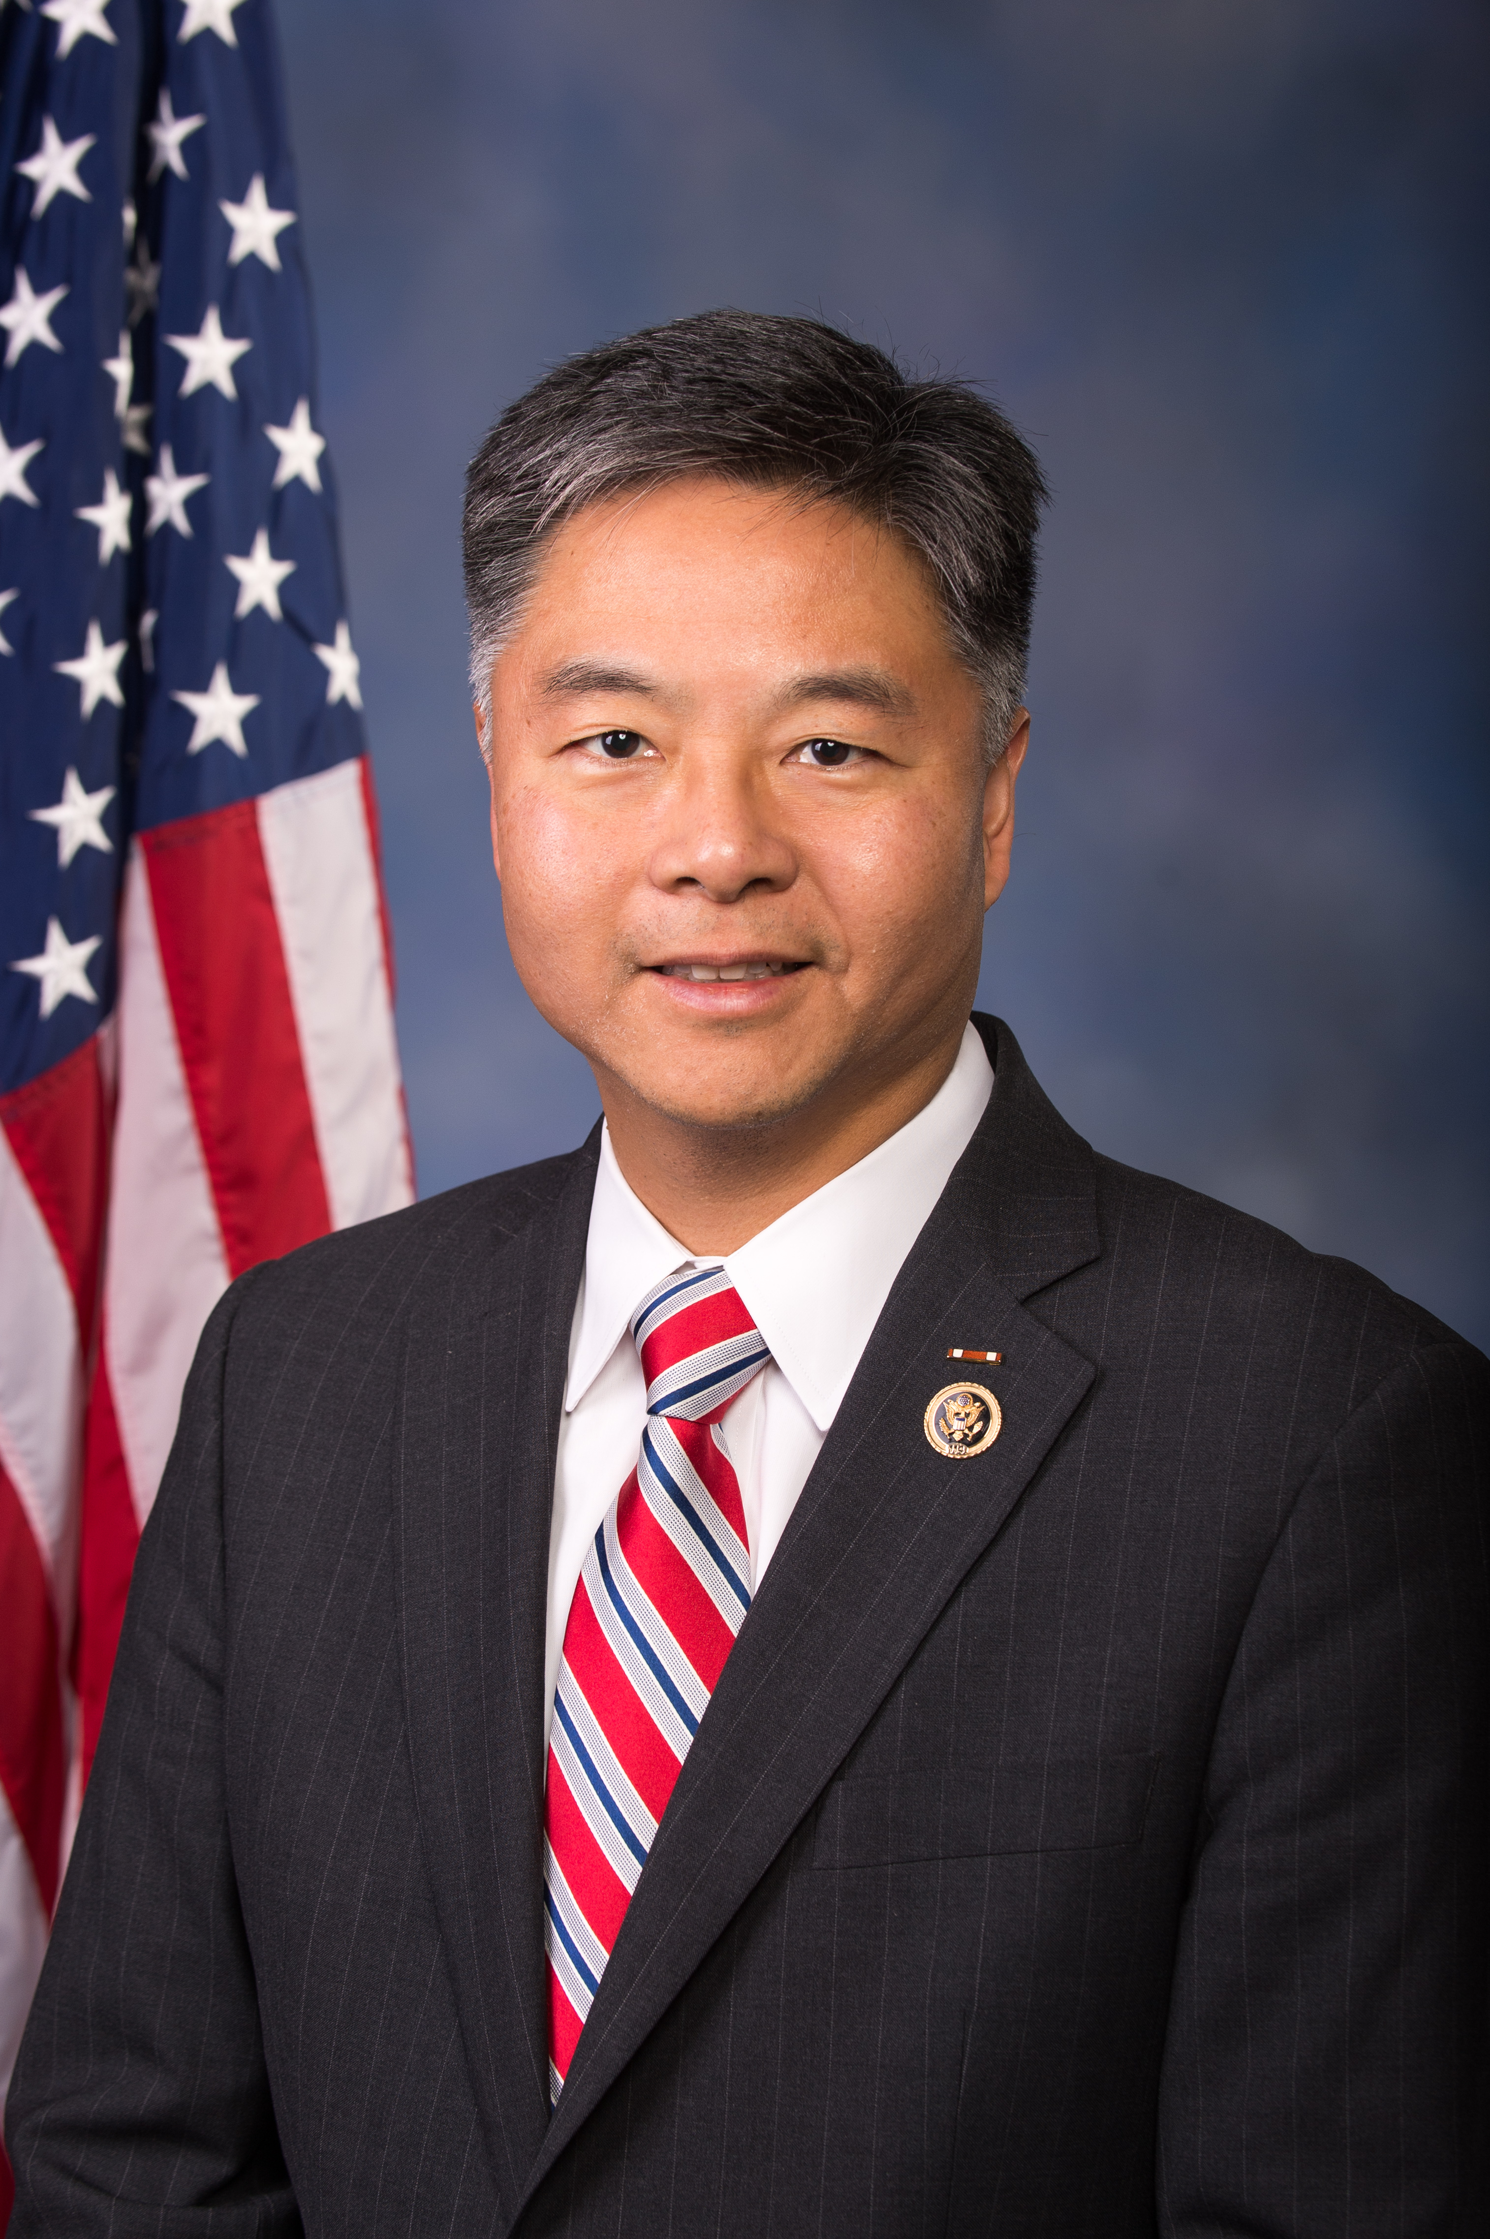
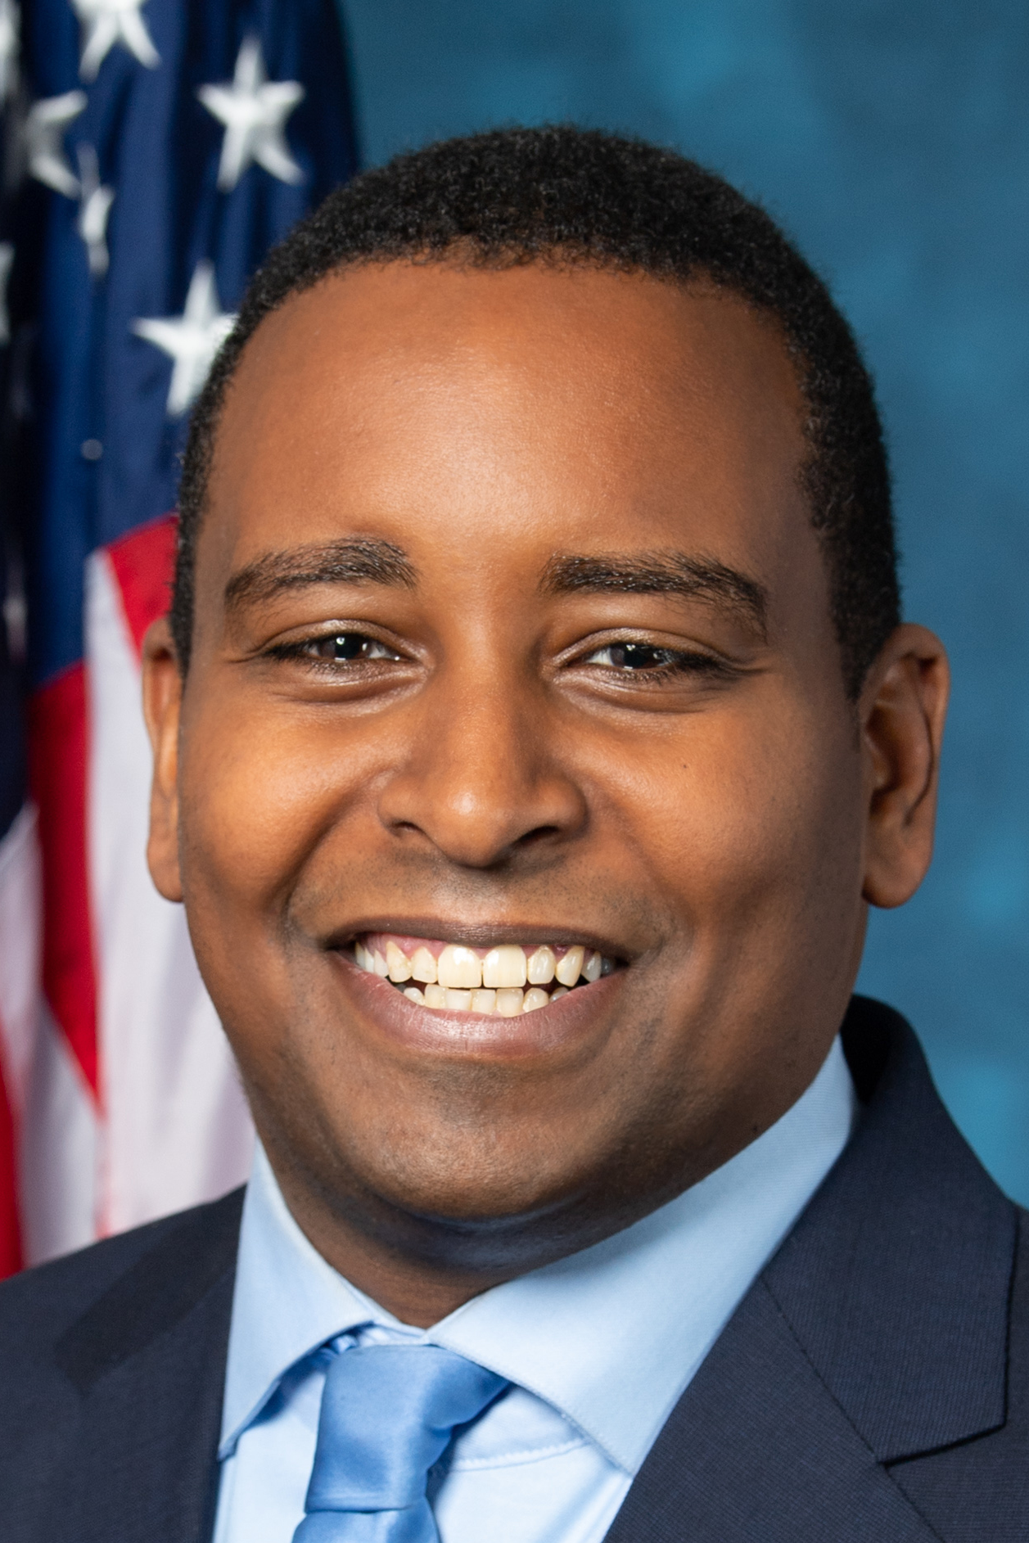
House Democratic leadership
Hakeem Jeffries (NY-08)
Minority Leader
Won bid to become the House’s top Democrat
Position in party previously held by Nancy Pelosi
Katherine Clark (MA-05)
Minority Whip
Newly elected as House minority whip
Position previously held by James Clyburn
Pete Aguilar (CA-31)
Democratic Caucus Chair
Newly elected as Democratic caucus chair
Position previously held by Steny Hoyer
James Clyburn (SC-06)
Assistant Caucus Leader
Elected as assistant caucus leader after challenger David Cicilline withdrew
Opted to stay in House Democratic leadership, previously House majority whip
Ted Lieu (CA-33)
Democratic Conference Vice-Chair
Elected as vice-chairman
Previously served as a co-chair on the Democratic Policy and Communications Committee
Joe Neguse (CO-02)
Chair of the Democratic Policy and Communications Committee
Elected as sole chair of the DPCC
Previously served as co-chair along with Ted Lieu, Debbie Dingell, and Matt Cartwright
SOURCE Clerk of the House
PRESENTATION CENTER 12/02/2022
Notes:
Sources:
“Leadership”. Clerk of the House of Representatives, accessed December 2, 2022. https://clerk.house.gov/Members/ViewLeadership#:~:text=Steny%20H.,Hoyer&text=Elected%20by%20the%20Democratic%20Caucus,House%20and%20schedules%20legislative%20business.
Daniella Diaz. “Jim Clyburn becomes assistant leader, stays in Democratic leadership.” CNN, December 1, 2022. https://www.cnn.com/2022/12/01/politics/james-clyburn-assistant-leader-democratic-leadership/index.html
Mike Lillis and Mychael Schnell. “House Democrats elect Ted Lieu as Party vice chair.” The Hill, November 30, 2022. https://thehill.com/homenews/house/3756909-democrats-elect-ted-lieu-as-party-vice-chair/
Andrew Maciejewski. “Neguse gains No. 5 spot in Democratic leadership for the US House of Representatives.” Summit Daily, December 1, 2022. https://www.summitdaily.com/news/neguse-gains-no-5-spot-in-democratic-party-leadership-for-the-us-house-of-representatives/
Daniella Diaz. “House Democrats pick Hakeem Jeffries to succeed Nancy Pelose, the first Black lawmaker to lead a party in Congress.” November 30, 2022. https://www.cnn.com/2022/11/30/politics/house-democratic-leadership-vote/index.html
Alexander Bolton. “Senate Democrats will hold leadership election week of Dec. 5.” The Hill, November 11, 2022. https://thehill.com/homenews/senate/3731757-senate-democrats-will-hold-leadership-election-week-of-dec-5/

Slide 9
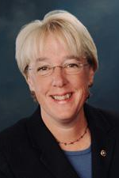
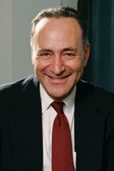
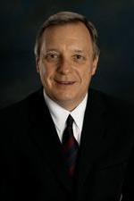
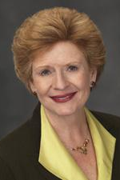
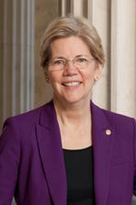
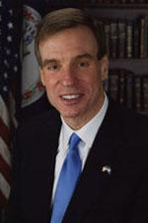
Senate Democratic leadership (1/2)
Patty Murray (WA)
President Pro Tempore
Previously held by Sen. Leahy (VT)
Nominally the President of the Senate, but holds far less power over the Democratic caucus than the majority leader
Chuck Schumer (NY)
Senate Majority Leader
Current Senate Majority Leader
Head representative of the Democratic party on the Senate floor
Dick Durbin (IL)
Democratic Majority Whip
Current Senate Majority Whip
Assistant leader, responsible for counting and securing party votes
Debbie Stabenow (MI)
Chair of Democratic Policy and Communications Committee
Current Vice-Chair of the House Democratic Caucus
Responsible for leading policy development for Senate Democrats
Elizabeth Warren (MA)
Vice Chair of Conference (Co-vice Chair)
Current Vice Chair of Conference
Assists Democratic leader in setting the Democratic agenda, messaging, and strategy
Mark Warner (VA)
Vice Chair of Conference (Co-vice Chair)
Current Vice Chair of Conference
Assists Democratic leader in setting the Democratic agenda, messaging, and strategy
SOURCE The Hill
PRESENTATION CENTER 12/09/2022
Notes:
Sources:
Alexander Bolton. “Schumer reelected as Senate majority leader.” The Hill, December 8, 2022. https://thehill.com/homenews/senate/3766968-schumer-re-elected-as-senate-majority-leader/

Slide 10
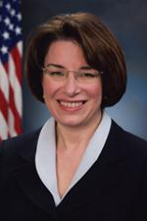
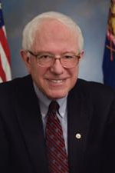
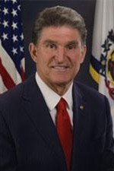
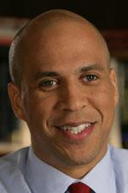
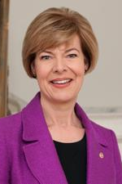
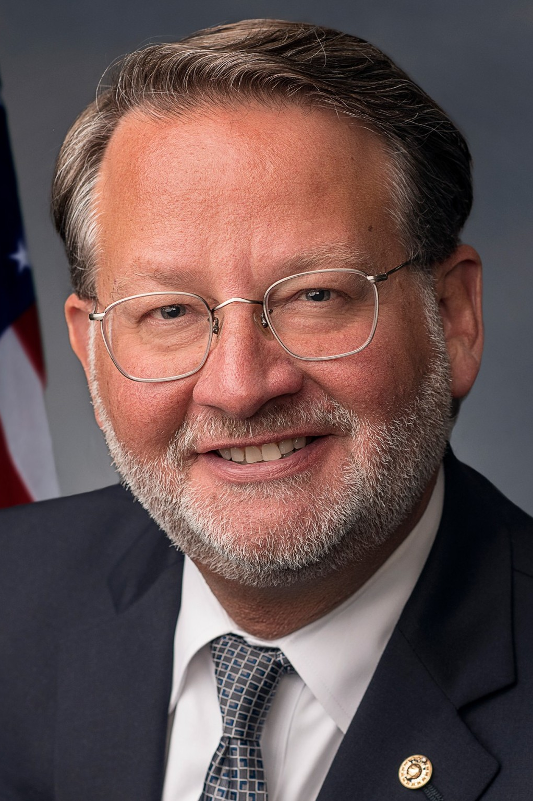
Senate Democratic leadership (2/2)
Amy Klobuchar (MN)
Chair of Steering Committee
Current Chair of the Steering Committee
Responsible for coordinating efforts between Democrats, advocacy groups and government agencies
Bernie Sanders (VT)
Chair of Outreach
Current Chair of Outreach
Leads efforts to engage Americans who feel disconnected from the political process
Joe Manchin (WV)
Vice Chair, Policy & Communications Committee (Co-vice Chair)
Current Vice Chair of Policy and Communications Committee
Assists Chair in leading policy development for Senate Democrats
Cory Booker (NJ)
Vice Chair, Policy & Communications Committee (Co-vice Chair)
Reelected as Vice Chair along with Joe Manchin
Tammy Baldwin (WI)
Secretary of Conference
Current Secretary of Conference
Responsible for intraparty committee assignments and leadership elections
Gary Peters (MI)
Chairman of the Democratic Senatorial Campaign Committee
Reelected as sole Chair
Responsible for coordinating Senate strategy to elect more Democrats
SOURCE The Hill
PRESENTATION CENTER 1/10/2023
Notes:
Sources:
Alexander Bolton. “Schumer reelected as Senate majority leader.” The Hill, December 8, 2022. https://thehill.com/homenews/senate/3766968-schumer-re-elected-as-senate-majority-leader/
Burgess Everett. “Schumer taps Peters again as Senate campaign chief in hopes of 2022 repeat.” Politico, January 9, 2023. https://www.politico.com/news/2023/01/09/senate-dems-tap-peters-again-as-campaign-chief-in-hopes-of-2022-repeat-00077011

