Slide 1
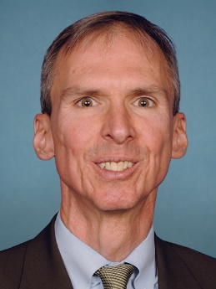
Rep. Daniel Lipinski (D-IL-3)
Background
Democrat Daniel Lipinski was first elected in 2004 to replace his father, Bill Lipinski, who represented the district for 22 years. Like his father, the younger Lipinski focuses on transportation and manufacturing, but puts his engineering background to work on cyber security and other technology issues. Keeping his pledge to reflect his father's views, who was the most conservative Democrat in the Illinois delegation, he opposes same-sex marriage and abortion rights except when the mother’s life is at stake. He was among the Democrats who declined to vote for California liberal Nancy Pelosi in 2011 as their party’s leader in the House. Lipinski declined to support the Democrats’ health care overhaul, saying that its provision banning federal funds for abortions wasn’t strong enough even as other anti-abortion Democrats expressed satisfaction with it. As a member of the Science, Space, and Technology Committee, he worked with Texas Republican Michael McCaul to get a cyber security bill through the House in April 2012. He won House passage in 2010 of a measure setting up a national manufacturing strategy, although it died in the Senate. He introduced a similar bill in 2012, which again passed the House but went no further.
District Profile
State: Illinois
District: 3rd
Chicago: Southwest Side, West Suburbs
Cook PVI: D+6
Biography
First Elected: 11/2/2004
Party: Democrat
Birth date: 7/15/1966
Education: PhD, Political Science, Duke University, 1998; MS, Engineering-Economic Systems, Stanford University, 1989; BS, Mechanical Engineering, Northwestern University, 1988
Family: Spouse: Judy Berkebile
Election Results
2018 General
Daniel Lipinski (D) | 74%
Art Jones (R) | 27%
Official Contact Info
Capitol Hill Office Building: Rayburn
Room Number: 2346
Phone Number: (202) 225-5701
Facebook: @repdanlipinski
Instagram:
Twitter: @replipinski
Committees
Science, Space, and Technology Transportation and Infrastructure
Slide updated: February 04, 2019

