Slide 1
The State of the Union: history & context
American presidents have delivered 95 in-person State of the Union Addresses
Origin & evolution
The President “shall from time to time give to the Congress Information of the State of the Union, and recommend to their Consideration such measures as he shall judge necessary and expedient.”
Article II, Section 3, Clause 1 of the US Constitution
Seating chart for the Address
First Lady’s Box
Guests
Speaker’s Box
1790: George Washington delivered the nation’s first “Annual Message” (now called the State of the Union).
1800s: Annual Messages consisted of detailed, written economic reports and federal budget requests.
1913: Woodrow Wilson presented his Annual Message to Congress in-person, as a platform to highlight his administration’s policy priorities.
1923: Calvin Coolidge became the first president to deliver his Annual Message over radio broadcast.
1947: Harry Truman became the first president to deliver a televised Annual Message, which was officially called, for the first time, the State of the Union.
GOP reps.
and senators
Dem. reps.
and senators
Leadership
Leadership
Cabinet and Diplomatic Corps
President
SCOTUS justices & Joint Chiefs of Staff
Speaker
of the House
Vice
President
Press Box
Sources: “State of the Union,” History, Art & Archives, US House of Representatives.
Shruthi Ashok | Slide last updated on: February 6, 2019

Slide 2
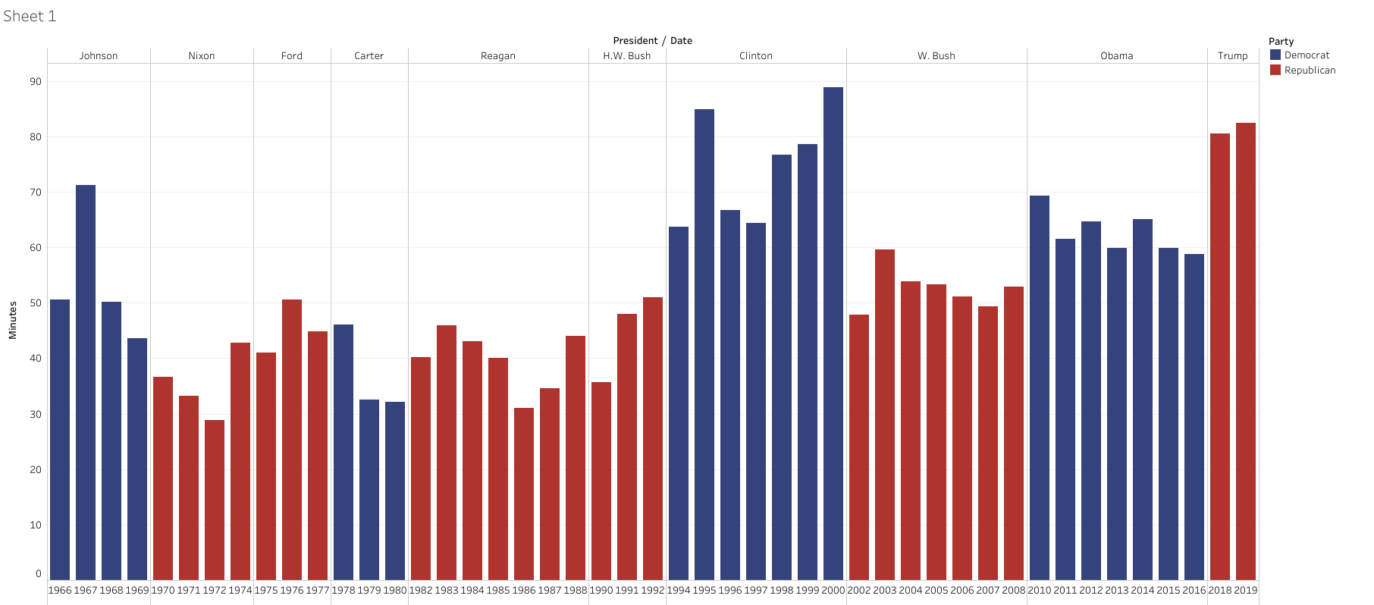
Former President Bill Clinton holds the record for the longest State of the Union address
Length of State of the Union addresses, in minutes
Sources: The American Presidency Project, University of California Santa Barbara
Alice Johnson | Slide last updated on: February 6, 2019

Slide 3
Key takeaways from the State of the Union
Five key points from President Trump’s address
Theme of unity
While Trump did not address the new Democratic majority in the House, he emphasized his desire to work with both parties to break the political stalemate
Trump highlighted the criminal justice reform bill as an example of bipartisan achievement in Congress, but also discussed highly partisan issues like border security and abortion
1
2
Border security debate
Trump did not declare a state of emergency along the southern border of the US, despite speculation that he might
He addressed the need for a border wall by talking about caravans, violence and gangs, and Democrats in the audience audibly rejected his points
3
Focus on investigations
Trump warned about the potential negative effects of investigations like the Special Counsel investigation
He said, “an economic miracle is taking place in the United States – and the only thing that can stop it are foolish wars, politics or ridiculous partisan investigations”
4
Women’s issues
Trump spent several minutes discussing how the economy has benefitted women in the country
He applauded the record-breaking number of women elected to office, after which female Democratic lawmakers, dressed all in white, stood up in celebration
5
Meeting with Kim Jong-un
Trump announced he will meet with North Korean leader Kim Jong-un for a second time in Vietnam on Feb. 27-28
He expressed hope that the meeting will continue the diplomatic communication between the two leaders that was established last June in Singapore
Sources: Glenn Thrush, “Takeaways From Trump’s 2019 State of the Union Address,” The New York Times. Feb. 6, 2019; Niall Stanage, “Six takeaways from the State of the Union,” The Hill. Feb. 6, 2019.
Alice Johnson | Slide last updated on: February 6, 2019

