Slide 1
Demographics of the 116th Congress
Visualizing ethnic/gender diversity, gender composition, LGBTQ+ representation and more
January 28, 2019
Producer
Danari White

Slide 2
Roadmap
Ethnic/racial composition
Immigrants and children of immigrants
Gender composition
LGBTQ+ representation
Generational composition
Religious composition
Spotlight: House freshmen by age, race and gender

Slide 3
116th Congress (2019-2020) by ethnic/racial background
Senate
House
Sources: Daily Kos analysis of member demographics
Danari White | Slide last updated on: January 28, 2019

Slide 4
The House and Senate have become more racially and ethnically diverse
Number of voting members of Congress that identify as a racial or ethnic minority, by year
■ African American ■ Hispanic ■ Asian American ■ Native American
Sources: Kristen Bialik and Jens Manuel Krogstad, “115th Congress sets new high for racial, ethnic diversity,” Pew Research Center, Jan. 24, 2017; Grace Panetta and Samantha Lee, “This one graphic shows how much more diverse the House of Representatives will become in January,” Business Insider, December 4, 2018.
Danari White | Slide last updated on: January 8, 2019

Slide 5
Roadmap
Ethnic/racial composition
Immigrants and children of immigrants
Gender composition
LGBTQ+ representation
Generational composition
Religious composition
Spotlight: House freshmen by age, race and gender

Slide 6
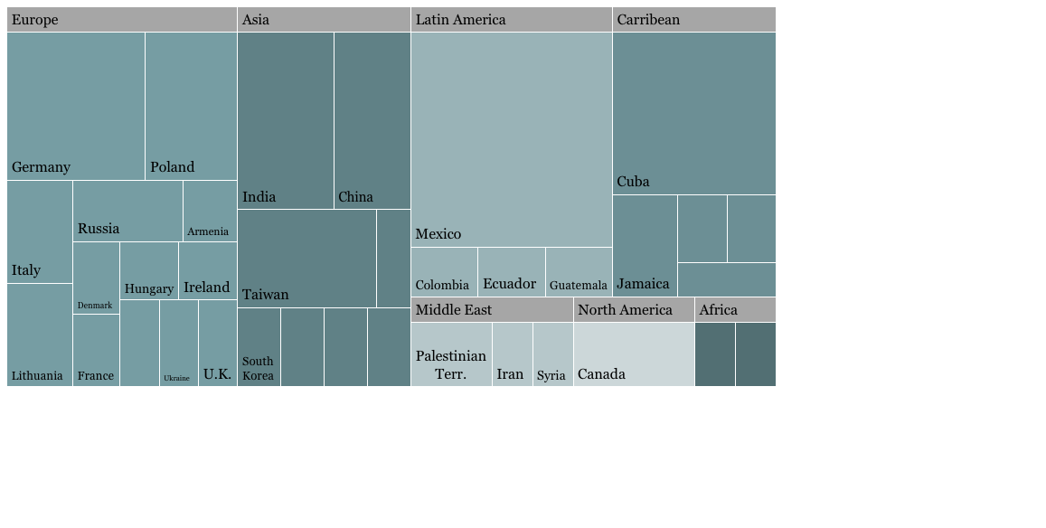
At least 13% of all voting members of the 116th Congress are immigrants or children of immigrants, with heritage in 37 countries
Birthplace and parentage of immigrants and children of immigrants in the 116th Congress, by country
Bermuda
Dominican Rep.
Japan
Trinidad and Tobago
Switzerland
Philippines
Thailand
Vietnam
Eritrea
Somalia
*Includes the Gaza Strip and the West Bank
Sources: Abigail Geiger, “In the 116th Congress, at least 13% of lawmakers are immigrants or the children of immigrants,” Pew Research Center, January 24, 2019.
Danari White | Slide last updated on: January 28, 2019

Slide 7
24 states are represented by immigrants and children of immigrants; nearly half of immigrants represent Western states
States represented by immigrants and children of immigrants, by region
■ Immigrant ■ Child of immigrant
Sources: Abigail Geiger, “In 116th Congress, at least 13% of lawmakers are immigrants or the children of immigrants,” Pew Research Center, January 24, 2019.
Danari White | Slide last updated on: January 28, 2019

Slide 8
Roadmap
Ethnic/racial composition
Immigrants and children of immigrants
Gender composition
LGBTQ+ representation
Generational composition
Religious composition
Spotlight: House freshmen by age, race and gender

Slide 9
116th Congress (2019-2020) by gender
Senate
House
Female
Male
*1 House race remains uncalled
Sources: ”The Women Candidate Tracker,” Politico. November 12, 2018.
Alice Johnson | Slide last updated on: January 8, 2019

Slide 10
More Democratic women serve in the 116th Congress than Republican women
An overview of women who serve in the Senate and House, by party
Republican incumbent
Democratic incumbent
Republican new member
Democratic new member
Senate
House
Sources: “2018 Summary of Women Candidates,” Rutgers University
Alice Johnson | Slide last updated on: November 28, 2018

Slide 11
Women candidates in the midterm election broke a number of long-standing barriers when they won
Historic firsts as congressional candidates
Ayanna Pressley (MA)
First black woman in Congress from Massachusetts
Janet Mills (ME)
First female governor of Maine
Veronica Escobar (TX) & Sylvia Garcia (TX)
First Latinas in Congress from Texas
Alexandria Ocasio-Cortez (NY) & Abby Finkenauer (IA)
Youngest women elected to Congress
Marsha Blackburn (TN)
First woman senator from Tennessee
Jahana Hayes (CT)
First black woman in Congress from Connecticut
Deb Haaland (NM) & Sharice Davids (KS)
First Native American women in Congress
Rashida Tlaib (MI) & Ilhan Omar (MN)
First Muslim women in Congress
Sources: ”9 women to watch from this year’s midterms,” Vox. July 25, 2018; Jeremy W. Peters and Jonathan Martin, “Groundbreaking Night for Women and Diversity, While a Trump Critic Falls,” August 14, 2018; Kayla Epstein and Eugene Scott, “The Historic Firsts of the 2018 Midterms,” The Washington Post. November 7, 2018.
Alice Johnson | Slide last updated on: January 8, 2019

Slide 12
More women were elected this year than in any other congressional session
Number of newly elected (non-incumbent) women, by congressional session (65th to 116th)
AS OF NOVEMBER 28, 2018
The previously held record for newly elected women in Congress was in the 1992 elections, also dubbed the “Year of the Woman”
Sources: “Women Representatives and Senators by Congress, 1917-Present,” US House of Representatives.
Alice Johnson | Slide last updated on: November 28, 2018

Slide 13
The number of total women in Congress has grown steadily since the first woman was elected in 1916
Number of women in the House and Senate
AS OF NOVEMBER 28, 2018
■ Members of the House and Senate ■ House only (including non-voting members) ■ Senators only
Sources: “Women in Congress: Statistics and Brief Overview,” Congressional Research Service; “The Women Candidate Tracker,” Politico. November 12, 2018.
Alice Johnson | Slide last updated on: November 28, 2018

Slide 14
Roadmap
Ethnic/racial composition
Immigrants and children of immigrants
Gender composition
LGBTQ+ representation
Generational composition
Religious composition
Spotlight: House freshmen by age, race and gender

Slide 15
There are ten total Members of Congress who openly identify as LGBTQ+
116th Congress (2019-2020) by sexual orientation
NUMBER OF MEMBERS IN BOTH CHAMBERS OF CONGRESS
■ Not openly LGBTQ+ ■ Openly gay ■ Openly lesbian ■ Openly bisexual
House
Senate
Sources: Daily Kos analysis of member demographics.
Danari White | Slide last updated on: January 8, 2019

Slide 16
There are five LGBTQ+ members returning to Congress (2019-2020)
Senate
Name | Party-State | First elected | Sexuality
Tammy Baldwin | D-WI | 2012 | Lesbian
House of Representatives
Name | Party-State- District | First elected | Sexuality
David Cicilline | D-RI-1 | 2010 | Gay
Mark Pocan | D-WI-2 | 2012 | Gay
Mark Takano | D-CA-41 | 2012 | Gay
Sean Patrick Maloney | D-NY-18 | 2012 | Gay
Sources: Daily Kos analysis of member demographics
Slide updated: January 08, 2019

Slide 17
Roadmap
Ethnic/racial composition
Immigrants and children of immigrants
Gender composition
LGBTQ+ representation
Generational composition
Religious composition
Spotlight: House freshmen by age, race and gender

Slide 18
Younger generations acquired a larger share of the House in the 2018 elections
Generational breakdown of the incoming and incumbent representatives
Analysis
The ages of the 116th Congress range from 29.2 to 85.6
The median age of incoming House Republicans is 48.9, younger than that of continuing House Republicans (58.4)
The median age of incoming House Democrats is 45.8, down from the median age of continuing members (65.3)
■ Millennial (1981-1996) ■ Gen X (1965-1980)
■ Boomer (1946-1964) ■ Silent (1928-1945)
115th Congress
116th Congress
1.1%
Sources: Drew DeSilver, “Millennials, Gen X increase their ranks in the House, especially among Democrats,” Pew Research, November 21, 2018.
Danari White | Slide last updated on: December 4, 2018

Slide 19
Roadmap
Ethnic/racial composition
Immigrants and children of immigrants
Gender composition
LGBTQ+ representation
Generational composition
Religious composition
Spotlight: House freshmen by age, race and gender

Slide 20
Congress is slightly more religiously diverse in 2019 than it was in 2018
Religious composition of the House of Representatives
TOTAL NUMBER, 116th CONGRESS (2019-2020)
■ Democrats ■ Republicans
Highlights
The 116th Congress has first two Muslim women to serve in the House of Representatives
Christians in Congress are overrepresented; however, the combined chambers saw a 3% decrease in Christian membership following the 2018 midterm elections
All Hindus, Muslims and Unitarians are in the House
Sources: Pew Center Research, “Faith on the Hill: The religious composition of the 116th Congress,” Jan. 3, 2019; Aleksandra Sandstrom, “Faith on the Hill: The religious composition of the 115th Congress,” Pew Research Center, Jan. 3, 2017.
Danari White | Slide last updated on: January 8, 2019

Slide 21
Both chambers saw an increase in members who do not specify a religious affiliation
Religious composition of the Senate
TOTAL NUMBER, 116th CONGRESS (2019-2020)
■ Democrats ■ Republicans
Highlights
The Senate gained its first member to identify as religiously unaffiliated with the election of Senator Kyrsten Sinema (D-AZ)
The Senate is less religiously diverse than the other Chamber, as all of the Hindus and Muslims are in the House
The Senate has a higher percentage of Jewish members than the House, at 8% to 6%
Sources: Pew Center Research, “Faith on the Hill: The religious composition of the 116th Congress,” Jan. 3, 2019; Aleksandra Sandstrom, “Faith on the Hill: The religious composition of the 115th Congress,” Pew Research Center, Jan. 3, 2017.
Danari White | Slide last updated on: January 8, 2019

Slide 22
Protestants still comprise majorities in both chambers, but the share of this denomination has decreased over time
Changes in religious composition of Congress, 1961-2019
TOTAL NUMBER OF MEMBERS
■ Protestant ■ Catholic ■ Mormon ■ Orthodox Christian ■ Jewish ■ Other ■ Don’t know/refused
Sources: Pew Center Research, “Faith on the Hill: The religious composition of the 116th Congress,” Jan. 3, 2019; Aleksandra Sandstrom, “Faith on the Hill: The religious composition of the 115th Congress,” Pew Research Center, Jan. 3, 2017.
Danari White | Slide last updated on: January 8, 2019

Slide 23
Roadmap
Ethnic/racial composition
Immigrants and children of immigrants
Gender composition
LGBTQ+ representation
Generational composition
Religious composition
Spotlight: House freshmen by age, race and gender

Slide 24
The incoming House Democratic class will be among the youngest and most diverse yet
Proportion of House Democratic freshmen with selected characteristics
Age
Race/Ethnicity
Gender
Sources: Daily Kos analysis of member demographics
Slide last updated on: December 19, 2018

Slide 25
The incoming House Republican class is less racially diverse than the previous House Republican class
Proportion of House Republican freshmen with selected characteristics
Age
Race/Ethnicity
Gender
Sources: Daily Kos analysis of member demographics
Slide last updated on: December 19, 2018

