Slide 1
2019 governor profiles
December 3, 2018
Producer
National Journal Presentation Center

Slide 2
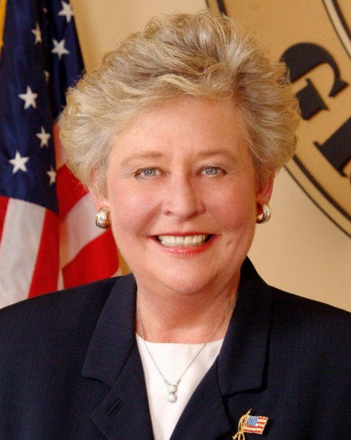
Gov. Kay Ivey (R-AL)
Background
Kay Ivey grew up in the small town of Camden, AL. Her first exposure to politics was in 1962 when she represented her high school at Alabama Girls State as lieutenant governor. She attended Auburn University and served in the Student Government Association all four years. She began getting involved in state politics while coordinating on-campus efforts for Lurleen Wallace’s gubernatorial campaign. After graduation she was offered a position on Wallace’s staff but turned it down to get married and move with her then-husband to California. She taught high school in California for several years before returning to Alabama to work with Merchants National Bank. In 1979, she left the bank to serve in Gov. Fob James’ cabinet. She then went on to serve as director of government affairs and communications for the Alabama Commission on Higher Education. Her first experience running for public office was her campaign to become state treasurer in 2002. She won her race and was re-elected in 2006. During her time as treasurer, she oversaw the state’s PACT program which allowed parents to pay college tuition years in advance. While in 2003 the program was one of the soundest college savings plan in the country, it collapsed during the 2008 financial crisis and was forced to settle a class-action lawsuit filed by contract holders. After reaching her term limit as state treasurer, she attempted to run for governor. The failure of the PACT program followed her campaign, leading Ivey to drop out of the race and run for lieutenant governor instead. She was elected in 2010 and won re-election in 2014. In 2017, Gov. Robert Bentley resigned ahead of an impeachment hearing related to an alleged affair. Ivey assumed the role, becoming the state’s second female governor.
Biography
Assumed office: 2017
Party: Republican
Birth Date: 10/15/1944
Education: BA, Auburn University
Family: Single
Election Results
2018 General
Kay Ivey (R) | 60%
Walter Maddox (D) | 40%
Notes:
https://www.nationaljournal.com/almanac/person/4715

Slide 3
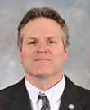
Gov. Mike Dunleavy (R-AK)
Background
Dunleavy was born in Scranton, Pennsylvania in 1961. He has a BA in history from Misercordia University and an MA in education from the University of Alaska Fairbanks. He has lived in Alaska since the early 1980s. Dunleavy has worked as director of K-12 outreach for the University of Alaska, program manager of the Alaska Statewide Mentor Project and owner of Dunleavy Educational Services. From 2013 to 2017, he was a member of the Alaska Senate, representing District E. In his 2018 gubernatorial campaign, Dunleavy emphasized Alaska’s high unemployment and crime rates, as well as its declining private sector investment, which he claimed was the result of incumbent Governor Bill Walker’s administration. He presented himself as the candidate that would restore prosperity and order to Alaska, highlighting his record in the Alaska Senate. In addition, he committed to investing in public safety and preserving the Permanent Fund Dividend program.
Biography
First Elected: 2018
Party: Republican
Birth Date: 05/05/1961
Education: MA, Education, University of Alaska Fairbanks, 1986-1991;BA, History, College Misericordia, 1983
Family: Spouse: Rose; 3 Children: Maggie, Catherine, Ceil Ann
Election Results
2018 General
Mike Dunleavy (R) | 52%
Mark Begich (D) | 44%

Slide 4
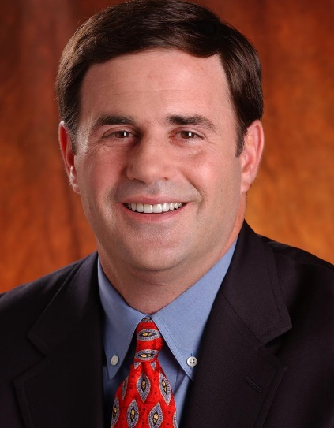
Gov. Doug Ducey (R-AZ)
Background
Doug Ducey was born on April 9, 1964 in Toledo, Ohio, where he attended St. John’s Jesuit High School. After graduating with a degree in finance from Arizona State University and working briefly for Procter & Gamble, Ducey co-founded Cold Stone Creamery, eventually becoming CEO. The ice cream store chain grew to more than 1,400 stores. After a difficult merger with Khala Corp., Ducey became chairman of a friend’s home movies startup, iMemories, where he was also the lead investor. Ducey parlayed that business experience into a successful 2010 campaign for state treasurer. When GOP Gov. Jan Brewer was term-limited four years later, Ducey ran the state’s top job as a self-styled “conservative ice cream guy,” winning both the GOP primary and November general election against former gubernatorial aide, Fred DuVal, by low double digits. Ducey has governed as a business-focused Republican, tackling state spending, education, and taxes while avoiding hot topics like immigration. Ducey won re-election in the November 2018 midterms. He told National Journal in late 2016, he is “focusing on the economy, K-12 education, public safety—these aren’t partisan issues.”
Biography
First Elected: 2014
Party: Republican
Birth Date: 04/09/1964
Education: BS, Arizona State University, 1986
Family: Spouse: Angela; 3 Children
Election Results
2018 General
Doug Ducey (R) | 56%
David Garcia (D) | 41%
Notes:
https://www.nationaljournal.com/almanac/person/4694

Slide 5
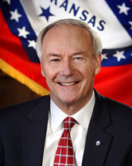
Gov. Asa Hutchinson (R-AR)
Background
Republican Asa Hutchinson was elected governor of Arkansas in 2014, after previously losing the gubernatorial election in 2006. He was born in Bentonville, the home of Wal-Mart, and later attended the conservative Christian Bob Jones University in South Carolina. He earned his law degree at the University of Arkansas and then practiced law in Fort Smith, AR. President Ronald Reagan appointed Hutchinson to be a U.S. attorney for the state of Arkansas, where he notably prosecuted the white supremacist group CSA. He ran for Congress in 1986, but lost the election to incumbent Democratic Senator Dale Bumpers. Hutchinson easily won an election to the House in 1996 to succeed his brother, who moved to the Senate. He combined a conservative voting record with a pleasant demeanor to become an important player in a short time, and served as one of the House's impeachment managers against Clinton in 1998. When George W. Bush became president, he tapped Hutchinson to head the Drug Enforcement Administration, then as undersecretary for transportation and border security in the new Homeland Security Department. Hutchinson returned to Arkansas to run for governor in 2006, but lost, and worked as a consultant and investor in Washington and Arkansas. When the incumbent reached his term limit, Hutchinson ran for election and won with 55% of the vote. Hutchinson has been a socially conservative governor. He also expanded Medicaid under Obamacare, but received a waiver so that the state can use Medicaid funds to buy exchange plans for recipients.
Biography
First Elected: 2014
Party: Republican
Birth Date: 12/03/1950
Education: BS, Bob Jones University, 1972; JD, University of Arkansas, 1975
Family: Spouse: Susan; 4 Children; 6 Grandchildren
Election Results
2018 General
Asa Hutchinson (R) | 65%
Jared Henderson (D) | 31%
Notes:
https://www.nationaljournal.com/almanac/person/4618

Slide 6
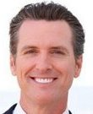
Gov. Gavin Newsom (D-CA)
Background
Before entering politics, Newsom ran the PlumpJack Group, 23 businesses named for an opera written by a family friend. PlumpJack began with a San Francisco wine store which Newsom founded soon after graduating from college. Newsom's political career began on the San Francisco board of supervisors, a position he held from 1997-2004; one of his key initiatives was reforming the "Muni" transit system. Newsom became mayor of San Francisco in 2004 and served until 2011. As mayor, he created a plan for universal health care and issued marriage licenses to same-sex couples, despite the illegality same-sex marriage under California law at the time. Newsom served as Gov. Jerry Brown's lieutenant governor since 2011. As lieutenant governor, Newsom endorsed a ballot measure for legalizing marijuana and two different measures which would have abolished capital punishment.
Biography
First Elected: 2018
Party: Democrat
Birth Date: 10/10/1967
Education: BA, Political Science, Santa Clara University, 1989
Family: Spouse: Jennifer; 3 Children: Montana, Hunter, Brooklynn
Election Results
2018 General
Gavin Newsom (D) | 59%
John Cox (R) | 41%

Slide 7
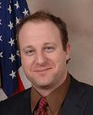
Gov. Jared Polis (D-CO)
Background
Polis is the first openly gay man elected to Congress. He was born in Boulder, but grew up in San Diego, returning to Colorado with his family during the summers. Several successful business ventures, including American Information Systems, an internet access provider; bluemountainarts.com and Proflowers.com, a flower delivery service, made Polis a multimillionaire and one of the wealthiest members of Congress. When Democratic Rep. Mark Udall in Colorado’s 2nd District decided to run for an open Senate seat in 2008, Polis ran for Udall’s House seat. In 2009, Polis jumped into the health care debate, taking a leading role in fighting a proposal by his own party that would pay for elements of the overhauled system with a tax on wealthy Americans. Polis is an impressive fundraiser, collecting from liberal interest groups and investment companies and donating money to politically vulnerable Democrats through his Jared Polis Victory Fund. In June 2017, Polis announced his candidacy for Governor of Colorado, winning the Democratic primary in June 2018.
Biography
First Elected: 2018
Party: Democrat
Birth Date: 05/12/1975
Education: BA, Political Science, Princeton University, 1992-1996
Family: Partner: Marlon Reis; 2 Children
Election Results
2018 General
Jared Polis (D) | 52%
Walker Stapleton (R) | 45%

Slide 8
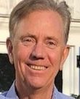
Gov. Ned Lamont (D-CT)
Background
Lamont was born in Washington, DC. He attended Phillips Exeter Academy, Harvard and the Yale School of Management. After graduating from Yale, Lamont worked in the cable television industry, first managing a start-up and later founding his own cable television company, Campus Televideo. He became a member of both the Greenwich Board of Selectmen and the Board of Estimate and Taxation, where he managed the budget. He also was chair of the State Investment Advisory Council, where he oversaw the investment of state pension funds. In 2006, he ran for the US Senate and defeated Sen. Joe Lieberman in the Democratic primary, but then lost to Lieberman, who ran as an independent candidate, in the general election. In 2010, Lamont ran to be the Democratic nomination for governor of Connecticut, but lost to Stamford Mayor Dan Malloy, who eventually became governor.
Biography
First Elected: 2018
Party: Democrat
Birth Date: 01/03/1954
Education: MBA, Yale School of Management, 1978-1980;Graduated, Harvard University, 1972-1976
Family: Spouse: Annie; 3 Children: Teddy, Lindsay, Emily
Election Results
2018 General
Ned Lamont (D) | 49%
Bob Stefanowski (R) | 46%

Slide 9
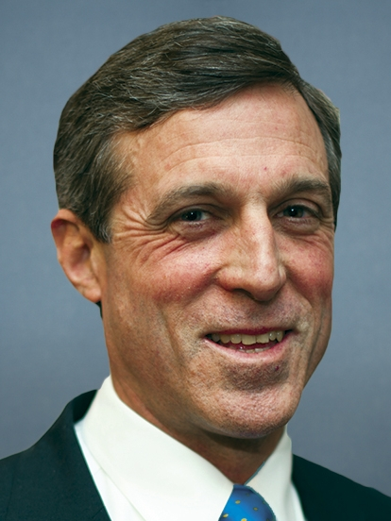
Gov. John Carney (D-DE)
Background
Democrat Carney serves as the 74th Governor of Delaware. Not long after taking office, he co-founded a policy group of Democrats and Republicans to discuss finding common ground. Carney has lived in Wilmington for most of his life, and spent nearly his entire adult life in public office, except for brief stints as president and chief operating officer of Transformative Technologies, a Delaware green technology firm, and as executive vice president of a wind farm start-up called DelaWind. After getting a degree in English at Dartmouth College and a master’s degree in public administration at the University of Delaware, Carney went to work as an aide to Senator Joe Biden. Carney was also the state secretary of finance under Carper from 1997 to 2000. In 2000, he won the first of two terms as Delaware’s lieutenant governor. Carney later ran for the at-large seat in the House and prevailed with 57% of the vote, a rare instance of a Democrat seizing Republican territory in the GOP-friendly year of 2010. Carney was assigned to the Financial Services Committee and struck up a friendship with fellow freshman James Renacci, a Republican from Ohio. They started a breakfast group that eventually grew to 14 lawmakers. Carney joined another GOP freshman, Stephen Fincher of Tennessee, in drafting legislation to make it easier for small and medium-sized companies to undertake an initial public offering and become a public firm. Their measure passed the committee and became law two months later. In 2016, Carney ran unopposed for the Democratic nomination for governor and then went on to win the general election.
Biography
First Elected: 2016
Party: Democrat
Birth Date: 05/20/1956
Education: BA, Dartmouth College, 1978; MPA, University of Delaware, 1987
Family: Spouse: Tracey; 2 Children
Election Results
2016 General
John Carney (D) | 58%
Colin Bonini (R) | 39%
Notes:
https://www.nationaljournal.com/almanac/person/1836
https://en.wikipedia.org/wiki/Delaware_gubernatorial_election,_2016

Slide 10
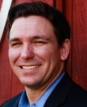
Gov. Ron DeSantis (R-FL)
Background
DeSantis grew up in northeast Florida. He attended Yale University and Harvard Law School. After, DeSantis commissioned in the U.S. Navy as a JAG officer, working at Guantanamo Bay and in Iraq, as an adviser to a U.S. Navy SEAL commander. Outside of his military service, DeSantis worked as a federal prosecutor. In 2012, DeSantis won a seat in the House, representing Florida’s 6th district. In Congress, DeSantis championed legislation to make it easier for the military to prosecute sexual assault. DeSantis is a proponents of working to stop toxic algae discharges. He also supports immigration reform, including enacting E-verify and not allowing sanctuary cities in Florida.
Biography
First Elected: 2018
Party: Republican
Birth Date: 09/14/1978
Education: BA, History, Yale University;JD, Harvard Law School
Family: Spouse: Casey; 2 Children: Madison, Mason
Election Results
2018 General
Ron DeSantis (R) | 50%
Andrew Gillum (D) | 49%

Slide 11
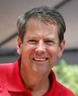
Gov. Brian Kemp (R-GA)
Background
Kemp was raised in Athens, Georgia and later attended the University of Georgia, where he graduated with a BS in agriculture. After graduating, Kemp was a home builder and developer, owning the Athens-based business Kemp Properties. First elected as a Georgia State Senator in 2003, Kemp served for four years in the state legislature. He then ran for agriculture commissioner of Georgia, but came second in the primary. Kemp was appointed in 2010 as Georgia’s secretary of state, and won the 2010 election, as well as reelection in 2014. In March 2017, Kemp announced his candidacy for governor of Georgia. Key aspects of his platform include promoting economic development and investment in rural Georgia, placing caps on state spending, combating street violence and reducing state regulations.
Biography
First Elected: 2018
Party: Republican
Birth Date: 11/02/1963
Education: BS, Agriculture, University of Georgia
Family: Spouse: Marty; 3 Children: Jarrett, Lucy, Amy Porter
Election Results
2018 General
Brian Kemp (R) | 50%
Stacey Abrams (D) | 49%

Slide 12
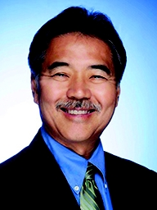
Gov. David Ige (D-HI)
Background
Democrat David Ige became Hawaii's eighth governor in 2014, coming on the heels of a dramatic primary upset in August over Gov. Neil Abercrombie. He took the office as a seasoned state legislator, having served most recently as the chairman of the state Senate's tax-writing committee. Ige built a reputation as a policy expert, working on issues ranging from education reform to auto insurance to land conservation. His years of committee work paid off when he rose to chair the Senate Ways and Means Committee in 2009. In addition to helping guide Hawaii's recent fiscal turnaround—thanks to a tourism surge combined with budget cuts—Ige introduced legislation to shore up pension and health care plans for state retirees so that Hawaii would not run into a Detroit-style crunch. Ige played up his image of quiet competence. That message resonated as the primary battle went on, and in a shocker, Abercrombie lost by a staggering 35 percentage points. Ige's next challenge was making sure that Hannemann didn't draw away too many centrist voters who would otherwise vote Democratic. By October, however, polls showed Ige consolidating his lead. He ended up winning with 49.5 percent of the vote. Upon taking office in December, Ige spoke of "hard work" ahead for the state. "It means taking a more active role in growing small business and diversifying our economic engine, as well as in supporting our larger and more established industries," he said. At the same time, he added, "It means doing the people’s business in a business-like way; being honest and transparent; watching closely how we spend the people’s money; and being accountable for all that we do.”
Biography
First Elected: 2014
Party: Democrat
Birth Date: 01/15/1957
Education: BS, University of Hawaii-Manoa, 1979; MBA, 1985
Family: Spouse: Dawn; 3 Children
Election Results
2018 General
David Ige (D) | 63%
Andria Tupola (R) | 34%
Notes:
https://www.nationaljournal.com/almanac/person/4533
https://en.wikipedia.org/wiki/Hawaii_gubernatorial_election,_2018

Slide 13
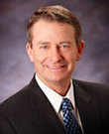
Gov. Brad Little (R-ID)
Background
Little was born in Emmett, Idaho. He attended the University of Idaho and earned a BS in Agribusiness. After graduation, he returned to work at his family’s ranch, Little Land and Livestock Company. He eventually became the owner and general partner, and serves on the boards of Home Federal Bank and Performance Design Incorporated. Little first entered politics when he was appointed to fill a vacant seat in the Idaho State Senate. He was then elected and re-elected to the seat four times and became the Republican Caucus chairman. In 2009, Little was appointed to lieutenant governor of Idaho. As governor, Little plans to allow all college and universities to keep the sales tax that is generated on their campuses to control tuition costs. He also plans to cut the income tax for Idahoans by $350 million.
Biography
First Elected: 2018
Party: Republican
Birth Date: 02/15/1954
Education: BS, Agribusiness, University of Idaho, 1976
Family: Spouse: Teresa; 2 Children: Adam, David
Election Results
2018 General
Brad Little (R) | 60%
Paulette Jordan (D) | 38%

Slide 14
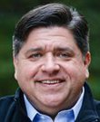
Gov. JB Pritzker (D-IL)
Background
Pritzker was born in California. The Pritzker family own the Hyatt hotel chain. It is estimated that his net worth is $3.5 billion. In 1998, Pritzker ran for the House in Illinois’ 9th district. He then served as a trustee of Northwestern University and was the Chair Emeritus of ChicagoNEXT, Rahm Emmanuel’s council on technology. Pritzker ran a progressive campaign for governor of Illinois, with a focus on immigration, creating more jobs and legalizing marijuana in the state. Like many other Democrats, Pritzker also ran on the platform of expanding the ACA and access to healthcare. The Illinois governor race was one of the most expensive races in US history, with Rauner and Pritzker injecting the race with millions of their own funds.
Biography
First Elected: 2018
Party: Democrat
Birth Date: 01/19/1965
Education: JD, Corporate, Finance, and Securities Law, Northwestern University School of Law, 1990-1993;AB, Political Science & Government, Duke University
Family: Spouse: M.K.; 2 Children: Teddi, Donny
Election Results
2018 General
JB Pritzker (D) | 54%
Bruce Rauner (R) | 39%

Slide 15
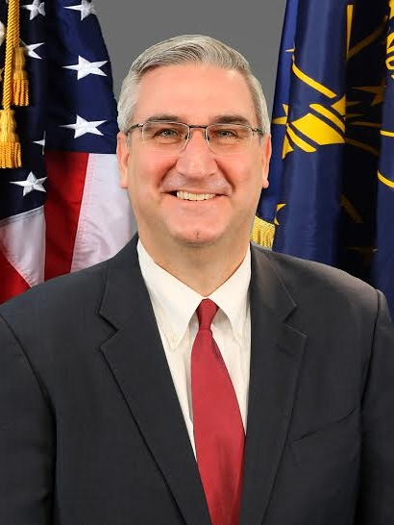
Gov. Eric Holcomb (R-IN)
Background
Eric Holcomb was born in 1968 in Indianapolis, Indiana. He spent six years in the U.S. Navy after receiving his bachelor’s of arts in U.S. history from Hanover College in 1990. He was stationed in Jacksonville, Florida and took a special duty in Lisbon, working in an underground NATO war headquarters. After his service, he began working for U.S. Representative John Hostettler in 1997. Holcomb ran for the Indiana House of Representatives in 2000, but was defeated by John Frenz. Holcomb later managed Mitch Daniels’ campaign for governor in 2007, subsequently serving in Daniels’ administration as deputy chief of staff, managing his re-election campaign and overseeing the governor’s state political action committee. Holcomb became the state chairman of the Indiana Republican Party from 2011 to 2013 and then state chief of staff for U.S. Senator Dan Coats from 2013 to 2015. Holcomb decided to run for the U.S. Senate after Coats announced his resignation, but withdrew in February 2016. Days later, Lieutenant Governor Sue Ellspermann announced her resignation, and Holcomb was chosen by Mike Pence to replace her. When Pence withdrew from the 2016 gubernatorial race to be Donald Trump’s running mate in the presidential race, Holcomb announced that he would seek the gubernatorial nomination.
Biography
First Elected: 2016
Party: Republican
Birth Date: 05/02/1968
Education: BA, Hanover College, 1990
Family: Spouse: Janet
Election Results
2016 General
Eric Holcomb (R) | 51%
John Gregg (D) | 45%
Notes:
https://www.nationaljournal.com/almanac/person/4691

Slide 16
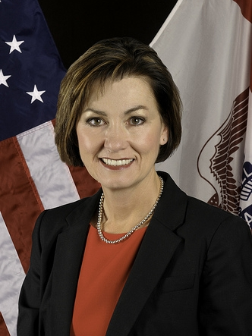
Gov. Kim Reynolds (R-IA)
Background
Republican Kim Reynolds was first elected as Iowa’s lieutenant governor in 2010, won re-election in 2014 and became governor when former Governor Terry Branstad was appointed as the U.S. ambassador to China. In her position as lieutenant governor, Reynolds served on the STEM Advisory Council, the Iowa Partnership for Economic Progress board, the Military Children Education Coalition and the Iowa State Fair board. Before her position as lieutenant governor, Reynolds was elected to the Iowa State Senate in 2008 and served as the state senator for the 48th district until 2010. She also served as an at-large delegate for Iowa at the 2016 Republican National Convention. Earlier, Reynolds was a pharmacist assistant and then worked at the Clarke County Treasurer’s Office, Department of Motor Vehicles. From 1996 to 2001, she was a board member of the Iowa Public Employees Retirement System. Her position as the governor of Iowa brings her into the spotlight of national Republican politics and she has already met with President Trump multiple times. She won her first election to serve a full term as governor in 2018.
Biography
Assumed office: 2017
Party: Republican
Birth Date: 08/04/1959
Education: Attended Northwest Missouri State University, 1977-1980
Family: Spouse: Kevin; 3 Children; 9 Grandchildren
Election Results
2018 General
Kim Reynolds (R) | 50%
Fred Hubbell (D) | 48%
Notes:
https://www.nationaljournal.com/almanac/person/4707
https://en.wikipedia.org/wiki/Iowa_gubernatorial_election,_2018

Slide 17
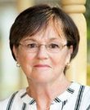
Gov. Laura Kelly (D-KS)
Background
Kelly earned a BS in psychology from Bradley University and an MS in Park and Recreation Administration with an emphasis in therapeutic recreation from Indiana University Bloomington. She served as the executive director of the Kansas Recreation and Park Association for 16 years and as director of Recreation Therapy and Physical Education at the National Jewish Hospital for Respiratory and Immune Diseases. Kelly was first elected to the Kansas State Senate in 2004, where she became the minority whip and later the assistant minority leader. She was also the ranking member on the Ways and Means committee. Kelly defeated former Kansas Secretary of State Kris Kobach, in the election to become governor.
Biography
First Elected: 2018
Party: Democrat
Birth Date: 01/24/1950
Education: BS, Psychology, Bradley University;MS, Park and Recreation Administration, emphasis in Therapeutic, Indiana University Bloomington
Family: Spouse: Ted; 2 Children: Kathleen, Molly
Election Results
2018 General
Laura Kelly (D) | 48%
Kris Kobach (R) | 43%

Slide 18
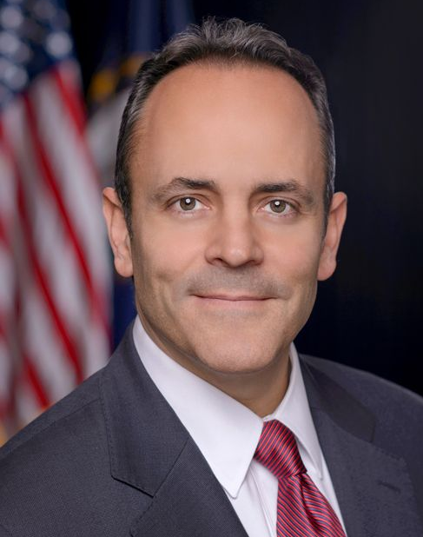
Gov. Matt Bevin (R-KY)
Background
Republican Matt Bevin was elected Governor of Kentucky in 2015. After going to Washington and Lee University on a four-year ROTC scholarship, Bevin spent four years as an officer in the U.S. Army and rose to the rank of captain. When he completed his military service he worked in the financial industry. Bevin and his wife, Glenna, moved to Kentucky in 1999 to work at National Asset Management. He later went on to found manufacturing and technology companies in Kentucky and across the United States. In 2011, Bevin became president of his family’s bell-making company, Bevin Brothers, which has operated since 1832. Bevin rose to political prominence when he unsuccessfully challenged then-Senate Minority Leader Mitch McConnell in 2014. He made his political comeback within a year, when he narrowly defeated a gubernatorial field of Republicans in the primary, including the establishment favorite. He went on to defeat then-Attorney General Jack Conway to replace term-limited Democratic Gov. Steve Beshear. Throughout his first year in office, Bevin publicly battled with the Democratic-controlled House, former Gov. Beshear and state Attorney General Andy Beshear, the former governor’s son. After Republicans flipped the House in 2016, Bevin signed in short order “right-to-work” legislation and banned abortions after 20 weeks. His current term ends in 2019.
Biography
First Elected: 2015
Party: Republican
Birth Date: 01/09/1967
Education: BA, Washington & Lee University, 1989
Family: Spouse: Glenna; 10 Children (1 deceased)
Election Results
2015 General
Matt Bevin (R) | 53%
Jack Conway (D) | 44%
Notes:
https://www.nationaljournal.com/almanac/person/4692
https://ballotpedia.org/Matt_Bevin

Slide 19
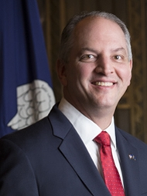
Gov. John Bel Edwards (D-LA)
Background
Democrat John Bel Edwards was elected governor of Louisiana in 2015 after a heated four-way primary against three Republicans and a runoff election against former Republican Sen. David Vitter. Vitter’s campaign was dogged by a prostitution scandal earlier in his career and Vitter was attacked by both his Democratic and Republican opponents over the matter during the primary, which aided Edwards in the runoff. Edwards was also buoyed by the unpopularity of outgoing two-term Republican Gov. Bobby Jindal, who left the state with a large budget deficit and had become personally unpopular due to his interest in a 2016 presidential run. Before Edwards was elected governor, he served four two-year terms in the Louisiana State House and served as chairman of the house Democratic caucus. Edwards is a graduate of the U.S. Military Academy at West Point, and served eight years in the U.S. Army before attending law school at Louisiana State University. Edwards’ unique blend of military experience and cultural conservatism allowed him to make a moral case against Vitter in the 2015 governor’s race and win over enough independents and Republicans to handily win the runoff. Edwards is currently the only Democratic governor in the Deep South and plans to run for reelection in 2019. He has expressed willingness to work with President Trump’s cabinet on Medicaid expansion and federal infrastructure projects.
Biography
First Elected: 2015
Party: Democrat
Birth Date: 09/16/1966
Education: BA, US Military Academy, 1988; JD, Louisiana State University, 1999
Family: Spouse: Donna; 3 Children
Election Results
2015 General
John Bel Edwards (D) | 56%
David Ritter (R) | 44%
Notes:
https://www.nationaljournal.com/almanac/person/4693

Slide 20
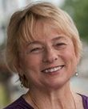
Gov. Janet Mills (D-ME)
Background
Mills was born in Farmington, Maine. She obtained her BA from the University of Massachusetts, Boston, before going on to receive her JD from the University of Maine School of Law. From 1976 to 1980, she worked as an assistant attorney general for Maine. She then became district attorney for Androscoggin, Franklin and Oxford counties in 1980. This made her the first woman district attorney in New England. In 2002, she became a representative in the Maine House of Representatives. She served from 2002-2010, after which time she became the vice chair of the Maine Democratic Party. From 2012-2018, she has again served as attorney general. During her 2018 campaign to become governor of Maine, she voiced her support for implementing universal pre-K education for every four-year old in Maine, expanding Medicaid, limiting the effects of rollbacks of ACA protections in Maine and protecting abortion rights in the state.
Biography
First Elected: 2018
Party: Democrat
Birth Date: 12/30/1947
Education: BA, University of Massachusetts, Boston;JD, University of Maine School of Law
Family: Spouse: Stanley; 5 Step-Children
Election Results
2018 General
Janet Mills (D) | 51%
Shawn Moody (R) | 43%

Slide 21
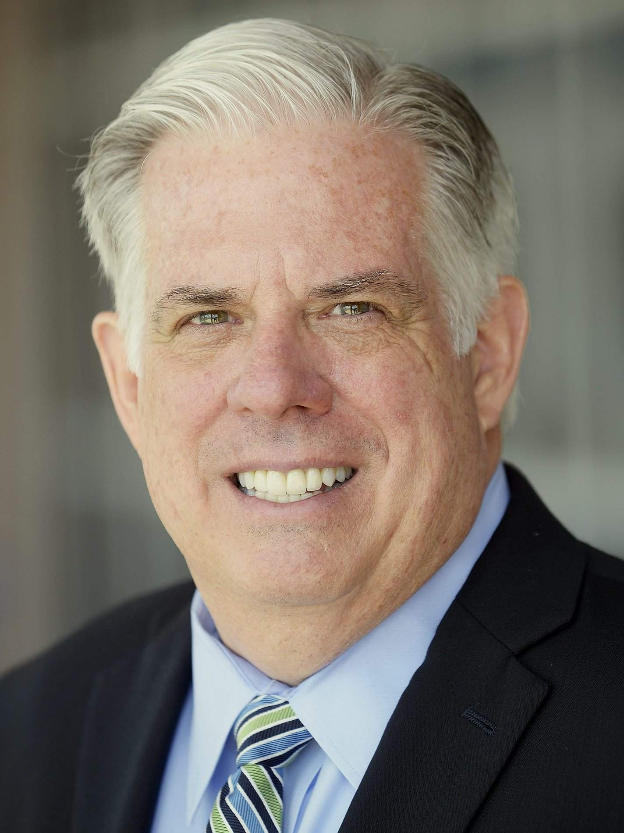
Gov. Larry Hogan (R-MD)
Background
Republican businessman and activist Larry Hogan won a surprise victory in 2014 as governor over Lt. Gov. Anthony Brown in deep-blue Maryland. Hogan relentlessly portrayed Brown's campaign as essentially the third term for outgoing Democratic Gov. Martin O'Malley, who angered moderates and independents by raising taxes and tightening gun-control laws. Hogan grew up immersed in politics: His father, Larry Hogan Sr., served in the U.S. House from 1969 to 1975 and as Prince George's County executive from 1978 to 1982. The younger Hogan graduated from Florida State University and eventually launched an Annapolis-based group of real estate businesses focused on brokerage, consulting, investment, and development. Hogan initially sought elected office in 1992 by challenging Rep. Steny Hoyer after Hoyer's district was reconfigured to extend beyond Prince George's County. He lost, but held Hoyer to 53 percent of the vote. A decade later, when Republican Robert Ehrlich won the governorship, he made Hogan his secretary of appointments, overseeing the appointments of nominees to the executive, legislative, and judicial branches. In 2011, he founded Change Maryland, an anti-tax group that scrutinized the economic impact of the O'Malley administration's actions. He started as an underdog against Brown but repeatedly declared that O'Malley and Brown had raised taxes too often and too much. The national discontent with Obama and the fervency of Hogan's anti-tax message helped push the Republican over the top.
Biography
First Elected: 2014
Party: Republican
Birth Date: 05/25/1956
Education: BA, Florida State University, 1978
Family: Spouse: Yumi; 3 Children
Election Results
2018 General
Larry Hogan (R) | 55%
Ben Jealous (D) | 44%
Notes:
https://www.nationaljournal.com/almanac/person/4622
https://en.wikipedia.org/wiki/Maryland_gubernatorial_election,_2018

Slide 22
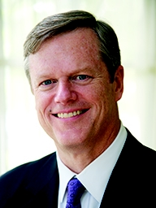
Gov. Charles Baker (R-MA)
Background
Charlie Baker won the Massachusetts governorship in 2014 by tapping two inherent advantages: He's a moderate Republican in a blue state with a history of electing socially liberal, fiscally conservative Republicans to the post. And he was running against Democrat Martha Coakley, the state attorney general still smarting from her upset loss to Scott Brown in the 2010 election to fill the seat of the late Sen. Edward Kennedy. Baker, who was raised in Needham, Mass., served in the administrations of two GOP Massachusetts governors—William Weld and Paul Cellucci—and was the architect of the financial plan for the Big Dig, the Boston tunnel project plagued by delays and cost overruns. Baker went on to become CEO of Harvard Pilgrim Health Care, a nonprofit health benefits organization. Baker ran for and lost the 2010 gubernatorial campaign against Gov. Deval Patrick, who was seeking a second term. But in the 2014 race, Baker was a changed candidate, softening his image from the brash campaigner of 2010 to a more genial—and female-voter-friendly—contender against Coakley. Baker cast himself as a fiscally responsible businessman, able to use his private-sector fiscal skills to heal what he called a poorly run Democratic administration. He emphasized his liberal take on social issues such as abortion and gay marriage. After stumbling with female voters in 2010, Baker picked a woman, Karyn Polito, as his running mate. Baker's GOP status served as something of a plus in deep-blue Massachusetts. He promised to be a check and balance on the heavily Democratic state Legislature.
Biography
First Elected: 2014
Party: Republican
Birth Date: 11/13/1956
Education: BA, Harvard College, 1979; MBA, Kellogg Graduate School of Management, 1986
Family: Spouse: Lauren; 3 Children
Election Results
2018 General
Charles Baker (R) | 67%
Paulette Jordan (D) | 33%
Notes:
https://www.nationaljournal.com/almanac/person/4615
https://en.wikipedia.org/wiki/Massachusetts_gubernatorial_election,_2018

Slide 23
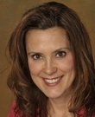
Gov. Gretchen Whitmer (D-MI)
Background
Whitmer was born in Lansing, Michigan. Whitmer attended Michigan State University, where she earned both her undergraduate degree in communications and her JD. After school, she worked as a policy analyst in the Michigan State House of Representatives and was a lecturer on gender and the law at Michigan State University. She also spent time in a private practice, Dickinson Wright, LLC where she worked as an associate attorney and then as counsel. Further, Whitmer was a Towsley Policy Maker in Residence for the Gerald R. Ford School of Public Policy at University of Michigan. She served as prosecutor for Ingham County in 2016. She was a state representative from 2000-2006 and a state senator from 2006-2014. While in the Michigan Senate, she was minority leader from 2011-2014.
Biography
First Elected: 2018
Party: Democrat
Birth Date: 08/23/1971
Education: JD, Detroit College of Law at Michigan State University, 1998;BA, Communications, Michigan State University, 1989-1993
Family: Spouse: Marc; 5 Children: Sherry, Sydney, Mason, Alex, Winston
Election Results
2018 General
Gretchen Whitmer (D) | 53%
Bill Schuette (R) | 44%

Slide 24
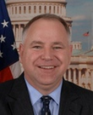
Gov. Tim Walz (D-MN)
Background
Walz, a Democrat first elected to the US House in 2006, has entrenched himself in his rural district by balancing strong support for farmers, military veterans and gun owners with a commitment to the main economic planks of his party’s agenda. Walz joined the Army National Guard when he was 17 and retired from the military in 2005. He earned his teaching degree in Nebraska, taught in China for a year and later established an educational travel company. He and his wife moved to Minnesota in 1996, where he taught high school geography and coached the football team. In 2006, Walz successfully challenged six-term Republican Rep. Gil Gutknecht to win in a historically Republican district. In the House, Walz established a mostly centrist voting record with an emphasis on good-government. In March 2017, Walz announced his bid for governor and beat two competitors in the primary. His lieutenant governor running mate is Peggy Flanagan, who has served in the Minnesota State House since 2015.
Biography
First Elected: 2018
Party: Democrat
Birth Date: 04/06/1964
Education: Attending, Saint Mary's University, present;MS, Educational Leadership, Minnesota State University, Mankato, 2001;BS, Social Science Education, Chadron State College, 1989
Family: Spouse: Gwen; 2 Children: Hope, Gus
Election Results
2018 General
Tim Walz (D) | 54%
Jeff Johnson (R) | 42%

Slide 25
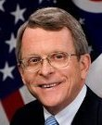
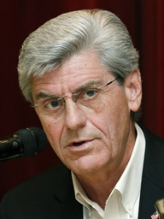
Gov. Phil Bryant (R-MS)
Background
Republican Phil Bryant succeeded term-limited Haley Barbour in 2011. Bryant had served as lieutenant governor under Barbour, and though he lacks his predecessor’s humor and common touch, he has pleased conservatives with his willingness to go even further to the right than Barbour on social issues. Bryant was born in Moorhead in the Mississippi Delta. His father was a diesel mechanic and his mother a homemaker. His family eventually relocated to South Jackson, where Bryant finished up high school. Bryant first ran for office in 1991, winning a state House seat representing Rankin County. In 1996, he was appointed as state auditor by Republican Gov. Kirk Fordice. Bryant was elected to two full terms as auditor in 1999 and 2003 before being elected on the Barbour ticket as lieutenant governor in 2007. He became a favorite of tea party groups for his tough stance on illegal immigration, which included pushing for a law requiring employers to use the E-Verify system for checking the immigration status of new hires. After two terms, Barbour was term-limited and Bryant decided to run for governor himself. Despite his ties to the popular incumbent, Bryant had to fight off four other candidates in the Republican primary. He won with 59% of the vote, with businessman Dave Dennis coming in second with 26%. During his first term, Bryant advocated expanding natural gas usage to help create jobs and offered incentives in the health care industry to bring new doctors to the state. He ran for re-election in 2015 and beat his Democratic opponent by over 30 points.
Biography
First Elected: 2011
Party: Republican
Birth Date: 12/09/1954
Education: BS, University of Southern Mississippi, 1977; MS, Mississippi College, 1988
Family: Spouse: Deborah; 2 Children
Election Results
2015 General
Phil Bryant (R) | 67%
Robert Gray (D) | 32%
Notes:
https://en.wikipedia.org/wiki/Mississippi_gubernatorial_election,_2015
https://www.nationaljournal.com/almanac/person/3491

Slide 26
Gov. Mike Parson (R-MO)
Background
Parson was born and raised in Wheatland, MO. He is an army veteran, having served two tours in the Military Police between 1975 and 1981. After his military service, he became the first criminal investigator at the Polk County Sherriff’s Office in Missouri. In 2004, he was elected to the Missouri House of Representatives, where he served until 2010. As a member of the Missouri House of Representatives, Parson supported a bill to expand Castle Doctrine rights and pledged not to support any legislation that would raise taxes. In 2010, he was elected to the Missouri State Senate. From 2016-2018, he served as lieutenant governor of Missouri. In 2018, he was appointed the governor of Missouri when former governor Eric Greitens resigned. He supports protecting second amendment rights, growing the economy and promoting the agricultural industry, and opposes abortion.
Biography
Assumed Office: 2018
Party: Republican
Birth Date: 09/17/1955
Education: BA, University of Maryland-College Park; University of Hawaii at Manoa
Family: Spouse: Teresa; 2 Children
Election Results
2018 General
Mike Parson (R) | N/A (Appointed)
Notes:
https://www.nationaljournal.com/md/644789/gov-mike-parson-profile?mref=dashboard-featured-1

Slide 27
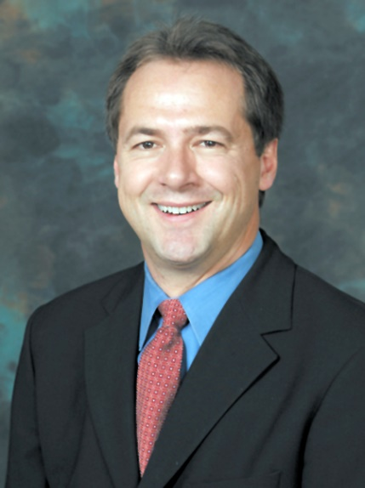
Gov. Steve Bullock (D-MT)
Background
Democrat Steve Bullock was elected governor of Montana in 2012 to replace term-limited Democrat Brian Schweitzer. A popular state attorney general, he beat former Rep. Rick Hill, a Libertarian candidate. In 2012, Bullock ran for governor to replace the term-limited Schweitzer, who by then had developed a national reputation with his folksy social conservatism and efforts to improve Montana’s education system. Bullock portrayed his candidacy as a continuation of Schweitzer’s work. After the primary, he told the Missoulian that the race is about “what sort of progressive Montana we want this to be.” On the campaign trail, he promoted creating better paying jobs in research, technology, and manufacturing while lowering college education costs. He also discussed maintaining the state’s rural identity while responsibly developing its natural resources. In marked contrast to Schweitzer, who was often dismissive of the Republican-dominated Legislature, Bullock appealed to lawmakers for cooperation in his initial “State of the State” speech in January 2013. “We need each other if we are going to make progress,” he said. In outlining a $1.35 billion, two-year budget, he called for a freeze on Montana colleges’ tuition and outlined a $100 million plan to build college and vocational school buildings that he said could help train nurses, welders, diesel mechanics, and workers in other high-growth fields while creating construction jobs. He also said he wanted to tighten rules requiring Montana workers on public projects and to provide state assistance to eastern Montana counties struggling to build infrastructure to keep pace with the region’s oil boom.
Biography
First Elected: 2012
Party: Democrat
Birth Date: 04/11/1966
Education: BA, Claremont McKenna College, 1988; JD, Columbia University, 1994
Family: Spouse: Lisa; 3 Children
Election Results
2016 General
Steve Bullock (D) | 50%
Greg Gianforte (R) | 46%
Notes:
https://www.nationaljournal.com/almanac/person/3599
https://en.wikipedia.org/wiki/Steve_Bullock_(American_politician)#Electoral_history

Slide 28
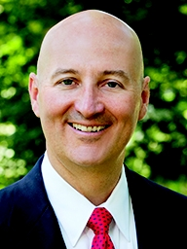
Gov. Pete Ricketts (R-NE)
Background
Republican Pete Ricketts was elected Nebraska governor in 2014. His name was known nationally before he ever tried for public office; his politically active and wealthy family owns the Chicago Cubs and has raised and spent millions on election campaigns. Ricketts worked to revamp his reputation as more than a candidate with deep pockets, and to fend off continued allegations that he—and his father—were trying to buy the office. After attending the University of Chicago, Ricketts joined the family business, ultimately rising to president and chief operating officer. He left in 2005 to run for the U.S. Senate against Democrat Ben Nelson. Ricketts lost overwhelmingly, 36 percent to Nelson's 64 percent, despite high-profile endorsements from President George W. Bush and Vice President Dick Cheney, and despite spending $11.6 million of his own money. For the next five years, Ricketts served on the Republican National Committee and expanded his political connections. He also invested in start-ups, served on various boards, and developed philanthropic interests. He founded Drakon LLC, which helps entrepreneurs, and the Platte Institute for Economic Research. During the primary, Republican challengers criticized Ricketts for highlighting opposition to same-sex marriage and for distancing himself from the Cubs' sponsorship of gay-pride events. Ricketts barely won the six-candidate primary with just over 26 percent of the vote, outdoing Attorney General Jon Bruning by 1 percentage point. Ricketts, campaigning against Democratic nominee Chuck Hassebrook, emphasized his business experience and said he wants to focus on reducing state spending, taxes, and business regulations.
Biography
First Elected: 2014
Party: Republican
Birth Date: 08/19/1964
Education: AB, University of Chicago, 1986; MBA, 1991
Family: Spouse: Susanne; 3 Children
Election Results
2018 General
Pete Ricketts (R) | 59%
Bob Krist (D) | 40%
Notes:
https://www.nationaljournal.com/almanac/person/4616
https://en.wikipedia.org/wiki/Nebraska_gubernatorial_election,_2018

Slide 29
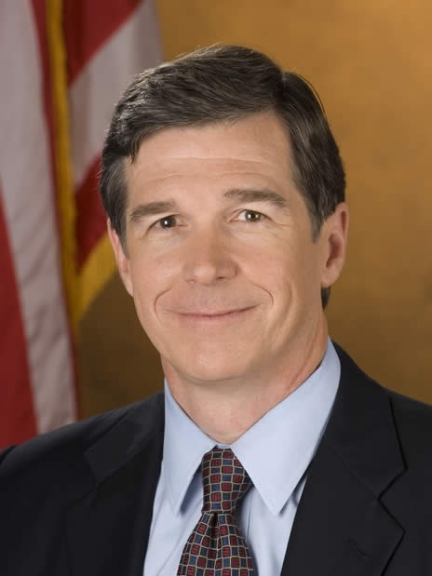
Gov. Roy Cooper (D-NC)
Background
Democrat Roy Cooper was elected governor of North Carolina in 2016, succeeding Republican Pat McCrory. Cooper served as attorney general of North Carolina from 2001 to 2016, winning reelection three times. He grew up in rural Nash County, NC as the son of a schoolteacher and a lawyer and attended UNC-Chapel Hill for his undergraduate and law degree. While practicing law at his family’s firm, he was elected to the NC House and then later to the NC Senate, eventually rising to become Senate majority leader in 1997. He ran successfully for attorney general in 2000 to replace then-Attorney General Mike Easley, who ran successfully for governor. As attorney general, Cooper notably dismissed the scandalous Duke lacrosse case after taking over the prosecution when the district attorney recused himself. He also uncovered a practice by the NC State Bureau of Investigation of hiding evidence. Instead of running for a fifth term, Cooper decided to run against Governor Pat McCrory. The incumbent Republican was facing backlash from HB2, the bathroom bill, which had spurred high profile boycotts by the NCAA, NBA and celebrity performers. He won by only 10,000 votes, which were contested by the McCrory campaign for over a month after the election. The Republican legislature then held a controversial special session during McCrory’s lame duck period to revoke some gubernatorial powers, which are being appealed as unconstitutional. Cooper is a moderate who ran on a platform of bolstering the public sector, especially teachers, and promoting business through incentives.
Biography
First Elected: 2016
Party: Democrat
Birth Date: 06/13/1957
Education: BA, University of North Carolina-Chapel Hill, 1979; JD, 1982
Family: Spouse: Kristen; 3 Children
Election Results
2016 General
Roy Cooper (D) | 49%
Pat McCrory (R) | 48.8%
Notes:
https://www.nationaljournal.com/almanac/person/4697
https://ballotpedia.org/Roy_Cooper

Slide 30
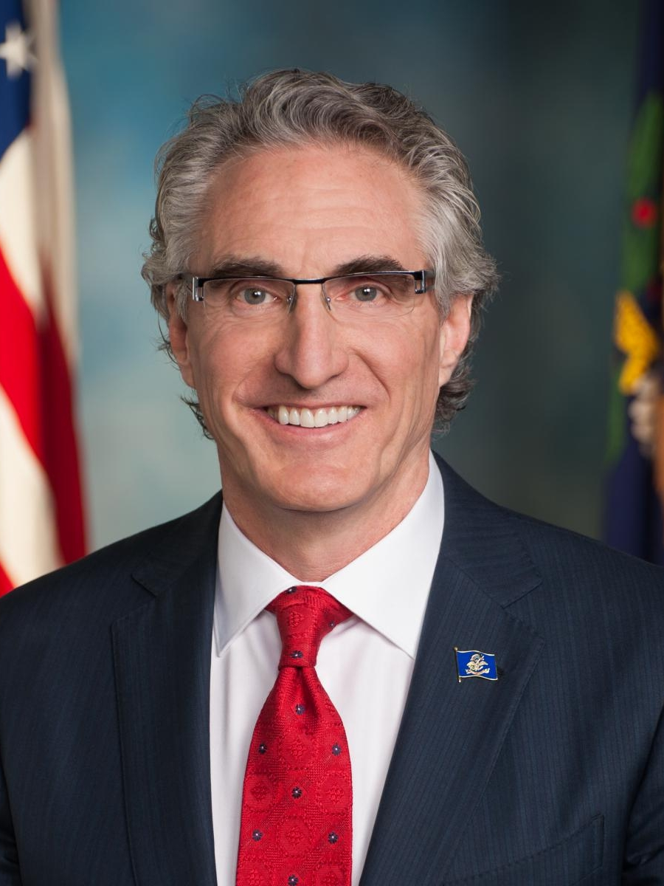
Gov. Doug Burgum (R-ND)
Background
Doug Burgum was born on August 1, 1956 in Arthur, North Dakota, where his grandfather started a grain elevator. In 1978, Burgum graduated from North Dakota State University and then immediately moved to Palo Alto where he earned his M.B.A. from Stanford University in 1980. After getting his M.B.A, Burgum worked in Chicago for McKinsey & Company. After a couple of years, Burgum moved to Fargo, North Dakota where he mortgaged his family’s farm in order to garner seed capital for the accounting software firm Great Plains Software. He became CEO and led it successfully to its eventual acquisition by Microsoft in 2001. After his company was acquired, Burgum went on to serve as senior vice-president of Microsoft Business Solutions until 2007. Since leaving Microsoft, Burgum has been on various boards of directors, including SuccessFactors, Preventice, The Arthur Companies, Loyalty Builders and was on the Positive Coaching Alliances’ National Advisory Board. Burgum co-founded Killborne Group, a real estate firm which aims to revitalize downtown Fargo. He also co-founded and became a partner at Arthur Ventures, a venture capital firm focused on software technology companies. When Governor Marvin Nelson announced he would not run for reelection, Burgum announced his candidacy. Although Burgum had no experience holding public office, he won the Republican primary with 59% of the vote, and he went on to defeat Democratic candidate State Senator Marvin Nelson and Libertarian candidate Marty Riske in the general election.
Biography
First Elected: 2016
Party: Republican
Birth Date: 08/01/1956
Education: BS, North Dakota State University,1978; MBA, Stanford University School of Business,1980
Family: Spouse: Kathryn; 3 Children
Election Results
2018 General
Doug Burgum (R) | 77%
Marvin Nelson (D) | 19%
Notes:
https://www.nationaljournal.com/almanac/person/4698
https://en.wikipedia.org/wiki/North_Dakota_gubernatorial_election,_2016

Slide 31
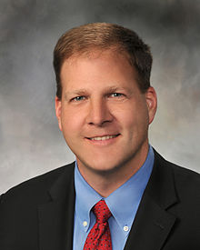
Gov. Chris Sununu (R-NH)
Background
Born in Salem, New Hampshire in 1974, Chris Sununu is the son of former New Hampshire Governor John H. Sununu and the brother of former Congressman John. E. Sununu. After earning his bachelor of science in civil and environmental engineering from the Massachusetts Institute of Technology, Sununu spent a decade cleaning up hazardous waste sites. He served as the director of Sununu Enterprises, a family business and consulting firm based in New Hampshire, and subsequently joined the Waterville Valley Resort as the chief executive officer. Sununu entered politics in 2010, securing a seat on the five-member New Hampshire Executive Council, where he represents approximately 250,000 New Hampshire residents. Currently in his third term as executive councilor, Sununu lives in Newfields with his wife, Valerie, and their three children. Sununu defeated his opponent in the New Hampshire governor’s race, Colin Van Ostern, in November 2016, winning by 49% to 47%.
Biography
First Elected: 2016
Party: Republican
Birth Date: 11/05/1974
Education: BS, Massachusetts Institute of Technology, 1998
Family: Spouse: Valerie; 3 Children
Election Results
2016 General
Chris Sununu (R) | 49%
Colin Van Ostern (D) | 47%
Notes:
https://www.nationaljournal.com/almanac/person/4696
https://en.wikipedia.org/wiki/Chris_Sununu#Electoral_history

Slide 32
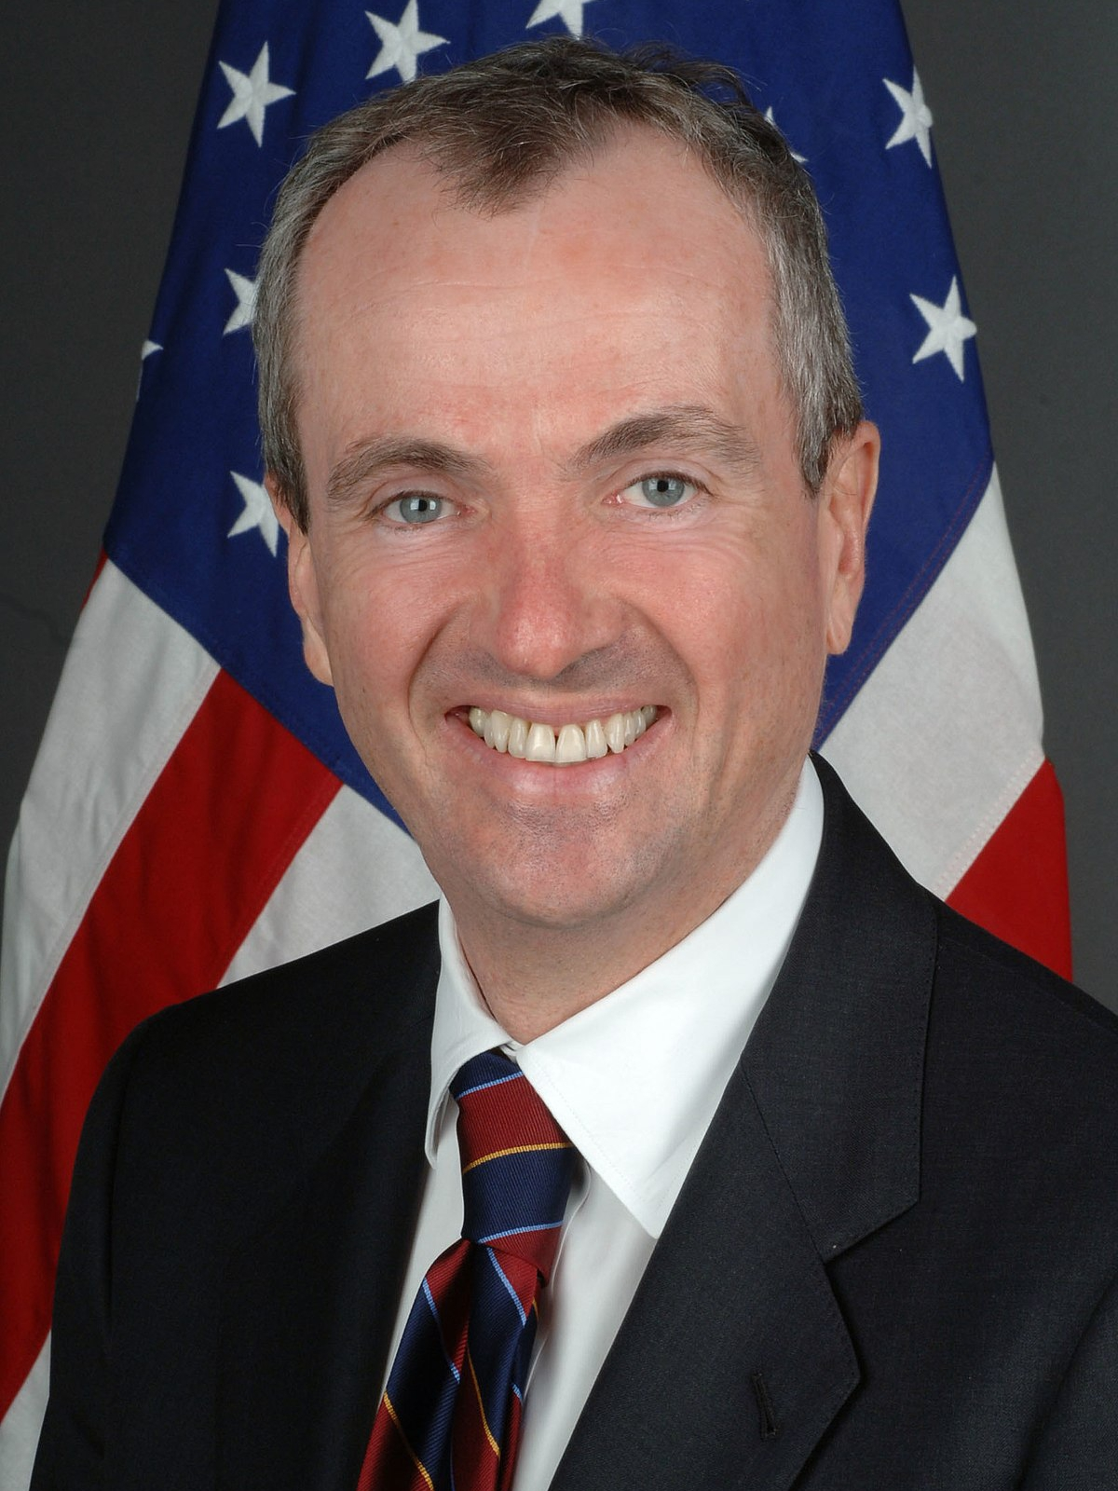
Gov. Phil Murphy (D-NJ)
Background
Born in 1957 in Newton, MA, Phil Murphy attended Harvard University and the Wharton School of Business at the University of Pennsylvania. He joined Goldman Sachs the year before receiving his master's degree and worked with the firm until 2006. His career at Goldman Sachs included four years in Germany and three years in Hong Kong during the 1990s, where Murphy worked on the privatization of services previously run by the Chinese government. In May 2005, Murphy was named chair of the New Jersey Benefits Task Force to address the New Jersey pension crisis. Murphy then served from 2006 to 2009 as the national finance chair of the DNC. In this position he financed Dean’s “50 state strategy.” Murphy was nominated by President Obama to serve as the United States Ambassador to Germany in 2009 and served until 2013. Murphy has a wife and four children and resides in Monmouth County, NJ.
Biography
First Elected: 2017
Party: Democrat
Birth Date: 08/16/1957
Education: BA, Harvard University; MBA, Wharton School of Business at the University of Pennsylvania
Family: Spouse: Tammy; 4 Children
Election Results
2017 General
Phil Murphy (D) | 56%
Kim Guadagno (R) | 43%
Notes:
https://www.nationaljournal.com/almanac/person/4773
https://en.wikipedia.org/wiki/2017_New_Jersey_gubernatorial_election

Slide 33
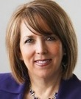
Gov. Michelle Lujan Grisham (D-NM)
Background
Lujan Grisham was born in Los Alamos. In 1991, she was appointed to be the director of the State Agency on Aging and served as director for 13 years under both Republican and Democratic governors. After her husband’s death in 2004, Grisham was appointed New Mexico’s Secretary of Health. During her tenure, Grisham emphasized precautionary principles to combat medical mistakes. In 2008, Grisham unsuccessfully ran for New Mexico’s 1st congressional district. Two years later she became the commissioner of Bernallio County. In 2012, Grisham ran again for New Mexico’s 1st congressional district, and won. In the House of Representatives, Grisham has been a consistent advocate for protecting the elderly and supporting social safety net programs like Medicare and Social Security. She currently chairs the Congressional Hispanic Caucus.
Biography
First Elected: 2018
Party: Democrat
Birth Date: 10/24/1959
Education: JD, School of Law, University of New Mexico, 1983-1987;Bachelors, University Studies, University of New Mexico, 1977-1981
Family: Widow; 2 Children: Taylor, Erin
Election Results
2018 General
Michelle Lujan Grisham (D) | 57%
Steve Pearce (R) | 43%

Slide 34
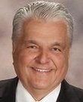
Gov. Steve Sisolak (D-NV)
Background
Sisolak was born and raised in Milwaukee, Wisconsin. He received his master's degree from University of Nevada Las Vegas in 1978. He started a communications business and served on various boards, including the Nevada Board of Regents and the Las Vegas District Board of Directors. Most recently, Sisolak served as the chairman of the Clark County Commission and as the chair of Big Bend Water District Board of Trustees. During the 2018 campaign, Sisolak ran on education as his primary focus. He has publicly stated his interest in increasing funding for the public school system in Nevada and increasing the salaries of teachers. Sisolak also ran on a platform of increasing jobs in Nevada by promoting clean energy and the manufacturing industry.
Biography
First Elected: 2018
Party: Democrat
Birth Date: 12/26/1953
Education: MBA, University of Nevada Las Vegas, 1978;BA, Univeristy of Wisconsin at Milwaukee, 1974
Family: Spouse: Dallas; 2 Children
Election Results
2018 General
Steve Sisolak (D) | 49%
Adam Laxalt (R) | 45%

Slide 35
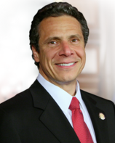
Gov. Andrew Cuomo (D-NY)
Background
Andrew Cuomo was born in Queens and grew up in Hollis. His father is former three-term Gov. Mario Cuomo. After working in the Manhattan DA’s office, Cuomo founded the Housing Enterprise for the Less Privileged (HELP USA), a nonprofit organization offering shelter, job training, education, drug treatment, and other assistance. Cuomo’s work at HELP caught the attention of Bill Clinton, who asked Cuomo to serve on his transition team after being elected president in 1992 and then as assistant secretary of community planning and development at HUD. After Clinton’s reelection in 1996, Cuomo took over as secretary of the department. In 2006, he ran for New York attorney general and easily beat Republican nominee Jeanine Pirro 58%-40%. He conducted investigations of the financial industry’s alleged misdeeds, looked into the student loan industry’s deceptive marketing practices, uncovered fraud among health insurers, and crusaded against online child pornography. In 2010, Cuomo announced his candidacy for governor and won with a vote of 63%-33%. Cuomo successfully worked on legalizing same-sex marriage. Other accomplishments followed, including the implementation of a 2% annual cap on property taxes and a rewrite of the state tax code. In 2013, Cuomo called for raising New York’s minimum wage, decriminalizing small amounts of marijuana, and a Women’s Equality Act that would promote pay equity, stop pregnancy discrimination, and toughen human-trafficking laws. He also proposed tightening the definition of assault weapons and lowering the maximum magazine capacity. After defeating Zephyr Teachout in the 2014 Democratic primary, Cuomo won with 54% of the vote in the general election against Republican Rob Astorino.
Biography
First Elected: 2010
Party: Democrat
Birth Date: 12/06/1957
Education: BA, Fordham University, 1957; JD, Albany Law School, 1982
Family: Partner: Sandra; 3 Children
Election Results
2018 General
Andrew Cuomo (D) | 58%
Marc Molinaro (R) | 36%
Notes:
https://www.nationaljournal.com/almanac/person/1903
https://en.wikipedia.org/wiki/New_York_gubernatorial_election,_2018

Slide 36
Gov. Mike DeWine (R-OH)
Background
DeWine was born in Springfield, Ohio. He received a BS in Education from Miami University of Ohio and a JD from Ohio Northern University College of Law. He has been a visiting scholar at Miami University of Ohio, Ohio Northern University, and Cedarville University. DeWine served as assistant prosecuting attorney and then prosecuting attorney of Greene County, Ohio. He has spent much of his life in politics first serving as senator for the Ohio State Senate in 1980. He then served four terms in the US House of Representatives and as lieutenant governor of Ohio from 1990 to 1994. DeWine had a failed campaign for US Senate in 1992, but won his bid for the Senate in 1994. He then lost his second re-election to US Senate in 2006. He is currently serving as the attorney general of Ohio.
Biography
First Elected: 2018
Party: Republican
Birth Date: 01/05/1947
Education: JD, Ohio Northern University College of Law, 1972;BS, Education, Miami University of Ohio, 1969
Family: Spouse: Frances; 8 Children: Patrick, Jill, Rebecca, John, Brian, Alice, Mark, Anna
Election Results
2018 General
Mike DeWine (R) | 51%
Richard Cordray (D) | 46%

Slide 37
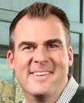
Gov. Kevin Stitt (R-OK)
Background
Stitt is a fourth generation Oklahoman, and graduated from Norman High School. He attended Oklahoma State University, where he earned a degree in accounting. Stitt is the founder and CEO of Gateway Mortgage Group, which employs 1,200 people and has offices in 41 states. His candidacy for governor was his first attempt at political office. Stitt plans to prioritize government efficiency and give the governor the authority to fire underperforming leaders in appointed positions. He also plans to reform education by raising teacher pay to match the pay in neighboring states, and expand the use of video technology in the classroom. Further, Stitt plans to enhance recruitment programs to bring businesses to Oklahoma and create jobs.
Biography
First Elected: 2018
Party: Republican
Birth Date: Unknown
Education: Bachelor's, Accounting, Oklahoma State University, 1991-1996
Family: Spouse: Sarah; 6 Children
Election Results
2018 General
Kevin Stitt (R) | 54%
Drew Edmondson (D) | 42%

Slide 38
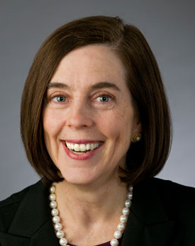
Gov. Kate Brown (D-OR)
Background
Democrat Kate Brown was sworn in as Oregon governor in February 2015 following the resignation of John Kitzhaber, who had just been reelected in November to a fourth term. Kitzhaber, a Democrat, became enmeshed in a scandal over the awarding of state consulting work to his fiancée that spurred multiple investigations. Because Oregon has no lieutenant governor, Brown was next in the line of succession due to serving as secretary of state, a job she had held since 2009. Brown's ascension to the job drew considerable national attention not just because of the circumstances that led to Kitzhaber's departure, but because she is the nation's first openly bisexual governor. She was born in Spain, where her father was serving in the Air Force, but raised in Minnesota. She received a bachelor's from the University of Colorado-Boulder, then went on to obtain her law degree at Lewis and Clark College's law school. Brown got her start in politics in 1991, when she was appointed to fill a vacancy in the Oregon House. She later moved on to the state Senate, where she rose to majority leader in 2004, becoming the first woman to occupy that post. She announced her candidacy for secretary of state in 2007 and won election a year later in a 51%-46% victory over Republican Rick Dancer. Years later, in taking over for Kitzhaber, Brown stressed the need to restore trust in government. She called on lawmakers to strengthen the state's Government Ethics Commission and said neither she nor any members of her household and staff would accept any outside business. "We must work together to address these and other real problems in real time; to strengthen Oregon's recovery from the recession; to improve access to quality education and health care, and create more living-wage jobs in every single corner of the state," she said.
Biography
Assumed office: 2015
Party: Democrat
Birth Date: 06/21/1960
Education: BA, University of Colorado, 1981; JD, Lewis & Clark College Northwestern School of Law, 1985
Family: Spouse: Dan; 2 Step-children
Election Results
2018 General
Kate Brown (D) | 50%
Knute Buehler (R) | 44%
Notes:
https://www.nationaljournal.com/almanac/person/4626
https://en.wikipedia.org/wiki/Kate_Brown#Electoral_history

Slide 39
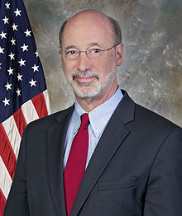
Gov. Tom Wolf (D-PA)
Background
Democrat Tom Wolf was born in York, Pennsylvania on November 17, 1948. He earned degrees from Dartmouth College, the University of London, and the Massachusetts Institute of Technology. During that time, he interrupted his studies to join the Peace Corps, serving two years in a village in India. After graduation, Wolf went on to work for the family business as a forklift operator at the Wolf Organization, a cabinet and building-materials company. In 1985, Wolf and two of his cousins bought the company and more than doubled its size. After selling the company to a private-equity firm in 2006, Wolf was confirmed to be Pennsylvania revenue secretary under Democratic Gov. Ed Rendell. Wolf intended to mount a campaign for governor to succeed Rendell, who was term-limited. However, when the family business was on the brink of bankruptcy and collapse, Wolf abandoned the campaign and repurchased the company, refocusing its business model and restoring it to financial solvency. He stepped down as CEO in 2013 to focus on his 2014 quest for the governorship. Wolf poured $10 million of his own money into the primary race, allowing him to blanket the airwaves from January 2014 through May. He won the four-way primary easily with 58 percent of the vote. In the general election, Wolf had the air and campaign strategy of an incumbent. Wolf was elected governor in 2014. He capitalized on the unpopularity of two-term GOP Gov. Tom Corbett to return control of the swing state to the Democrats. Though Corbett had won the job in 2010 with 55 percent of the vote, he struggled in office and was trounced in running for reelection.
Biography
First Elected: 2014
Party: Democrat
Birth Date: 11/17/1948
Education: BA, Dartmouth College, 1972; MPhil, University of London, 1978; PhD, Massachusetts Institute of Technology, 1981
Family: Spouse: Frances; 2 Children
Election Results
2018 General
Tom Wolf (D) | 58%
Scott Wagner (R) | 41%
Notes:
https://www.nationaljournal.com/almanac/person/4621
https://en.wikipedia.org/wiki/2018_Pennsylvania_gubernatorial_election

Slide 40
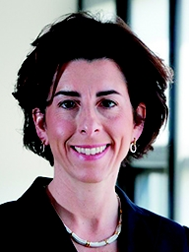
Gov. Gina Raimondo (D-RI)
Background
Democrat Gina Raimondo—a Rhodes scholar, lawyer, and Harvard graduate—was elected Rhode Island's first female governor in 2014. After winning a contested primary, Raimondo defeated Republican Cranston Mayor Alan Fung by benefiting from the state's Democratic leanings and casting herself as the better economic steward of a state still struggling out of the recession. Raimondo was elected Rhode Island treasurer in 2010 and set about fixing the state's public-employee pension system. She crafted a 2011 pension law that froze automatic cost-of-living increases and raised retirement ages, angering public employee unions. At first, it appeared the Democratic primary race for governor was headed toward a battle between Raimondo, running as a fiscal reformer, and Providence Mayor Angel Taveras, running as a progressive who would win support from labor unions. But when former U.S. Education Department official Clay Pell got into the race, union support was divided, with firefighters, police, supermarket clerks, and city employees backing Taveras, and the teachers union—unhappy with Taveras's support of charter schools—siding with Pell. Raimondo benefited from the split and won the primary with 42 percent of the vote. Raimondo sought to mend fences with organized labor in the general election. She was helped by the fact that Fung had come out against raising the minimum wage and in favor of "right-to-work" legislation that would ban union shops from requiring workers to pay union dues. Each candidate claimed to be the better protector of the middle class. Fung pledged to cut taxes and spending. Raimondo called it "wrong-headed economic theory." She ended up winning with 41 percent to Fung's 36 percent.
Biography
First Elected: 2014
Party: Democrat
Birth Date: 05/17/1971
Education: BA, Harvard University, 1993; PhD, University of Oxford, 1995; JD, Yale Law School, 1998
Family: Spouse: Andy; 2 Children
Election Results
2018 General
Gina Raimondo (D) | 53%
Allan Fung (R) | 37%
Notes:
https://www.nationaljournal.com/almanac/person/4536
https://en.wikipedia.org/wiki/Rhode_Island_gubernatorial_election,_2018

Slide 41
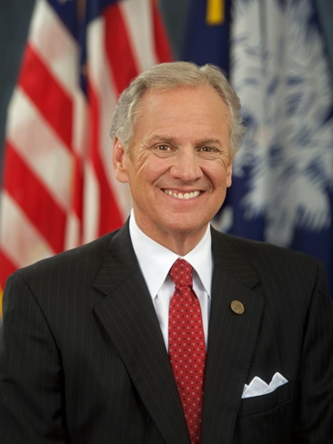
Gov. Henry McMaster (R-SC)
Background
Republican Henry McMaster was born on May 27,1947 in Columbia, South Carolina. Prior to pursuing his education in law, McMaster joined the United States Army Reserve, receiving his honorable discharge in 1975. In 1973, he worked as a legislative assistant to U.S. Senator Strom Thurmond in Washington D.C. McMaster remained there until 1974, when he returned to the private sector in his home state and served as a partner in the law firm of Tompkins & McMaster. He was admitted to practice before the federal Court of Claims in 1974, the United States Court of Appeals for the Fourth Circuit in 1975, and, in 1978, upon motion of Senator Thurmond, the Supreme Court of the United States. McMaster then served as the U.S. attorney for South Carolina. McMaster received the Republican nomination in 1986 in his campaign for the United States Senate; he was ultimately defeated by Democratic incumbent Senator Ernest F. "Fritz" Hollings. Four years later, he lost his bid for lieutenant governor. In 1991, however, McMaster was nominated by then-Governor Carroll A. Campbell, Jr. to serve on the Commission on Higher Education; he was later confirmed by the South Carolina State Legislature. McMaster then served two terms as attorney general of South Carolina. Though he was eligible to run for a third term, he instead announced his candidacy for the state's 2010 gubernatorial election, but lost in the Republican primary to Nikki Haley. In 2015 he became Haley’s lieutenant governor and replaced her when she was confirmed as U.S. ambassador to the U.N.
Biography
Assumed office: 2017
Party: Republican
Birth Date: 05/27/1947
Education: BA, University of South Carolina, 1969; JD, 1973
Family: Spouse: Peggy Jean; 2 Children
Election Results
2018 General
Henry McMaster (R) | 54%
James Smith (D) | 46%
Notes:
https://www.nationaljournal.com/almanac/person/4735#narrative
https://en.wikipedia.org/wiki/South_Carolina_gubernatorial_election,_2018

Slide 42
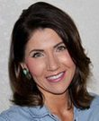
Gov. Kristi Noem (R-SD)
Background
Born in Watertown, South Dakota, Noem received her BA in Political Science from South Dakota State University. Before getting into politics, Noem was a small business owner and manager, as well as a rancher, operating her family’s farm after her father died. She was elected to the South Dakota State House of Representatives in 2006 and then as the singular at-large member U.S. representative in 2010. She sat on the House Ways and Means Committee. While in Congress, Noem voted against her party 4.1% of the time, below the House average. While campaigning for governor, Noem highlighted what she refers to as the “four pillars of protection”. This includes, protection from tax increases, protection from government growth, protection from federal intrusion and protection from government secrecy.
Biography
First Elected: 2018
Party: Republican
Birth Date: 11/30/1971
Education: BA, Political Science, South Dakota State University, 2011;Attended, Northern State University, 1990-1992;Attended, Mount Marty College, Watertown
Family: Spouse: Bryon; 3 Children: Kassidy, Kennedy, Booker
Election Results
2018 General
Kristi Noem (R) | 51%
Billie Sutton (D) | 48%

Slide 43
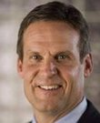
Gov. Bill Lee (R-TN)
Background
Lee was born and raised in Franklin, Tennessee. After attending Williamson County Schools, he studied mechanical engineering at Auburn University. He then returned home to work at his grandfather’s business, Lee Company. He served as president of the Lee Company from 1992-2016 and then as Chair of the Lee company from 2016 on. The Lee company employs more than 1,200 individuals and generates $215 million in annual revenue. Lee served as the 7th congressional district’s representative to the Tennessee Higher Education Commission and on the Board of Trustees at Belmont University. Further, Lee has previously served as president of Tennesseans for Economic Growth, chairman of the YMCA of Middle Tennessee and president of the Associated Builders and Contractors. Prior to running for governor, Lee did not have any experience in elected office.
Biography
First Elected: 2018
Party: Republican
Birth Date: 10/09/1959
Education: BSME, Mechanical Engineering, Auburn University, 1977-1981
Family: Spouse: Maria; 4 Children: Jessica, Jacob, Caleb, Sarah Kate
Election Results
2018 General
Bill Lee (R) | 60%
Karl Dean (D) | 39%

Slide 44
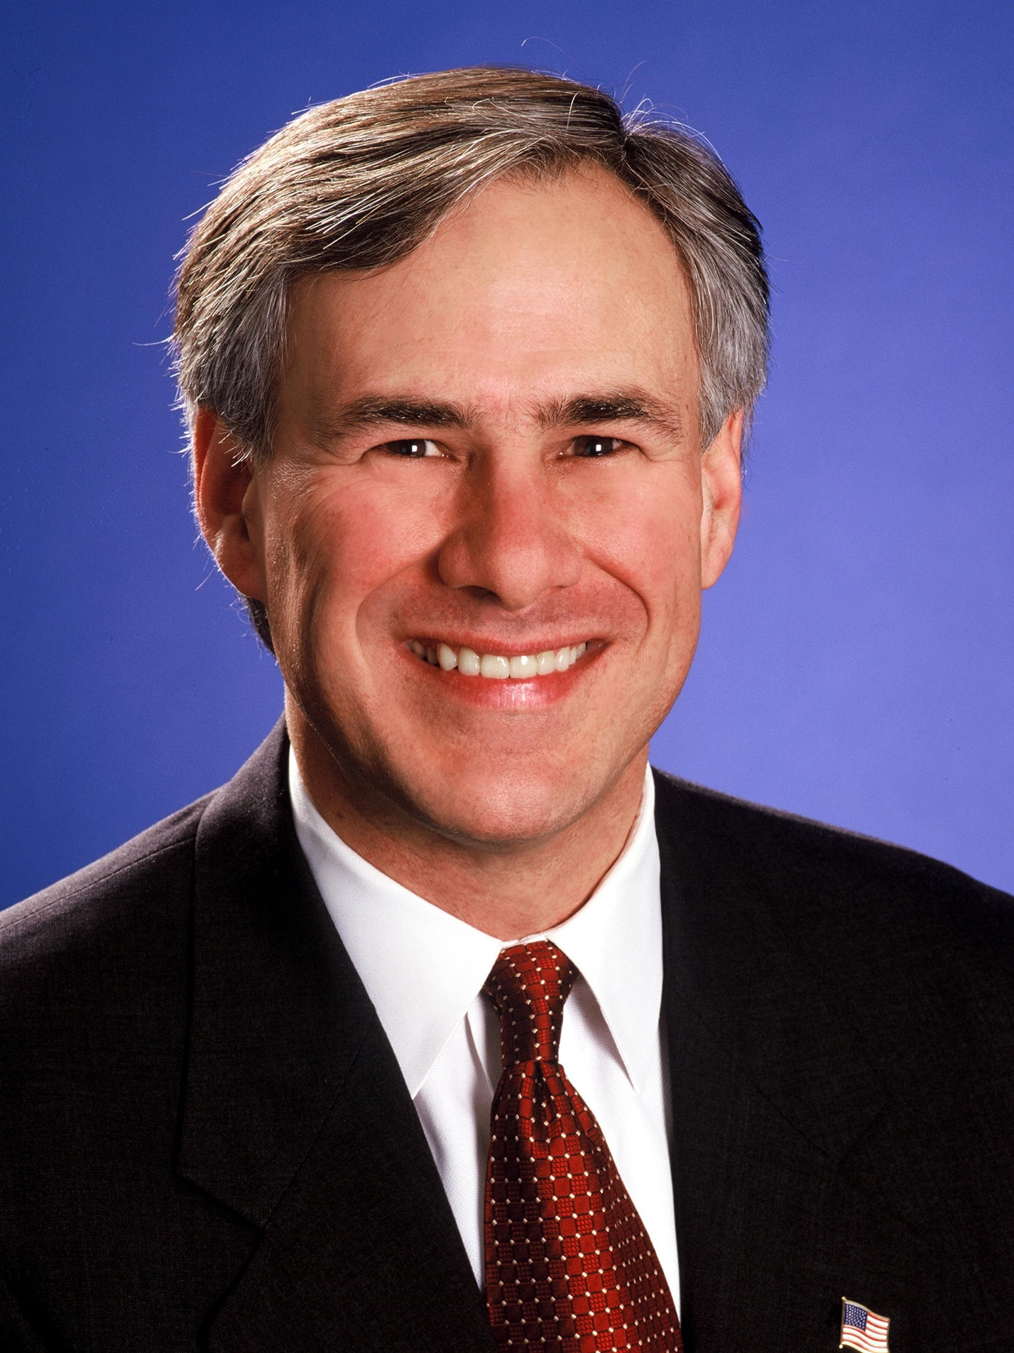
Gov. Greg Abbott (R-TX)
Background
Republican Greg Abbott was elected governor of Texas in 2014, succeeding Rick Perry. Abbott once described his job as the state's attorney general this way: "I go into the office in the morning, I sue Barack Obama, and then I go home." It was that reputation that won Abbott the governorship, entrenching Republican domination in a state that has not elected a Democrat to statewide office in two decades. He bested Democrat Wendy Davis, who had gained national attention for her failed efforts to block a law restricting abortion. The year he finished law school, in 1984, Abbott was injured by a falling tree while he was out for a run. The incident made him a paraplegic, and he has used a wheelchair ever since. After a stint in private practice, Abbott became an associate justice on the Texas Supreme Court in 1995, appointed by then-Gov. George W. Bush to fill a vacancy. Abbot won election twice more to the state's highest civil court, and in 2001 he resigned to run for attorney general. Abbott won reelection twice and became the longest-serving state attorney general in Texas history. Less than a week after Perry announced he would not seek another term, Abbott declared his candidacy for the job. Upon taking office, Abbott hewed to Perry's pugnacious state's-rights populism.
Biography
First Elected: 2014
Party: Republican
Birth Date: 11/13/1957
Education: BBA, University of Texas, 1981; JD, Vanderbilt University Law School, 1984
Family: Spouse: Cecilia; 1 Child
Election Results
2018 General
Greg Abbott (R) | 56%
Lupe Valdez (D) | 43%
Notes:
https://www.nationaljournal.com/almanac/person/4620
https://en.wikipedia.org/wiki/Texas_gubernatorial_election,_2018

Slide 45
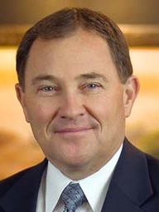
Gov. Gary Herbert (R-UT)
Background
Republican Utah Gov. Gary Herbert assumed office in August 2009 following the resignation of Republican Jon Huntsman Jr., who became U.S. ambassador to China in the Obama administration. He was elected in 2010 to serve the remainder of Huntsman’s term, and then won reelection comfortably on his own in 2012. Herbert has been extremely popular in a state that has enjoyed significant economic growth. In running for a four-year term of his own in 2012, Herbert touted the state’s economic comeback, with 36,000 new jobs created in 2011 along with an unemployment rate that fell from 8% to 5.7%, among the nation’s lowest. He drew five Republican challengers and won 58% on the first ballot at the state’s GOP convention, then trounced runner-up Morgan Philpot, a former state representative, 63%-37% in a runoff. Herbert’s Democratic opponent, Peter Cooke sought to highlight what he called his rival’s lack of transparency and pointed to mismanagement at the Department of Alcoholic Beverage Control. Herbert couldn’t match Romney’s 73% showing in Utah, but he still won 68%-28%. He carried every county by 50%-47%. Following the election, the Obama administration approved Herbert’s request to operate a state health insurance exchange under the new health care law. The state previously had sought relief from some of the law’s requirements; it already operated a statewide insurance marketplace called Avenue H, where small companies can send employees to buy coverage. Unlike the new law’s exchanges, Avenue H does not allow individuals to shop for coverage and does not involve the state’s Medicaid program. But U.S. Health and Human Services officials said they would work with the state to make its program compliant with the law.
Biography
Assumed office: 2009
Party: Republican
Birth Date: 05/07/1947
Education: Attended Brigham Young University, 1968-1970
Family: Spouse: Jeanette; 6 Children
Election Results
2016 General
Gary Herbert (R) | 67%
Mike Weinholtz (D) | 29%
Notes:
https://www.nationaljournal.com/almanac/person/1772
https://en.wikipedia.org/wiki/Utah_gubernatorial_election,_2016

Slide 46
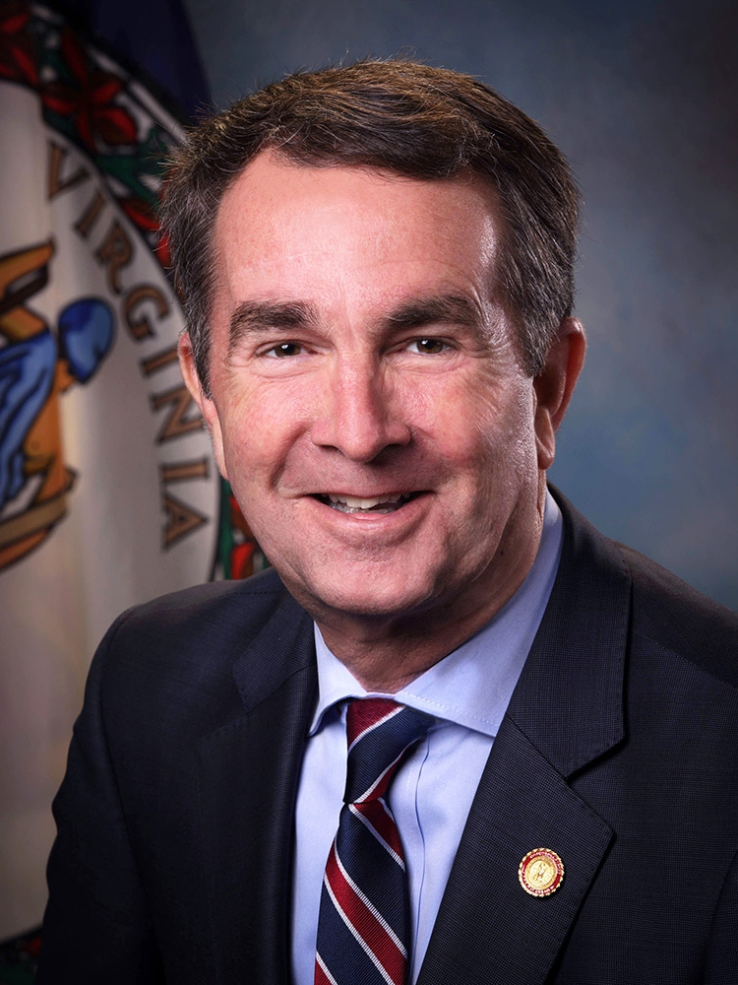
Gov. Ralph Northam (D-VA)
Background
Ralph Northam grew up on Virginia’s Eastern Shore and attended local public schools. He attended the Virginia Military Institute (VMI), where he graduated with distinction. After VMI, Ralph was commissioned a second lieutenant in the United States Army. He attended Eastern Virginia Medical School and then traveled to San Antonio for a pediatric residency, where he met his wife Pam—a pediatric occupational therapist at the same hospital. Ralph served eight years of active duty and rose to the rank of major. Ralph did his residencies at the Walter Reed Army Medical Center, and he served as chief neurological resident at Johns Hopkins Hospital. As an Army doctor, he served in Germany, treating soldiers wounded in Operation Desert Storm. Northam was first elected to the Virginia State Senate in 2007 and served until 2013 when he was elected lieutenant governor. As lieutenant governor, he supported efforts to end veteran homelessness and fostered bipartisan support for legislation banning smoking in Virginia’s public restaurants.
Biography
First Elected: 2017
Party: Democrat
Birth Date: 09/13/1959
Education: BS, Virginia Military Institute; MD, Eastern Virginia Medical School
Family: Spouse: Pam; 2 Children
Election Results
2017 General
Ralph Northam (D) | 54%
Ed Gillespie (R) | 45%
Notes:
https://www.nationaljournal.com/md/660471/gov-ralph-northam-profile?mref=dashboard-featured-1
https://www.nationaljournal.com/almanac/person/4741

Slide 47
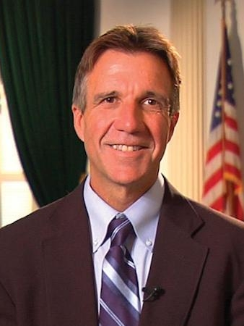
Gov. Phil Scott (R-VT)
Background
Philip Scott was born on August 4, 1958 in Barre, Vermont. He graduated from University of Vermont in 1980. After graduating from college, Scott started a construction shop but later went on to work for Dubois Construction. In 2000, Scott decided to run for Vermont State Senate and was reelected five times, representing Washington County. During his time in the state Senate, he served on the Institutions Committee and Transportation Committee. In 2010, he decided to run for lieutenant governor of Vermont and won, making him one of the only lieutenant governors to serve alongside a Democratic governor. During his time as lieutenant governor, Scott started the “Vermont Everyday Jobs” program, as part of which he worked a few hours several times a month in local jobs. In December 2015, Scott decided to run for governor after Governor Peter Shumlin announced that he would not seek reelection. In the primary, Scott managed to beat one other Republican opponent with 59.77% of the vote. In the general election, he went on to defeat Democratic candidate Sue Minter.
Biography
First Elected: 2016
Party: Republican
Birth Date: 08/04/1958
Education: BS, University of Vermont, 1980
Family: Spouse: Diana; 2 Children
Election Results
2016 General
Phil Scott (R) | 53%
Sue Minter (D) | 44%
Notes:
https://www.nationaljournal.com/almanac/person/4699

Slide 48
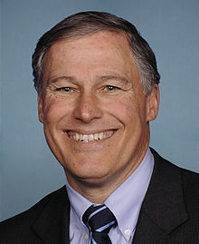
Gov. Jay Inslee (D-WA)
Background
Democrat Jay Inslee was narrowly elected Washington’s governor in 2012 after serving 13 years in the U.S. House. In Congress, Inslee was a moderate-to-liberal Democrat who notched no significant legislative accomplishments or attained a leadership position, two criticisms that Washington Republicans raised during the governor’s race. He joined in protecting the privacy of consumer financial records—an issue important to Microsoft, his largest single source of campaign funds as a congressman. He and Sen. Maria Cantwell, D-Wash., pressed the Federal Communications Commission in December 2010 for stricter rules on the FCC’s proposed net-neutrality order that some Republicans said was already too unfriendly to business. When security experts reported in 2011 that Apple’s iPhone could secretly track its users’ movements, Inslee called for greater government oversight of data collection. In February 2011, Inslee seconded the GOP’s alarm about growing budget deficits and called for closing tax loopholes. Inslee served in Congress until 2012 before announcing his candidacy in the Washington gubernatorial election. He then defeated Republican Rob McKenna to become the governor. In November of 2016, he won reelection against Republican Bill Bryant.
Biography
First Elected: 2012
Party: Democrat
Birth Date: 02/09/1951
Education: BA, University of Washington, 1973; JD, Willamette University, 1976
Family: Spouse: Trudi Ann; 3 Children
Election Results
2016 General
Jay Inslee (D) | 54%
Bill Bryant (R) | 46%
Notes:
https://www.nationaljournal.com/almanac/person/237

Slide 49
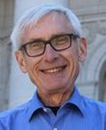
Gov. Tony Evers (D-WI)
Background
Evers was born in Plymouth, Wisconsin. Before entering politics, Evers spent his entire career in education. He has been a principal, the superintendent of Verona School District and Oakfield School District, and the chief administrator of the Cooperative Educational Service Agency 6. His first political role was as Superintendent of Public Instruction for the State of Wisconsin which he was elected to in 2009. As governor, Evers plans to increase investments in early childhood education and quality childcare, including helping families afford increasing childcare costs. He also plans to accept the Medicaid expansion dollars offered by the federal government, and to lower prescription drug costs. Further, he plans to ensure access to broadband throughout Wisconsin, as well as invest in the state’s infrastructure.
Biography
First Elected: 2018
Party: Democrat
Birth Date: 11/05/1951
Education: Doctorate, University of Wisconsin at Madison, 1986; Masters, Educational Administration, University of Wisconsin at Madison,1976; Bachelors, Educational Administration, University of Wisconsin at Madison, 1973
Family: Spouse: Kathy; 3 Children: Erin, Nick, Katie
Election Results
2018 General
Tony Evers (D) | 50%
Scott Walker (R) | 36%

Slide 50
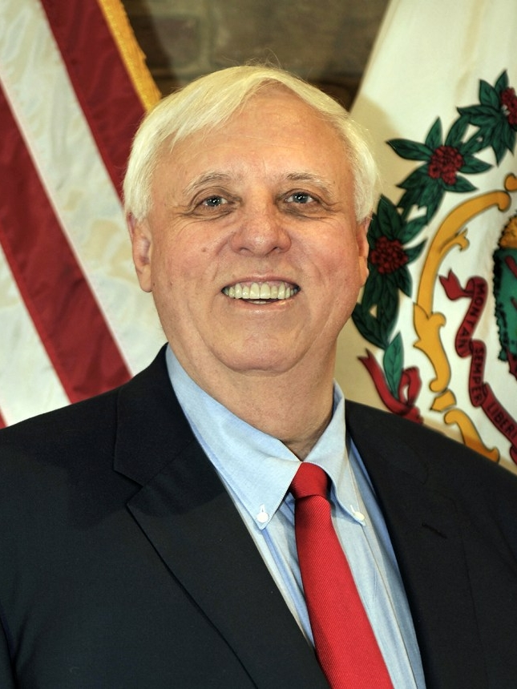
Gov. Jim Justice (R-WV)
Background
Jim Justice was born on April 27, 1951 in Charleston, West Virginia. He began his undergraduate studies at the University of Tennessee before transferring to Marshall University, where he received his B.A. and M.B.A. Following his studies, Justice worked in his family’s agriculture business and in 1977 founded Bluestone Farms. He inherited ownership of Bluestone Coal Corporation from his father in 1993, and has since been active in West Virginia’s coal mining sector. Justice currently serves as the owner or CEO of over 50 companies, including The Greenbrier resort in White Sulphur Springs, West Virginia. He has an estimated net worth of $1.9 billion, which would make him the richest man in West Virginia. In 2015, Justice announced his run for governor as a member of the Democratic Party, despite having been registered as a Republican until February 2015. He won the Democratic nomination in May 2016, and went on to defeat Republican Bill Cole with 49% of the vote in the general election. In August 2017, Justice announced that he switched his party registration back to Republican.
Biography
First Elected: 2016
Party: Republican
Birth Date: 04/27/1951
Education: BA, Marshall University; MBA, Marshall University
Family: Spouse: Cathy; 2 Children
Election Results
2016 General
Jim Justice (D) | 49%
Bill Cole (R) | 42%
Notes:
https://www.nationaljournal.com/almanac/person/4700

Slide 51
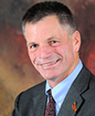
Gov. Mark Gordon (R-WY)
Background
Gordon is a native of Wyoming. He graduated from Middlebury College in 1979 with a degree in history. After working as a rancher and serving on the Board of Directors for the Federal Reserve Bank of Kansas City, he was appointed as treasurer for the state of Wyoming. Gordon unsuccessfully ran for Wyoming US House at-large in 2008. He was then elected to serve a full term as state treasurer in 2012. During his gubernatorial campaign, Gordon emphasized his plans to reduce the size of government and decrease spending. Gordon also plans to work on decreasing federal regulations on Wyoming’s natural resources, while still protecting open spaces and access to public lands. He supports the second amendment and has been a lifelong member of the NRA, using guns on his ranch and for personal protection.
Biography
First Elected: 2018
Party: Republican
Birth Date: 03/14/1957
Education: BA, History, Middlebury College, 1979
Family: Spouse: Jennie; 4 Children
Election Results
2018 General
Mark Gordon (R) | 67%
Mary Throne (D) | 28%

Slide 52
Ways to edit these slides
Looking to customize these slides yourself?
No problem. The slides in this deck can be edited to suit your needs. However, if you alter text, data or images on our slides, we ask that you remove National Journal logos and branding prior to distribution or public use. Examples to look for:
Looking for assistance with customization?
We’re here to help. If you’d like our team of policy researchers and data visualization specialists to customize this deck with your vision in mind, contact your Dedicated Advisor or email service@nationaljournal.com. This service is included in most membership packages.
Feel free to delete this slide before presenting.
2018 | National Journal Presentation Center

