Slide 1
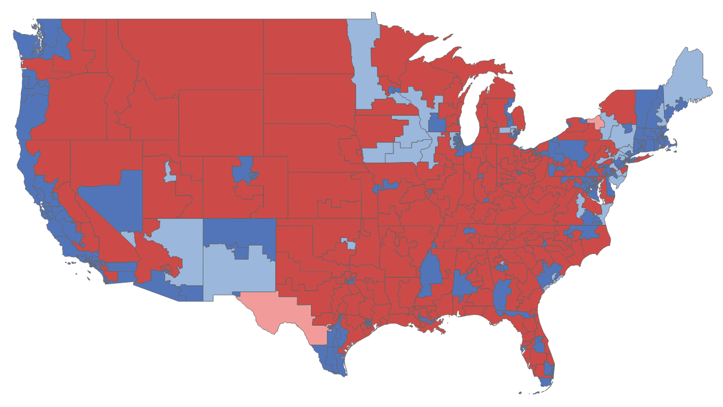
Of districts that Trump carried in 2016, Republicans won almost 200 in 2018 – but lost 30 to Democrats
Change in party vote from the 2016 presidential race results to the 2018 House race results, by district
■ Democrats in districts won by Clinton in 2016
■ Democrats in districts won by Trump in 2016
■ Republicans in districts won by Trump in 2016
■ Republicans in districts won by Clinton in 2016
Sources: Daily Kos Elections estimates of district demographic data, Cook Political Report estimate of 2018 vote share
Alice Johnson | Slide last updated on: December 11, 2018

