Slide 1
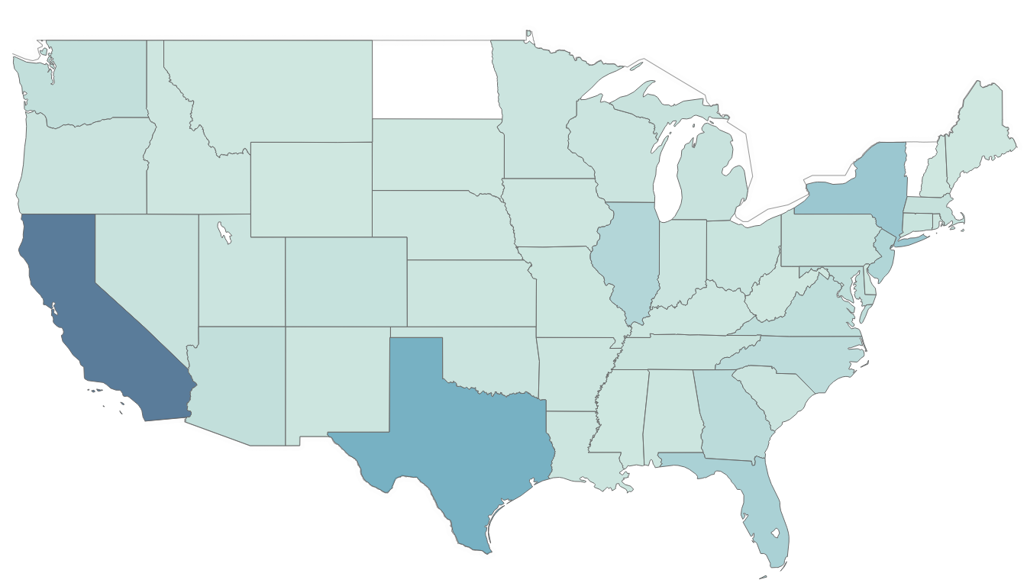
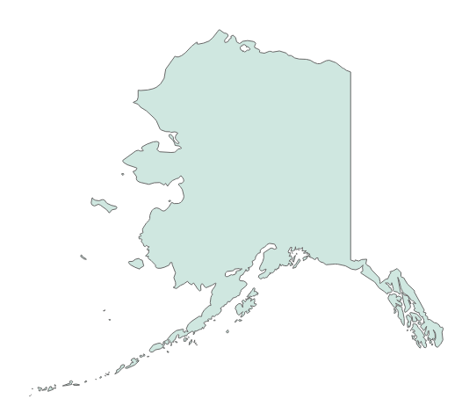
About 11.3 million undocumented immigrants live in the United States
Estimated undocumented immigrant population by state
California has the highest number of undocumented immigrants (3,059,000)
Texas has the second-highest number of undocumented immigrants (1,597,000)
Data not available for North Dakota or Vermont
Sources: Migration Policy Institution tabulation of American Community Survey data and Census Bureau data
Nicholas Wu | Slide last updated on: November 28, 2018
Notes:
https://www.migrationpolicy.org/programs/us-immigration-policy-program-data-hub/unauthorized-immigrant-population-profiles

Slide 2
The most undocumented immigrants live in California, and the fewest live in Montana
State | Population | State | Population | State | Population
California | 3,059,000 | Tennessee | 121,000 | Kentucky | 44,000
Texas | 1,597,000 | Oregon | 113,000 | Iowa | 38,000
New York | 940,000 | Ohio | 107,000 | Nebraska | 38,000
Florida | 656,000 | Connecticut | 102,000 | Hawaii | 36,000
New Jersey | 526,000 | Indiana | 92,000 | Idaho | 30,000
Illinois | 487,000 | South Carolina | 87,000 | Washington, D.C. | 27,000
Georgia | 351,000 | Wisconsin | 86,000 | Rhode Island | 26,000
North Carolina | 321,000 | Minnesota | 83,000 | Mississippi | 25,000
Virginia | 269,000 | Oklahoma | 82,000 | Delaware | 22,000
Maryland | 247,000 | Utah | 79,000 | Alaska | 11,000
Washington | 229,000 | Kansas | 64,000 | New Hampshire | 9,000
Arizona | 226,000 | Alabama | 63,000 | South Dakota | 6,000
Massachusetts | 173,000 | Arkansas | 63,000 | West Virginia | 6,000
Colorado | 162,000 | Louisiana | 63,000 | Wyoming | 6,000
Pennsylvania | 141,000 | New Mexico | 58,000 | Maine | 5,000
Michigan | 129,000 | Missouri | 54,000 | Montana | 3,000
Nevada | 129,000
Data not available for North Dakota or Vermont
Sources: Migration Policy Institution tabulation of American Community Survey data and Census Bureau data
Nicholas Wu | Slide last updated on: November 28, 2018

