Slide 1
2018 midterm elections overview
A look ahead to the 2018 congressional and gubernatorial elections
October 2018
Producer
Presentation Center Staff
Director
Alistair Taylor

Slide 2
Roadmap
Historic midterm trends
2018 midterms
Overall
House
Senate
Governors

Slide 3
The president’s party has lost an average of 25 seats in midterm elections since World War II
President’s party gain/loss of seats in House
VITAL STATISTICS ON CONGRESS
■ Democrats ■ Republicans
2010: Democrats lose control of the House after passing the ACA
1994: Democrats lose their House majority due to health reform plans and Gingrich’s “Contract with America”
Sources: UC Santa Barbara, “The American Presidency Project”
Daniel Stublen | Slide last updated on: July 17, 2018

Slide 4
The president’s party has lost Senate seats in 19 of the last 26 midterm elections
President’s party gain/loss of seats in Senate
VITAL STATISTICS ON CONGRESS
■ Democrats ■ Republicans
2014
Surge and decline theory
When presidents are elected or reelected, their party picks up House and Senate seats, causing them to be overexposed in the following midterm election, or six years later in the Senate
1914
Sources: Charlie Cook, “Will History Hold in 2018 Midterms?” The Cook Political Report, January 9, 2017.
Daniel Stublen | Slide last updated on: July 17, 2018

Slide 5
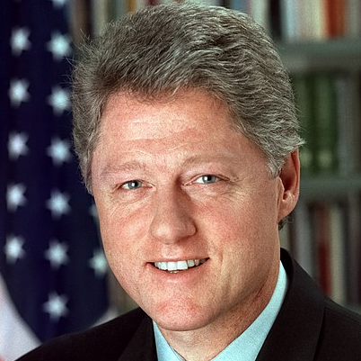
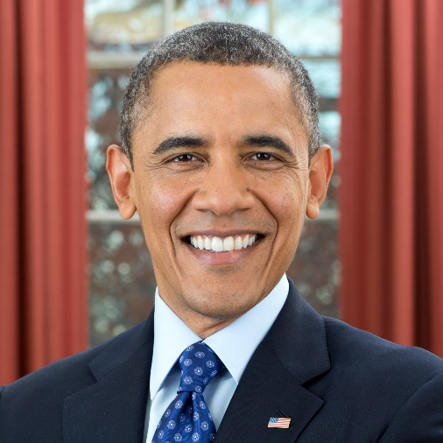
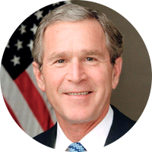
Recent midterm wave elections
1994 elections
President: Bill Clinton (D)
Republican gains:
54 seats in the House
8 seats in the Senate
2010 elections
President: Barack Obama (D)
Republican gains:
63 seats in the House
6 seats in the Senate
2006 elections
President: George W. Bush (R)
Democratic gains:
31 seats in the House
6 seats in the Senate
Sources: National Journal research, 2018.
Daniel Stublen | Slide last updated on: July 17, 2018

Slide 6
Historic polling of generic ballots suggests Democrats will gain seats in 2018, but will it be enough to flip the House?
Comparison between generic ballot polling and House election outcomes
NBC/WSJ POLL
■ Final NBC/WSJ general ballot poll before election
■ Democratic seat gain in election
■ Republican seat gain in election
Current generic ballot:
D+8
Most recent NBC/WSJ Poll: Sept. 19, 2018
Sources: NBC/WSJ
Slide last updated: September 27, 2018

Slide 7
Presidents with a sub-50% approval rating lose an average of 40 seats in the midterms
Presidential job approval vs. midterm results since 1966
■ Gallup presidential approval the week before the midterm
■ Seats gained/lost by president’s party in the midterm
Trump Job Approval
44.3%
RCP Average: Oct. 18, 2018
Job Approval
Over 60%
50%-60%
Under 50%
Average Change
+3 Seats
-12 Seats
-40 Seats
Sources: Gallup presidential approval poll, RealClearPolitics 2018 presidential approval tracking poll
Daniel Stublen | Slide last updated on: October 18, 2018

Slide 8
Roadmap
Historic midterm trends
2018 midterms
Overall
House
Senate
Governors

Slide 9
Current House and Senate divisions
House of Representatives
Senate
50 votes for majority
215 votes needed to pass*
60 votes for supermajority
Total Republicans | 235
Total Democrats | 193
Vacancies | 7
Total Republicans | 51
Total Democrats/Independents | 49
Vacancies | 0
*With seven vacancies and if all sitting members vote
Sources: House and Senate Clerks
Daniel Stublen | Slide last updated on: October 4, 2018

Slide 10
The national GOP committees ended Q3 with over $7 million more cash on hand than their Democratic counterparts
Total cash on hand by national party PACs at end of Q3
AS OF OCTOBER 1, 2018
■ Democratic PAC ■ Republican PAC
Sources: Federal Election Commission, 2018.
Daniel Stublen | Slide last updated on: October 11, 2018

Slide 11
The national GOP committees have raised about $99 million more than their Democratic counterparts so far
Total receipts by national party PACs at end of Q3
AS OF OCTOBER 1, 2018
■ Democratic PAC ■ Republican PAC
Sources: Federal Election Commission, 2018.
Daniel Stublen | Slide last updated on: October 11, 2018

Slide 12
Major super PACs still hold nearly $200 million to spend on independent expenditures
Total cash on hand by major super PACs at end of Q3
AS OF OCTOBER 1, 2018
■ Democratic super PAC ■ Republican super PAC
Sources: Federal Election Commission, 2018.
Daniel Stublen | Slide last updated on: October 11, 2018

Slide 13
Roadmap
Historic midterm trends
2018 midterms
Overall
House
Senate
Governors

Slide 14
Based on 2016 results, Democrats need an average 5%-7.5% swing to recapture the House
Vulnerable seats based on 2016 House results
MARGIN OF VICTORY CALCULATED BY SUBTRACTING WINNER % FROM 2ND HIGHEST OPPONENT
■ Democrat-held seats ■ GOP-held seats
Sources: National Journal Research, 2018.
Daniel Stublen | Slide last updated on: July 17, 2018

Slide 15
Of all registered voters, 52% say they support the Democratic candidate in their district
% of registered voters who say they support the ___ candidate for Congress in their district
PEW RESEARCH POLL; SEPT. 18-24, 2018
■ Republican ■ Democrat
Sources: Pew Research Center
Alice Johnson | Slide last updated on: October 2, 2019
Notes:
http://www.people-press.org/2018/09/26/voter-enthusiasm-at-record-high-in-nationalized-midterm-environment/

Slide 16
House members with the largest war chests remaining for the 2018 midterm elections
Top 10 House candidates with the most cash on hand
AS OF OCTOBER 17, 2018
■ Democrat ■ Republican
Sources: OpenSecrets.org, “Top Cash on Hand”
Nicholas Wu | Slide last updated on: October 17, 2018

Slide 17
Incumbents with the least cash on hand are mostly in safe districts
Cash on hand totals current as of Q3 2018
Senate
House
Cook rating | State | Senator | Cash on hand
Lean R | MS | Hyde-Smith | $2,732,521
Solid D | DE | Carper | $3,987,635
Solid D | HI | Hirono | $4,519,497
Solid D | MD | Cardin | $4,860,813
Solid D | ME | King | $5,246,182
Solid R | NE | Fischer | $6,061,233
Solid D | RI | Whitehouse | $6,275,961
Solid R | MS | Wicker | $6,306,738
Solid R | WY | Barrasso | $7,186,371
Lean D | MN | Smith | $7,365,772
Cook rating | District | Representative | Cash on hand
Solid D | NY-15 | Serrano | $56,289
Solid D | WI-04 | Moore | $53,668
Solid D | DC | Holmes Norton | $58,947
Solid D | FL-5 | Lawson | $60,3030
Solid D | IL-1 | Rush | $64,363
Solid D | PA-02 | Evans | $66,398
Solid D | FL-20 | Hastings | $82, 164
Solid D | CA-40 | Roybal-Allard | $87,449
Solid R | TX-01 | Gohmert | $90,294
Solid D | NJ-10 | Payne | $93,418
Sources: Opensecrets.org Q3 2018 fundraising totals
Nicholas Wu | Slide last updated on: October 17, 2018

Slide 18
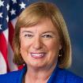
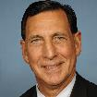
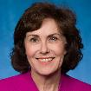
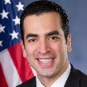
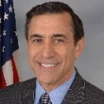
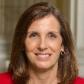
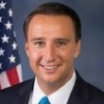
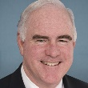
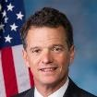
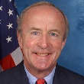
Three open Republican seats are rated “Likely Democratic,” and four open Republican seats are rated “Lean Democratic”
Representatives not seeking re-election in D-leaning districts
NAME OF RETIRING INCUMBENT (“PARTISAN VOTER INDEX”), (PARTY-STATE-DISTRICT)
Solid Democratic
Likely Democratic
Lean Democratic
D+34 Mike Capuano (D-MA07)
D+33 Luis Gutierrez (D-IL04)
D+32 John Conyers (D-MI13)†
D+31 Robert Brady (D-PA04)
D+29 Joe Crowley (D-NY14)
D+26 Keith Ellison (D-MN05)
D+19 Gene Green (D-TX29)
D+17 Colleen Hanabusa (D-HI01)*
Beto O’Rourke (D-TX16)*
D+9 Jared Polis (D-CO02)
Niki Tsongas (D-MA03)
D+7 Michelle Lujan Grisham (D-NM01)
D+6 John Delaney (D-MD06)
D+4 Sandy Levin (D-MI09)
Kyrsten Sinema (D-AZ09)*
Elizabeth Esty (D-CT05)*
Carol Shea-Porter (R+2)
(D-NH01)
Frank LoBiondo (R+1)
(R-NJ02)
Jacky Rosen (R+2)
(D-NV03)*
Ruben Kihuen (D+3)
(D-NV04)
Darrell Issa (R+1)
(R-CA49)
Martha McSally (R+1)
(R-AZ02)*
Ryan Costello (R+2)
(R-PA06)
Patrick Meehan (R+1)
(R-PA05) †
David Trott (R+4)
(R-MI11)
R. Frelinghuysen (R+3)
(R-NJ11)
*Seeking another office
†Resigning before end of term
Sources: “2018 House summary” The Cook Political Report.
Daniel Stublen | Slide last updated on: October 18, 2018

Slide 19
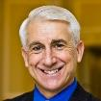
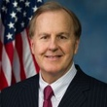
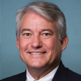
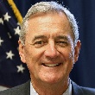
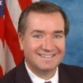
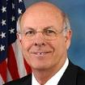
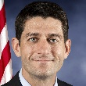
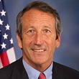
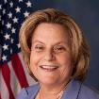
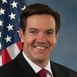
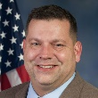
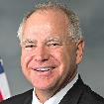
Six open Republican seats and one open Democratic seat are rated “Toss Ups”
Representatives not seeking re-election
NAME OF RETIRING INCUMBENT (“PARTISAN VOTER INDEX”), (PARTY-STATE-DISTRICT)
Toss-Ups
Lean Republican
Solid Republican
R+8 Jim Renacci (R-OH16)
R+9 Joe Barton (R-TX06)
R+11 Tim Murphy (R-PA18) †
R+13 Trent Franks (R-AZ08) †
Ken Buck (R-CO04)
Tom Rooney (R-FL17)
Gregg Harper (R-MS03)
Sam Johnson (R-TX03)
Blake Farenthold (R-TX27) †
Bob Goodlatte (R-VA06)
R+14 Kristi Noem (R-SD-At large)*
Lou Barletta (R-PA09)*
R+15 Trey Gowdy (R-SC04)
R+16 Kevin Cramer (R-ND At large)*
Jeb Hensarling (R-TX05)
R+17 Todd Rokita (R-IN04)*
Jim Bridenstine (R-OK01) †
R+18 Luke Messer (R-IN06)*
R+20 Marsha Blackburn (R-TN07)*
Jimmy Duncan (R-TN02)
R+21 Raul Labrador (R-ID01)*
R+22 Bill Shuster (R-PA13)
R+24 Diane Black (R-TN06)*
Dave Reichert (even)
(R-WA08)
Robert Pittenger (R+7)
(R-NC09)
Dennis Ross (R+6)
(R-FL15)
Rick Nolan (R+4)
(D-MN08)*
Ed Royce (even)
(R-CA39)
Steve Pearce (R+6)
(R-NM02)*
Paul Ryan (R+5)
(R-WI01)
Mark Sanford (R+10)
(R-SC01)
Lynn Jenkins (R+10)
(R-KS02)
Ileana Ros-Lehtinen
(D+5) (R-FL27)
Evan Jenkins (R+23)*
(R-WV03)
Tom Garrett (R+6)
(R-VA05)
Likely Republican
Tim Walz (R+5)
(D-MN01)*
R+7 Ron DeSantis (R-FL06)
R+10 Lamar Smith (R-TX21)
R+11 Ted Poe (R-TX02)
R+14 Conor Lamb (D-PA14)
*Seeking another office
†Resigning before end of term
Sources: “2018 House summary” The Cook Political Report.
Daniel Stublen | Slide last updated on: October 18, 2018

Slide 20
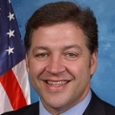
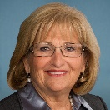
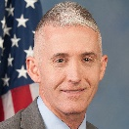
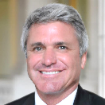
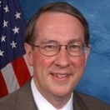
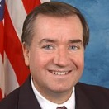
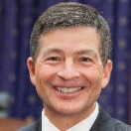
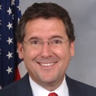
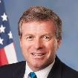
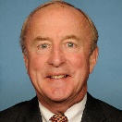
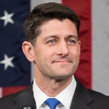
Brain drain? Many Republican committee chairs will not seek reelection in 2018, as well as Speaker Ryan
Republican committee and subcommittee chairs retiring after 2018
REPUBLICAN CONFERENCE RULES LIMIT CHAIRMANSHIPS TO 6 YEARS
Term-limited and retiring
Retiring but not term-limited
Term-limited but still running
Space, Science & Technology
Lamar Smith (R-TX21)
Transportation & Infrastructure
Bill Shuster (R-PA9)
Budget
Diane Black (R-TN6)
Oversight
Trey Gowdy (R-SC4)
Homeland Security
Michael McCaul (R-TX10)
Judiciary
Bob Goodlatte (R-VA6)
Foreign Affairs
Ed Royce (R-CA39)
Financial Services
Jeb Hensarling (R-TX5)
Administration
Gregg Harper (R-MS3)
VA Appropriations Sub.*
Charlie Dent (R-PA15)
Aviation Sub.
Frank LoBiondo (R-NJ2)
Appropriations
Rodney Frelinghuysen (R-NJ11)
Speaker of the House
Paul Ryan (R-WI1)
*Dent is also the chair of the House Ethics Committee but is not term-limited from that position
Sources: National Journal Research, 2017.
Daniel Stublen | Slide last updated on: July 17, 2018

Slide 21
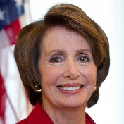
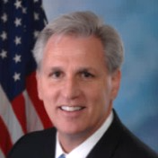
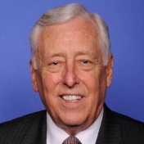
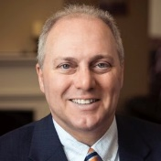
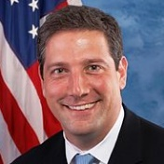
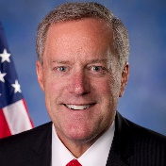
The 2018 election will determine who will replace Paul Ryan as speaker in the 116th Congress
Frontrunners in the race for speaker of the House
Nancy Pelosi (D-CA)
Minority Leader – No. 1 House Democrat
Previous experience as speaker
Largest Dem. fundraiser
Has led House Dems since 2003
Kevin McCarthy (R-CA)
Majority Leader – No. 2 House Republican
Has ties to President Trump
Major fundraiser for House Republicans
Lacked support in 2015 from Freedom Caucus
Steny Hoyer (D-MD)
Minority Whip – No. 2 House Democrat
Has been deputy to Pelosi for 15 years
Steve Scalise (R-LA)
Majority Whip – No. 3 House Republican
Former Republican Study Committee chair
First elected in 2008
Has some support from conservatives
Tim Ryan (D-OH)
Long shot because he is not in leadership
Ranking member of the Appropriations Subcommittee for the Legislative Branch
Unsuccessfully challenged Pelosi in 2016
Mark Meadows (R-NC)
Chair of the House Freedom Caucus
First elected in 2012
Campaigned with Pres. Trump in NC
Sources: Deirdre Shesgreen and Deborah Barfield Berry, “Who's who in the race to become the next House speaker?”, April 12, 2018, USA Today
Daniel Stublen | Slide last updated on: July 17, 2018

Slide 22
Pelosi faces increasing opposition, with over 40 House candidates saying they would not back her for Speaker
Potential problems for Pelosi:
Unlike party positions such as minority and majority leader, the whole House formally votes for the speaker
Parties vote by secret ballot beforehand to choose their nominee, and then they vote en bloc for that candidate in the formal House vote
However, over 40 Democratic House candidates have said they will not support Pelosi for Speaker of the House, which could pose problems if they only win a small majority
If Democrats win the majority by just 1 vote (218-217), Pelosi would need 109 votes to win her party’s nomination
In 2016, she won the minority leader position against Rep. Tim Ryan (D-OH) on a vote of 134-63
Sources: House.gov; Ella Nilsen, “More than 40 Democratic House candidates want Nancy Pelosi to step aside after 2018,” Vox. August 10, 2018.
Alice Johnson | Slide last updated on: August 13, 2018

Slide 23
Roadmap
Historic midterm trends
2018 midterms
Overall
House
Senate
Governors

Slide 24
2018 Senate candidates with the largest war chests for the midterm elections
Top 10 Senate candidates with the most cash on hand at the end of Q3
AS OF OCTOBER 1, 2018
■ Democrat ■ Republican
Sources: OpenSecrets.org, “Top Cash on Hand”
Daniel Stublen | Slide last updated on: October 17, 2018

Slide 25
Of the 26 Democratic senators up for re-election, Trump won 10 of their states – and five by double digits
Senators up for re-election in states won by the opposing party’s 2016 presidential candidate
PERCENTS INSIDE THE STATE REPRESENT BY HOW MUCH THE OTHER PARTY’S PRESIDENTIAL CANDIDATE WON IN 2016
Clinton victory Trump victory ■ Democratic senator up for re-election ■ Republican senator up for re-election
Jon Tester (D) won in 2012 by 4%
Heidi Heitkamp (D) won in 2012 by 0.9%
Tammy Baldwin (D) won in 2012 by 5.6%
Debbie Stabenow (D) won in 2012 by 21%
WA
Joe Donnelly (D) won in 2012 by 5.7%
MT
20%
ND
36%
ME
Dean Heller (R) won in 2012 by 1.2%
OR
MN
ID
SD
WI
0.7%
NY
Sherrod Brown (D) won in 2012 by 6.0%
WY
MI
0.3%
NV
2.4%
IA
PA
0.7%
NE
IN
19%
OH
8.1%
Bob Casey, Jr. (D) won in 2012 by 9.1%
UT
IL
WV
42%
CA
CO
KS
MO
19%
VA
KY
Joe Manchin (D) won in 2012 by 14%
AZ
TN
NC
NM
OK
AR
SC
MS
AL
GA
Claire McCaskill (D) won in 2012 by 16%
AK
TX
LA
Bill Nelson (D) won in 2012 by 13%
HI
FL
1.2%
Sources: National Journal Research, 2017.
Daniel Stublen | Slide last updated on: July 17, 2018

Slide 26
Three Republican Senate seats are now considered among the 10 most likely to flip in November
Hotline’s 2018 Senate power rankings
■ Seat held by Republican ■ Seat held by Democrat
■ Top five states most likely to flip
1. Nevada:
Incumbent: Dean Heller (R)
Challenger: US Rep. Jacky Rosen (D)
2. North Dakota :
Incumbent: Heidi Heitkamp (D)
Challenger: US Rep. Kevin Cramer (R)
3. Indiana:
Incumbent: Joe Donnelly (D)
Challenger: Former IN State Rep. Mike Braun (R)
4. Missouri:
Incumbent: Claire McCaskill (D)
Challenger: AG Josh Hawley (R)
5. Arizona:
Current: Jeff Flake (R), retiring
Candidates: Rep. Martha McSally (R)
Rep. Krysten Sinema (D)
2
1
3
4
5
6. Florida — Bill Nelson (D)
7. West Virginia — Joe Manchin (D)
8. Montana — Jon Tester (D)
9. Tennessee — Bob Corker (R), retiring
10. Wisconsin — Tammy Baldwin (D)
Sources: Zach Cohen and Kyle Trygstad, “Hotline’s Senate Power Rankings,” National Journal, July 31, 2018.
Alice Johnson | Slide last updated on: August 1, 2018

Slide 27
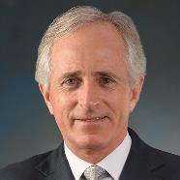
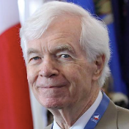
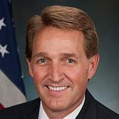
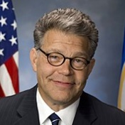
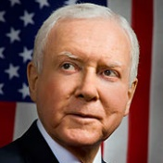
Retirements from the Senate open seats to costly primaries and potentially contentious general elections
Senators retiring and not seeking reelection in 2018
Corker has been an outspoken critic of Trump
Rep. Marsha Blackburn (R-TN) is the Republican frontrunner
Former Democratic TN governor Phil Bredesen (2003-2011) also announced his candidacy
Cochran announced his resignation due to health concerns
Gov. Phil Bryant (R) appointed Ag Commissioner Cindy Hyde-Smith, a former Democrat, to fill the seat until a Nov. 2018 special election
She will be challenged by hard-right state senator Chris McDaniel (R)
Mike Espy (D), a former US secretary of agriculture, intends to run
Sen. Roger Wicker (R) is also up for re-election in 2018
Bob Corker
(R-TN)
Thad Cochran
(R-MS)
Flake decided not to run in light of low polling numbers and a strong challenge by Kelli Ward
Competitive Republican primary between Rep. Martha McSally (R-AZ02), State Rep. Kelli Ward and former sheriff Joe Arpaio
Rep. Kyrsten Sinema (D-AZ09) is considered the Democratic frontrunner
Jeff Flake
(R-AZ)
Franken resigned on January 2nd amid a sexual harassment scandal
He was replaced by Tina Smith (D) to fill his seat until a special election in November 2018
Both Minnesota Senate seats will be on the ballot in November
Hatch announced his retirement after initially deciding to run
Former MA governor and presidential candidate Mitt Romney announced he was running for the open seat in mid-February and is expected to win the seat
Al Franken
(D-MN)
Orrin Hatch
(R-UT)
Sources: National Journal Research 2017. *Includes Sen. Al Franken (D-MN) who resigned in January and was replaced by the Tina Smith (D)
Daniel Stublen | Slide last updated on: July 17, 2018

Slide 28
Roadmap
Historic midterm trends
2018 midterms
Overall
House
Senate
Governors

Slide 29
In 2018, Republicans must defend 13 governorships without an incumbent running, as opposed to only 4 for Democrats
2018 gubernatorial races by incumbent and status
■ Dem. incumbent (5) ■ Dem. open* (4) ■ Ind. incumbent (1)
■ GOP incumbent (13) ■ GOP open* (13) ■ No election (14)
WA
MT
ND
VT
ME
OR
MN
NH
ID
SD
WI
NY
WY
MI
MA
NV
NE
IA
PA
RI
UT
IL
IN
OH
CO
WV
CT
CA
KS
MO
KY
VA
NJ
TN
NC
DE
AZ
NM
OK
AR
SC
MD
MS
AL
GA
AK
TX
LA
HI
FL
*“Open seats” are governorships where incumbent governors are term-limited or they have announced that they are not running for re-election
Sources: Cook Political Report, 2017.
Daniel Stublen | Slide last updated on: August 16, 2018

Slide 30
Democrats have a shot at picking up several governorships
Hotline’s power rankings for gubernatorial elections
■ Democrat incumbent ■ Republican incumbent
Seats most vulnerable to change parties
1. Illinois: Bruce Rauner (R)
Challenger: JB Pritzker (D)
2. New Mexico: Susana Martinez (R) (retiring)
Candidates: Rep. Steve Pearce (R)
Michelle Lujan Grisham (D)
3. Maine: Paul LePage (R) (retiring)
Candidates: Janet Mills (D)
Shawn Moody (R)
4. Alaska: Bill Walker (I)
Challengers: Mike Dunleavy (R)
Mark Begich (D)
5. Nevada: Brian Sandoval (R) (retiring)
Candidates: Steve Sisolak (D)
Adam Laxalt (R)
6. Michigan: Rick Snyder (R) (retiring)
7. Connecticut: Dan Malloy (D) (retiring)
8. Florida: Rick Scott (R) (retiring)
9. Minnesota: Mark Dayton (D) (retiring)
10. Ohio: John Kasich (R) (retiring)
Sources: Zach Cohen and Kyle Trygstad, “Hotline’s Governor Race Power Rankings,” National Journal, April 24, 2018; National Journal Research, 2o18.
Daniel Stublen | Slide last updated on: August 23, 2018

Slide 31
Most states held their primaries in June or August
2018 congressional primary calendar
■ Completed primary election ■ Primary election to come
March
May
June
 |  |  |  | 1 | 2 | 3
4 | 5 | 6 | 7 | 8 | 9 | 10
11 | 12 | 13 | 14 | 15 | 16 | 17
18 | 19 | 20 | 21 | 22 | 23 | 24
25 | 26 | 27 | 28 | 29 | 30 | 31
 |  | 1 | 2 | 3 | 4 | 5
6 | 7 | 8 | 9 | 10 | 11 | 12
13 | 14 | 15 | 16 | 17 | 18 | 19
20 | 21 | 22 | 23 | 24 | 25 | 26
27 | 28 | 29 | 30 | 31
 |  |  |  |  | 1 | 2
3 | 4 | 5 | 6 | 7 | 8 | 9
10 | 11 | 12 | 13 | 14 | 15 | 16
17 | 18 | 19 | 20 | 21 | 22 | 23
24 | 25 | 26 | 27 | 28 | 29 | 30
August
September
November
 |  |  | 1 | 2 | 3 | 4
5 | 6 | 7 | 8 | 9 | 10 | 11
12 | 13 | 14 | 15 | 16 | 17 | 18
19 | 20 | 21 | 22 | 23 | 24 | 25
26 | 27 | 28 | 29 | 30 | 31
 |  |  |  |  |  | 1
2 | 3 | 4 | 5 | 6 | 7 | 8
9 | 10 | 11 | 12 | 13 | 14 | 15
16 | 17 | 18 | 19 | 20 | 21 | 22
23 | 24 | 25 | 26 | 27 | 28 | 29
30
 |  |  |  | 1 | 2 | 3
4 | 5 | 6 | 7 | 8 | 9 | 10
11 | 12 | 13 | 14 | 15 | 16 | 17
18 | 19 | 20 | 21 | 22 | 23 | 24
25 | 26 | 27 | 28 | 29 | 30 | 31
March 6: TX March 20: IL | May 8: IN, NC, OH, WV May 15: ID, NE, OR, PA May 22: AR, GA, KY | June 5: AL, CA, IA, MS, MT, NJ, NM, SD June 12: ME, NV, ND, SC, VA | June 19: DC June 26: CO, MD, NY, OK, UT
Aug. 2: TN Aug. 7: KS, MI, MO, WA Aug. 11: HI | Aug. 14: CT, MN, VT, WI Aug. 21: AK, WY Aug. 28: AZ, FL | Sept. 11: DE, NH Sept. 12: RI Sept. 18: MA | Nov. 6: LA
*No primary elections in April, July or October
Source: National Journal Research, 2018.
Daniel Stublen | Slide last updated on: September 27, 2018

