Slide 1
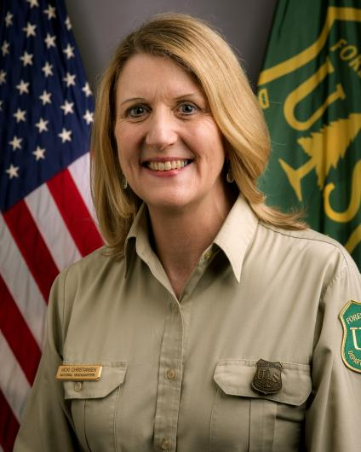
U.S. Forest Service Chief Vicki Christiansen
Biography
Current position: Chief of the U.S. Forest Service Assumed position: October 11, 2018 Education: B.A., University of Washington, 1983 Family: Married (Mike Harris), 2. children
Professional Experience
Worked for the Washington State Department of Natural Resources for 26 years as a wildland firefighter and fire manager
Previously served as the Arizona State Forester and Director of the Arizona Division of Forestry
Came to the U.S. Forest Service in 2010 as Deputy Director of Fire and Aviation Management
Has served as interim chief since March 2018, and was Deputy Chief, State and Private Forestry before that
Was Chair of the Wildland Fire Committee for the National Association of State Foresters
Contact
USDA Forest Service Sidney R. Yates Federal Building 201 14th Street, SW Washington, DC 20024 Phone: (800) 832-1355
“
As a former wildland firefighter and fire manager, Chief Christiansen knows what’s needed to restore our forests and put them back to work for the taxpayers.
Secretary of Agriculture Sonny Perdue on the announcement of Christiansen’s nomination
Sources: National Journal Research, 2018
Nicholas Wu | Slide last updated on: October 12, 2018

