Slide 1
PAC Insights Report: Alpha Organization
SAMPLE REPORT
Contributions to 2018 federal races &
comparison with peer organizations
October 5, 2018
**This is a sample report, and all numbers are for illustration purposes only.

Slide 2
Table of contents
Background & highlights
PAC contributions: 2018 cycle
PAC intelligence report & competitive analysis
National Journal has worked to ensure the accuracy of the information it provides to its members. This report relies upon data obtained from many sources, however, and National Journal is not able to guarantee the accuracy of the information or analysis contained in these materials. Furthermore, National Journal is not engaged in rendering legal, accounting, or any other professional services. National Journal specifically disclaims liability for any damages, claims or losses that may arise from a) any errors or omissions in these materials, whether caused by National Journal or its sources, or b) reliance upon any recommendation made by National Journal.

Slide 3
Background on PAC giving
Political committees
Super PACs
Candidate committees
Automatically created when a candidate declares an intention to run
Money donated goes directly to the candidate’s campaign and must be disclosed to the FEC
Cannot directly donate to federal candidates or parties.
Candidate-aligned
Party-aligned
Party committees
Fundraise each election cycle in the same way that candidates do
Parties may only raise "hard money," which is given by individuals and political action committees and is subject to federal contribution limits
Issue-aligned
PACs
PACs can give $5,000 to a candidate committee per election (primary, general or special)
They can also give up to $15,000 annually to any national party committee, and $5,000 annually to any other PAC
PACs may receive up to $5,000 from any one individual, PAC or party committee per calendar year
A PAC must register with the FEC within 10 days of its formation, providing name and address for the PAC, its treasurer and any connected organizations
Affiliated PACs are treated as one donor for the purpose of contribution limits.
Sources: FEC, 2018; National Journal Research, 2018.

Slide 4
Highlights from Alpha Company’s PAC activities
2018 CYCLE
Candidate success rate
Disbursements
Candidates supported
Financial report
Total receipts | $1,457,040
Cash balance beginning of year | $262,294
Cash balance end of year | $1,503,294
Total disbursements to campaigns | $1,259,284
Total number of campaigns | 190
Sources: FEC, 2018; National Journal Research, 2018.

Slide 5
In 2018, Alpha Company PAC gave to both Republican and Democratic PACs
Contributions to 2018 general election candidates, by election outcome
AS OF DECEMBER 31, 2018
■ Contributions to D winners ■ Contributions to D losers ■ Contributions to politicians not up for election*
■ Contributions to R winners ■ Contributions to R losers
■ Total donations to winners ■ Total donations to losers
* Candidates not up for election are politicians that were either retiring, seeking another office in 2016 or not up for re-election in the Senate.
Sources: FEC, 2018; National Journal Research, 2018.

Slide 6
Alpha Company PAC spent $60,000 on party committees
PAC to PAC/party donations, 2018
AS OF AUGUST 21, 2018
Sources: Federal Election Commission, 2018.

Slide 7
Alpha Company PAC spent $100,500 on both House and Senate races in California
Top 10 states by total disbursements
AS OF AUGUST 21, 2018
Sources: Federal Election Commission, 2018.

Slide 8
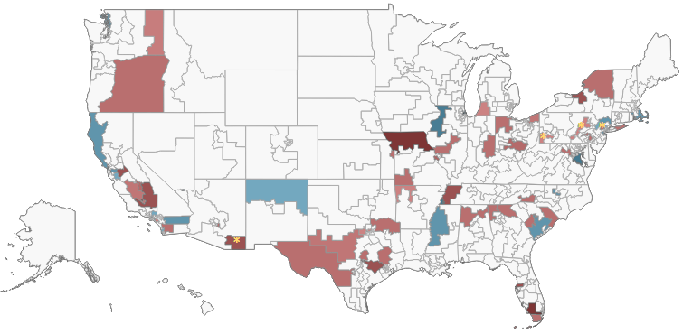
For the 2018 midterms, Alpha Company PAC has already given to many campaigns nationwide
Contributions to 2018 House races
AS OF JUNE 30, 2018
Donation
$0
$10,000+
$0
$10,000+
C – Donations to non-incumbents
* — Donations to a candidate that is retiring or seeking another office
Sources: FEC, 2018; National Journal Research, 2018.

Slide 9
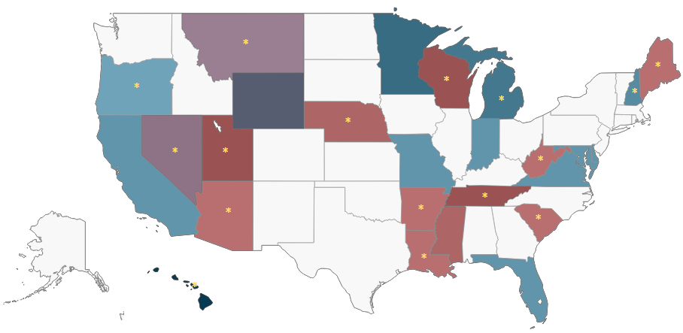
Alpha Company PAC has given to key 2018 Senate races and many senators not up for re-election until 2020
Contributions to 2018 Senate races
AS OF JUNE 30, 2018
Donation
$0
$10,000+
$0
$10,000+
C – Donations to non-incumbents
* — Donations to a candidate that is retiring or not up for reelection
Sources: FEC, 2018; National Journal Research, 2018.

Slide 10
The finance, insurance & real estate industry spent $67,705,076 on the 2018 midterms
Total PAC contributions by industry, 2018
AS OF AUGUST 21, 2018
D: $6,816,837 | R: $14,115,173
D: $9,478,080 | R: $12,103,881
D: $2,838,103 | R: $8,297,869
D: $5,547,590 | R: $8,919,280
D: $5,701,519 | R: $17,439,568
D: $26,267,887 | R: $41,437,189
D: $17,187,732 | R: $23,435,122
D: $27,089,089 | R: $29,396,355
D: $33,073,081 | R: $7,057,440
D: $5,649,713 | R: $4,885,118
D: $11,362,183 | R: $20,019,233
D: $6,769,030 | R: $13,546,181
Sources: Federal Election Commission, 2018.

Slide 11
Alpha Company PAC spent $1,259,284 in 2018
Total money raised and spent in 2018 cycle
AS OF AUGUST 31, 2018
■ Total receipts ■ Total spent
Sources: Federal Election Commission, 2018.

Slide 12
Alpha Company PAC has $1,503,294 remaining cash on hand
Money spent in 2018 cycle combined with cash on hand
AS OF AUGUST 31, 2018
■ Total money spent so far in 2018 cycle ■ Total cash on hand remaining
Sources: Federal Election Commission, 2018.

