Slide 1
Key Senate votes on Supreme Court nominee Kavanaugh
October 1, 2018
Producer
Nicholas Wu

Slide 2
Current Senate divisions
50 votes for majority
Republicans only hold a one-vote majority
In April 2017, the Senate confirmed Supreme Court Justice Neil Gorsuch 54-45, with three Democrats joining all Republicans
Democrat Doug Jones’s (D-AL) surprise victory in the Alabama special Senate race has narrowed the Republican majority to two votes
Trump must hold all Republicans together or woo enough vulnerable Democrats to confirm Kavanaugh
Total Republicans | 51
Total Democrats/Independents | 49
Vacancies | 0
Sources: National Journal Research, 2018
Nicholas Wu | Slide last updated on: October 1, 2018

Slide 3
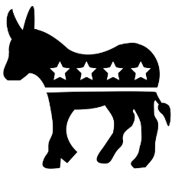
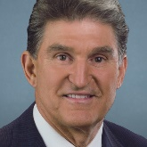
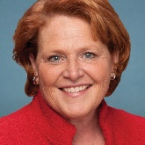
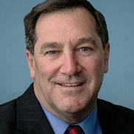
Pivotal votes: Democrats up for reelection in states won by President Trump in 2016
Red-state Democrats
Sens. Manchin (D-WV), Heitkamp (D-SD), and Donnelly (D-IN) are vulnerable Democrats in states Trump won by Trump by 15+ points in 2016
They all voted to confirm Trump’s nominee Neil Gorsuch to the Supreme Court in 2017
Sen. Donnelly has announced his opposition; Sens. Manchin and Heitkamp remain undecided
“It took courage to take a stand and call for a one-week FBI investigation to get to the bottom of the allegations against Judge Kavanaugh. This has been a partisan and divisive process.”
- Sen. Manchin, in a September 28 statement
“This isn’t an easy decision. And honestly, I don’t think it should be easy for anyone”.
- Sen. Heitkamp, in a Sept. 28 interview with the Grand Forks Herald
"While I would gladly welcome the opportunity to work with President Trump on a new nominee for this critically important position, if Judge Kavanaugh's nomination comes before the full Senate for a vote under these circumstances, I will oppose it,"
- Sen. Donnelly, in a September 28 statement announcing his opposition
Sources: National Journal Research; Washington Post; Grand Forks Herald
Nicholas Wu | Slide last updated on: October 1, 2018

Slide 4
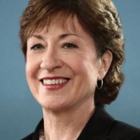
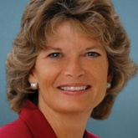
Pivotal votes: moderate Republicans
Moderate Republicans
Moderate Sens. Collins (R-ME) and Murkowski (R-AK) have historically supported pro-choice candidates and bucked party leadership on reforming the ACA repeal and other issues
Both Collins and Murkowski voted to confirm Kavanaugh’s federal judge nomination in 2006
Both remain swing votes after the Judiciary Committee hearing with Kavanaugh and Christine Blasey Ford
Both support the FBI investigation
“In the end, I have to be able to look in the mirror and say I did what I thought was right.”
- Sen. Collins, reported in the Boston Globe on September 22
“We are now in a place where it’s not about whether or not Judge Kavanaugh is qualified. It is about whether or not a woman who has been a victim at some point in her life is to be believed.”
- Sen. Murkowski, in an interview with the New York Times on September 25
Sources: National Journal Research; New York Times; Boston Globe
Nicholas Wu | Slide last updated on: October 1, 2018

Slide 5
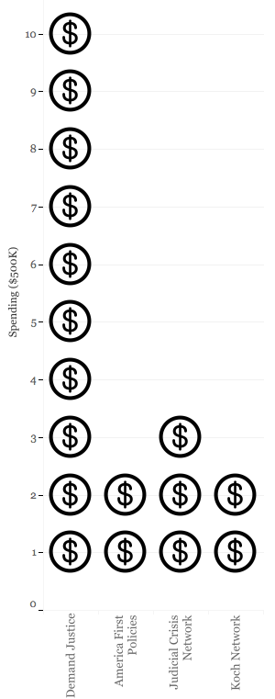
Outside political pressure
Outside spending
Outside groups plan to spend at least $10 million dollars to pressure senators to confirm or oppose Kavanaugh
Liberal-aligned group Demand Justice has committed at least $5 million in an attempt to flip Sens. Murkowski and Collins, and to ensure the opposition of Sens. Donnelly, Heitkamp, and Manchin
Sources: National Journal Research; Roll Call; Wall Street Journal
Nicholas Wu | Slide last updated on: July 12, 2018

