Slide 1
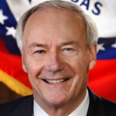
2018 election dashboard: Arkansas governor
Seat currently held by:
Asa Hutchinson (R)
Cook Rating: Solid R
2018 Primary Results
Election dates
Filing deadline — March 1, 2018
Primary election – May 22, 2018
General election — November 6, 2018
*Primary winners
Cash on Hand
Previous election results
Sources: National Journal Research, 2018; Ballotpedia, 2018; Cook Political Report, 2018; The New York Times; Michigan Secretary of State
Slide last updated on: August 8, 2018

Slide 2
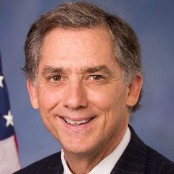
2018 election dashboard: AR-2
Seat currently held by:
French Hill (R)
Cook Rating: Lean R
Cook Partisan Voting Index: R+7
Election dates
Filing deadline — March 1, 2018
Primary election – May 22, 2018
General election — November 6, 2018
Previous election results
Sources: National Journal Research, 2018; Ballotpedia, 2018; Cook Political Report, 2018.
Slide last updated on: August 27, 2018

