Slide 1
Overview of the AIM Higher Act
House Dems proposed a multi-pronged reauthorization bill, countering much of the PROSPER Act
Improving access to a quality degree
Making college more affordable
Increasing college completion
Provisions
Funds state efforts to increase student access to early credit pathways
Increases funding to federal outreach and student services programs TRIO and GREAR UP
Funds local efforts to help foster and homeless youth attend college
Allows recipients of DACA access to federal aid
Makes Pell Grants available to incarcerated individuals
Provides tuition assistance to Native American students and students in US territories
Simplifies the FAFSA form
Provisions
Increases the maximum Pell Grant award amount by $500 each award year and “permanently indexes the Pell award to inflation”
Preserves the Teacher Education Assistance for College and Higher Education (TEACH) Grant, from which teachers can receive up to $4000
Eliminates origination fees for federal loans: allows students to pay up to 4.264 percent of their loan amount in origination fees each time they borrow
Nearly doubles the federal allocation for the federal work study program
Provisions
Provides grant aid to low-income students who transfer from a community college to an MSI*
Increases funding to Child Care Access means Parents in School (CCAMPIS)
Authorizes grants to institutions that serve a significant number of veterans
Amends the Family Educational Rights and Privacy Act (FERPA) to allow for the reverse transfer of student data
Increases funding to under-sourced community colleges, HBCUs* and MSIs
*MSI: Minority-Serving Institution
*HBCU: Historically Black College/University
Sources: Congress.gov; Democrats-edworkforce.house.gov.
Danari White | Slide last updated on: September 21, 2018

Slide 2
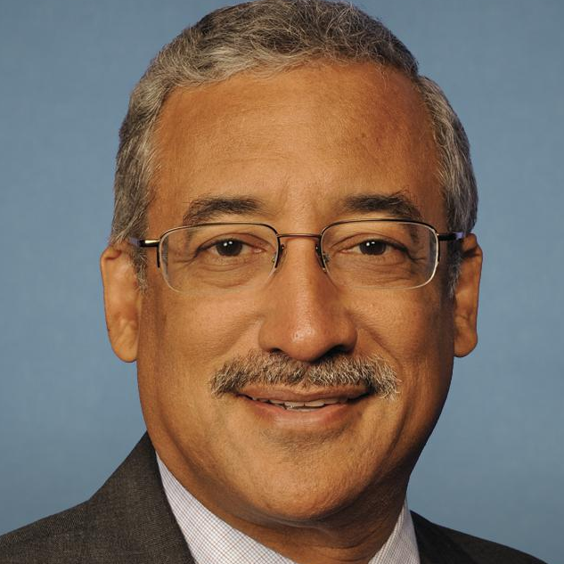
HEA reauthorization: AIM Higher Act
H.R. 6543
Bill at a glance
Introduced
7/26/18
Passed House
Passed Senate
To president
Signed into law
Bill overview
The Aim Higher Act is the House Democrats’ proposed reauthorization bill for the Higher Education Act, which authorizes most federal higher education student aid
The bill was drafted as the Democratic alternative to the controversial GOP proposal for HEA reauthorization, a bill called the PROSPER Act
The bill would provide states with grant aid to leverage reforms
It rewards states that make tuition at state college colleges and universities more affordable and make an associate’s degree at the state’s public two-year colleges free for every student
It also authorizes additional quality checks for federally-aided programs using a Competency Based Education (CBE) model
The bill requires the Secretary to appoint a Special Assistant for Equity and Inclusion
Robert Scott
(D-VA-3)
Bill sponsor
Co-sponsors: 63
Status in Congress
House: Introduced and referred to House Committee on Education and the Workforce
Points of controversy
The Congressional Budget Office has yet to assess how much the Aim Higher Act plan would cost the government
Sources: Congress.gov; Democrats-edworkforce.house.gov.
Danari White | Slide last updated on: September 21, 2018

