Slide 1
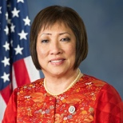
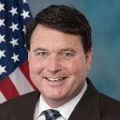
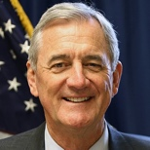
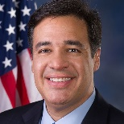
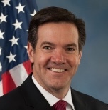
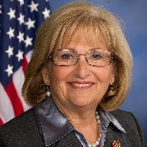
Five Republicans and two Democrats have so far lost in primaries for another office
Lost in primaries for another office
Luke Messer (R-IN6)
Defeated in the May primary for US Senate by businessman Mike Braun
Colleen Hanabusa (D-HI1)
Defeated in the August primary for Governor of Hawaii by incumbent David Ige
Todd Rokita (R-IN4)
Defeated in the May primary for US Senate by businessman Mike Braun
Rick Nolan (D-MN8)
Defeated in the August primary for Lieutenant Governor of Minnesota by Minnesota House member Peggy Flanagan
Raúl Labrador (R-ID1)
Defeated in the May primary for Idaho governor by Lt. Gov. Brad Little
Evan Jenkins (R-WV3)
Defeated in the May primary for US Senate by WV Attorney General Patrick Morrisey
Diane Black (R-TN6)
Defeated in the July primary for Tennessee governor by businessman Bill Lee
Sources: Roll Call, Congressional Casualty List
Nicholas Wu | Slide last updated on: September 6, 2018

Slide 2
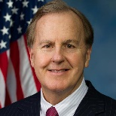
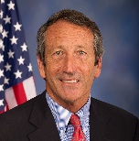
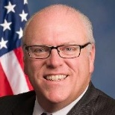
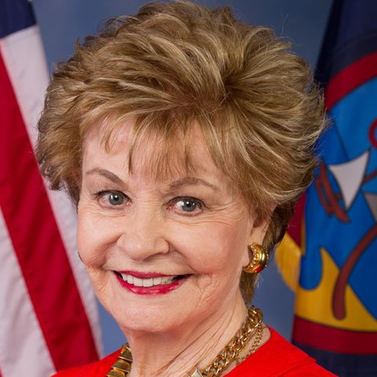
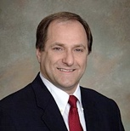
Two Republicans and three Democrats have so far lost in primaries for reelection
Lost to primary challengers
Robert Pittenger (R-NC9)
Defeated in the May primary by pastor Mark Harris, who narrowly lost to Pittenger in 2016
Mark Sanford (R-SC1)
Defeated in the June primary by Trump-endorsed State Representative Katie Arrington
Joe Crowley (D-NY14)
Defeated in the June primary by Democratic Socialist Alexandria Ocasio-Cortez
Madeleine Bordallo (D-Guam)
Defeated in the August primary by territorial senator Michael San Nicolas
Mike Capuano (D-MA7)
Defeated in the September primary by Boston City Council member Ayanna Pressley
Sources: Roll Call, Congressional Casualty List
Nicholas Wu | Slide last updated on: September 19, 2018

