Slide 1
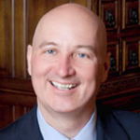
2018 election dashboard: Nebraska governor
Seat currently held by:
Pete Ricketts (R)
Cook Rating: Solid R
2018 Primary Results
Election dates
Filing deadline — March 1, 2018
Primary election – May 15, 2018
General election — November 6, 2018
*Primary winners
Cash on Hand
Previous election results
Sources: National Journal Research, 2018; Ballotpedia, 2018; Cook Political Report, 2018; The New York Times.
Slide last updated on: September 13, 2018

Slide 2
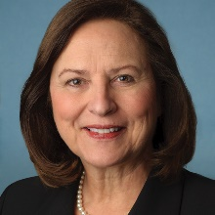
2018 election dashboard: NE-Senate
Seat currently held by:
Deb Fischer (R)
Cook Rating: Likely R
Election dates
Filing deadline — March 1, 2018
Primary election – May 15, 2018
General election — November 6, 2018
Previous election results
Sources: National Journal Research, 2018; Ballotpedia, 2018; Cook Political Report, 2018.
Slide last updated on: September 11, 2018

Slide 3
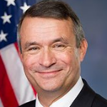
2018 election dashboard: NE-2
Seat currently held by:
Don Bacon (R)
Cook Rating: Lean R
Cook Partisan Voting Index: R+4
Election dates
Filing deadline — March 1, 2018
Primary election – May 15, 2018
General election — November 6, 2018
Previous election results
Sources: National Journal Research, 2018; Ballotpedia, 2018; Cook Political Report, 2018.
Slide last updated on: September 11, 2018

