Slide 1
MIDTERM DASHBOARD
2018 election dashboard: Illinois governor
Seat currently held by:
Bruce Rauner (R)
Cook Rating: Solid R
2018 Primary Results
Election dates
Filing deadline — December 4, 2017
Primary election – March 20, 2018
General election — November 6, 2018
*Primary winners
Cash on Hand
Previous election results
Sources: National Journal Research, 2018; Ballotpedia, 2018; Cook Political Report, 2018; The New York Times, 2018.
Slide last updated on: September 6, 2018

Slide 2
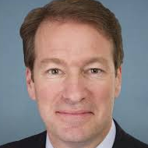
2018 election dashboard: IL-6
Seat currently held by:
Peter Roskam (R)
Cook Rating: Toss Up
Cook Partisan Voting Index: R+2
Election dates
Filing deadline — December 4, 2017
Primary election – March 20, 2018
General election — November 6, 2018
Previous election results
Sources: National Journal Research, 2018; Ballotpedia, 2018; Cook Political Report, 2018.
Slide last updated on: September 6, 2018

Slide 3
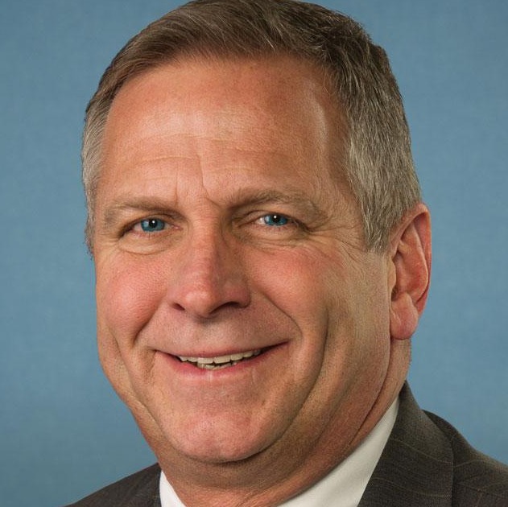
2018 election dashboard: IL-12
Seat currently held by:
Mike Bost (R)
Cook Rating: Toss Up
Cook Partisan Voting Index: R+5
Election dates
Filing deadline — December 4, 2017
Primary election – March 20, 2018
General election — November 6, 2018
Previous election results
Sources: National Journal Research, 2018; Ballotpedia, 2018; Cook Political Report, 2018.
Slide last updated on: September 6, 2018

Slide 4
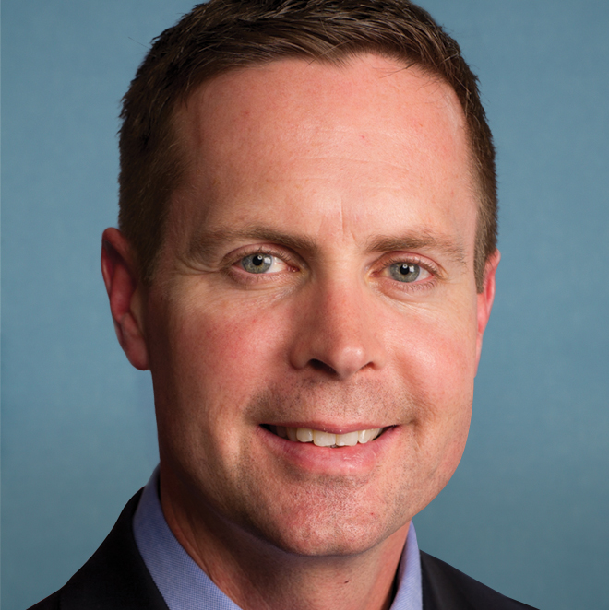
2018 election dashboard: IL-13
Seat currently held by:
Rodney Davis (R)
Cook Rating: Lean R
Cook Partisan Voting Index: R+3
Election dates
Filing deadline — December 4, 2017
Primary election – March 20, 2018
General election — November 6, 2018
Previous election results
Sources: National Journal Research, 2018; Ballotpedia, 2018; Cook Political Report, 2018.
Slide last updated on: September 6, 2018

Slide 5
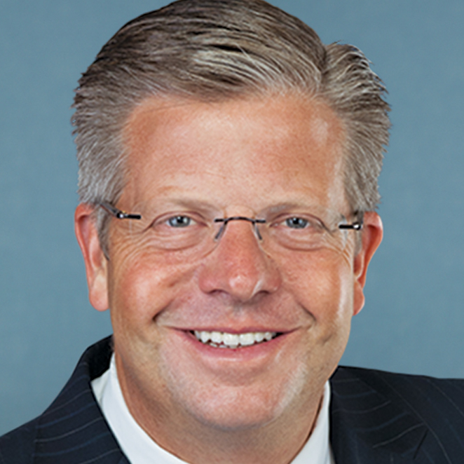
2018 election dashboard: IL-14
Seat currently held by:
Randy Hultgren (R)
Cook Rating: Lean R
Cook Partisan Voting Index: R+5
Election dates
Filing deadline — December 4, 2017
Primary election – March 20, 2018
General election — November 6, 2018
Previous election results
Sources: National Journal Research, 2018; Ballotpedia, 2018; Cook Political Report, 2018.
Slide last updated on: September 6, 2018

