Slide 1
2018 election dashboard: Florida governor
Seat currently held by:
Rick Scott (R)
Cook Rating: Toss Up
2018 Primary Results
Election dates
Filing deadline — May 4, 2018
Primary election – August 28, 2018
General election — November 6, 2018
*Primary winners
Cash on Hand
Previous election results
Sources: National Journal Research, 2018; Ballotpedia, 2018; Cook Political Report, 2018; The New York Times.
Slide last updated on: August 29, 2018

Slide 2
2018 election dashboard: FL-Senate
Seat currently held by:
Bill Nelson (D)
Cook Rating: Toss Up
Election dates
Filing deadline — May 4, 2018
Primary election – August 28, 2018
General election — November 6, 2018
Previous election results
Sources: National Journal Research, 2018; Ballotpedia, 2018; Cook Political Report, 2018.
Slide last updated on: August 29, 2018

Slide 3
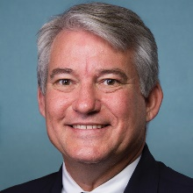
2018 election dashboard: FL-15
Seat currently held by:
Dennis Ross (R)
Cook Rating: Lean R
Cook Partisan Voting Index: R+6
Election dates
Filing deadline — May 4, 2018
Primary election – August 28, 2018
General election — November 6, 2018
Previous election results
Sources: National Journal Research, 2018; Ballotpedia, 2018; Cook Political Report, 2018.
Slide last updated on: August 29, 2018

Slide 4
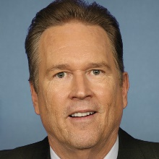
2018 election dashboard: FL-16
Seat currently held by:
Vern Buchanan (R)
Cook Rating: Lean R
Cook Partisan Voting Index: R+7
Election dates
Filing deadline — May 4, 2018
Primary election – August 28, 2018
General election — November 6, 2018
Previous election results
Sources: National Journal Research, 2018; Ballotpedia, 2018; Cook Political Report, 2018.
Slide last updated on: August 29, 2018

Slide 5
2018 election dashboard: FL-18
Seat currently held by:
Brian Mast (R)
Cook Rating: Lean R
Cook Partisan Voting Index: R+5
Election dates
Filing deadline — May 4, 2018
Primary election – August 28, 2018
General election — November 6, 2018
Previous election results
Sources: National Journal Research, 2018; Ballotpedia, 2018; Cook Political Report, 2018.
Slide last updated on: August 29, 2018

Slide 6
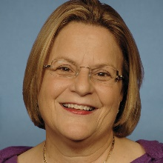
2018 election dashboard: FL-27
Seat currently held by:
Ileana Ros-Lehtinen (R)
Cook Rating: Lean D
Cook Partisan Voting Index: D+5
Election dates
Filing deadline — May 4, 2018
Primary election – August 28, 2018
General election — November 6, 2018
Previous election results
Sources: National Journal Research, 2018; Ballotpedia, 2018; Cook Political Report, 2018.
Slide last updated on: August 29, 2018

