Slide 1
Smart grid primer
A look at energy grid modernization and an overview of smart grid legislation
August 13, 2018
Producer
Sean Lambert
Director
Alistair Taylor

Slide 2
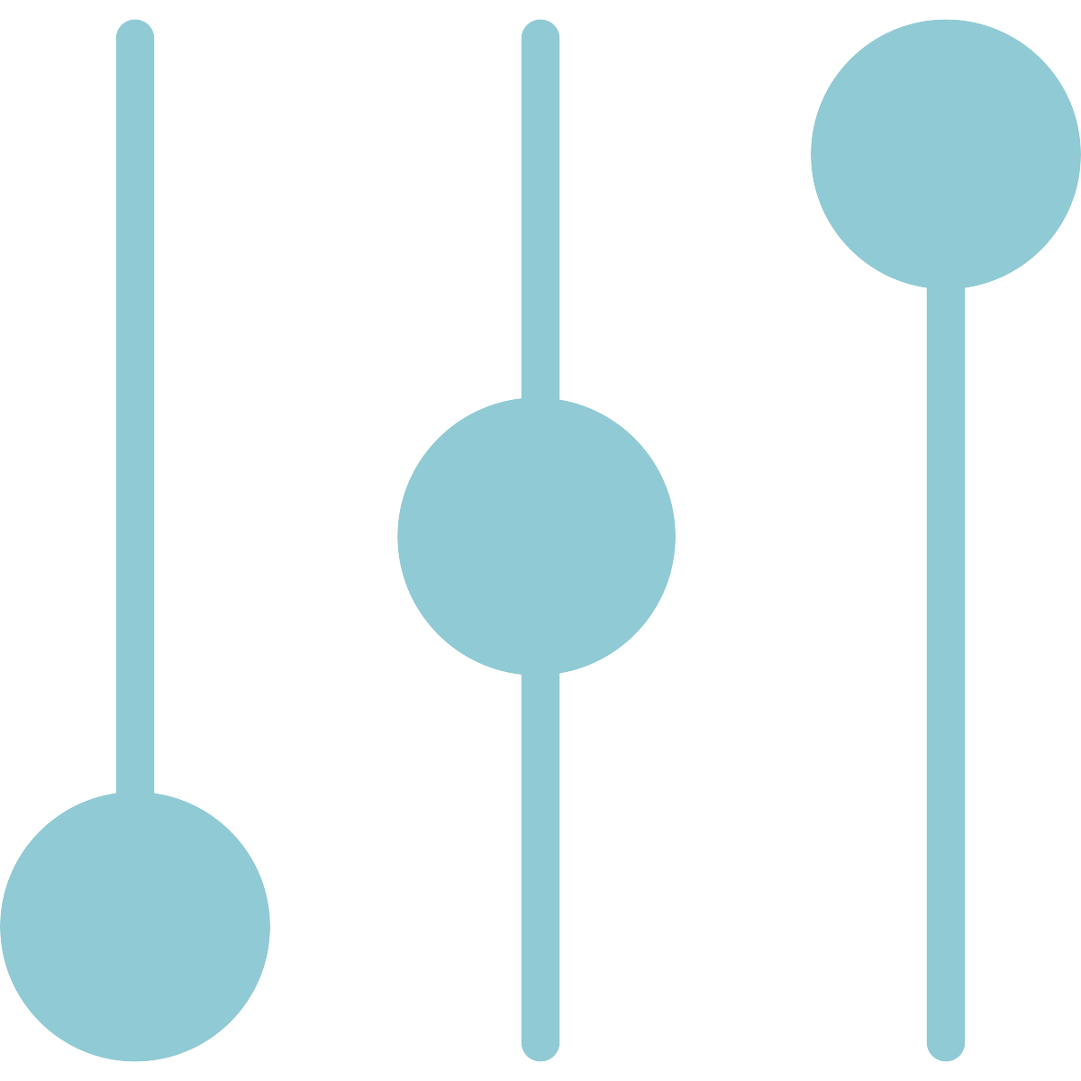
What is the smart grid?
Like the internet, the smart grid will involve different technologies and mechanisms working together to respond digitally to quickly changing electrical demand
Background
The US electric grid was built in the 1890s
The grid has more than 9,200 electric generating units
Its generating capacity is more than 1 million megawatts
It has more than 300,000 miles of transmission lines
Computers
What makes a grid smart?
Digital technology
Two-way communication between a utility and its customers
Sensors along transmission lines
Controls
Automation
Equipment
Sources: “What is the Smart Grid?” Smartgrid.gov
Sean Lambert | Slide last updated on: July 30, 2018

Slide 3
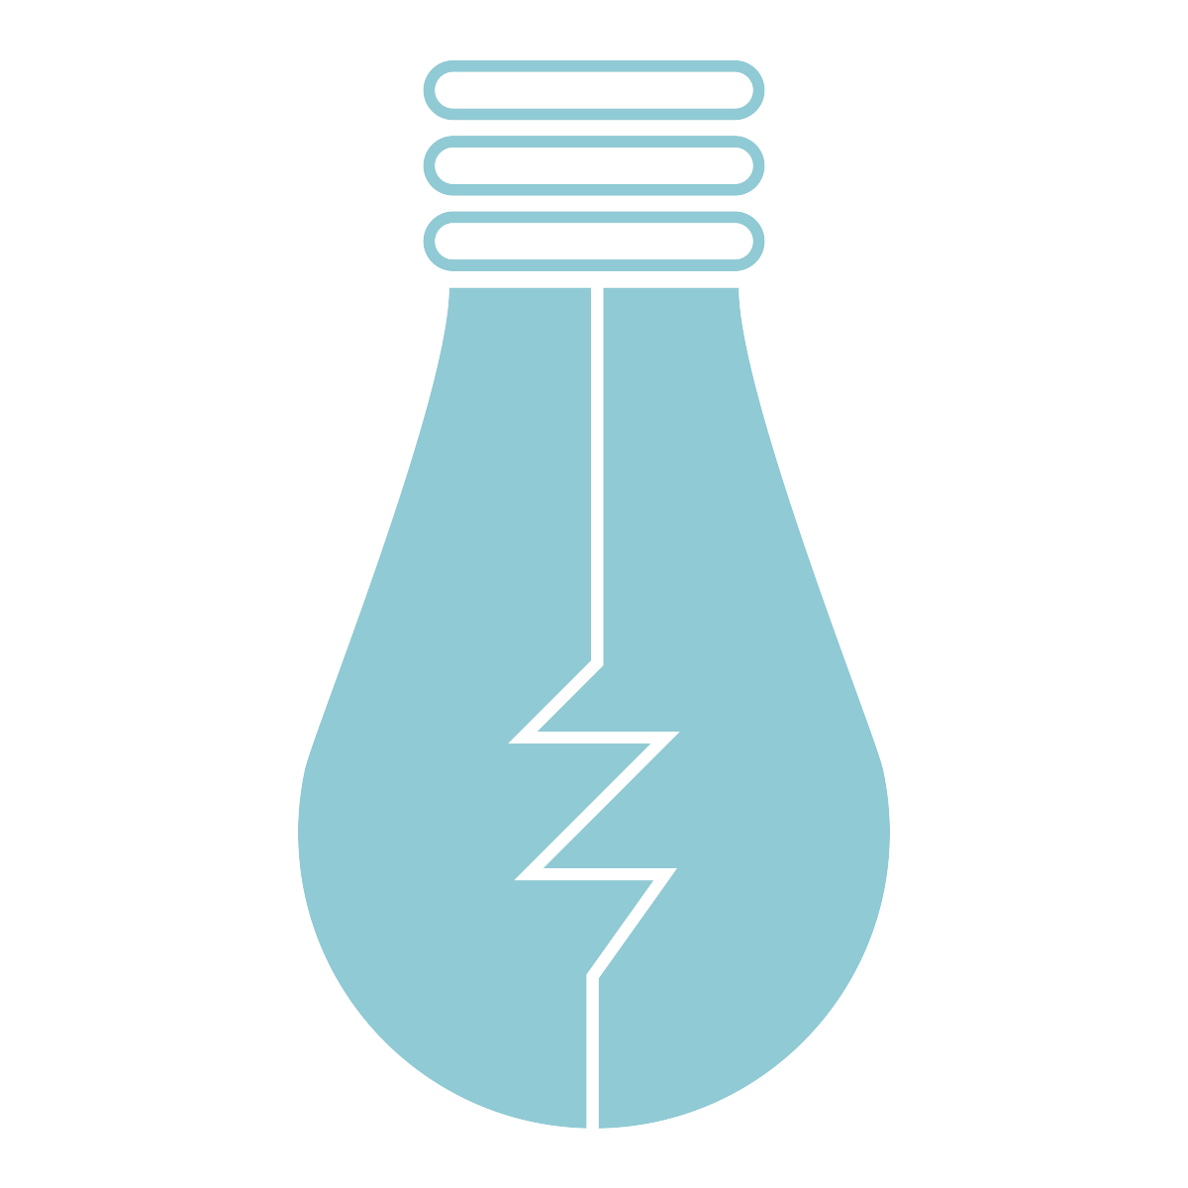
What does a smart grid do?
Quicker restoration of electricity after power disturbances
More efficient transmission of electricity
Reduced operations and management costs for utilities
Reduced peak demand, which will also help lower electricity rates
Increased integration of large-scale renewable energy systems
Better integration of customer-owner power generation systems and renewable energy systems
Improved security
More resilient to disruptions due to weather and natural disasters
Sources: “What is the smart grid?” Smartgrid.gov.
Sean Lambert | Slide last updated on: July 30, 2018

Slide 4
Consumer benefits of the smart grid
Smart meters
“Smart meters” will let customers see how much electricity they use, when they use it and the cost
The meters will come with real-time pricing
They will allow customers to save power when electricity is most expensive
Economics
National security
In-home generators
In-home generators will allow consumers to save money by generating their own power
This will help them manage their electricity usage with greater autonomy, saving money
Renewable energy goals
Cheaper electricity
Sources: “Consumer engagement,” Smartgrid.gov.
Sean Lambert | Slide last updated on: August 7, 2018

Slide 5
Plug-in electric vehicles could function as a distributed source of energy
“Vehicle to Grid”
PEVs will play an important part in balancing the smart grid by serving as a distributed source of stored energy
By drawing on batteries plugged in throughout the smart grid, a utility can inject extra power into the grid at critical moments
This has the potential to reduce brownouts or rolling blackouts
PEVs can keep parts of the grid operating during blackouts
They can also help integrate wind and solar power into the grid
Sources: Plug-in electric vehicles,” Smartgrid.gov.
Sean Lambert | Slide last updated on: August 7, 2018

Slide 6
The smart home will give consumers greater control over their home energy use
Home energy management systems
Smart meters will allow for interface between consumers and their energy providers
These can help consumers cut energy costs, and provide real-time updates about how much energy consumers are using
Smart appliances
Appliances will be networked together in the smart home, which will help consumers keep track of how much energy all their appliances are using at all times
Smart appliances will also respond to signals from energy providers to avoid using energy during times of peak demand, reducing stress on the grid
Home power generation
Rooftop solar electricity systems, wind turbines, and small hydropower systems are just some of the ways that consumers will be able to generate power at home using the smart grid
Sources: “The Smart Home,” Smartgrid.gov.
Sean Lambert | Slide last updated on: August 7, 2018

Slide 7
Smart grid legislation to watch
S. 1874: Distributed Energy Demonstration Act of 2017
Sponsor: Ron Wyden (D-OR)
Reauthorizes the DOE’s grant program for smart grid investments through FY2025
Received in House
Passed committee
Passed House
Differences
resolved
Signed
into law
Introduced in Senate
9/27/17
Passed committee
Passed Senate
H.R. 2479: Leading Infrastructure for Tomorrow’s America Act
Sponsor: Frank Pallone, Jr. (D-NJ)
Authorizes appropriations to improve infrastructure, with provisions for modernizing the energy grid
Introduced in House
5/17/17
Passed committee
Passed House
Differences
resolved
Signed
into law
Received in Senate
Passed committee
Passed Senate
H.R. 3275: Water and Energy Sustainability Through Technology Act
Sponsor: Jerry McNerney (D-CA)
Begins a smart energy and water efficiency pilot program that makes use of smart meters
Introduced in House
7/17/17
Passed committee
Passed House
Differences
resolved
Signed
into law
Received in Senate
Passed committee
Passed Senate
Sources: National Journal research; Congress.gov.
Slide last updated on August 7, 2018

