Slide 1
Charlie Cook’s Tour of American Politics
Insights into the 2018 midterm elections
August 2018
Producer
National Journal Presentation Center
Director
Alistair Taylor

Slide 2
Roadmap
Eight things to watch in 2018
Generic ballot polling
Direction of country polling
Trump approval ratings
Trump approval by intensity
Political party approval ratings
Consumer confidence/consumer sentiment
Unemployment rate
Policy polling: tax reform vs. ACA
Political trends in the US
Previous wave elections
Insights on 2020

Slide 3
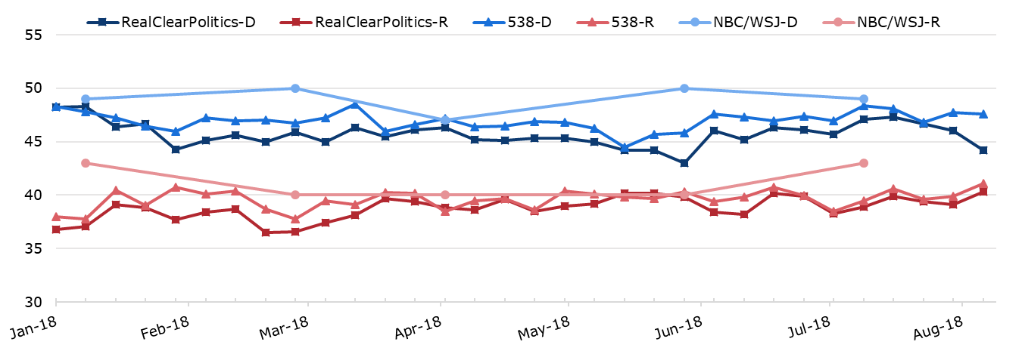
Democrats hold about a 7-point lead in generic ballot polling
Do you prefer a Congress controlled by Republicans or Democrats?
AS A PERCENTAGE OF TOTAL RESPONSES
D+3.9
RealClearPolitics Average
Week of August 12, 2018
D+6.5
FiveThirtyEight Average
Week of August 12, 2018
D+6.0
NBC News/WSJ
Last poll: July 15, 2018:
Sources: RealClearPolitics.com, FiveThirtyEight.com, NBC News/WSJ survey, 2018.
Daniel Stublen | Slide last updated on: August 13, 2018

Slide 4
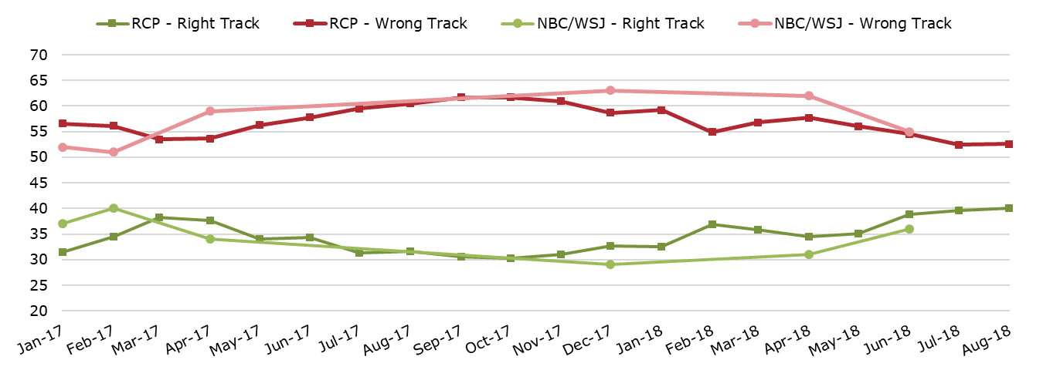
Americans hold a pessimistic view of the country’s future
In what direction is the country headed?
AS A PERCENTAGE OF TOTAL RESPONSES
40.1% 52.6%
RealClearPolitics Average
Week of August 1, 2018
36% 55%
NBC News/WSJ
Last poll: June 4, 2018:
Sources: RealClearPolitics.com, NBC News/WSJ survey, 2018.
Daniel Stublen | Slide last updated on: August 6, 2018

Slide 5
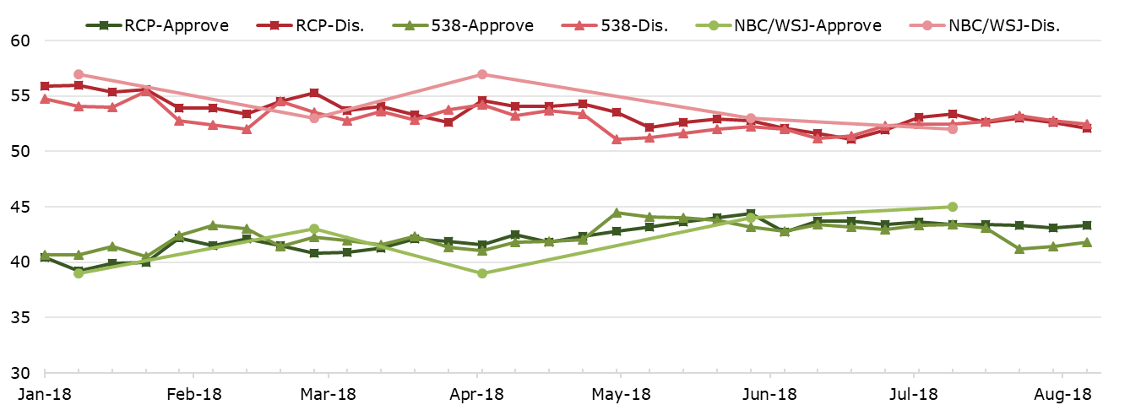
Trump’s approval rating has hovered in the low 40% range
Do you approve or disapprove of President Trump’s job performance?
AS A PERCENTAGE OF TOTAL RESPONSES
43.3% 52.1%
RealClearPolitics Average
Week of August 12, 2018
41.8% 52.5%
FiveThirtyEight Average
Week of August 12, 2018
45% 52%
NBC News/WSJ
Last poll: July 15, 2018:
Sources: RealClearPolitics.com, FiveThirtyEight.com, NBC News/WSJ, 2018.
Daniel Stublen | Slide last updated on: August 13, 2018

Slide 6
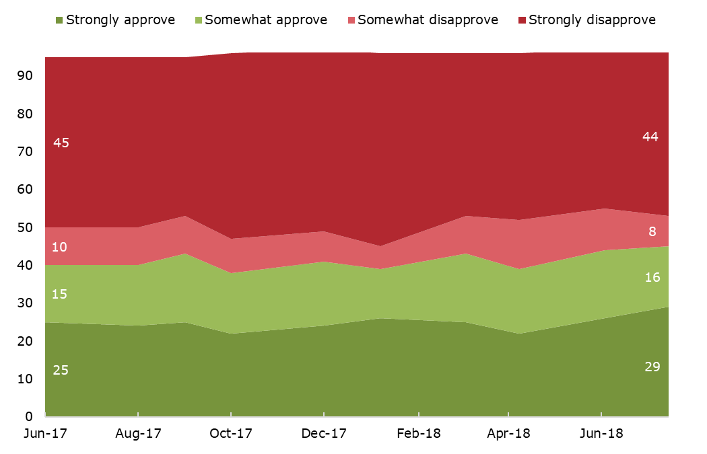
More people strongly disapprove of President Trump’s job performance than strongly approve
How much do you approve or disapprove of President Trump’s job performance?
NBC/WSJ; AS A PERCENTAGE OF TOTAL RESPONSES
52%
Total disapprove
45%
Total approve
Sources: NBC News/WSJ survey, 2018.
Daniel Stublen | Slide last updated on: July 25, 2018

Slide 7
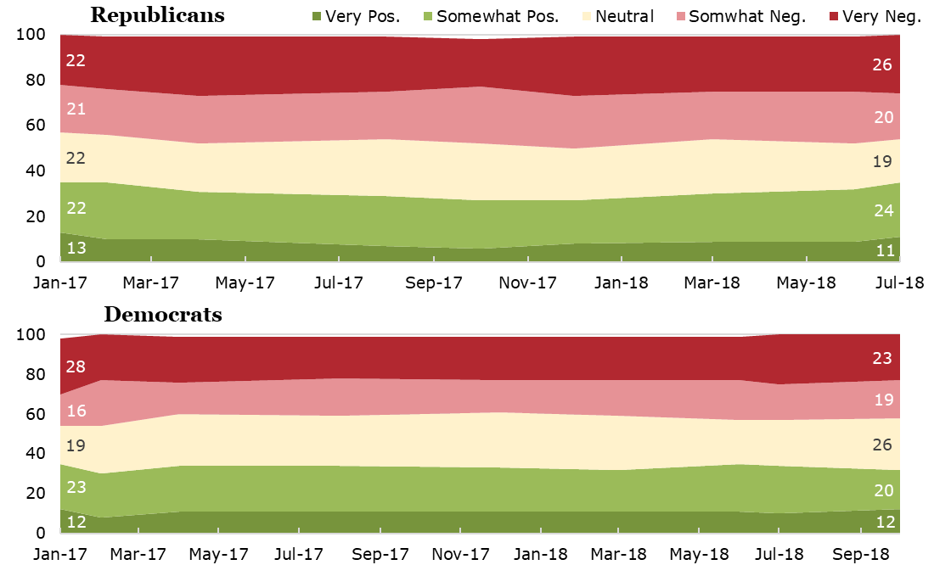
Americans hold a generally negative view towards both parties
Do you approve or disapprove of the Democratic/Republican party?
AS A PERCENTAGE OF TOTAL RESPONSES
46%
Total disapprove
35%
Total approve
43%
Total disapprove
34%
Total approve
Sources: NBC News/WSJ survey, 2018.
Daniel Stublen | Slide last updated on: July 25, 2018

Slide 8
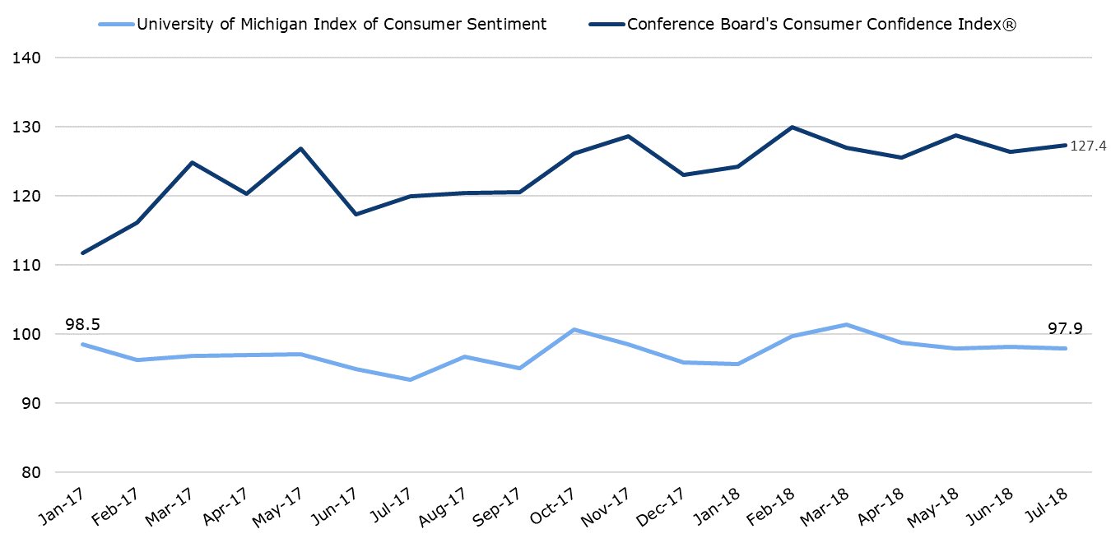
Consumer confidence has declined slightly in recent months
Tracking polls of consumers
INDICES CALCULATED BY THE SURVEYING ORGANZATIONS
Sources: Conference Board, 2018; University of Michigan Surveys of Consumers, 2018.
Daniel Stublen | Slide last updated on August 6, 2018

Slide 9
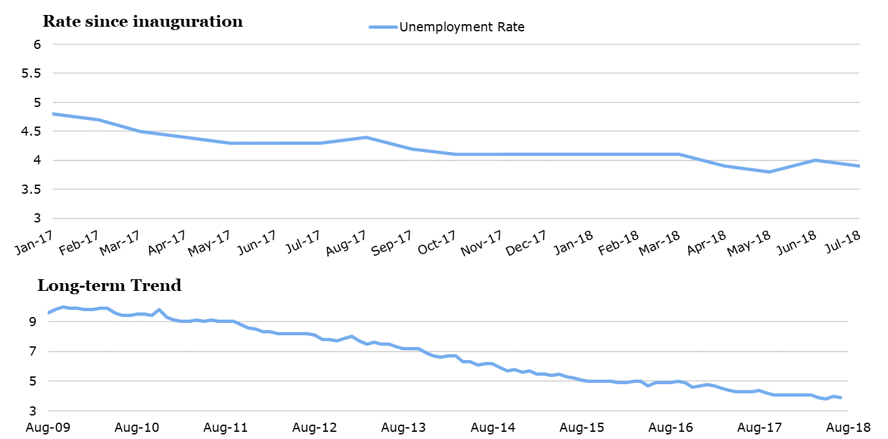
The unemployment rate is at an almost historic low of 4%
Monthly civilian unemployment rate
PERCENTAGE OF TOTAL LABOR FORCE; SEASONALLY ADJUSTED
Sources: Bureau of Labor Statistics, 2018.
Daniel Stublen | Slide last updated on: August 13, 2018

Slide 10
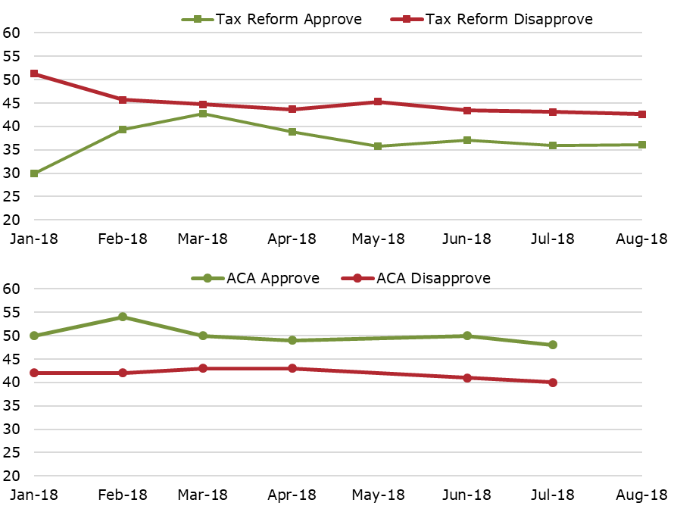
The Affordable Care Act outperforms the Tax Cuts & Jobs Act in opinion polls
Do you approve or disapprove of the Tax Cuts and Jobs Act/Affordable Care Act?
AS A PERCENTAGE OF TOTAL RESPONSES
-6.5%
RealClearPolitics average
Most recent: Aug. 1, 2018
+8.0%
Kaiser Family Foundation
Most recent poll: July 25, 2018
Sources: RealClearPolitics.com, 2018; Kaiser Family Foundation, 2018.
Daniel Stublen | Slide last updated on: August 6, 2018

Slide 11
Roadmap
Eight things to watch in 2018
Generic ballot polling
Direction of country polling
Trump approval ratings
Trump approval by intensity
Political party approval ratings
Consumer confidence/consumer sentiment
Unemployment rate
Policy polling: tax reform vs. ACA
Political trends in the US
Previous wave elections
Insights on 2020

Slide 12
Historical partisan control of Congress after elections
House of Representatives
88TH-115TH CONGRESS
Senate
88TH-115TH CONGRESS
Source: Senate.gov, 2017; Office of the Clerk of the House of Representatives, 2017.
Daniel Stublen | Slide last updated on: July 27, 2018

Slide 13
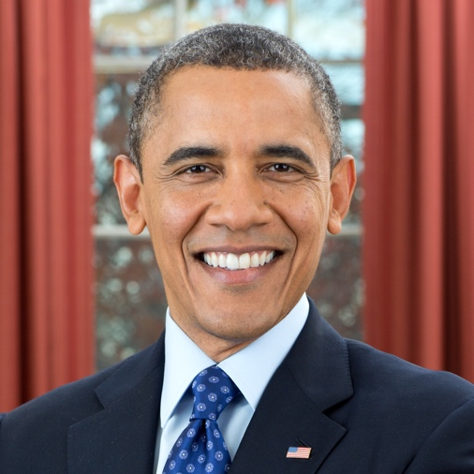
Recent midterm wave elections
1994 elections
President: Bill Clinton (D)
Republican gains:
54 seats in the House
8 seats in the Senate
2010 elections
President: Barack Obama (D)
Republican gains:
63 seats in the House
6 seats in the Senate
2006 elections
President: George W. Bush (R)
Democratic gains:
31 seats in the House
6 seats in the Senate
Sources: National Journal research, 2018.
Daniel Stublen | Slide last updated on: July 27, 2018

Slide 14
Trump’s approval numbers are near or slightly below recent presidents who experienced a wave election
Gallup comparative presidential approval ratings
IN AUGUST OF EACH PRESIDENT’S SECOND YEAR
Source: Gallup, 2018.
Daniel Stublen | Slide last updated on: July 27, 2018

Slide 15
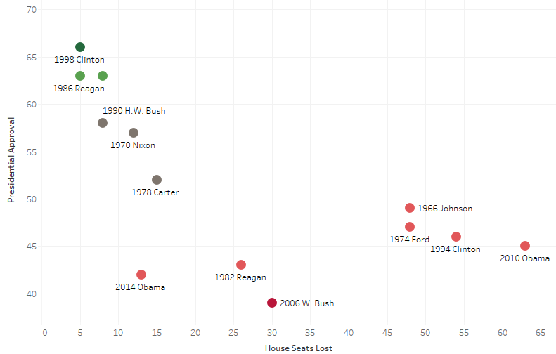
History suggests that the president’s party will lose seats in midterm elections
Presidential approval ratings vs. House seats lost, 1966-2014
Since the end of World War II, the party in control of the White House has had an average net loss of 26 House seats in midterm elections
2002 G.W. Bush
Sources: Ally Flinn, David Wasserman, “Follow 2018 with us,” The Cook Political Report, April 10, 2018.
Daniel Stublen | Slide last updated on: July 27, 2018

Slide 16
Presidents with a sub-50% approval rating lose an average of 40 seats in the midterms
Presidential job approval vs. midterm results since 1966
Trump Job Approval
43.3%
RCP Average: August 13, 2018
Job Approval
Over 60%
50%-60%
Under 50%
Average Change
+3 seats
-12 seats
-40 seats
Sources: Gallup, The Cook Political Report, National Journal, RealClearPolitics.com, 2018.
Daniel Stublen | Slide last updated on: August 13,, 2018

Slide 17
Historic polling of generic ballots suggests Democrats will gain seats in 2018, but will it be enough to flip the House?
Comparison between generic ballot polling and House outcomes
NBC/WSJ POLL
■ Democratic seat gain ■ Republican seat gain
Current generic ballot:
D+6
Most recent NBC/WSJ Poll: July 15, 2018
Sources: NBC/WSJ survey, 2018.
Daniel Stublen | Slide last updated on: July 27, 2018

Slide 18
House districts have become increasingly partisan with only one-sixth considered “swing” districts
Cook Political Report Partisan Voter Index
■ Democratic seat (D+5 or greater) ■ Republican seat (R+5 or greater) ■ Swing seat (D+5 to R+5)
Source: Cook Political Report, 2017.
Daniel Stublen | Slide last updated on: July 27, 2018

Slide 19
Democrats have no chance of picking up enough seats to remove Trump from office without Republican votes
House of Representatives
Senate
2/3 majority: 291
2/3 majority:
67
Simple majority:
218
Simple majority: 51
Safe Republican seats | 181
Safe Democratic seats | 193
Toss Up or Lean R/D | 61
Safe Republican seats | 48
Safe Dem./Ind. seats | 43
Toss Up or Lean R/D | 10
Impeachment process
Simple majority vote in House to indict president for “treason, bribery, or other high crimes & misdemeanors”
2/3 vote in the Senate to convict president and remove from office
25th Amendment process
VP and a majority of the cabinet tell Congress the president is “unable to discharge the powers & duties of his office”
If the president appeals, 2/3 vote in both House and Senate removes president from office
Sources: Charlie Savage, “How the Impeachment Process Works,” The New York Times, May 17, 2017; Rating from Cook Political Report, 2018.
Alice Johnson | Slide last updated on: August 6, 2018

Slide 20
Trump’s narrow victories in key states leave him vulnerable to even a small swing in 2020
10 states were decided by less than 5%
■ Clinton win ■ Trump win
Clinton by 1.5% (44,470 votes)
Trump by 1% (27,257 votes)
Clinton by 2.7% (19,995 votes)
WA
Trump by 0.3% (13,080 votes)
VT
ME*
MT
ND
VT
VT-3
OR
MN
NH
ID
SD
WI
NY
NY
NH-4
WY
MI
Clinton by 0.4% (2,701 votes)
Clinton by 2.4% (26,434 votes)
NV
NE
IA
PA
UT
IL
IN
OH
Trump by 1.2% (68,236 votes)
CA
CO
KS
MO
WV
VA
KY
AZ
TN
NC
Trump by 3.9 % (91,682 votes)
NM
OK
AR
SC
MS
AL
GA
Trump by 3.8% (177,009 votes)
TX
LA
AK
FL
HI
Trump by 1.2% (112,911 votes)
*Clinton won Maine’s statewide vote, but Trump received an electoral vote for winning the 2nd district
Source: National Journal research, 2018.
Nicholas Wu | Slide last updated on: July 27, 2018

