Slide 1
2018 election dashboard: Tennessee governor
Seat currently held by:
Bill Haslam (R)
Cook Rating: Likely R
2018 Primary Results
Election dates
Filing deadline — April 5, 2018
Primary election – August 2, 2018
General election — November 6, 2018
*Primary winners
Cash on Hand
Previous election results
Sources: National Journal Research, 2018; Ballotpedia, 2018; Cook Political Report, 2018.
Slide last updated on: June 13, 2018

Slide 2
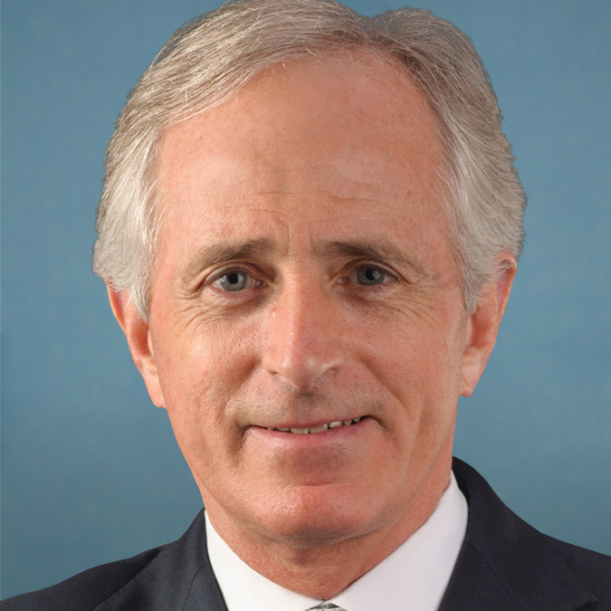
2018 election dashboard: TN-Senate
Seat currently held by:
Corker (R)
Cook Rating: Toss Up
Election dates
Filing deadline — April 5, 2018
Primary election – August 2, 2018
General election — November 6, 2018
Previous election results
Sources: National Journal Research, 2018; Ballotpedia, 2018; Cook Political Report, 2018.
Slide last updated on: August 3, 2018

