Slide 1
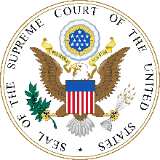
SUPREME COURT
Supreme Court nomination and confirmation statistics
Since the Johnson administration:
3 nominees have been rejected by a full Senate vote
3 nominees have been withdrawn by the president
4 times cloture has been invoked
3 successful: Alito, Rehnquist and Gorsuch for associate justice positions
1 unsuccessful: Rehnquist for chief justice (vote later allowed under unanimous consent and confirmed)
1 nominee never withdrawn or voted upon in the Senate (Garland
28 nominations since 1965
Timeline for last 19 confirmed justices (average, excluding Gorsuch)
Day 0
Day 32
Day 45
Day 58
The president formally submits his nomination to the Senate
The Senate Judiciary Committee commences public hearings
The Senate Judiciary Committee votes
The full Senate votes to confirm or deny (60 votes required to overcome filibuster)
Sources: Denis Rutkus and Maureen Beardon, “Supreme Court Nominations, 1789 to the Present: Actions by the Senate, the Judiciary Committee, and the President,” Congressional Research Service, December 7, 2012.
June 28, 2018 | Daniel Stublen

