Slide 1

Webinar: Resourcing the government affairs function
Budgeting, headcount and investment trends for 2018 and beyond from National Journal’s resource benchmarking study
October 26, 2017
Presenter
Gina Kim
Chief Analytics Officer
Technical difficulties? Email us at membershipevents@nationaljournal.com

Slide 2
Resource benchmarking webinar
Roadmap
Overview of the Resource Benchmarking Initiative
Exploring patterns in spending and staffing levels
Closer look at budget and headcount trends
Long-term investment priorities
Takeaways from the initiative
Question and answer
© National Journal 2017
2

Slide 3

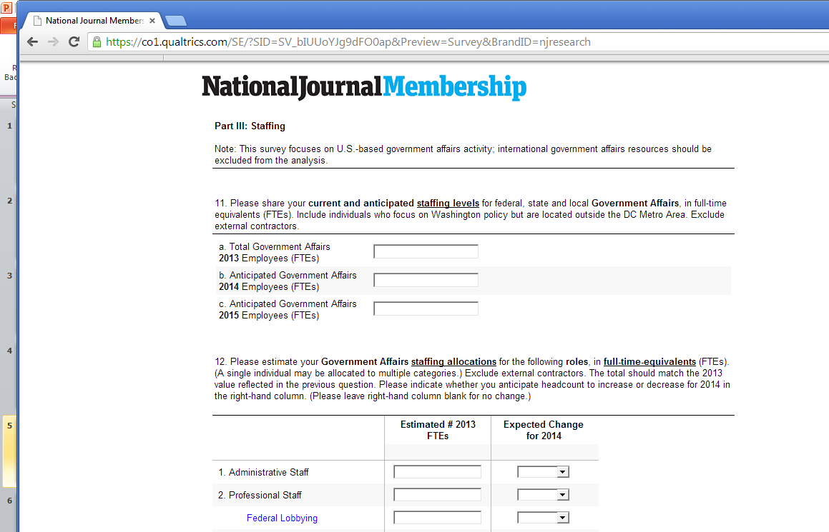
Resource benchmarking webinar
Government Affairs Resource Benchmarking Initiative
Scope of Survey
Organizational Background and Reporting Structure
Strategic Goals, Functional Activities and Outcomes
Current and Future Staffing
Current and Future Spending
Professional Services Firm Utilization
Social Media and Digital Communications
~150+ variables analyzed
Participants receive custom reports tailored to their organization, with peer comparisons based on industry, size and strategy
Source: Government Affairs Resource Benchmarking 2017; National Journal research and analysis.
© National Journal 2017
3

Slide 4
Resource benchmarking webinar
Broad range of views from across the membership
Organization Industry
MAJOR SECTORS REPRESENTED
Agriculture & Food
Consumer Goods & Services
Education
Energy & Natural Resources
Finance & Banking
Health Care
Manufacturing
Materials
Professional Services
Technology
Telecommunications
Transportation
Utilities
Organization Type
PERCENTAGE OF RESPONDENTS*
Organization Size
PERCENTAGE OF RESPONDENTS
ASSOCIATIONS**
CORPORATIONS
3-5 PEOPLE
6-10 PEOPLE
1-2 PEOPLE
11+ PEOPLE
*86 respondents, contributing ~10,000 data points
**Associations data include responses from interest groups, think tanks, and other not-for-profit advocacy entities
Source: Government Affairs Resource Benchmarking 2017; National Journal research and analysis.
© National Journal 2017
4

Slide 5
Resource benchmarking webinar
Roadmap
Overview of the Resource Benchmarking Initiative
Exploring patterns in spending and staffing levels
Closer look at budget and headcount trends
Long-term investment priorities
Takeaways from the initiative
Question and answer
© National Journal 2017
5

Slide 6
Resource benchmarking webinar
Busy while Congress is out of session
Activity highest in August; most organizations have three weeks (or more) dedicated to budgeting
Number of Weeks Devoted to Annual Budgeting Process
Four weeks
Four weeks
Three weeks
Three weeks
One week
One week
Two weeks
Two weeks
Source: Government Affairs Resource Benchmarking 2017; National Journal research and analysis.
© National Journal 2017
6

Slide 7


What’s hard about resourcing?
Resource benchmarking webinar
Whether budgets are shrinking, staying flat or growing, widespread agreement that challenges exist
Doing more with less…
…recalibrating spending levels…
…ensuring productivity
  “[Our] challenge will be how to prepare for the future and add value with a smaller budget.”
  —Vice President, Americas
  “With a flat budget, we are constantly reprioritizing.”
  —Senior Vice President
  Industry Relations
  “[We haven’t seen the] legislative action we expected—we staffed up and prepared for a game that has not begun.”
  —President, Corporation
  “My budget and headcount have decreased, however, the workload has not.”
  —VP, Federal Affairs
  “Organizational budget restraints limit our ability to invest in new initiatives.”
  —Senior Vice President Government Relations
  “I'm adding headcount… eliminating outside lobbying firms and many associations, [looking] to build internal energy and capabilities.”
  —SVP, External Affairs
Source: Government Affairs Resource Benchmarking 2017; National Journal research and analysis.
© National Journal 2017
7

Slide 8
Finding wide variation in budgets
Resource benchmarking webinar
Corporations “outspending” associations by a factor of 2x
Source: Government Affairs Resource Benchmarking 2017; National Journal research and analysis.
© National Journal 2017
8

Slide 9
Itemizing the budget across categories
Resource benchmarking webinar
Personnel and professional services the largest areas of spend
48% of budget for Associations,
40% for Corporations
4% of budget for Associations,
11% for Corporations
22% of budget for Associations,
25% for Corporations
*Due to averaging, totals do not necessarily round to 100%.
**Personnel / Human Resources excludes external (contract) lobbyists; these individuals are captured in Professional Services.
Source: Government Affairs Resource Benchmarking 2017; National Journal research and analysis.
© National Journal 2017
9

Slide 10
Resource benchmarking webinar
Seeing variability across headcount too
Differences in staffing levels mirror differences in spending levels
Source: Government Affairs Resource Benchmarking 2017; National Journal research and analysis.
© National Journal 2017
10

Slide 11
But office size doesn’t explain everything…
Resource benchmarking webinar
Wide variation across different staffing levels
Source: Government Affairs Resource Benchmarking 2017; National Journal research and analysis.
© National Journal 2017
11

Slide 12
…And industry is an imperfect predictor of budget trends as well
Resource benchmarking webinar
Even greater variation when industry is taken into account
Source: Government Affairs Resource Benchmarking 2017; National Journal research and analysis.
© National Journal 2017
12

Slide 13





Which organizational attributes correlate to higher spend?
Resource benchmarking webinar
Past research finds operational complexity a driver of cost for the government affairs function
Office Size
Greater variability of spend as offices grow in size
Industry
Greater variability of spend within select industries
Geographic Distribution
Higher spending associated with geographic dispersion
Organizational Structure
Higher spending associated with matrixed staff structures
Scope of Activity
Directional impact of increased activity to be determined
Source: Government Affairs Resource Benchmarking 2017; National Journal research and analysis.
© National Journal 2017
13

Slide 14
An expanding portfolio, requiring greater collaboration
Resource benchmarking webinar
Today’s government affairs organizations contribute to a variety of activities beyond traditional lobbying
Government Affairs Functional Activities |  | % Participation by Associations |  | % Participation by Corporations
Federal Legislative Lobbying |  | 96% |  | 93%
Executive Branch / Regulatory Lobbying |  | 96% |  | 93%
State / Local Government Lobbying |  | 52% |  | 75%
Issue Tracking & Portfolio Management |  | 100% |  | 98%
Policy Position Development & Analysis |  | 96% |  | 98%
Policy Risk Identification & Monitoring |  | 93% |  | 98%
Grassroots / Grasstops Management |  | 98% |  | 80%
Coalition Management |  | 91% |  | 88%
Stakeholder Mapping |  | 72% |  | 85%
Thought Leadership Content Development |  | 78% |  | 83%
Public Relations and Communications |  | 85% |  | 58%
Social Media Advocacy |  | 85% |  | 30%
55% of Corporations share responsibility for position development; 70% share responsibility for risk identification
Most Associations and Corporations share responsibility for these activities with other groups or departments
78% of Associations share responsibility for PR and communications; 70% share responsibility for social media advocacy
90%+ of Associations participate in this activity
75%+ of Associations participate in this activity
90%+ of Corporations participate in this activity
75%+ of Corporations participate in this activity
Source: Government Affairs Resource Benchmarking 2017; National Journal research and analysis.
© National Journal 2017
14

Slide 15
Resource benchmarking webinar
What metrics does your
Government Affairs group
use to measure performance?
Source: Government Affairs Resource Benchmarking 2017; National Journal research and analysis.
© National Journal 2017
15

Slide 16



Closer Look – Performance Management
Part 1: Assessing past performance
Beyond policy outcomes, associations focus on stakeholder measures while corporates emphasize financial metrics
Policy Outcome
Measures
Stakeholder
Measures
Financial
Measures
Utilization Among
Association Respondents
Utilization Among
Corporate Respondents
Tying action to impact
Capturing functional value
  “It’s hard for us to prove any impact one way or another… the nature of our work really prevents us from being able to point to successes on any sort of consistent basis.”
  —EVP, Government Relations
“It is always difficult to quantify the value of Government Affairs; much is determined by opinion of our CEO regarding importance of engagement.”
—VP, Federal Affairs
Source: Government Affairs Resource Benchmarking 2017; National Journal research and analysis.
© National Journal 2017
16

Slide 17


Closer Look – Performance Management
Part 2: Moving towards a more “balanced” scorecard
Counting wins and losses may be less meaningful for demonstrating value in a slow-moving Washington
Policy Outcome
Measures
Stakeholder
Measures
Financial
Measures
Capacity
Measures
Perceptual
Measures
Utilization Among
Association Respondents
Utilization Among
Corporate Respondents
Source: Government Affairs Resource Benchmarking 2017; National Journal research and analysis.
© National Journal 2017
17

Slide 18
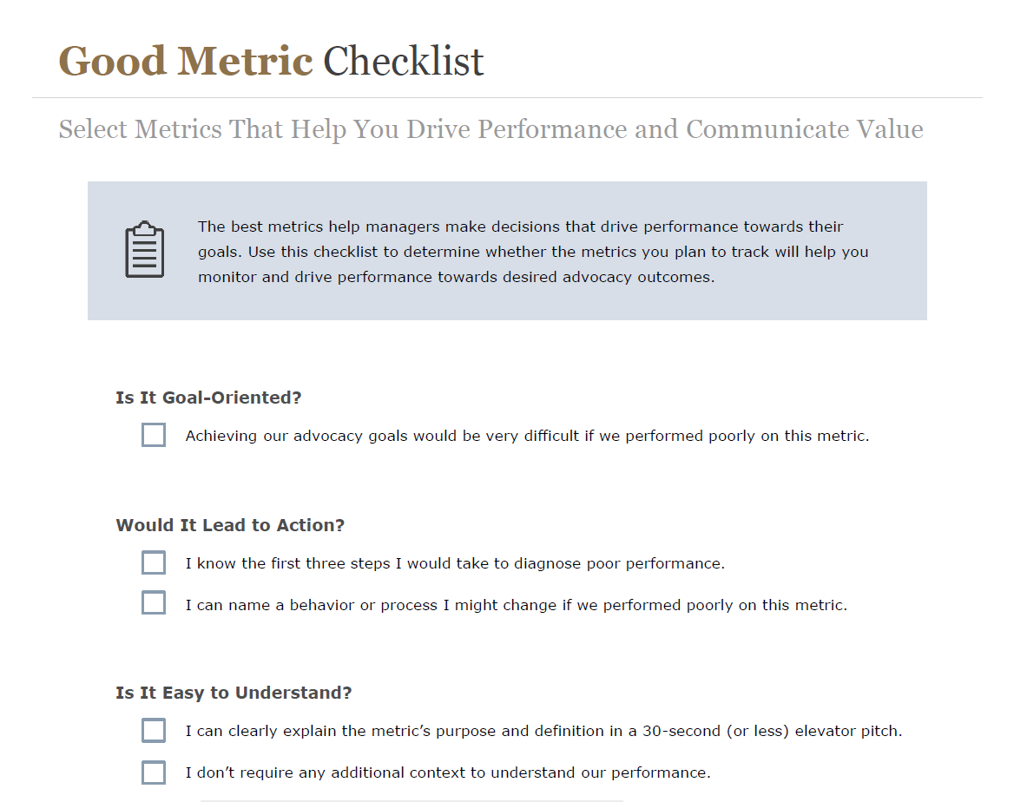
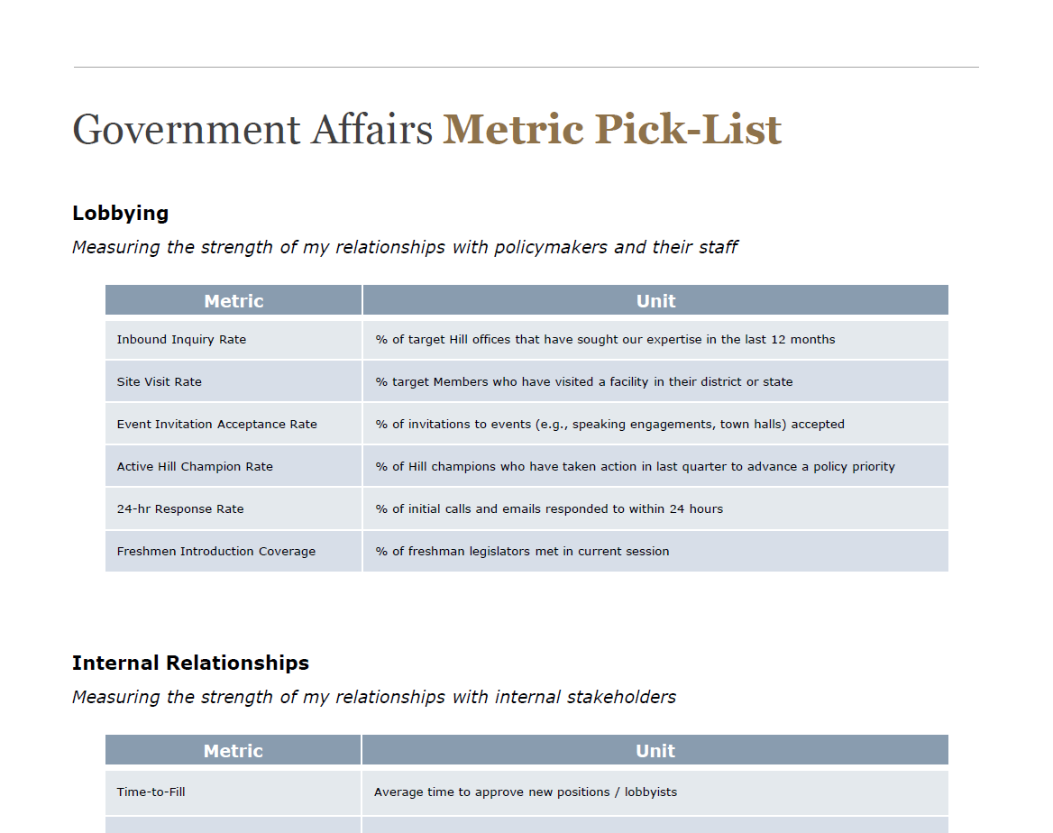
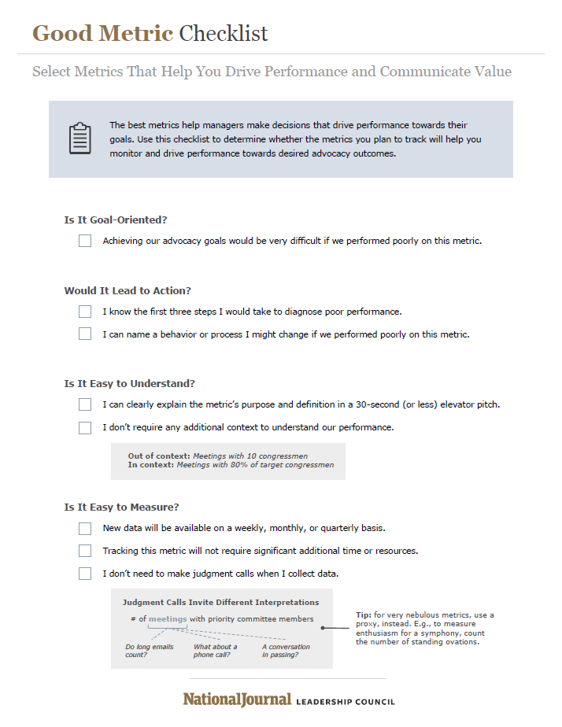
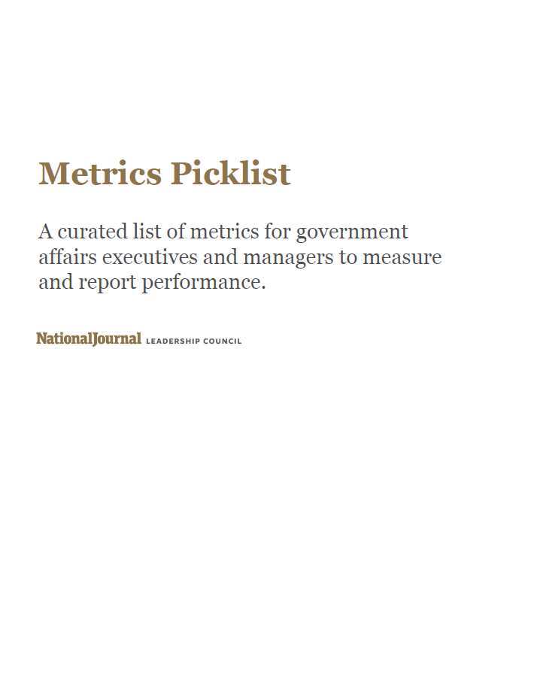
Closer Look – Performance Management
National Journal support for your performance metrics
Good Metric Checklist
Metrics Picklist
Source: Government Affairs Resource Benchmarking 2017; National Journal research and analysis.
© National Journal 2017
18

Slide 19
Not just show and tell
Closer Look – Performance Management
Activity reporting more prevalent among associations; corporations more focused on measurement
Reporting on Activity
Reporting on Performance
Source: Government Affairs Resource Benchmarking 2017; National Journal research and analysis.
© National Journal 2017
19

Slide 20






What’s the frequency?
Closer Look – Performance Management
Associations formally updating leadership more often than their corporate peers
Source: Government Affairs Resource Benchmarking 2017; National Journal research and analysis.
© National Journal 2017
20

Slide 21
Closer Look – Performance Management
National Journal support for your policy / politics updates
Daily:
Daily Presentation Center email containing slides on the latest events around politics and policy
Weekly:
Washington Briefing, a weekly Thursday newsletter with content from NJ's Hotline and The Atlantic
Monthly:
Legislative Forecast, a monthly overview of major issues facing Congress as well as a forecast of outcomes
Quarterly:
Washington Quarterly Report, offering a review of government actions, financial indicators and upcoming elections
Yearly:
Presentation products that chronicle long-term themes, such as the year-in-review, Trump administration toolbox and election intel decks
Source: Government Affairs Resource Benchmarking 2017; National Journal research and analysis.
© National Journal 2017
21

Slide 22
Resource benchmarking webinar
Roadmap
Overview of the Resource Benchmarking Initiative
Exploring patterns in spending and staffing levels
Closer look at budget and headcount trends
Long-term investment priorities
Takeaways from the initiative
Question and answer
© National Journal 2017
22

Slide 23
Spending Trends
Modest growth in spending levels for 2018
Half of the associations surveyed look to increase budgets, while half of corporates plan to hold spending constant
Average size of spending increase for Associations growing budgets between 2017-2018
+9.9%
Average size of spending increase for Corporations growing budgets between 2017-2018
+7.5%
Source: Government Affairs Resource Benchmarking 2017; National Journal research and analysis.
© National Journal 2017
23

Slide 24
Closer Look – Spending Trends
No cons for pros
Associations and corporations more likely to increase spending on professional staff, compared to other budget categories
Professional staff investments the main focus of budget increases
Source: Government Affairs Resource Benchmarking 2017; National Journal research and analysis.
© National Journal 2017
24

Slide 25
Staffing Trends
Majority plan to hold headcount levels flat for 2018
Those that plan to increase headcount will raise staffing levels by 20-40%
Average size of staffing increase for Associations growing headcount between 2017-2018
+19.5%
Average size of staffing increase for Corporations growing headcount between 2017-2018
+37.1%
Source: Government Affairs Resource Benchmarking 2017; National Journal research and analysis.
© National Journal 2017
25

Slide 26
Closer Look – Staffing Trends
Not yet fed up
Associations and corporations more likely to add staff for federal government affairs, compared to other headcount categories
Federal government affairs a main focus of headcount increases
Source: Government Affairs Resource Benchmarking 2017; National Journal research and analysis.
© National Journal 2017
26

Slide 27
Maintaining focus on state / local activity
Closer Look – State / Local Government Affairs
Investment in state and local activity constant or growing
For government affairs offices growing budgets in 2018, three-quarters (72%) of those with an existing state / local strategy plan to increase spending on this area
Source: Government Affairs Resource Benchmarking 2017; National Journal research and analysis.
© National Journal 2017
27

Slide 28
Growing grassroots programming
Closer Look – Grassroots / Grasstops Activities
Grassroots a continued priority among Associations in particular
For government affairs offices growing budgets in 2018, two-thirds (67%) of those with an existing grassroots program plan to increase spending on this area
Source: Government Affairs Resource Benchmarking 2017; National Journal research and analysis.
© National Journal 2017
28

Slide 29
Closer Look – Professional Services Firms
Higher utilization of external lobbyists by corporate offices
Both associations and corporations rely on outside firms for other services as well
87% of Associations and 85% of Corporations plan to keep contract lobbying firms flat for 2018
93% of Associations and 83% of Corporations plan to keep other professional services flat for 2018
Source: Government Affairs Resource Benchmarking 2017; National Journal research and analysis.
© National Journal 2017
29
Notes:
*Corporate respondent number excludes an outlier in the data (included in custom reports); otherwise figures would be 10.4 external lobbying, 2.3 other prof’l services

Slide 30
Closer Look – Professional Services Firms
Looking to outside firms strategic advice beyond lobbying
Use of firms for regulatory lobbying remains high; corporations more likely to rely on counsel for state/local GA activity
Professional Services Firm Engagement by Services Utilized |  | Utilization Among Association Respondents |  | Utilization Among Corporate Respondents
Federal Legislative Lobbying
Federal Regulatory Lobbying
Federal Legislative or Regulatory Strategy
State/Local Lobbying or Strategy
International Lobbying or Strategy
PAC Management
Public Relations and Communications
Grassroots / Community Management
Opinion Research
Compliance Services
HIGH
MEDIUM
LOW
Source: Government Affairs Resource Benchmarking 2017; National Journal research and analysis.
© National Journal 2017
30

Slide 31
Resource benchmarking webinar
Roadmap
Overview of the Resource Benchmarking Initiative
Exploring patterns in spending and staffing levels
Closer look at budget and headcount trends
Long-term investment priorities
Takeaways from the initiative
Question and answer
© National Journal 2017
31

Slide 32
Resource benchmarking webinar
Where do you anticipate the
Government Affairs group
making significant investments—
whether in time, staffing, or spending—over the next three years?
Source: Government Affairs Resource Benchmarking 2017; National Journal research and analysis.
© National Journal 2017
32

Slide 33
Associations plan for investments in “core” activities
Closer Look – Investment Areas
Top investment areas—in terms of dollars, staffing or time—reflect grassroots or federal affairs, as well as brand building
Source: Government Affairs Resource Benchmarking 2017; National Journal research and analysis.
© National Journal 2017
33

Slide 34
Corporates also prioritize “upward management” investments
Closer Look – Investment Areas
Top investment areas focus on brand building, extending organizational reach and demonstrating value
Source: Government Affairs Resource Benchmarking 2017; National Journal research and analysis.
© National Journal 2017
34

Slide 35








Drill-down into anticipated investments
Closer Look – Investment Areas
Associations focus on “external” investments, corporations maintain “internal” focus; share 2 of 5 priority investments
Top 5 Areas of Projected Investment
ASSOCIATIONS’ TOP 5 PROJECTED INVESTMENTS
CORPORATIONS’ TOP 5 PROJECTED INVESTMENTS
Top 5 Areas of Investment Over the Next Three Years |  |  | % of Association Respondents
 | Pursuing Grassroots or Grasstops Advocacy |  | 72%
 | Executive Branch & Regulatory Affairs |  | 65%
 | Employing Social Media / Digital Communications Tools |  | 63%
 | Federal Legislative Affairs |  | 62%
 | Building or Managing the Org.'s Reputation in Washington |  | 60%
Top 5 Areas of Investment Over the Next Three Years |  |  | % of Corporation Respondents
 | Building or Managing the Org.'s Reputation in Washington |  | 58%
 | Building Coalitions and Partnerships |  | 55%
 | Employing Social Media / Digital Communications Tools |  | 53%
 | Engaging Org.'s Sr. Leadership and/or Board of Directors |  | 52%
 | Measuring Government Affairs' Impact on the Organization |  | 52%
Areas of overlap in shared investment priorities
Source: Government Affairs Resource Benchmarking 2017; National Journal research and analysis.
© National Journal 2017
35

Slide 36
Who’s in control?
Closer Look – Social Media / Digital Tools
Ownership of social and digital tools varies between associations and corporations
Source: Government Affairs Resource Benchmarking 2017; National Journal research and analysis.
© National Journal 2017
36

Slide 37


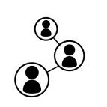
Two approaches to social media
Closer Look – Social Media / Digital Tools
Associations and corporations track issues on social, but associations far more likely to engage on policy, with advocates
Gathering
Intelligence
Spreading
Your
Message
Driving
Action
Utilization Among
Association Respondents
Utilization Among
Corporate Respondents
Source: Government Affairs Resource Benchmarking 2017; National Journal research and analysis.
© National Journal 2017
37

Slide 38
Resource benchmarking webinar
Roadmap
Overview of the Resource Benchmarking Initiative
Exploring patterns in spending and staffing levels
Closer look at budget and headcount trends
Long-term investment priorities
Takeaways from the initiative
Question and answer
© National Journal 2017
38

Slide 39
Takeaways from the initiative
Resource benchmarking webinar
1 | Not so bullish yet. For 2018, spending increases are more likely than staffing increases among associations, while most corporations—roughly half of those surveyed—will hold spending and staffing flat; approximately one-half of associations expect budget growth, compared to one-third of corporations
2 | Approaching 2018 staffing with caution. The majority of government affairs organizations are holding headcount levels steady in 2018—perhaps reflecting the uncertainty of the economic and policy environment—while one-quarter of associations and one-third of corporations plan for increases
3 | Commonalities in top spending and staffing priorities for 2018. Both associations and corporations with plans to increase budgets are most likely to invest in professional staff, and those that anticipate headcount increases plan to hire federal government affairs talent
4 | Growth offices look to complement “boots-on-the-ground.” Organizations with growing budgets aim to increase grassroots and state spend, suggesting that tactics to grow constituent networks and “go-local” approaches are viewed as higher return investments in today’s Washington
5 | Slowdown in Washington drives broader view of performance. With fewer legislative and regulatory outcomes to point to, organizations are exploring forward-looking metrics that capture advocacy capacity and stakeholder mindshare, markers of an opportunity for future success
6 | Expanded metrics mirror anticipated investments. Common long-term priorities for associations and corporations include a focus on organizational brand building and use of social media and digital tools, signaling continued awareness of the need for a “surround sound” approach to DC advocacy
7 | Small bets on everything. The near-term investments in federal affairs staff—including lobbyists—as well as grassroots and state/local programs, coupled with longer-term investment in brand building and social media suggest that, in an unpredictable policy environment, most are opting to take small bets on everything, rather than go “all in” around any specific area
Source: Government Affairs Resource Benchmarking 2017; National Journal research and analysis.
© National Journal 2017
39

Slide 40
Resource benchmarking webinar
Roadmap
Overview of the Resource Benchmarking Initiative
Exploring patterns in spending and staffing levels
Closer look at budget and headcount trends
Long-term investment priorities
Takeaways from the initiative
Question and answer
10.25.17
© National Journal 2017
40

