Slide 1
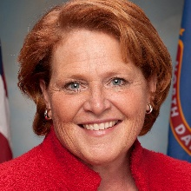
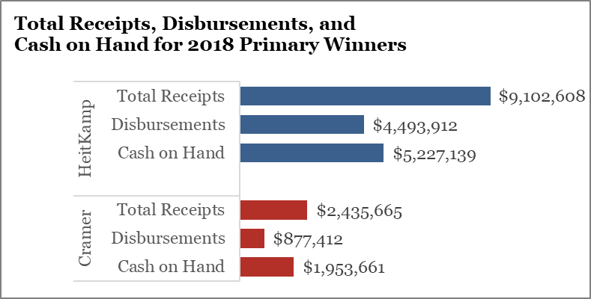
MIDTERM DASHBOARD
2018 election dashboard: North Dakota Senate
Seat currently held by:
Heidi Heitkamp (D)
Cook Rating: Toss Up
2018 Primary Results
Election dates
Filing deadline — April 9, 2018
Primary election – June 12, 2018
General election — November 6, 2018
Previous election results
Sources: National Journal Research, 2018; Ballotpedia, 2018; Cook Political Report, 2018.
Slide last updated on: June 13, 2018

