Slide 1
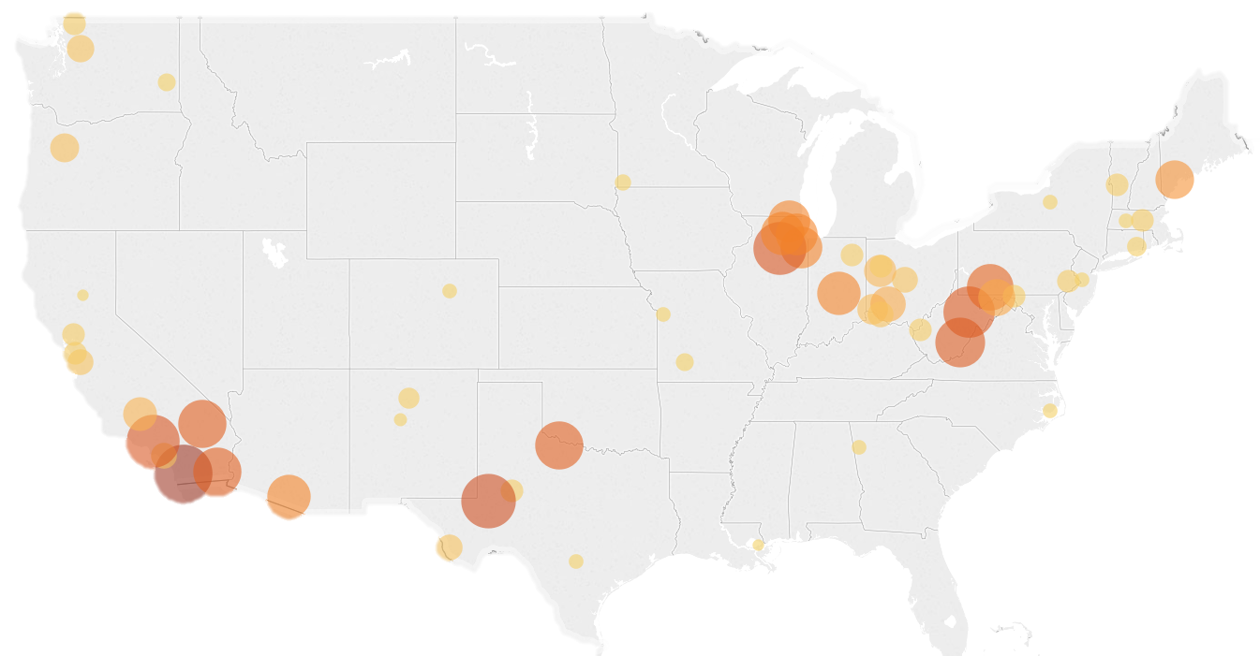
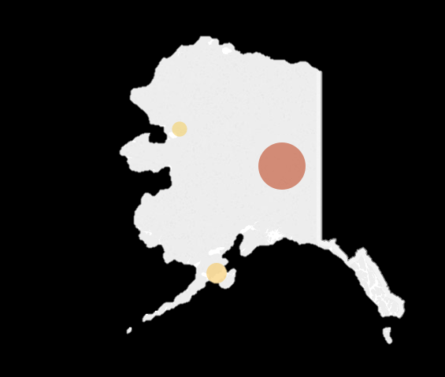
BATTERY STORAGE
The US installed 708 megawatts of battery storage in 2017
Large-scale battery storage installations, 2017
0.5 MW 40 MW
Sources: EIA, “U.S. Battery Storage Market Trends,” May 21,2018.
June 11, 2018 | Julianna Bradley

Slide 2
BATTERY STORAGE
Lithium-ion batteries continue to dominate new battery installations
Large-scale battery storage capacity by type (megawatt hours and percent total)
Sources: EIA, “U.S. Battery Storage Market Trends,” May 21,2018.
June 11, 2018 | Julianna Bradley

