Slide 1
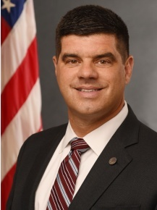
JOHN O’BRIEN
John O’Brien
Biography
Dr. O’Brien was appointed deputy assistant secretary for health policy, in HHS’s Office of Planning and Evaluation, in March. He is also an interim advisor to the secretary in the Immediate Office of the Secretary. He previously was VP of public policy at CareFirst BlueCross BlueShield where he advised leadership on federal and state policy, led internal research and external program evaluations, and served as an internal expert on payment policy and delivery system reform. He also worked at CMS in the Obama administration, and before that was a professor at Notre Dame of Maryland University College of Pharmacy. John has a master’s degree in public health from the Hopkins Bloomberg School of Public Health, a pharmacy degree from Nova Southeastern University, and studied pharmacy and public policy at the University of Florida.
Professional Experience
Pharmaceutical Research and Manufacturers of America
Centers for Medicare and Medicaid Services, Senior Advisor and Policy Coordinator
Notre Dame of Maryland University College of Pharmacy
CareFirst BlueCross BlueShield, Vice President of Public Policy
“
"Both of the Senior Advisors will be supported by John O’Brien, who will continue to be detailed from ASPE to assist the IOS for issues related to CMS, HRSA, AHRQ, and ONC.“
- Secretary Azar, Department of Health and Human Services
Contact
U.S. Department of Health and Human Services 200 Independence Avenue, SW Phone: (202) 690-7858
Sources: U.S. Department of Health and Human Services, Office of the Assistant Secretary for Planning and Evaluation. The Secretary of Health and Human Services, Immediate Office of the Secretary Organization., March 29, 2018.
May 24, 2018 | Julianna Bradley

