Slide 1
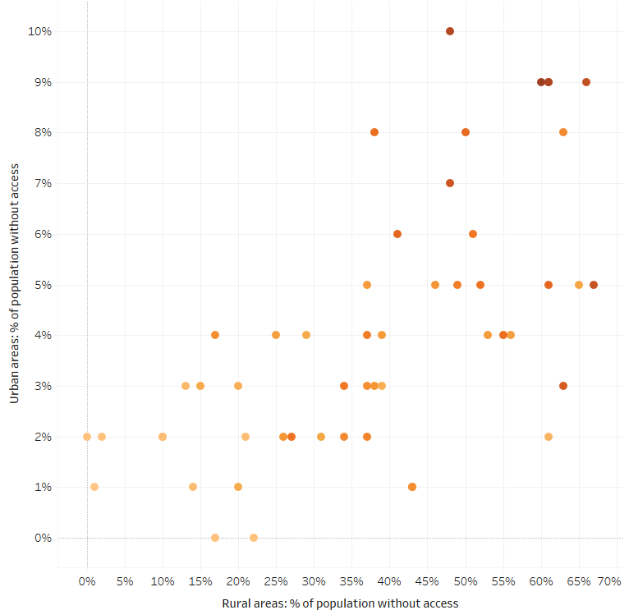
RURAL BROADBAND
Mississippi
Overview
Notable legislation, grants and initiatives*
House Bill No. 1650, introduced by Mississippi Representative Bryant Clark in February 2018, would have created a rural counties and municipalities cellular and broadband grant program and authorized issuance of bonds for these purposes
Mississippi Broadband Technology Tax Credit
Mississippi
All areas: 34%
Urban areas: 9%
Rural areas: 60%
“Connecting more Mississippians to high-speed internet is essential to our state’s economic future.”
— Senator Roger Wicker, January 2018
“It’s critical to expand broadband access, especially for the millions of rural Americans who are on the wrong side of the digital divide.”
— Governor Phil Bryant, January 2018
 | All areas | Urban areas | Rural areas
Population without access | 1,034,047 | 129,674 | 904,373
% of population without access | 34% | 9% | 60%
Broadband deployment in Mississippi
All areas: % of population without access
1%
34%
* This is not an exhaustive list.
Sources: FCC; National Journal Research; MorningStar. Overview scatterplot and table are based on the FCC’s “Broadband Progress Report” and ACS data from December, 2014.
May 3, 2018 | Theo Goetemann

