Slide 1
Facebook’s data breach
An overview of data breaches, Mark Zuckerberg’s testimony to Congress, key players and outcomes of the breach
April 19, 2018
Producer
Theo Goetemann
Director
Alistair Taylor

Slide 2
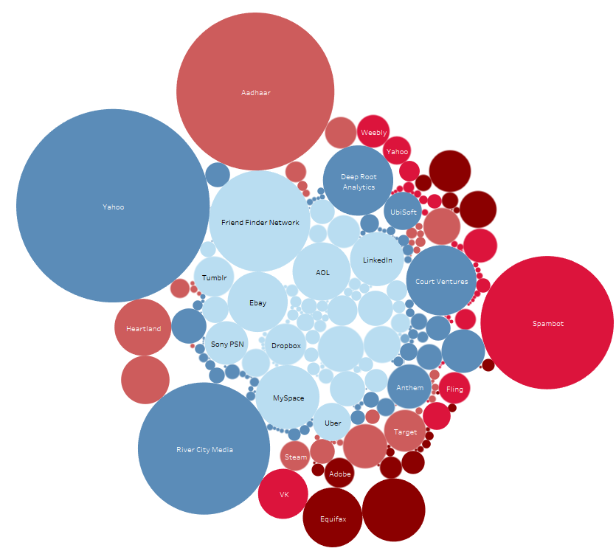
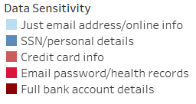
DATA BREACHES
Facebook’s data scandal and other data breaches
On April 4th, 2018, Facebook announced that 87 million people had their data mined by the political firm Cambridge Analytica, 70.6 million of whom were in the US. This is ~40 million more users than previously thought.
Scope of data breaches
in the US since 2004
* Size of circle depicts number of
records stolen
Sources: DataBreaches.net; IDTheftCentre; NextGob.
April 10, 2018 | Theo Goetemann

Slide 3
TRUST IN TECH COMPANIES
Facebook’s approval ratings among the American public have plunged in the past five months
Net favorability in October 2017 and March 2018
Axios/SurveyMonkey conducted polls in October 2017 and March 2018, after the Cambridge Analytica story broke. 2,878 adults were surveyed in the US (error estimate 2.5%).
Facebook’s net favorability dropped twice as much as its peers.
Sources: Axios.
April 16, 2018 | Theo Goetemann

Slide 4
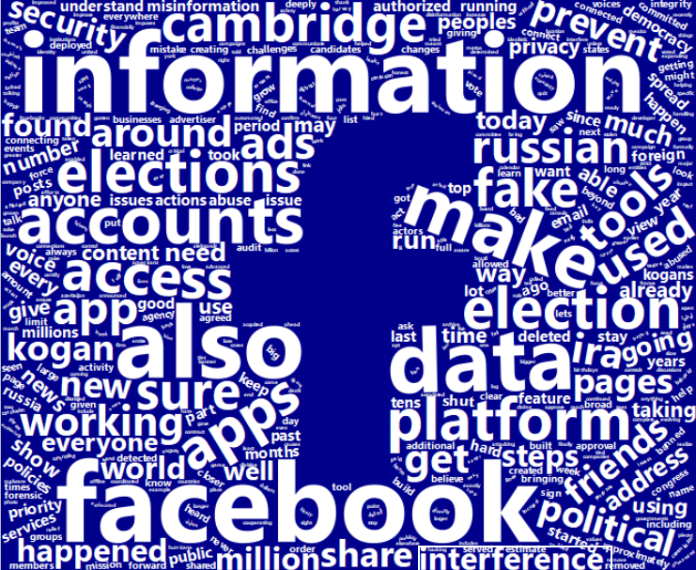
FACEBOOK
Mark Zuckerberg’s testimony to the Senate
Key takeaways and Senate concerns
Senators on both sides of the aisle criticized Facebook’s privacy policy for being inadequate and confusing.
Many Senate members were not convinced by Zuckerberg’s promises to self-police Facebook in the future, and the EU’s General Data Protection Regulation (GDPR) to safeguard individual privacy was mentioned in conjunction with this issue.
Senators focused on Facebook’s market dominance, asking questions about its competitors and alternatives.
Some Republican senators were concerned about whether Facebook’s future content policing methods will be biased against conservative content.
Facebook’s stock jumped more than 5% following Zuckerberg’s testimony
A wordcloud depicting the frequency of words in Mark Zuckerberg’s prepared testimony to Congress
Sources: National Journal Research; The Verge.
April 9, 2018 | Theo Goetemann

Slide 5
FACEBOOK
Mark Zuckerberg’s testimony to the House
Key takeaways and House concerns
Zuckerberg told House members that Facebook would roll out GDPR-style protections globally, but provided an unclear answer to Rep. Janice Schakowsky (D-IL) when pressed whether the same rights will be applied to Americans.
Some representatives believe Facebook violated its consent decree with the Federal Trade Commission, which requires Facebook to identify and address emerging threats to user privacy
Mark Zuckerberg’s own Facebook profile was part of the Cambridge Analytica data leak.
House members pressed Zuckerberg on increased privacy for minors using Facebook.
House members also inquired about removing opioid advertisements on Facebook.
A wordcloud depicting the frequency of words in Mark Zuckerberg’s prepared testimony to Congress
Sources: National Journal Research; The Verge.
April 9, 2018 | Theo Goetemann

Slide 6
FACEBOOK
Key players in Facebook’s data breach
Facebook is an American online social media company based in Menlo Park, California. It was launched in 2004 and, as of January 2018, has more than 2.2 billion monthly active users. The company has recently faced increasing pressure to act on fake news, hate speech and bullying, depictions of violence in its content and data privacy issues.
Cambridge Analytica is a British political consulting firm that offers data mining, brokerage and analysis services. The company is partly owned by the family of Robert Mercer, an American hedge-fund manager who supports politically conservative causes. Former CEO Alexander Nix said in 2014 that Cambridge Analytica has been involved in 44 US political races.
Sources: National Journal Research.
April 9, 2018 | Theo Goetemann

Slide 7
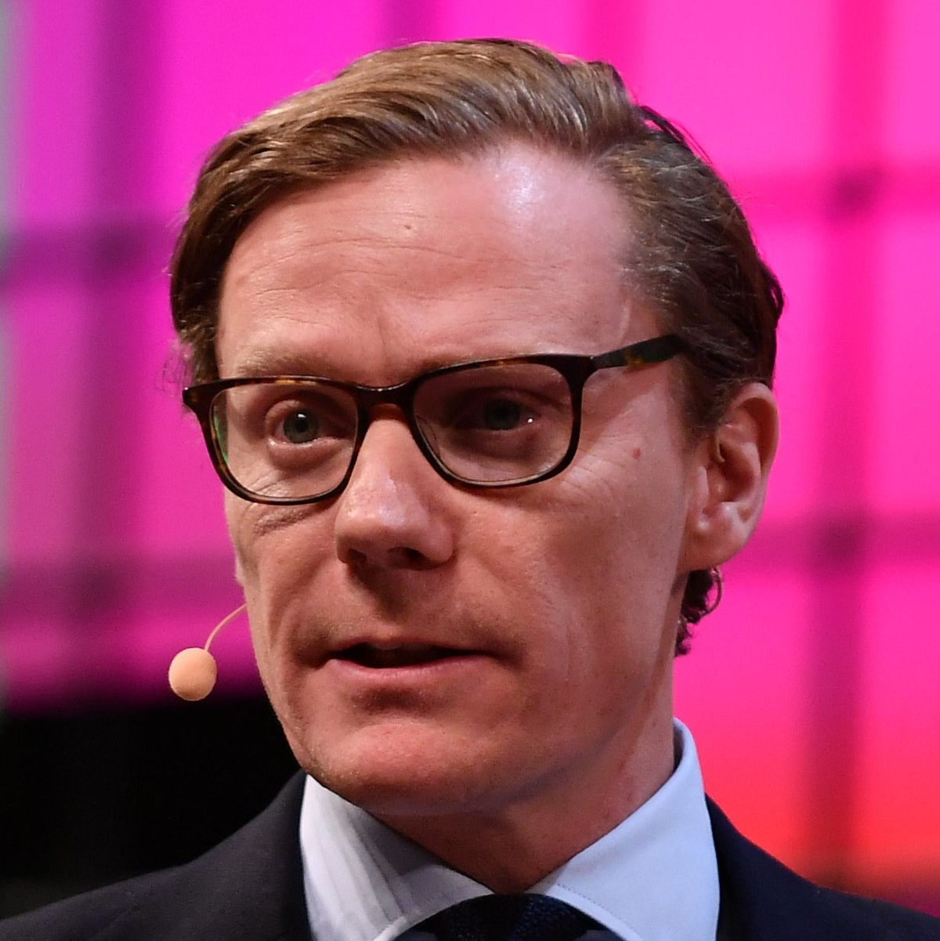
FACEBOOK
Key players in Facebook’s data breach
Mark Zuckerberg is a co-founder and CEO of Facebook. Over the past several years, Zuckerberg has faced increasing scrutiny over the issue of data privacy on Facebook.
Alexander Nix, the 42-year-old former CEO of Cambridge Analytica, has found himself at the center of Facebook’s data mining scandal. Nix was suspended after British broadcaster Channel 4 aired an undercover video in which Nix described questionable data mining practices that he claimed played a decisive role in Trump’s 2016 victory.
Aleksandr Kogan was the creator of the app “thisisyourdigitallife,” which offered Facebook users personality predictions in exchange for accessing their personal data on Facebook and limited information about their friends. Cambridge Analytica was able to mine tens of millions of profiles through this tool.
Christopher Wylie is the whistleblower who provided the British daily newspaper The Guardian with documents that laid out Cambridge Analytica’s practices. He was previously the firm’s research director.
Sources: National Journal Research.
April 9, 2018 | Theo Goetemann

Slide 8
FACEBOOK
Outcomes and proposed legislation following Facebook’s data breach
Facebook’s stock has been downgraded for the first time by the research firm OTR Global. Its stock dropped 1.7% following the downgrade. Since the data breach its stock has fallen from $185.09 (March 16, 2018) to $152.22 (March 27, 2018), its lowest price since July 2017.
Senator Amy Klobuchar (D-MN) and
John Kennedy (R-LA) have stated they will introduce legislation to address seven key points:
Give consumers the right to opt out and keep their information private by disabling data collection.
Give users greater access to and control over their data.
Require terms of service agreements to be written in “plain language.”
Ensure users can see what information about them has already been collected and shared.
Mandate that users be notified of a breach of their information within 72 hours.
Offer remedies for users when a breach occurs,
Require online platforms to have a privacy program in place.
Senator Richard Blumenthal (D-CT) and Ed Markey (D-MA) introduced the CONSENT Act (Customer Online Notification for Stopping Edge-provider Network Transgressions) on April 10th, 2018.
The CONSENT Act provides similar provisions as Klobuchar and Kennedy’s key points, but requires explicit consent from users to use, share, or sell any of their personal information, as well as a clear notification any time their data is collected, shared, or used.
Similar bills have stalled in the Senate, such as the Honest Ads Act, introduced in October 2017, which would have regulated political ads on the internet.
Sources: National Journal Research.
April 9, 2018 | Theo Goetemann

Slide 9
Ways to edit these slides
Looking to customize these slides yourself?
No problem. The slides in this deck can be edited to suit your needs. However, if you alter text, data or images on our slides, we ask that you remove National Journal logos and branding prior to distribution or public use. Examples to look for:
Looking for assistance with customization?
We’re here to help. If you’d like our team of policy researchers and data visualization specialists to customize this deck with your vision in mind, contact your Dedicated Advisor or email service@nationaljournal.com. This service is included in most membership packages.
Feel free to delete this slide before presenting.
2018 | National Journal Presentation Center

