Slide 1
Signs of a wave election
Using history as a guide to the 2018 midterms with The Cook Political Report
April 17, 2018
Producer
Madelaine Pisani
Director
Alistair Taylor

Slide 2
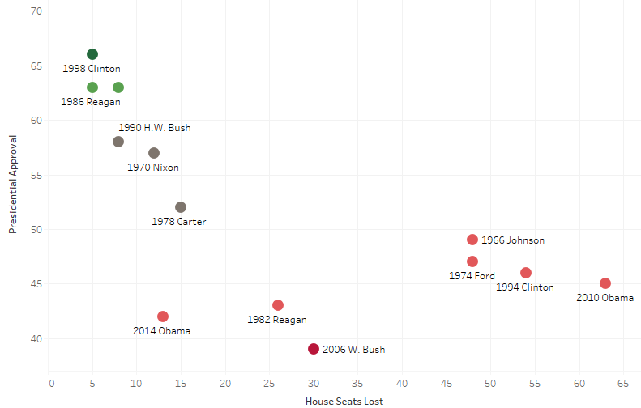
WAVE ELECTIONS
History tells us that the president's party will lose seats in midterm elections
Presidential approval ratings vs. House seats lost, 1966-2014
2002 G.W. Bush
Sources: Ally Flinn, David Wasserman, “Follow 2018 with us,” The Cook Political Report, April 10, 2018.
April 17, 2018 | Madelaine Pisani

Slide 3
2018 MIDTERM ELECTIONS
Presidents with a sub-50% approval rating lose an average of 40 House seats in the midterms
Presidential job approval vs. midterm results since 1966
Trump Job Approval
42.4%
RCP Average: April 16, 2018
Job Approval
Over 60%
50%-60%
Under 50%
Average Change
+3 Seats
-12 Seats
-40 Seats
Sources: Gallup, The Cook Political Report, National Journal
April 16, 2018 | Adriana Morton, Madelaine Pisani

Slide 4
WAVE ELECTIONS
In the last four House wave elections, roughly two-thirds of vulnerable incumbents from the president’s party still won
Incumbent party’s retention rates in the past four House wave elections*
■ Open seats ■ Incumbent running
*1994, 2006, 2008, 2010
WHEN THE DISTRICT’S PVI FAVORS…
Analysis
Incumbents are hard to beat, even in wave elections
In the last four House wave elections, 59% of incumbents from the president’s party in districts with a PVI favoring the other party by 0-5 points still won
However, when those seats were open, the president’s party only held 6% of them
Sources: Ally Flinn, David Wasserman, “Follow 2018 with us,” The Cook Political Report, April 10, 2018.
April 16, 2018 | Madelaine Pisani

Slide 5
WAVE ELECTIONS
In the last three midterm waves, the out party won an average of 71% of seats in the Toss Up or worse column
How races in Toss Up or worse break in midterm wave elections*
*1994, 2006, 2010
■ Seats in Toss Up or worse ■ Seats won in Toss Up or worse
Analysis
Democrats need to flip 24 seats to take back the House
As the ratings currently stand, Democrats would have to pick up over 82% of Republican-held seats in districts rated toss up or worse
Sources: Ally Flinn, David Wasserman, “Follow 2018 with us,” The Cook Political Report, April 10, 2018.
April 10, 2018 | Madelaine Pisani

Slide 6
WAVE ELECTIONS
In the last three midterm waves, the party that won the House also decisively won the independent vote
How races in Toss Up or worse break in midterm wave elections
■ House results (R) ■ Independent vote differential in favor of Republicans
■ House results (D) ■ Independent vote differential in favor of Democrats
Trump job approval among independent voters
33%
Gallup: April 15, 2018
Sources: Ally Flinn, David Wasserman, “Follow 2018 with us,” The Cook Political Report, April 10, 2018.
April 10, 2018 | Madelaine Pisani

Slide 7
WAVE ELECTIONS
Going into the last two wave elections Bush and Obama both had poor approval numbers among independents
Total job approval and independent job approval going into the last two wave elections*
■ Job approval (R) ■ Independent job approval (R)
■ Job approval (D) ■ Independent job approval (D)
*2006, 2010
Analysis
Currently Trump is polling poorly with independent voters, with a job approval rating of roughly 33%
According to Gallup, his highest approval was 42% when he first took office and his lowest was 29% in early August
Sources: Ally Flinn, David Wasserman, “Follow 2018 with us,” The Cook Political Report, April 10, 2018.
April 10, 2018 | Madelaine Pisani

