Slide 1
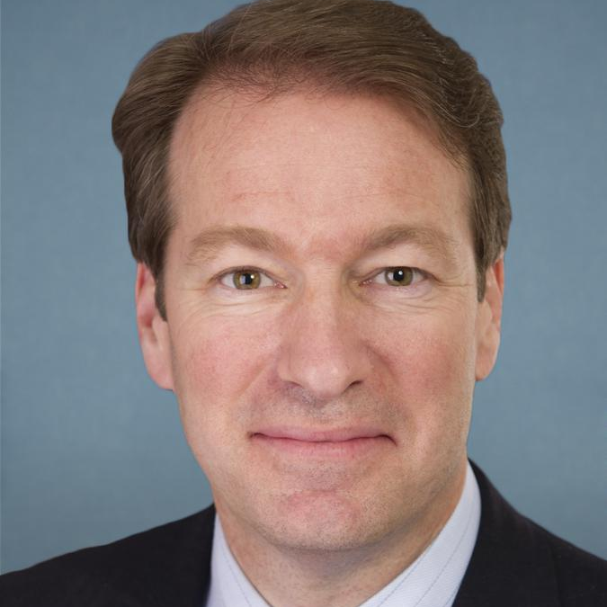
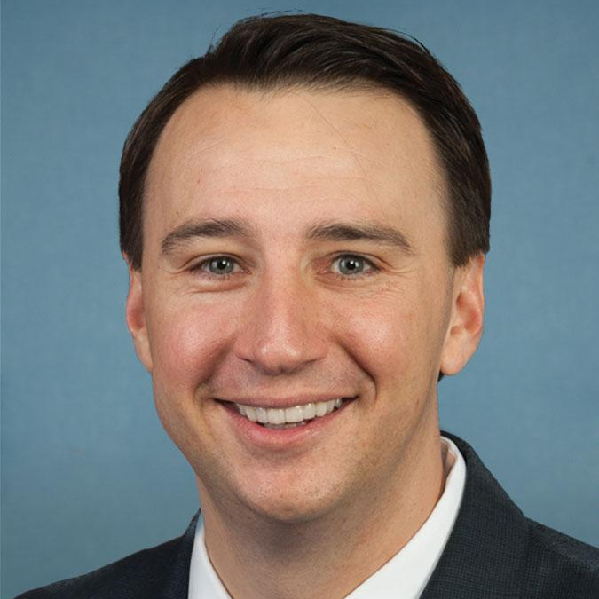
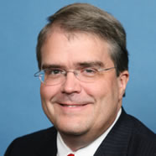
2018 BELLWETHER DISTRICTS
Kraushaar: “If Democrats hope … to retake the majority, these are the members of Congress they’ll need to oust”
Rep. Peter Roskam (R-IL06)
District profile
Suburban Chicago
Romney +8 in 2012, flipped to Clinton +7 in 2016
Internal polling shows he currently beats a generic Democrat, but with less than 50% of the vote
Rep. Ryan Costello (R-PA06)
District profile
Suburban Philadelphia
Romney +2, Clinton +0.6
Running against a leading Democratic recruit: military veteran Chrissy Houlahan
Rep. John Culberson (R-TX07)
District profile
Houston-area suburbs
Romney +21, Clinton +1
Slow to begin fundraising and ended 2017 with less cash on hand than a Democratic rival
Rep. Lee Zeldin (R-NY01)
District profile
Long Island, Trump +12
Running in a state negatively impacted by tax reform
Continues to support Trump amid controversy
Rep. Don Bacon (R-NE02)
District profile
Downtown Omaha and suburbs, Trump +2
Running against the Democrat incumbent that he defeated in 2016
Sources: Josh Kraushaar, “The Five Biggest House Bellwethers,” National Journal, January 16, 2018. DailyKos elections.
January 17, 2018 | Daniel Stublen

