Slide 1
RUSSIA INVESTIGATION
Russia relations: dossier alleging ties between Trump and Russia stokes partisan divide
Key events in January
Jan. 5: Republican congressional leaders refer dossier author for DOJ investigation
Sens. Lindsey Graham (R-SC) and Charles Grassley (R-IA) referred Christopher Steele, author of the opposition dossier on alleged ties between Trump and Russia, for a criminal investigation by the Department of Justice
The senators and committee aides have implied that concern arose because of an alleged discrepancy between Steele’s assertions, though the details are classified
Jan. 8: It is revealed that Mueller is likely to seek an interview with Trump
On January 8th, news broke that special counsel Robert Mueller informed Trump’s legal team in late December that his office would likely seek an interview with Trump
Trump’s legal team has been in contact with FBI officials about the possible interview and alternative format options, which could occur in the next few weeks
Jan. 9: Democratic leaders strike out independently with key interview transcript
On January 9th, Dianne Feinstein (CA), the Senate Judiciary Committee’s ranking Democrat, bypassed Chairman Charles Grassley (R-IA) to publish the interview transcript of a critical witness, Glenn Simpson, in the Russia investigation
Democrats have increasingly viewed recent GOP actions as efforts to undermine the Russia investigation; one aide called the DOJ referral for Mr. Steele “a breaking point” for Dems
Jan. 10: Trump attacks Feinstein via Twitter
"Maybe there is some innocent explanation for the inconsistencies we have seen, but it seems unlikely.” – Grassley, Jan. 5
“The American people deserve the opportunity to see what he said and judge for themselves.” – Feinstein, Jan. 9
“The fact that Sneaky Dianne Feinstein, who has on numerous occasions stated that collusion between Trump/Russia has not been found, would release testimony in such an underhanded and possibly illegal way, totally without authorization, is a disgrace. Must have tough Primary!”
Trump
Jan. 10
Sources: Jordain Carney, “GOP senators request criminal investigation of Trump dossier author,” The Hill, Jan. 5, 2018; Matt Flegenheimer, “Fusion GPS Founder Hauled From the Shadows for the Russia Election Investigation,” NYT, Jan. 8, 2018; Nicholas Fandoms et al., “Democratic Senator Releases Transcript of Interview With Dossier Firm,” NYT, Jan. 9, 2018; Carol D. Leonnig, “Mueller indicates he is likely to seek interview with Trump,” Washington Post, Jan. 8, 2018; Mary Claire Jalonick & Chad Day, “GOP Senators Target Trump Dossier Author Christopher Steele in Russia Investigation,” Time, Jan. 5, 2018.
January 11, 2017 | Taryn MacKinney

Slide 2
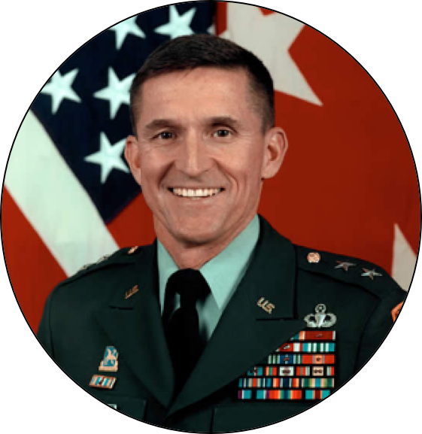
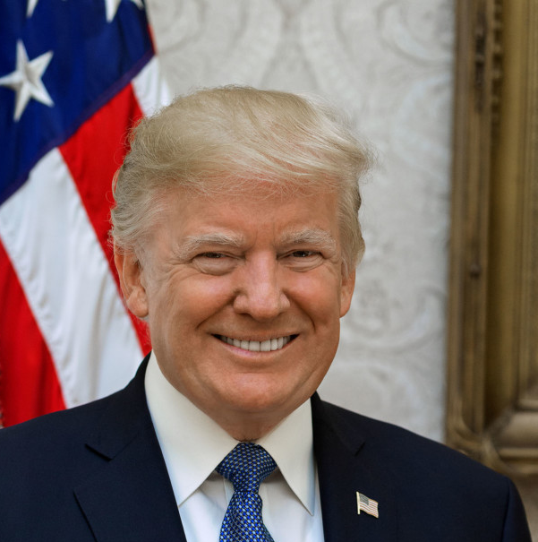
RUSSIA INVESTIGATION
Russia relations: Trump’s dismissed national security advisor, Michael Flynn, pleaded guilty to lying to the FBI
Michael Flynn pleads guilty to lying to FBI
Trump’s former national security adviser, Michael T. Flynn, pleaded guilty on Dec. 1 to lying to the FBI about conversations with Sergey I. Kislyak, the Russian ambassador, last December
As part of Flynn’s plea agreement, released documents indicated that Flynn’s conversations with the Russian ambassador were part of a coordinated effort by Trump aides to create foreign policy before Trump entered office – despite the White House’s claims that Flynn acted independently
Trump tweeted multiple times after the announcement of Flynn’s plea agreement, criticizing the FBI and appearing to admit knowledge of Flynn’s lie prior to firing him
“I had to fire General Flynn because he lied to the Vice President and the FBI”
Trump, Dec. 2
“After years of Comey, with the phony and dishonest Clinton investigation (and more), running the FBI, its reputation is in Tatters - worst in History!”
Possible implications
Flynn has agreed to cooperate with the FBI in Mueller’s investigation into Russian interference in the 2016 election
While the documents do not mention Trump directly, his lawyers believe that Jared Kushner, Trump’s son-in-law, may be implicated
Experts believe that Flynn’s plea may inform the special counsel’s examination into whether Trump obstructed justice when he fired James Comey in May 2017
Trump, Dec. 3
“I never asked Comey to stop investigating Flynn. Just more Fake News covering another Comey lie!”
Trump, Dec. 3
Sources: Matt Ford and Adam Serwer, “Robert Mueller’s first charges,” The Atlantic, Oct 27, 2017. Ryan Lucas, “Special Council Mueller unveils charges against 3 Trump aides,” NPR, Oct 30, 2017; John Wagner, “‘I never asked Comey to stop investigating Flynn’: Trump goes on tweetstorm about the FBI,” Dec. 3, 2017; John Wagner, et al., “Trump says he has nothing to fear from Flynn, then stokes new controversy with tweet,” Washington Post, Dec. 2, 2017.
December 4, 2017 | Taryn MacKinney

Slide 3
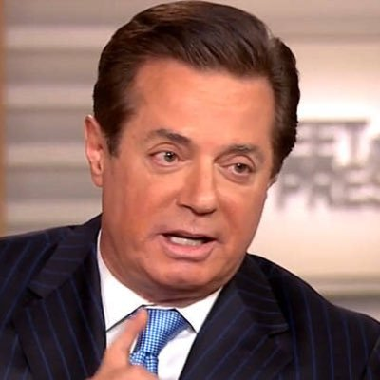
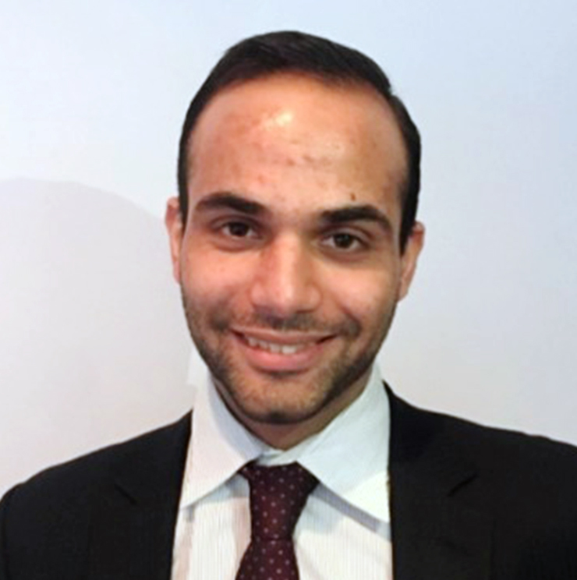
RUSSIA INVESTIGATION
Russia relations: 3 former Trump aides charged in Mueller’s investigation on Russian interference in the 2016 election
Paul Manafort – 12 charges, including:
Conspiracy against the US
Conspiracy to launder money
Failure to file reports of foreign bank and financial accounts (calendar years 2011-14)
Unregistered agent of a foreign principal
False and misleading FARA statements
False statements
Rick Gates – 12 charges, including:
Conspiracy against the US
Conspiracy to launder money
Failure to file reports of foreign bank and financial accounts (calendar years 2011-13)
Unregistered agent of a foreign principal
False and misleading FARA statements
False statements
George Papadopoulos
False statements
The arrests marked the first in the investigation, according to unsealed court documents. Manafort and Gates were charged with:
Conspiracy against the US by “impeding, impairing, obstructing, and defeating the…functions of” the DOJ, treasury
Conspiracy to launder money
Papadopoulos pleaded guilty to lying to FBI about a conversation tied to the Russian gov’t. The conversation – which took place while Papadopoulos was an adviser to Trump’s presidential campaign – involved “dirt” Moscow had on Hillary Clinton. Unsealed documents reveal that several senior campaign officials knew of Papadopoulos’ interactions with Russians
Sources: Matt Ford and Adam Serwer, “Robert Mueller’s first charges,” The Atlantic, Oct 27, 2017. Ryan Lucas, “Special Council Mueller unveils charges against 3 Trump aides,” NPR, Oct 30, 2017.
November 6, 2017 | Theo Goetemann, Taryn MacKinney

Slide 4
RUSSIA INVESTIGATION
Russia relations: Russian fake accounts ran thousands of political ads on Facebook
Facebook’s findings on fake advertising
June 2015-May 2017
Facebook found that a Russian organization linked to the Kremlin, known as the Internet Research Agency, ran 3,000 political ads (at a cost of $100,000) using fake accounts
Facebook has disclosed its findings to Special Counsel Robert Mueller and the House and Senate intelligence committees
Most of the ads focused on divisive social and political issues
Why it matters: It is illegal for foreign governments and companies to spend money to influence American politics
Internet Research Agency worker
Fake accounts
Propaganda, political ads
The Internet Research Agency
In a Jan. report, the FBI, CIA and NSA concluded that the Internet Research Agency was likely financed by a close Putin ally
The organization employs a staff of “trolls” to establish fake accounts and post propaganda
Online ad purchases: key October events
Oct. 19, 2017: Sens. Klobuchar (D), Warner (D) and McCain (R) introduced legislation to require social media to disclose political ad purchases
Oct. 30, 2017: Google acknowledged that it had found 1,108 videos and 43 hours of content related to Russian efforts; $4,700
Oct. 31, 2017: Facebook revealed that 126 million of its users may have seen content produced and circulated by Russian operatives
Nov. 1, 2017: The House Intelligence Committee released dozens of social media ads created by Russian operatives
Sources: Scott Shane and Vincu Goel, “Fake Russian Facebook accounts brought in $100,00 in political ads,” The New York Times, September 6, 2017;Adrian Chen, “The agency,” The New York Times, June 2, 2015; Craig Timberg & Elizabeth Dwoskin, Russian content on Facebook, Google and Twitter reached far more users than companies first disclosed, congressional testimony says,” Washington Post, Oct. 30, 2017; Nicholas Fandos et al., “House Intelligence Committee Releases Incendiary Russian Social Media Ads,” New York Times,
November 6, 2017 | Owen Minott, Taryn MacKinney
Notes:
Another component of the underlying tension between the US and Russia has to do with Russian infiltration of American social media
The extent of this infiltration has been the focus of recent hearing in the House Intelligence Committees → in the last few days, there have been new revelations about the scale of these Russian operatives’ efforts

