Slide 1
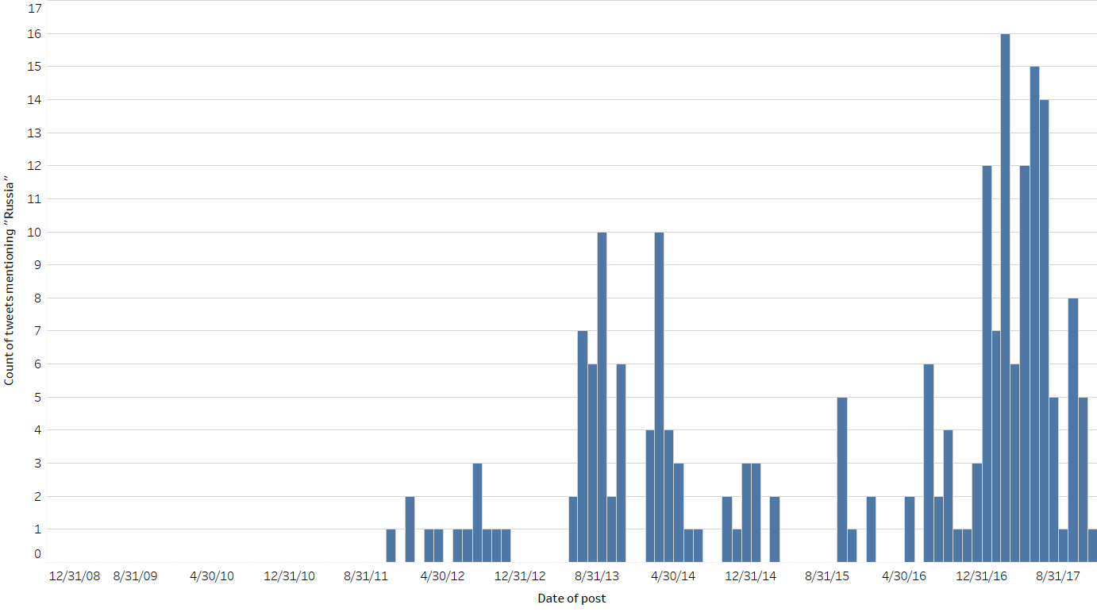
TRUMP & TWITTER
Trump’s tweets on “Russia,” 2009-2017
Count of tweets mentioning “Russia” per month
Sources: Twitter.
December 12, 2017 | Theo Goetemann

Slide 2
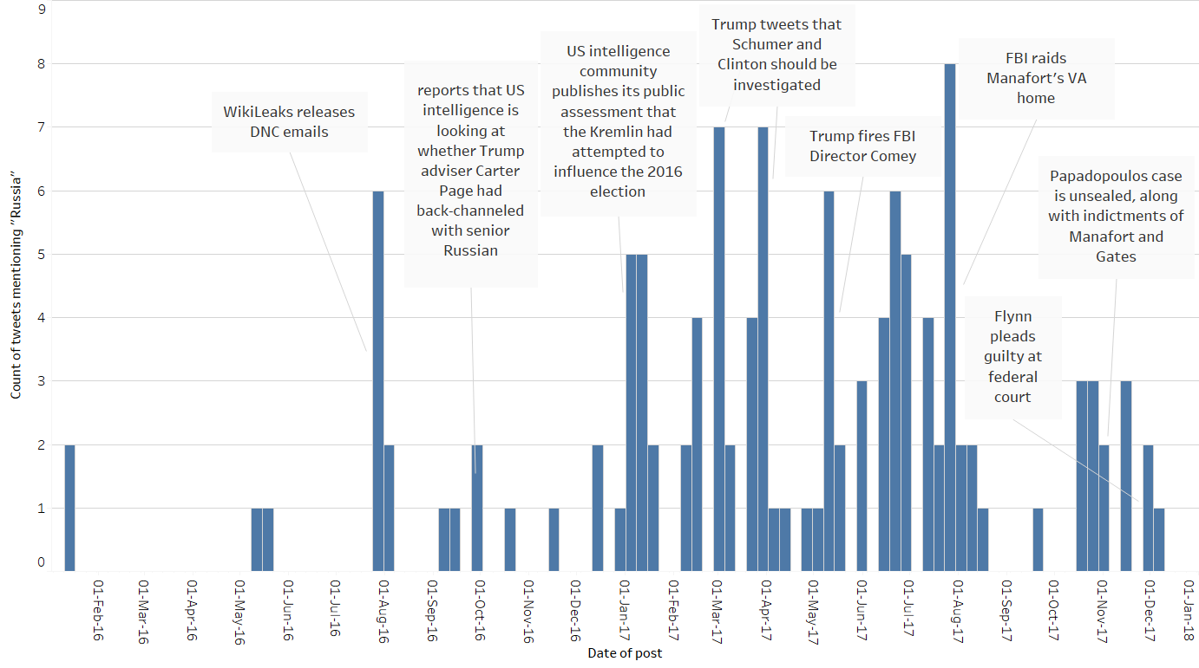
TRUMP & TWITTER
Trump’s tweets on “Russia,” 2016-2017
Count of tweets mentioning “Russia” per week
Sources: Twitter.
December 12, 2017 | Theo Goetemann

Slide 3
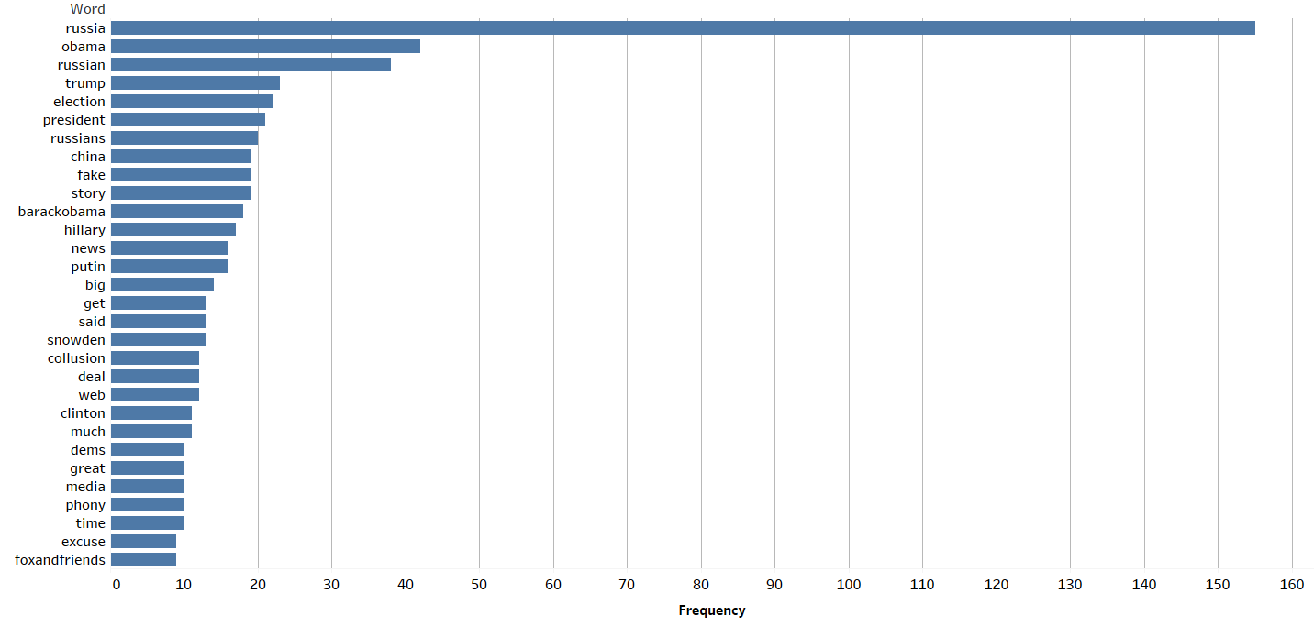
TRUMP & TWITTER
Word frequency of Trump’s tweets
Tweets mentioning the word “Russia,” 2009-2017
Sources: Twitter.
December 12, 2017 | Theo Goetemann

Slide 4
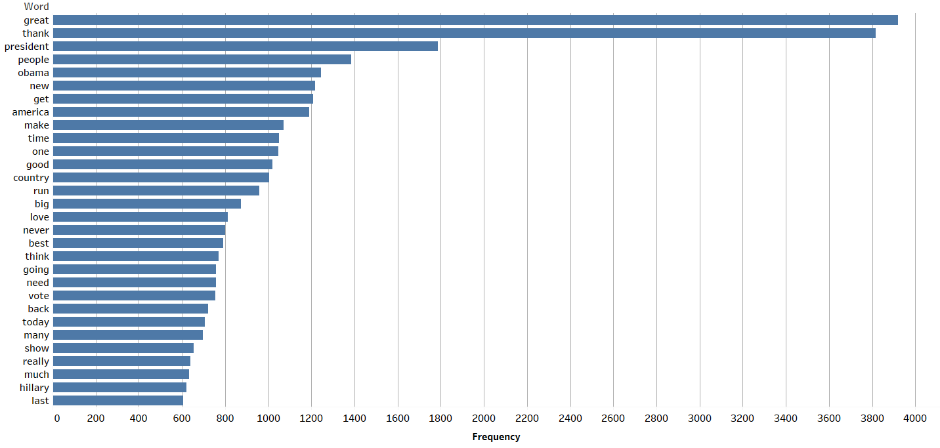
TRUMP & TWITTER
Word frequency of Trump’s tweets
All other tweets, 2009-2017
Sources: Twitter.
December 12, 2017 | Theo Goetemann

