Slide 1
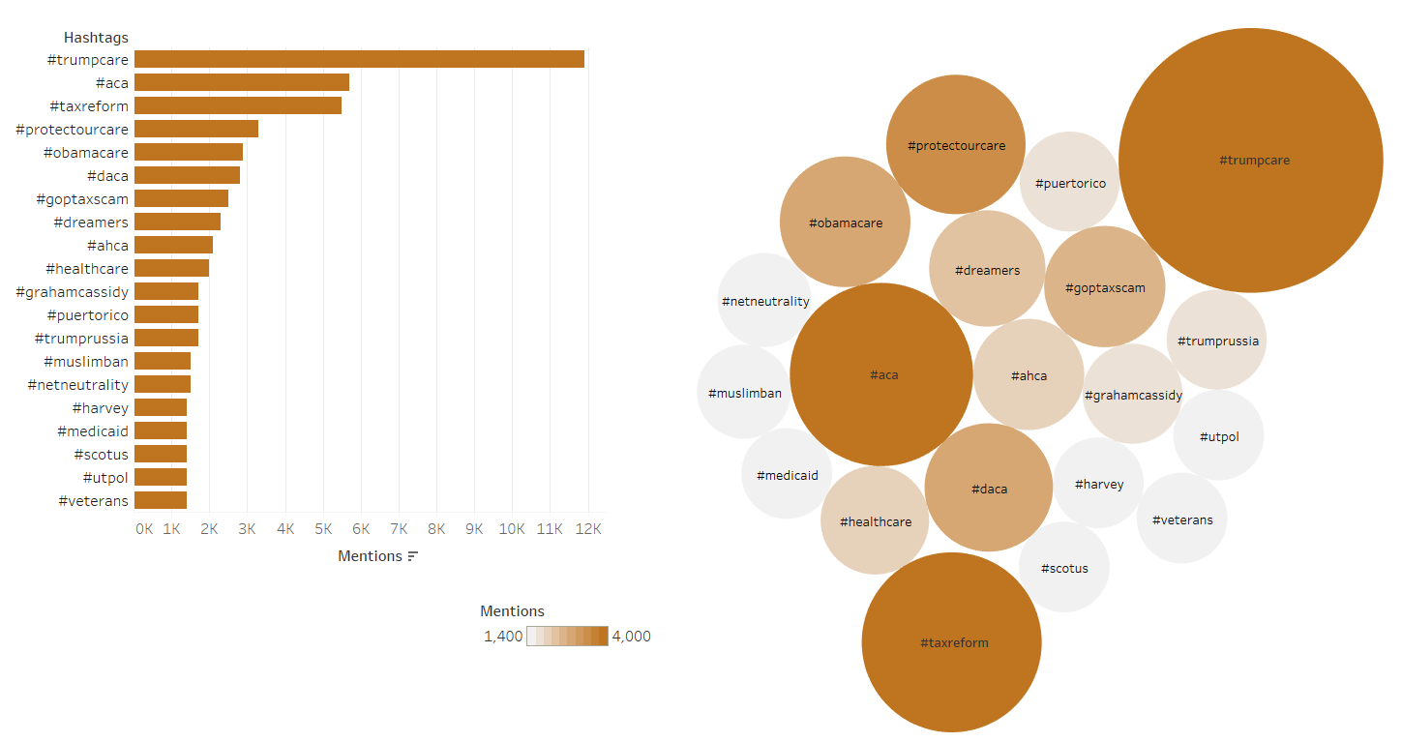
CONGRESS AND TWITTER
Top 20 hashtags used by members of Congress in 2017
Sources: Twitter. Quorum.
December 15, 2017 | Theo Goetemann

