Slide 1
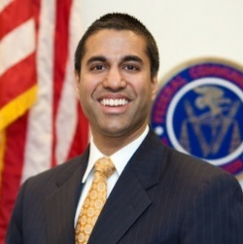
NET NEUTRALITY
FCC reportedly set to vote on net neutrality repeal in December
Reports of FCC Commissioner Pai’s plan for a December vote
Critics’ responses
“
Abandoning bipartisan net neutrality principles threatens to kill the streaming revolution … Chairman Pai’s affection for AT&T and Comcast holds great political risk for President Trump and the entire Republican Party.”
—Chip Pickering, CEO of Incompas, a trade group whose members include Amazon and Netflix
Ajit Pai
FCC commissioner
Ajit Pai, head of the FCC, is reportedly planning to schedule a December vote on repealing net neutrality
The FCC drafted a proposal in April, and received more than 22 million comments online
It is not clear whether the proposed repeal will be exactly the same as the April proposal
“
What consumers want is access to a free and open internet without fear of being throttled or assessed a toll by their broadband service provider.”
—Mignon Clyburn, part of the FCC’s Democratic minority
Sources: Todd Shields, “FCC plans December vote to kill net neutrality rules,” Bloomberg, November 15, 2017.
November 16, 2017 | Owen Minott

