Slide 1
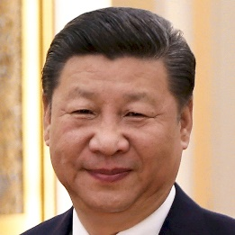
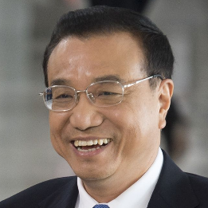
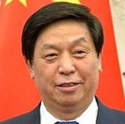
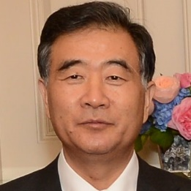
CHINA
Members of China’s Politburo Standing Committee announced
Profiles of the seven Standing Committee members
Xi Jinping
President of China since 2013. During his time as president, China has experienced continued economic growth and taken an increasingly assertive stance on foreign policy. Xi has been criticized for propagating an ethno-nationalist narrative and cracking down on religious, political and ethnic minorities. He is 64 years old.
Li Keqiang
Premier since 2013. Although formally in charge of economic decisions, Li has seen his power wane as Xi Jinping has become increasingly heavy-handed in his influence across party working groups and various ministries. Li is interested in high-tech industries and last year gave a speech popular among Chinese youth on fostering a new “culture of innovation and entrepreneurship.” He speaks English and is 62 years old.
Li Zhanshu
Head of the Chinese Communist Party’s general office. Li Zhanshu is close with Xi Jinping, and the two started their political careers as officials in adjacent areas outside Beijing. Li plays an active role in China’s foreign affairs and is expected to take over as chairman of the National People’s Congress. Li is 67 years old.
Wang Yang
Wang Yang is one of China’s four vice premiers. He is loyal to Xi Jinping and was the head of the delegation sent to the 2017 US-China strategic and economic dialogue. He is a committed economic reformer and during his time as party chief in Guangdong, he pushed through measures to publically publish Guangzhou’s budget. He is 62 years old.
Sources: National Journal research.
October 25, 2017 | Theo Goetemann

Slide 2
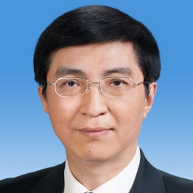
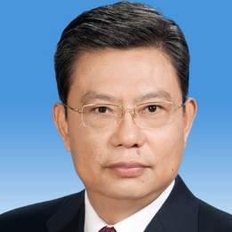
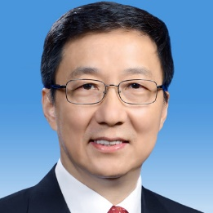
CHINA
Members of China’s Politburo Standing Committee announced
Profiles of the seven Standing Committee members
Wang Huning
Director of the policy research office. Wang Huning is close to Xi Jinping and considered by many to be the driver behind Xi’s heavy-handed style of governance. He is a strong advocate for authoritarian rule and centralizing power. Wang was previously the secretary of the secretariat at the CPC Central Committee from 2007 to 2012. He is 62 years old.
Zhao Leji
The party personnel chief, Zhao Leji runs the party’s Central Organization Department. Due to party age restrictions for Standing Committee membership, at 60 years old, Zhao will be one of the youngest Standing Committee members ever.
Han Zheng
The party chief for Shanghai. In 2003, he became mayor of Shanghai at age 48, the youngest person at the time to ever hold the office. Han Zheng is known as a seasoned economic technocrat. He is 63 years old.
Sources: National Journal research.
October 25, 2017 | Theo Goetemann

