Slide 1
Georgia’s 2018 gubernatorial election
Details on candidates, campaign spending and more
October 18, 2017
Producer
Michael Brady
Director
Alistair Taylor

Slide 2
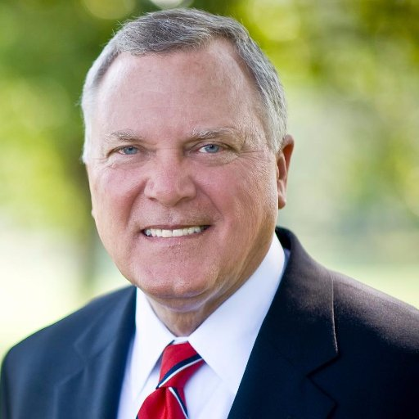
GEORGIA GUBERNATORIAL ELECTION
Overview of the 2018 Georgia gubernatorial election
Primary election:
May 22, 2018
In the event no candidate receives a majority, a primary runoff will be held on July 24, 2018. Only the top two finishers, one Republican and one Democrat, will advance to the general election
Nathan Deal
Republican
Current Georgia governor
Originally elected in 2010
Spent his career as a lawyer
Served from 1993 to 2010 in the U.S. House of Representatives, first as a Democrat, and then as a Republican starting in 1995
Has reached his term limit for the governorship
General election:
November 6, 2018
The governor and lieutenant governor run on separate tickets
The Cook Political Report:
Solid Republican
rating for Georgia’s gubernatorial election
Sources: The Cook Political Report, 2017; Public policy desk, “Primary elections in Georgia,” Ballotpedia, 2017.
October 18, 2017 | Michael Brady

Slide 3
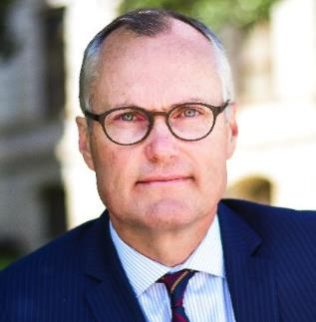
GEORGIA GUBERNATORIAL ELECTION
Cagle secures early funding, but still faces a tough pool of opponents
Key policy issues
Cargle sees tax and regulatory reform as a key issue in the upcoming election. His first initiative as governor would be to set up a liaison for businesses in Georgia to streamline the permitting processes in the state. He has also pledged to cut taxes by $100 million in his first 100 days in office. To accomplish this goal, he will increase the personal exemption and increase the standard deduction.
Cargle will also make job growth a top priority. He has developed a three-part plan that would add 500,000 jobs to the state of Georgia during his first term. His vision is to make Georgia hospitable for technology firms and start-up ventures.
Casey Cagle (R)
Currently: Lieutenant governor of Georgia
Previously: Georgia state senator
Founded his first business at 20, became a leader in small business in NE Georgia
Announced candidacy for the governorship in April 2017
The last reporting period showed that Cagle had $2.7 million saved for the election
Infrastructure will also be a top issue for Cargle. Repairing roads, bridges and expanding high-speed broadband connections to rural areas are central to his platform. Sustaining infrastructure, including hospitals, is especially important to the candidate.
Sources: Greg Bluestein, “Financial reports present an early test in Georgia governor race,” Atlanta Journal-Constitution, July 10, 2017; Casey Cagle, “A Leader on Conservative Solutions,” Cagle for Governor, 2017; Casey Cagle, “Casey’s vision for a better Georgia,” Cagle for Governor, 2017.
October 18, 2017 | Michael Brady

Slide 4
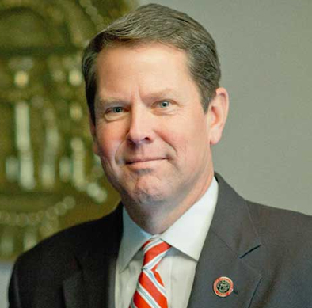
GEORGIA GUBERNATORIAL ELECTION
Kemp looks to capitalize off of populist rhetoric
Key policy issues
Small business is Kemp’s first priority. He has pledged to “chainsaw ridiculous regulations and burdensome mandates.” He also plans to fight against health care reform that he believes punishes small businesses.
Kemp has pledged to end government waste. He has supported a state spending cap that adjusts with population and inflation. He also hopes to eliminate bureaucratic and wasteful state-run programs.
Brian Kemp (R)
Currently: Georgia secretary of state
Previously: Georgia state senator
Kemp has founded and developed many small businesses. He remains an active small business owner involved in agribusiness, financial services, and real estate management and investment
Announced candidacy for the governorship in March 2017
The last reporting period showed that Cagle had raised $1.7 million for the election
Kemp’s platform vows to “put Georgia first,” echoing President Trump’s 2016 campaign. He takes a hard stance against illegal immigration. Kemp has vowed to defund sanctuary cities and campuses, as well as stop taxpayer-funded subsidies for illegal immigrants.
Sources: Office of Brian P. Kemp, “Brian P. Kemp biography,” Georgia Secretary of State, 2017; Greg Bluestein, “Financial reports present an early test in Georgia governor race,” Atlanta Journal-Constitution, July 10, 2017; Brian P. Kemp, “Kemp’s 4 Point Plan to Put Georgia First,” Kemp for Governor, October 2017.
October 18, 2017 | Michael Brady

Slide 5
GEORGIA GUBERNATORIAL ELECTION
Hunter Hill highlights impressive military career in his campaign
Key policy issues
Hill has proposed eliminating the state income tax. He believes that eliminating the tax will create more jobs across the state, attract more businesses to Georgia and benefit citizens with increased spending power.
Hill has also supported doubling Georgia’s investment in infrastructure without raising taxes. He has not divulged the financial specifics of this proposal, but claims infrastructure spending will benefit the economy.
Hunter Hill (R)
Currently: Georgia state senator
Previously: An officer in the U.S. army serving three tours in the Middle East
Founded his own real estate development company in Georgia
Announced candidacy April 2017
Has raised $1 million dollars for the campaign
Opposing “Common Core” in statewide education is also an important part of Hill’s platform. He supports giving parents more options for their children’s education and reducing statewide oversight of educational programs.
Sources: Hunter Hill, “I believe,” Hill for Governor, October 2017; Greg Bluestein, “Financial reports present an early test in Georgia governor race,” Atlanta Journal-Constitution, July 10, 2017.
October 18, 2017 | Michael Brady

Slide 6
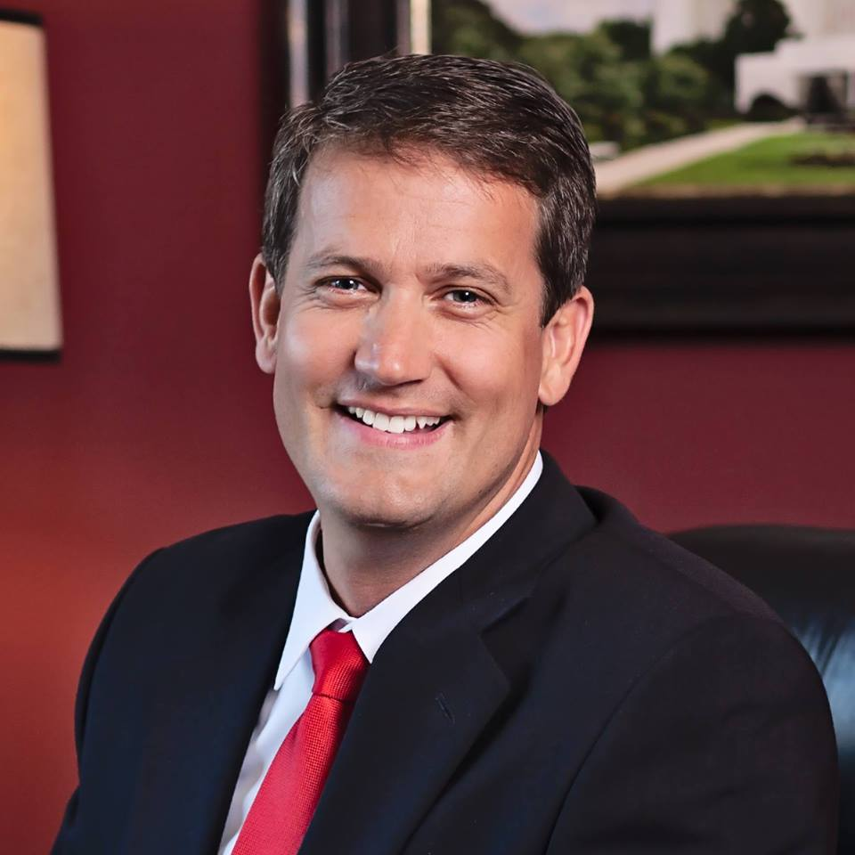
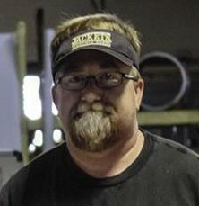
GEORGIA GUBERNATORIAL ELECTION
Other Republican candidates crowd the field, and two Democratic women counter the all-male Republican showing
Clay Tippins (R)
44-year-old tech executive and former Navy SEAL
No previous political experience, Tippins hopes to win support as an outsider
Michael Williams (R)
State senator and local businessman
The first state elected official to endorse Donald Trump for the presidency
Stacey Abrams (D)
Head of the Democratic Caucus in Georgia
Known to take bipartisan approaches to issues, rather than writing off GOP initiatives
Stacey Evans (D)
State representative known for activism on education
Doug Craig (L)
A veteran of the Gulf War and former chair of Georgia’s Libertarian Party
Sources: Greg Bluestein, “Georgia 2018: Who is running to be Georgia’s next governor,” Atlanta Journal-Constitution, September 14, 2017.
October 18, 2017 | Michael Brady

Slide 7
GEORGIA GUBERNATORIAL ELECTION
Cagle has a comfortable funding lead heading into 2018
Total amount raised since start of campaign
In millions of dollars
Sources: Greg Bluestein, “Financial reports present an early test in Georgia governor race,” Atlanta Journal-Constitution, July 10, 2017.
October 18, 2017 | Michael Brady

