Slide 1
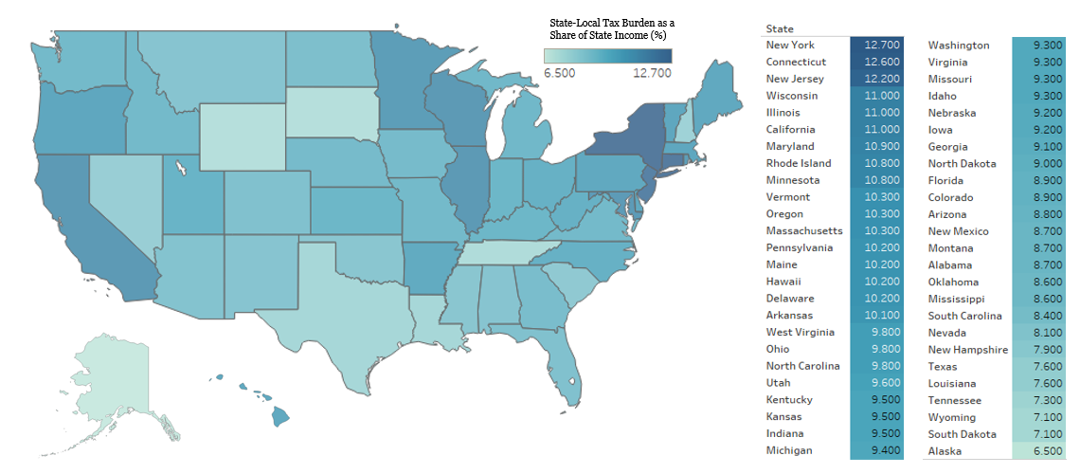
STATE AND LOCAL TAXES
State and local tax burdens as a share of state income
Sources: Morgan Scarboro, “Facts & Figures 2017: How Does Your State Compare?” Tax Foundation, March 13, 2017.
October 18, 2017 | Michael Brady

