Slide 1
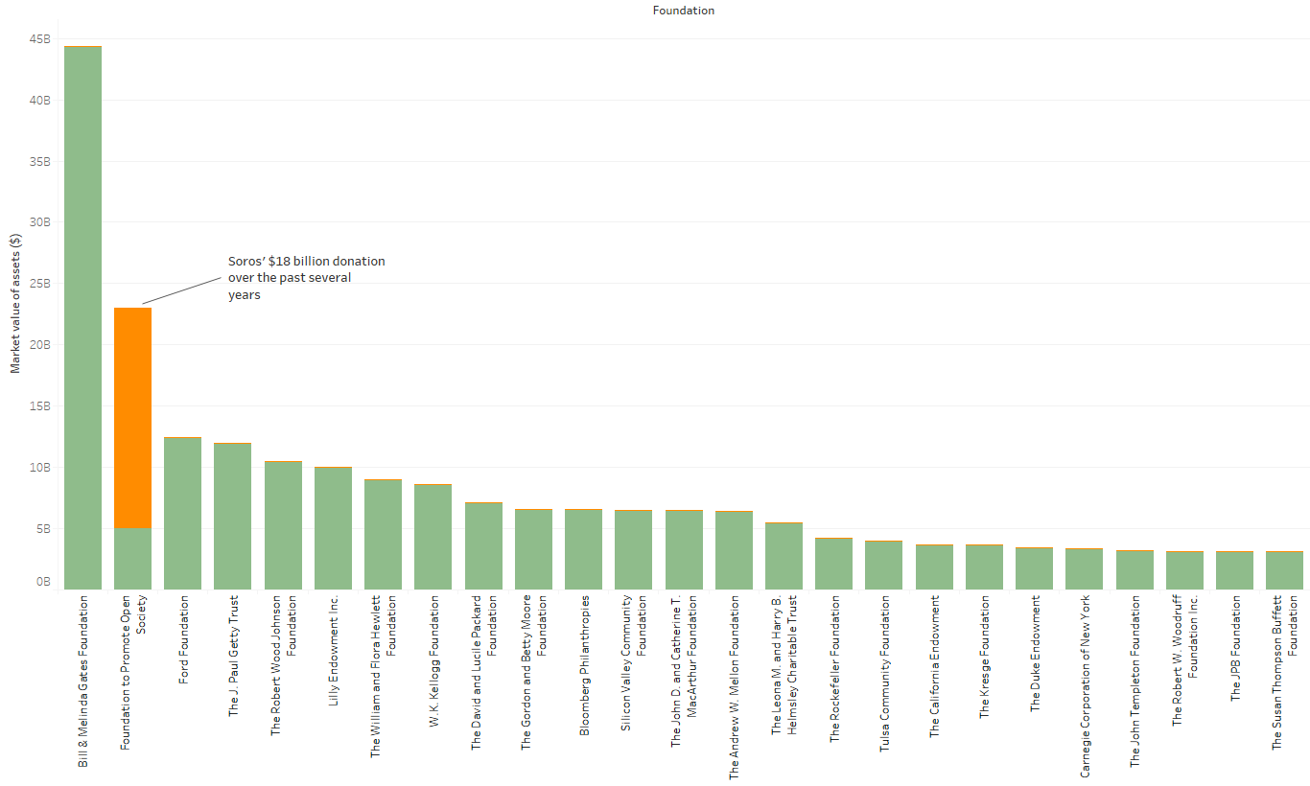
FOUNDATIONS
The Open Society Foundation is now the second largest grant-making foundation in the US
George Soros has donated $18 billion to his foundation over the past several years
The Open Society Foundation (formerly the Open Society Institute) is one of the largest grant-making foundations in the United States. Before Soros’ $18 billion donation, it was ranked as the 15th largest, but now it has surpassed the Ford Foundation as the second largest grant-making foundation in the country, behind only the Bill & Melinda Gates Foundation, whose value rests over $40 billion.
Sources: “25 largest US foundations by total assets,” National Philanthropic Trust, 2017.
October 18, 2017 | Theo Goetemann

Slide 2
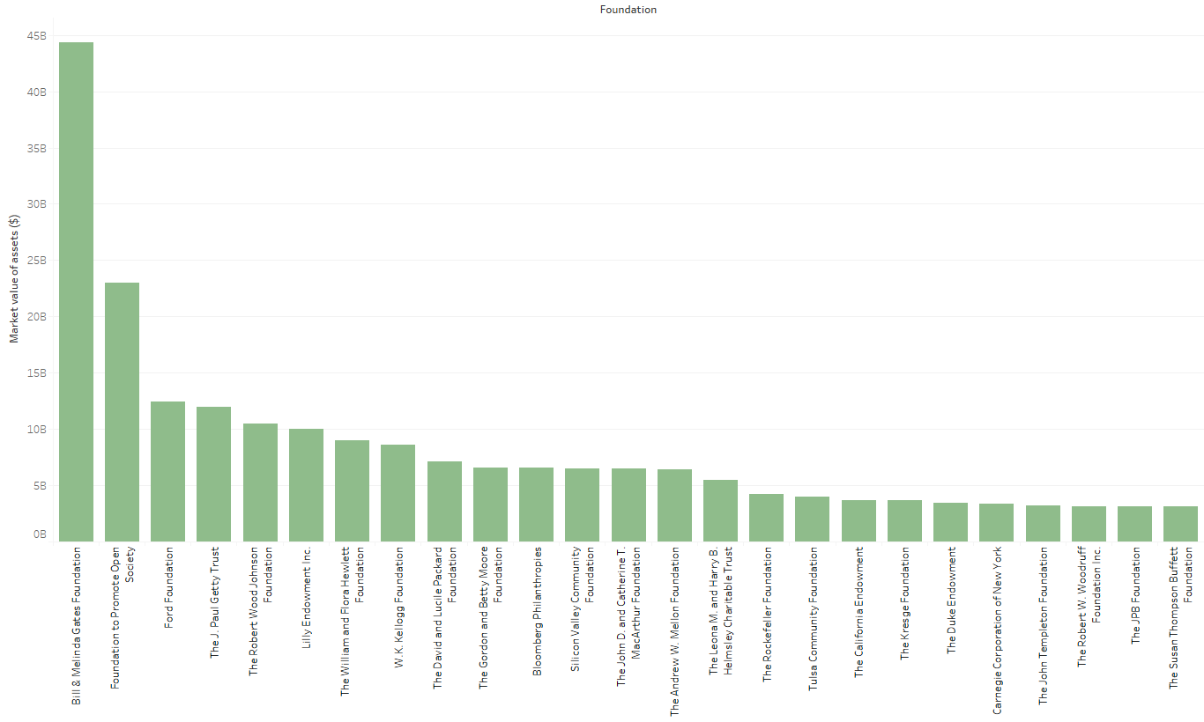
FOUNDATIONS
25 largest grant-making foundations in the US
Sources: “25 largest US foundations by total assets,” National Philanthropic Trust, 2017.
October 18, 2017 | Theo Goetemann

