Slide 1
Maine’s 2018 gubernatorial election
Details on candidates, campaign spending and more
September 25, 2017
Producer
Owen Minott
Director
Alistair Taylor

Slide 2
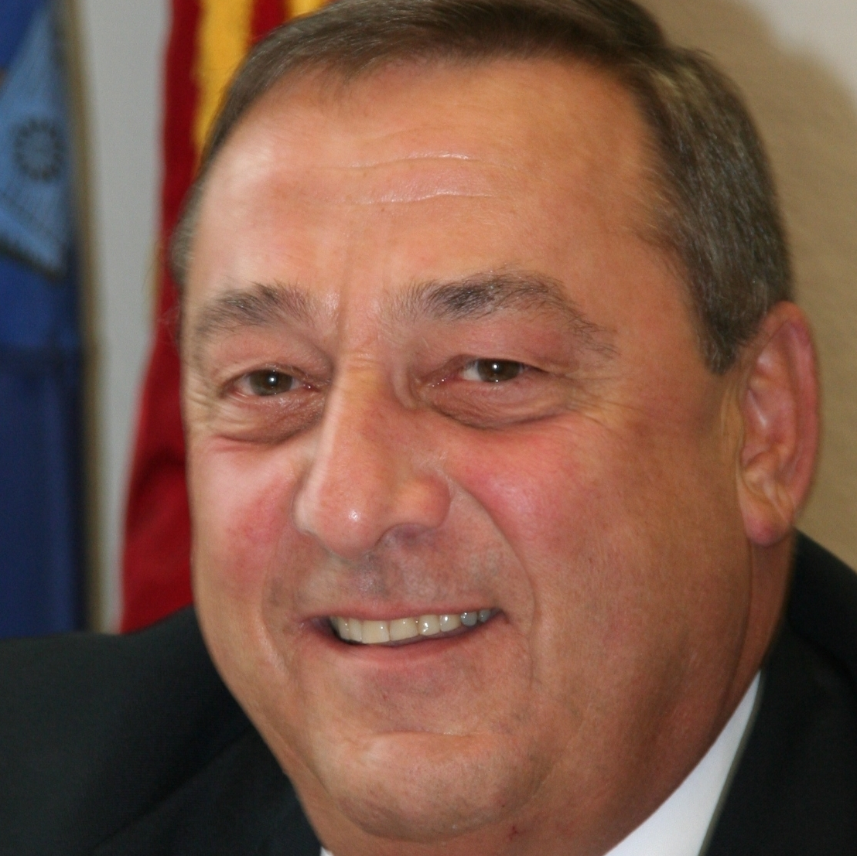
MAINE GUBERNATORIAL ELECTION
Overview of the 2018 Maine gubernatorial election
Primary election:
June 12, 2018
General election:
November 6, 2018
Paul LePage (R)
Current Maine governor
Originally elected in 2010,
Re-elected in 2014
Unable to run for re-election due to term limits
Maine does not have a lieutenant governor
The Cook Political Report:
Toss Up
rating for Maine’s gubernatorial election
Sources: Ballotpedia; National Journal research.
October 11, 2017 | Owen Minott

Slide 3
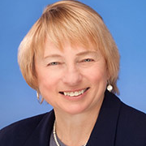
MAINE GUBERNATORIAL ELECTION
Attorney General Mills has been an adversary
of Governor LePage
Key policy issues
Mills supports efforts to reduce carbon emissions. She sued to block Trump’s EPA from repealing the Clean Power Plan.
Mills opposes efforts to repeal Obamacare. She refused to represent the governor’s office in challenging the ACA provision to extend Medicaid.
Janet Mills (D)
Currently: Maine Attorney General
Served in the Maine House of Representatives
Announced candidacy July 2017
Mills supports offering doctors incentives to prescribe alternatives to opioid painkillers.
Sources: Ballotpedia; National Journal research.
October 11, 2017 | Owen Minott

Slide 4
MAINE GUBERNATORIAL ELECTION
Several Democrats lacking name recognition have announced their candidacies
James Boyle (D)
Former State Senator
Former business owner
Adam Cote (D)
Maine Army National Guard member
Iraq War veteran
Former congressional candidate
Mark Eves (D)
Former Maine Speaker of the House
Former family therapist
Chellie Pingree (D), US Representative
Matthew Dunlap (D), Maine Secretary of State
Potential high-profile contenders that have not announced:
Sources: Ballotpedia; National Journal research.
September 25, 2017 | Owen Minott

Slide 5
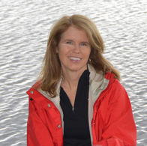
MAINE GUBERNATORIAL ELECTION
LePage’s former health commissioner is running for governor
Key policy issues
Mayhew opposes Medicaid expansion. During her tenure as health commissioner, Medicaid enrollment reduced by 67,000 people
Opposes a surtax on high earners, which was approved by Maine voters.
Mary Mayhew (R)
Previously: Commissioner of Health and Human Services
Served as a government relations manager for the Maine Hospital Association
Announced candidacy in May 2017
Sources: Ballotpedia; National Journal research.
October 11, 2017 | Owen Minott

Slide 6
MAINE GUBERNATORIAL ELECTION
Maine’s Senate majority leader has announced
his candidacy for governor
Key policy issues
Mason has firmly opposed “cap-and-trade” legislation in the state Senate.
Mason opposes abortion rights.
1
Mason opposes ranked-choice voting, which Maine voted to approve in 2016, and has sponsored legislation to repeal it.
Garrett Mason (R)
Currently: State Senate Majority Leader
Former public relations professional
2
3
Sources: Ballotpedia; National Journal research.
September 25, 2017 | Owen Minott

Slide 7
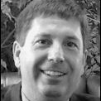
MAINE GUBERNATORIAL ELECTION
LePage ally Fredette to run for governor
Key policy issues
Fredette sponsored legislation to eliminate the income tax in Maine.
Fredette opposes expanding Medicaid.
Kenneth Fredette (R)
Currently: Maine State House Minority Leader
Served as a judge advocate in the JAG Corps for 12 years
Served in the Maine Air National Guard
Sources: Ballotpedia; National Journal research.
September 25, 2017 | Owen Minott

