Slide 1

California’s 2018 gubernatorial election
Details on candidates, campaign spending and more
July 24, 2017
Producer
Adriana Morton
Edited by
Madelaine Pisani
Director
Alistair Taylor

Slide 2
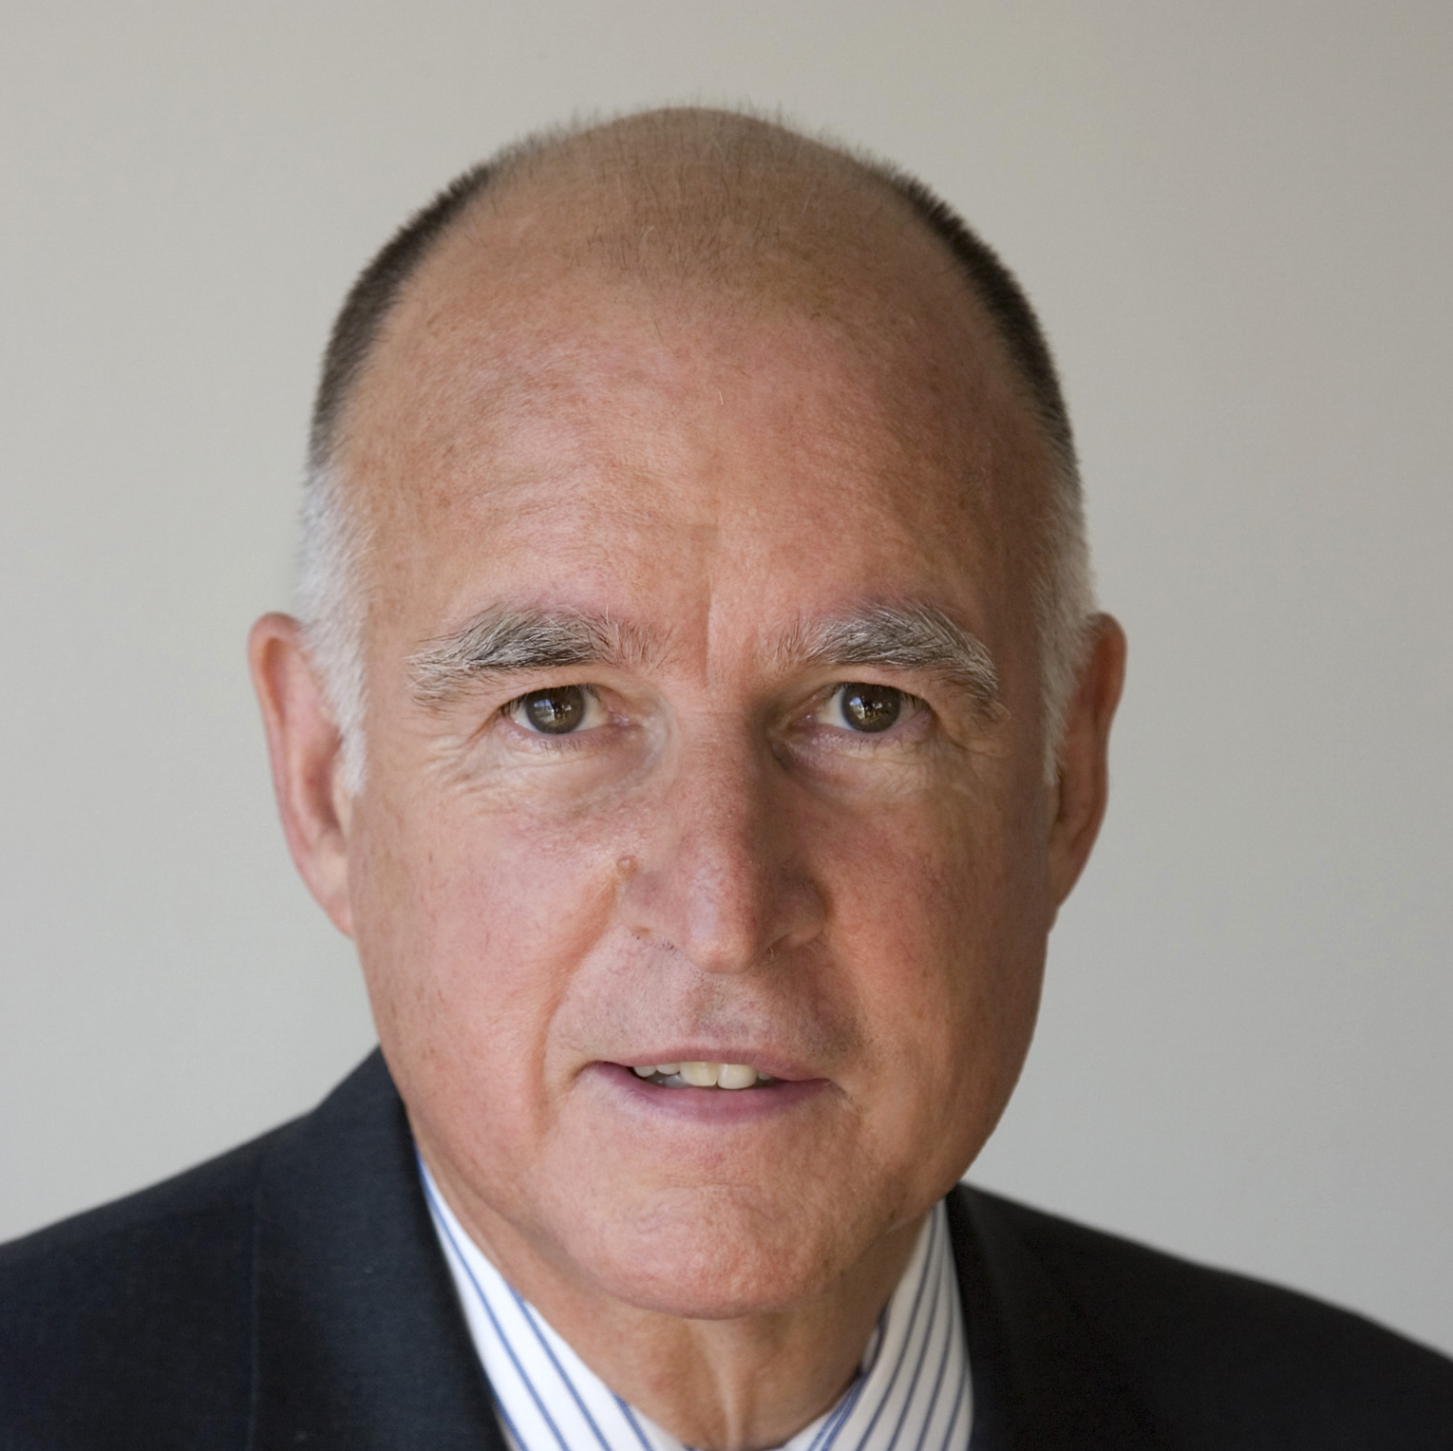
CALIFORNIA GUBERNATORIAL ELECTION
Overview of the 2018 California gubernatorial election
Primary election:
June 5, 2018
Only the top two finishers, regardless of party, will advance to the general election
General election:
November 6, 2018
Jerry Brown (D)
Democrat
Current California governor
Originally elected in 1974, served two terms as governor from 1975-1983
Re-elected in 2010, served two additional terms
Unable to run for re-election due to term limits
The governor and lieutenant governor do not run on the same ticket, are elected separately and can be members of different parties
The Cook Political Report:
Solid Democratic
rating for California’s gubernatorial election
Sources: The Cook Political Report, 2017; California Secretary of State, 2017;
July 24, 2017 | Adriana Morton

Slide 3
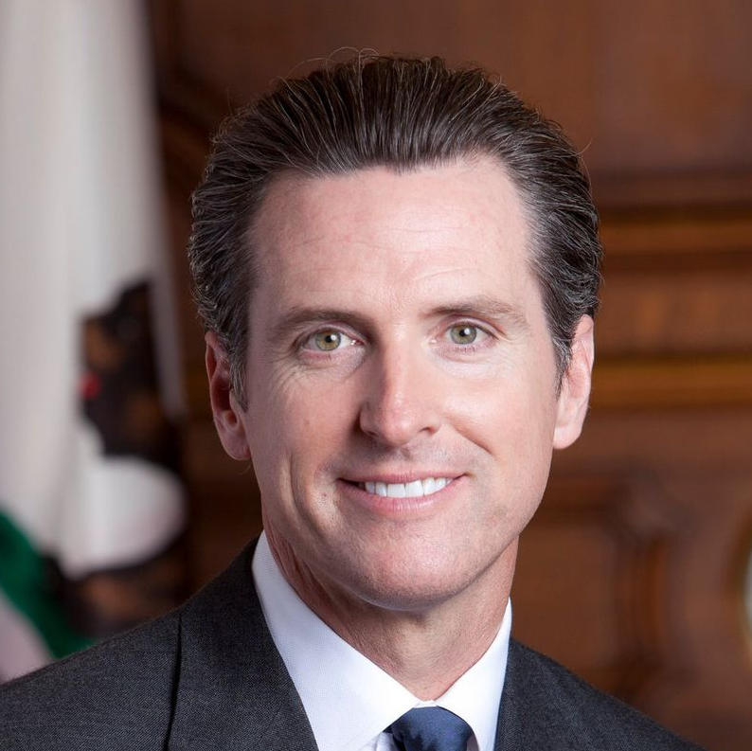



CALIFORNIA GUBERNATORIAL ELECTION
Current Lieutenant Governor Newsom has an early lead in funding and name recognition
Key policy issues
  Newsom announced he would support a proposition to go beyond the state legislature’s single-payer healthcare bill and guarantee universal healthcare in California as a response to the national-level AHCA legislation
As an advocate for increased gun control, Newsom was a major proponent of Proposition 63, an initiative to increase background checks that passed in the 2016 election
Gavin Newsom (D)
Currently: California’s lieutenant governor under Jerry Brown
Previously: Mayor of San Francisco from 2004-2011
Ran for governor briefly in 2009
Ordered San Francisco to issue same-sex marriage licenses in 2004
Announced candidacy February 2015
He is a supporter of the legalization of recreational marijuana and was one of the architects of Proposition 64, which also passed in the 2016 election and legalized marijuana in California
Sources: Phil Willon, “California’s next governor: Who’s running, who’s on the fence?” Los Angeles Times, June 22, 2017; Angela Hart, “Newsom to pitch universal health care as California governor’s race grows crowded,” Sacramento Bee, March 13, 2017; Ballotpedia, 2017; Gavin Newsom for Governor, 2017.
July 24, 2017 | Adriana Morton

Slide 4
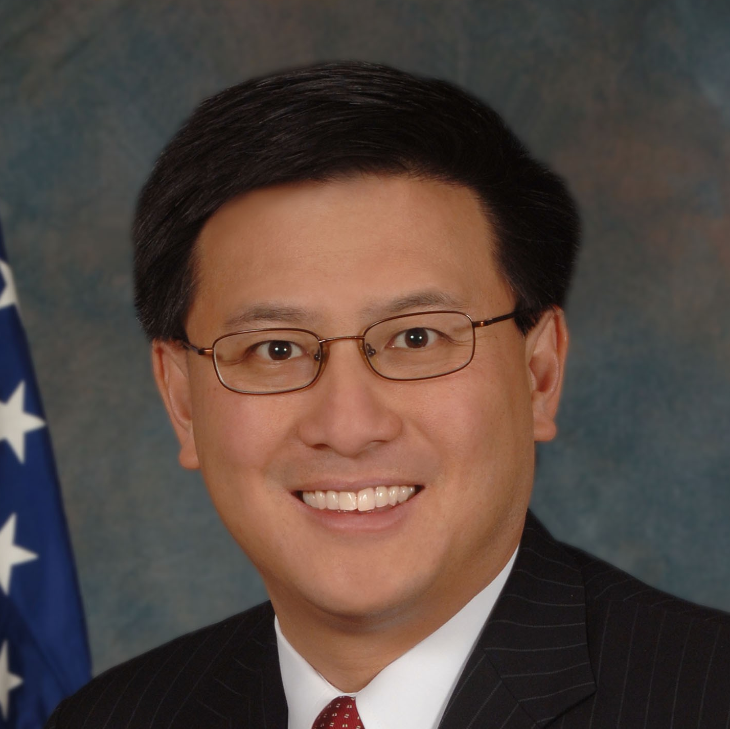



CALIFORNIA GUBERNATORIAL ELECTION
Elected in 2010 as state treasurer, Chiang is positioning himself as the natural successor to Governor Jerry Brown
Key policy issues
  During his tenure as treasurer, Chiang supported a state-run retirement program that would automatically enroll Californians, who would contribute 3 percent of their earnings
Chiang is a strong supporter of expanding access to both early education and higher education. He also supports Gov. Brown’s Local Control Funding Formula system of education funding
John Chiang (D)
Currently: California’s state treasurer
Previously: California’s state controller from 2007-2015
Cut state legislators’ salaries in 2011 after they failed to pass a balanced budget
Refused to furlough state employees under Governor Schwarzenegger
Announced candidacy May 2016
Chiang supports issuing bonds to fund the creation of more affordable housing and reforming the California Environmental Quality Act, which developers say hinders new construction
Sources: Phil Willon, “California’s next governor: Who’s running, who’s on the fence?” Los Angeles Times, June 22, 2017; Ballotpedia, 2017; Beau Yarbrough, “Treasurer John Chiang promises frugality during gubernatorial campaign stop in Rancho Cucamonga,” Daily Bulletin, July 13, 2017; John Chiang for Governor, 2017.
July 24, 2017 | Adriana Morton

Slide 5
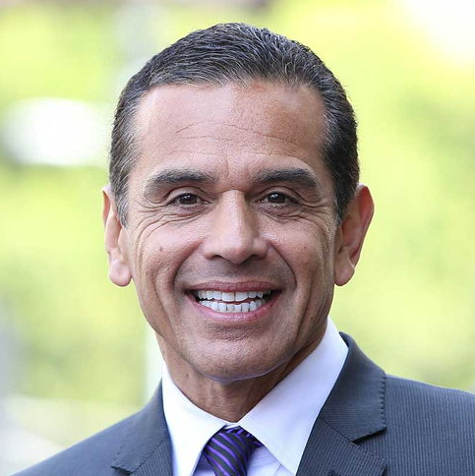



CALIFORNIA GUBERNATORIAL ELECTION
Former Los Angeles Mayor Villaraigosa is counting on the Latino vote in southern California
Key policy issues
  Villaraigosa supports expanding access to higher education, particularly for low-income and minority students, and emphasizes the importance of job training in higher education
Villaraigosa has pledged to focus on helping the middle class and creating opportunities for those left behind in the “new economy,” particularly through higher wages
Antonio Villaraigosa (D)
Previously: Speaker of the state Assembly from 1998-2000, Los Angeles mayor from 2005-2013
Faced difficulties managing the city budget deficit due to the recession
Led campaign for Measure R, a sales tax to pay for improvements to transportation in LA
Announced candidacy November 2016
Following the success of Measure R, Villaraigosa wants to expand on recent improvements to California’s transportation systems, with a focus on roads and other failing infrastructure
Sources: Phil Willon, “California’s next governor: Who’s running, who’s on the fence?” Los Angeles Times, June 22, 2017, Ballotpedia, 2017; Antonio for California, 2017.
July 24, 2017 | Adriana Morton

Slide 6
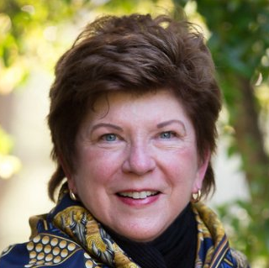
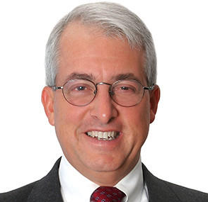
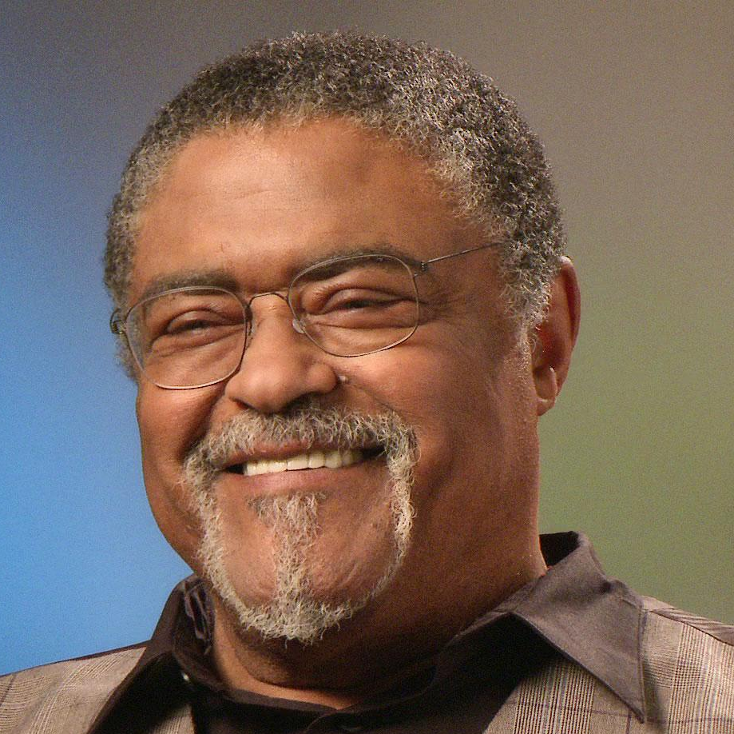
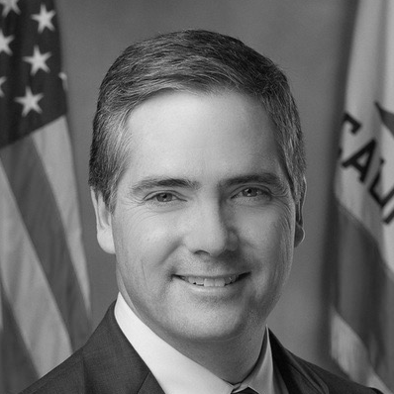
CALIFORNIA GUBERNATORIAL ELECTION
Republican and lesser-known Democratic candidates face challenges with funding and support
Delaine Eastin (D)
Democrat
Former state assemblymember and state superintendent of public instruction
Announced candidacy November 2017
John Cox (R)
Republican
Lawyer and accountant
Proposed creating a “neighborhood legislature”
Announced candidacy March 2017
Travis Allen (R)
Republican
Three-term state assemblyman
Opposes California gas taxes for road improvements
Announced candidacy June 2017
Other possible contenders:
Eric Garcetti (D), mayor of LA
Tom Steyer (D), hedge fund manager
Ashley Swearengin (R), former mayor of Fresno
Steve Westly (D), venture capitalist
Rosey Grier (R)
Republican
Former NFL athlete
Announced candidacy January 2017
David Hadley (R)
Republican
Former state assemblyman
Announced candidacy July 5 and ended candidacy July 19
Sources: Phil Willon, “California’s next governor: Who’s running, who’s on the fence?”
July 24, 2017 | Adriana Morton

Slide 7
CALIFORNIA GUBERNATORIAL ELECTION
Newsom leads in May poll, but most voters remain undecided
May 2017 poll: voter preferences for governor
Berkeley Institute of Governmental Studies
Sources: Mark DiCamillo, “While Newsom continues to lead in next year’s open primary for governor, Villaraigosa is running a close second,” Berkeley IGS Poll, June 8, 2018.
July 24, 2017 | Adriana Morton

Slide 8
CALIFORNIA GUBERNATORIAL ELECTION
Newsom leads in fundraising and candidates have already raised more than $25 million in total
Total amount raised since start of campaign
In millions of dollars
Newsom relies heavily on his Bay Area base for fundraising
Chiang and Villaraigosa both receive the majority of their funding from southern California
Sources: Ryan Menezes and Maloy Moore, “The race to become California’s next governor is already awash in cash,” Los Angeles Times, July 7, 2017.
July 24, 2017 | Adriana Morton

