Slide 1
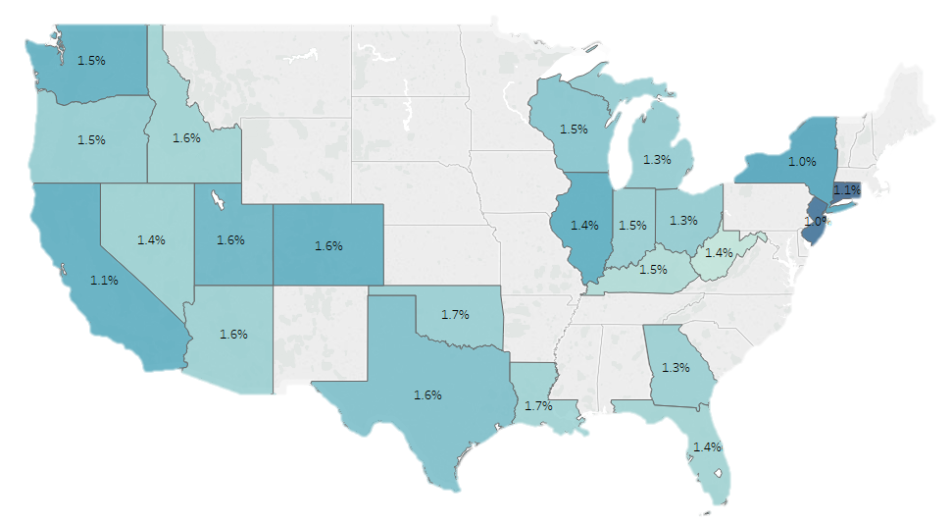
COST OF HEALTH CARE
Residents in Oklahoma and Louisiana spend the largest percentage of their take-home pay on health care costs
Health care costs as a percentage of take-home pay, by state
Based on 2.3 million Chase customers, representing 2 million families in 23 states
Average take-home pay In U.S. dollars
Sources: “Paying Out-of-Pocket: The Healthcare Spending of 2 Million US Families,” JPMorgan Chase & Co September 2017.
September 28, 2017 | Maansi Vatsan

