Slide 1
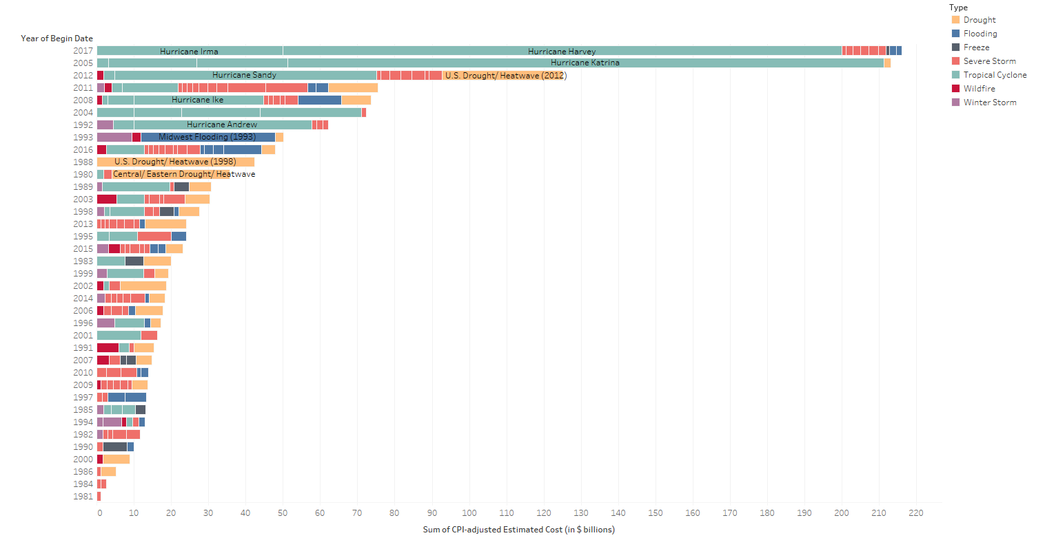
2017 HURRICANE DAMAGE
2017 already the most costly year ever for weather and climate disasters in the United States?
Billion-dollar US weather and climate disasters, 1980-2017
Sources: Marianna Parraga, Gary McWilliams, “Funding battle looms as Texas sees Harvey damage up to $180 billion,” Reuters, September 3, 2017. “Billion-dollar weather and climate disasters,” NOAA.
September 12, 2017 | Theo Goetemann

Slide 2
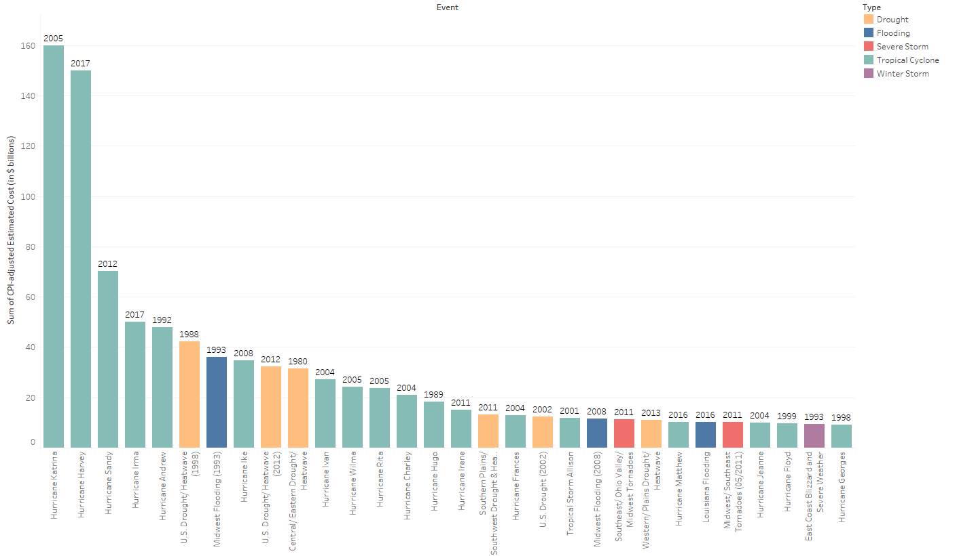
2017 HURRICANE DAMAGE
How much are Irma and Harvey likely to cost compared to past weather and climate disasters?
Top 30 U.S. weather and climate disasters 1980-2017
Sources: Marianna Parraga, Gary McWilliams, “Funding battle looms as Texas sees Harvey damage up to $180 billion,” Reuters, September 3, 2017. “Billion-dollar weather and climate disasters,” NOAA.
September 12, 2017 | Theo Goetemann

