Slide 1
Charlie Cook’s Tour of American Politics and Economics
August 22, 2017
Producer: Daniel Stublen
Director: Alistair Taylor

Slide 2
CHARLIE COOK’S TOUR OF POLITICS & ECONOMICS
Roadmap for the presentation
Economic vital signs
American politics
August 23, 2017 | Daniel Stublen

Slide 3
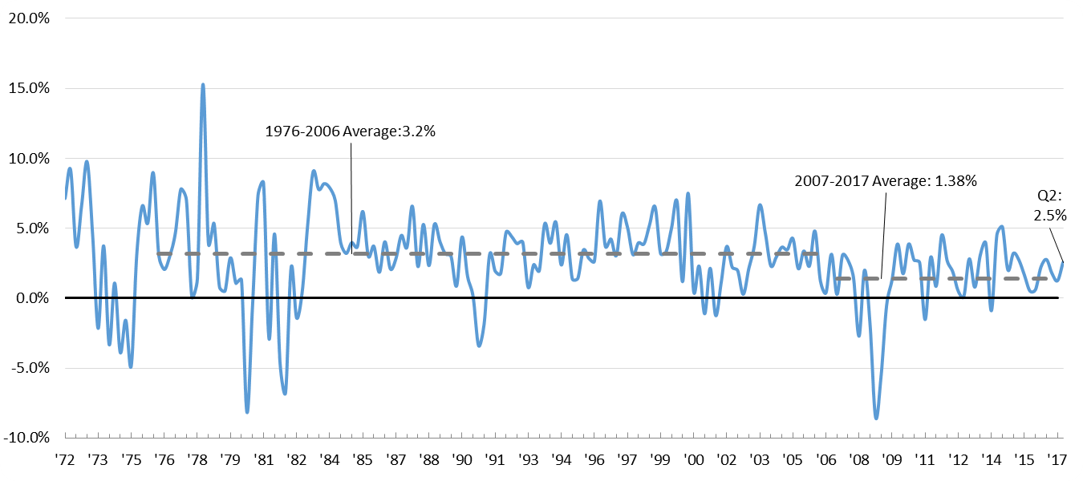
CHARLIE COOK’S TOUR OF POLITICS & ECONOMICS
Economic growth ticked up in Q2 of 2017 but remains lower than the pre-recession, 30-year average
Real GDP
PERCENT CHANGE FROM PRIOR QUARTER ANNUAL RATE
Source: St. Louis Federal Reserve, August 22, 2017.
August 23, 2017 | Daniel Stublen

Slide 4
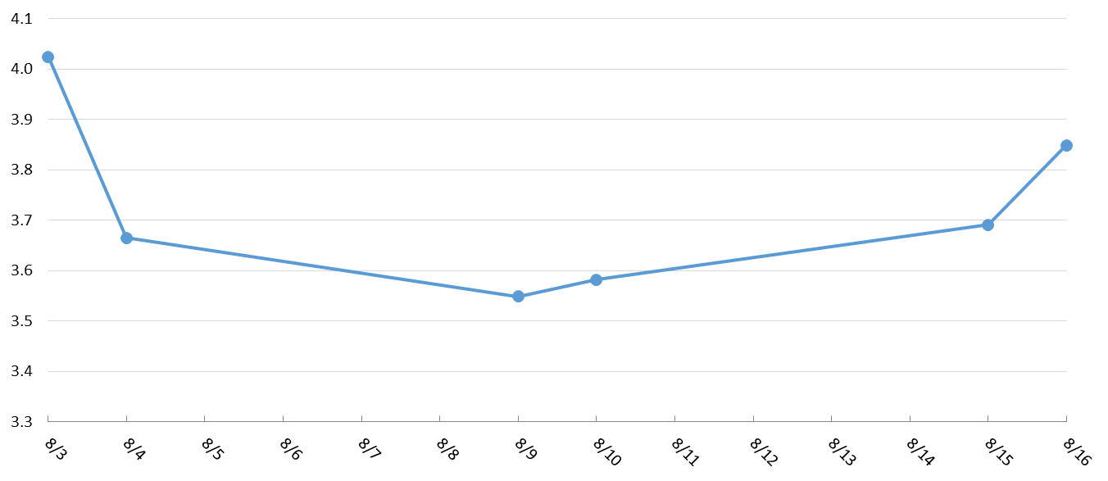
CHARLIE COOK’S TOUR OF POLITICS & ECONOMICS
GDPNow forecast predicts Q3 GDP growth will top 3.5%
Evolution of Atlanta Fed GDPNow* real GDP forecast for Q3 2017
QUARTERLY PERCENT CHANGE
Source: Federal Reserve Bank of Atlanta, August 22, 2017.
*(The Atlanta Fed’s GDPNow model provides an forecasted estimate prior to the final release)
August 23, 2017 | Daniel Stublen

Slide 5
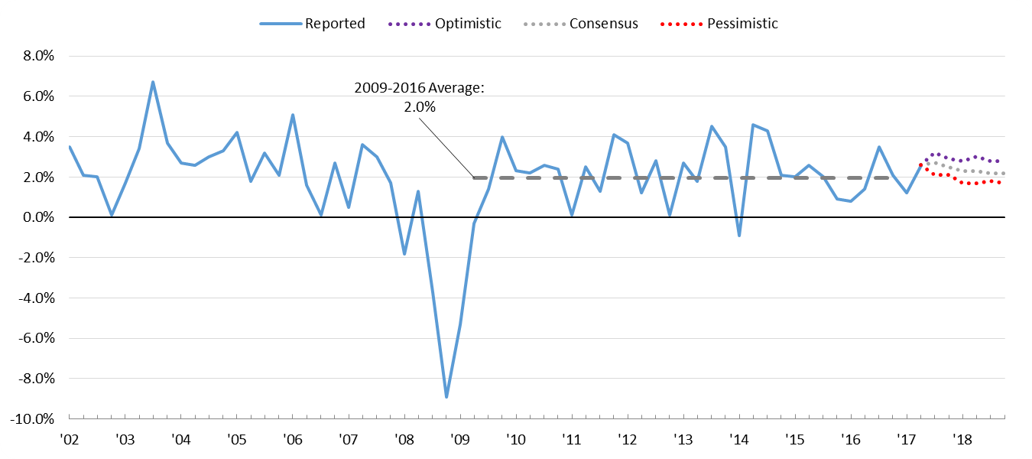
CHARLIE COOK’S TOUR OF POLITICS & ECONOMICS
Consensus estimates for quarterly economic growth hover around the 2% mark for the next two years
Blue Chip Economic Indicators: GDP
ESTIMATED QUARTERLY CHANGE IN GDP
Source: Blue Chip Economic Indicators, August, 2017.
August 23, 2017 | Daniel Stublen

Slide 6
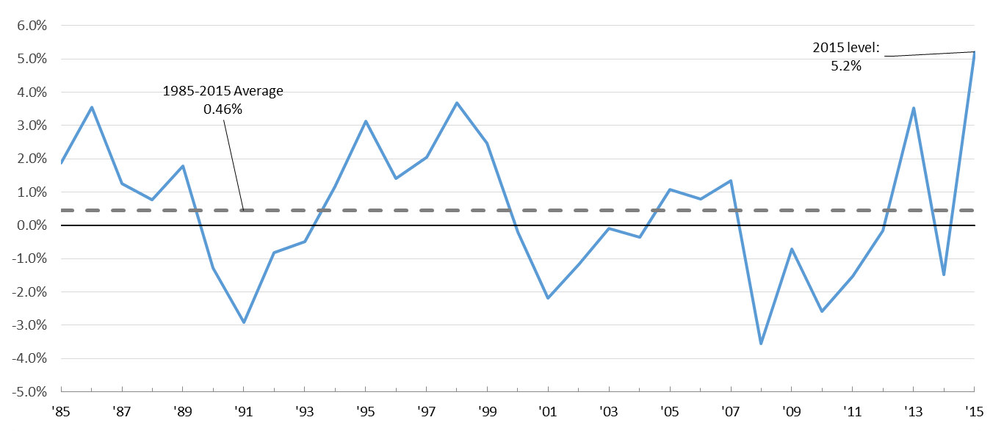
CHARLIE COOK’S TOUR OF POLITICS & ECONOMICS
Real median household income spiked over 5% in 2015 after declining in 2014
Real median household income in the United States
ANNUAL PERCENT CHANGE
Source: St. Louis Federal Reserve, September 13, 2016.
August 23, 2017 | Daniel Stublen

Slide 7
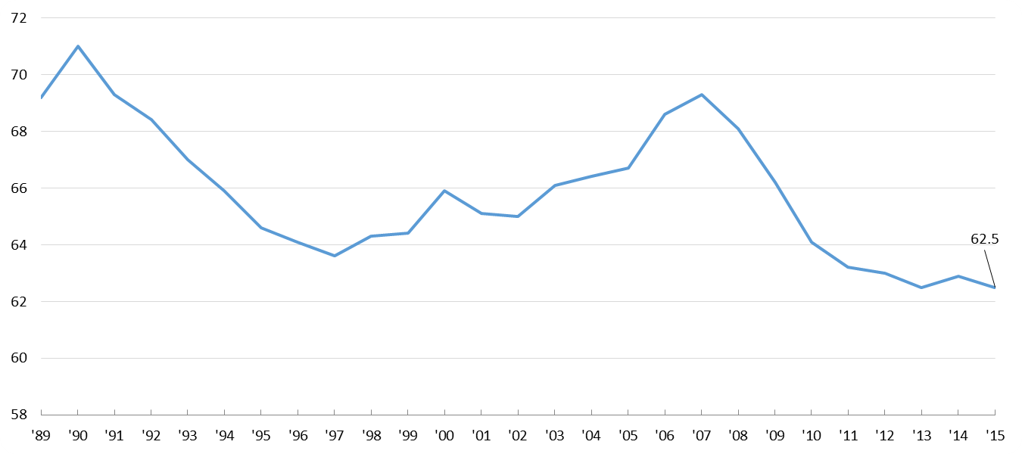
CHARLIE COOK’S TOUR OF POLITICS & ECONOMICS
Ultimate sign of pessimism: birth rate down – people are beginning to defer starting or expanding a family
U.S. general fertility rate
NUMBER OF BIRTHS PER 1000 WOMEN AGED 15-44 YEARS
Source: CDC, National Vital Statistics Report, June 2, 2016.
August 23, 2017 | Daniel Stublen

Slide 8
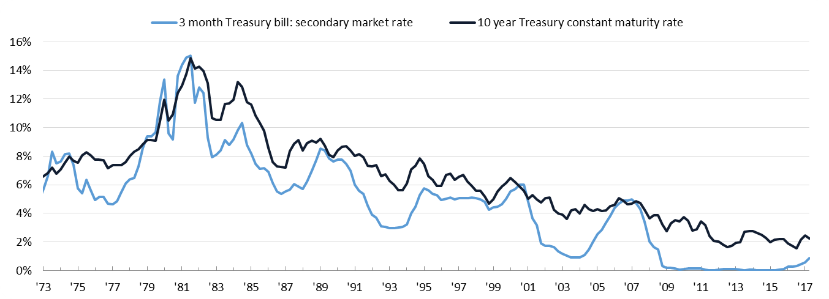
CHARLIE COOK’S TOUR OF POLITICS & ECONOMICS
Interest rates are beginning to creep up following period of historic lows
Interest rates
AVERAGE QUARTERLY PERCENT
1976-2006 average
2006-2017 average
3-month T-bills interest rate
6.0%
1.0%
10-year Treasury constant maturity rate
7.7%
3.0%
Source: Federal Reserve Bank of Atlanta, July 28, 2017.
August 23, 2017 | Daniel Stublen

Slide 9
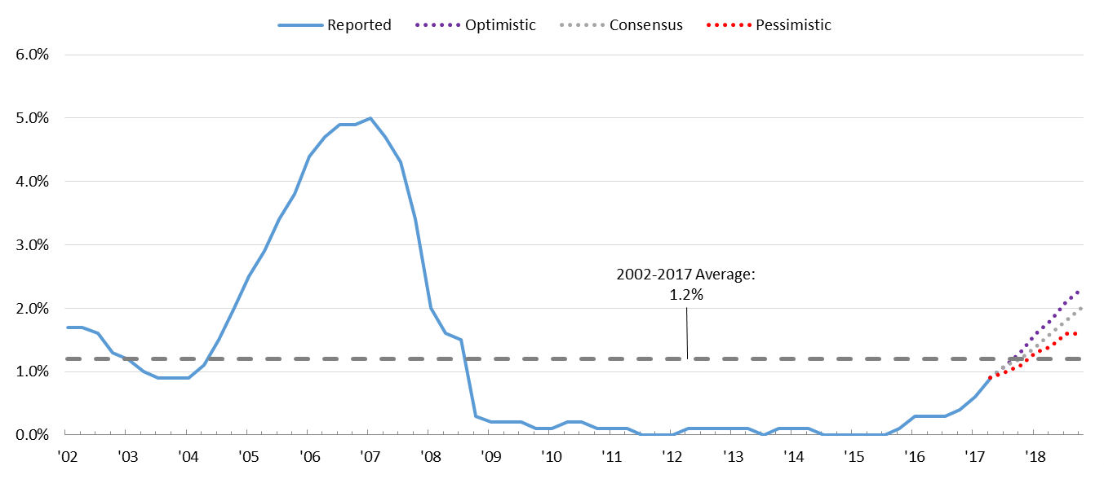
CHARLIE COOK’S TOUR OF POLITICS & ECONOMICS
Interest rates are expected to steadily rise through 2018
Blue Chip Economic Indicators: three-month Treasury bills
ESTIMATED QUARTERLY INTEREST OF THREE-MONTH T-BILLS
Source: Blue Chip Economic Indicators, August, 2017.
August 23, 2017 | Daniel Stublen

Slide 10
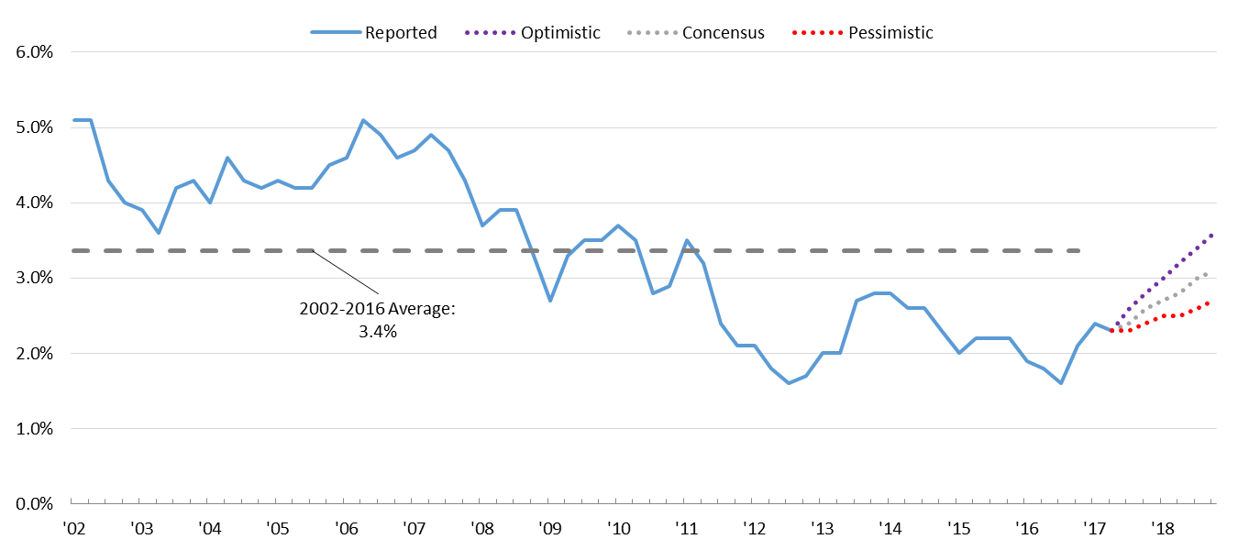
CHARLIE COOK’S TOUR OF POLITICS & ECONOMICS
Higher expectations for interest rates reflect a positive outlook for the economy
Blue Chip Economic Indicators: 10-year Treasury bills
ESTIMATED 10-YEAR TREASURY CONSTANT MATURITY RATE
Source: Blue Chip Economic Indicators, August, 2017.
August 23, 2017 | Daniel Stublen

Slide 11
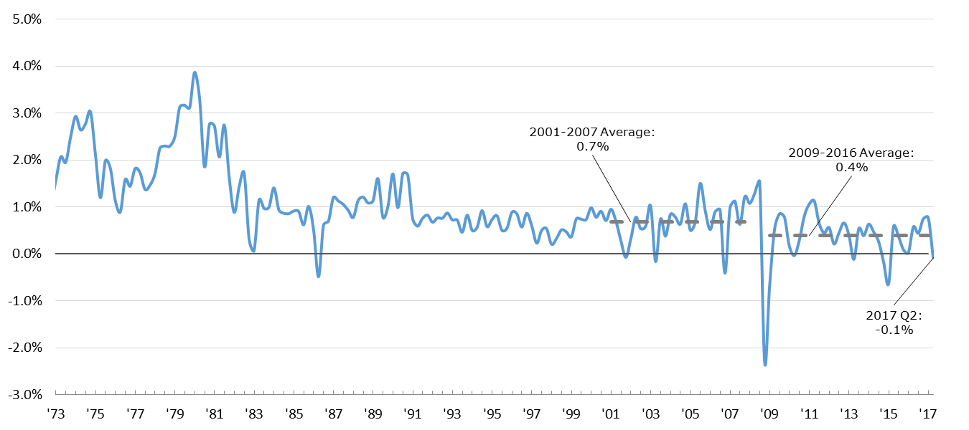
CHARLIE COOK’S TOUR OF POLITICS & ECONOMICS
After over a year of increasing, the Consumer Price Index fell in Q2 of 2017, signaling a slight deflation
Consumer Price Index for all urban consumers
QUARTERLY PERCENT CHANGE
Source: St. Louis Federal Reserve, June 28, 2017.
August 23, 2017 | Daniel Stublen

Slide 12
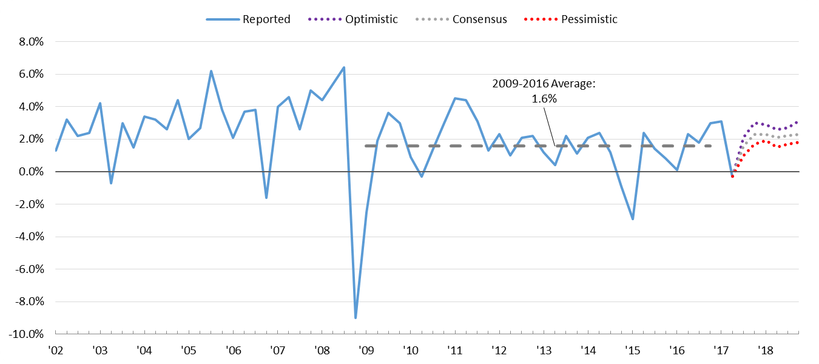
CHARLIE COOK’S TOUR OF POLITICS & ECONOMICS
The Consumer Price Index is expected to rise back up to 2% and signals a steady inflationary period
Blue Chip Economic Indicators: Consumer Price Index
ESTIMATED QUARTERLY CPI
Source: Blue Chip Economic Indicators, August, 2017.
August 23, 2017 | Daniel Stublen

Slide 13
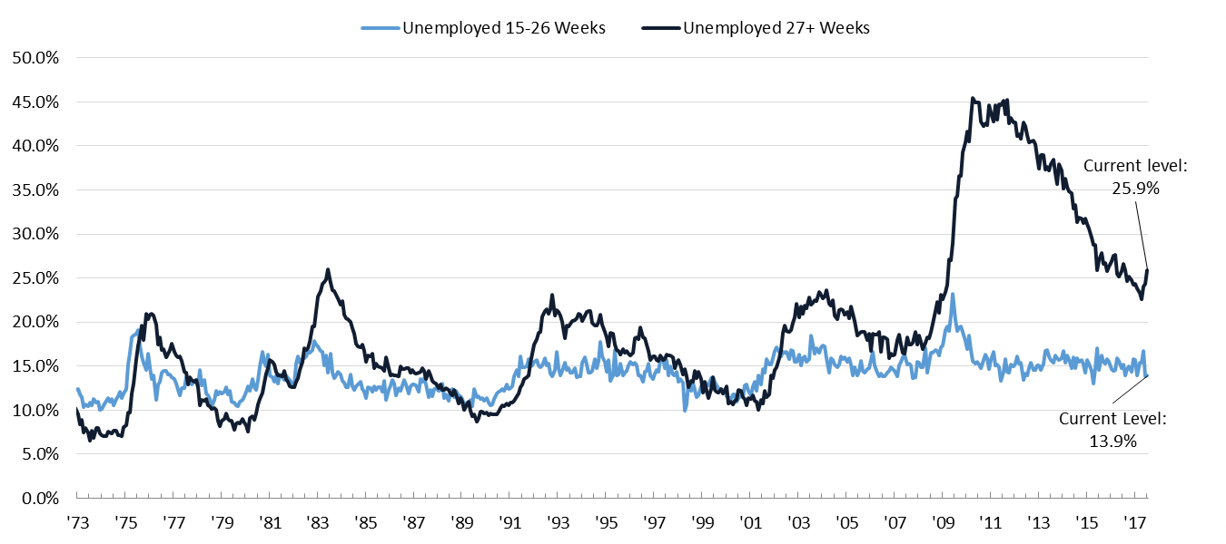
CHARLIE COOK’S TOUR OF POLITICS & ECONOMICS
Long-term unemployment increased for the third straight month in July, reversing its steady downward trend
Unemployment rate
PERCENTAGE OF UNEMPLOYED BY DURATION OF UNEMPLOYMENT
Source: St. Louis Federal Reserve, July 2017.
August 23, 2017 | Daniel Stublen

Slide 14
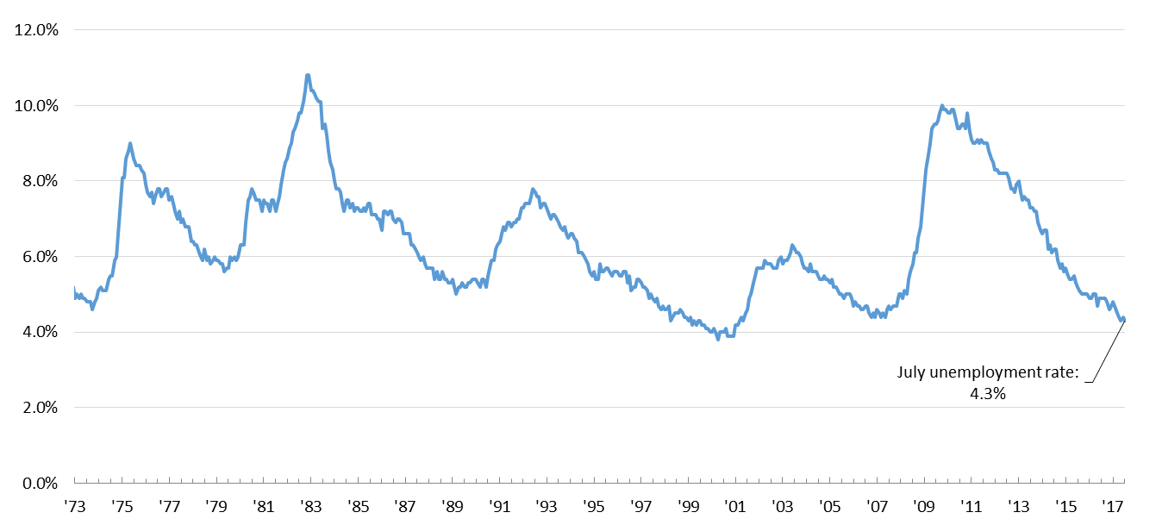
CHARLIE COOK’S TOUR OF POLITICS & ECONOMICS
The total unemployment rate continues its long-term decline
Unemployment rate
ACTUAL YEAR-TO-DATE UNEMPLOYMENT RATES
Source: St. Louis Federal Reserve, July, 2017.
August 23, 2017 | Daniel Stublen

Slide 15
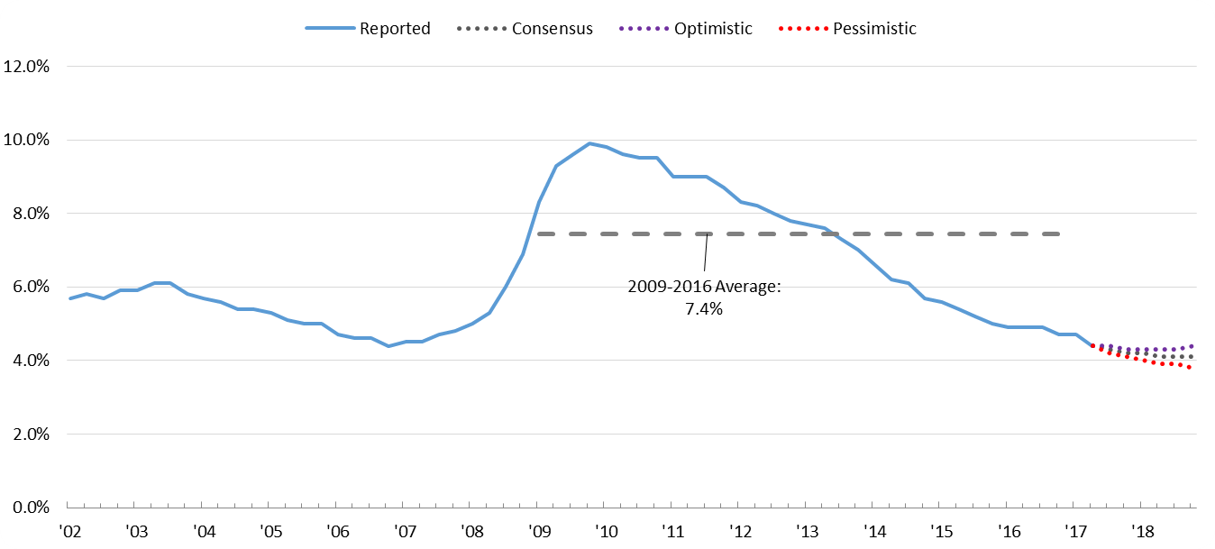
CHARLIE COOK’S TOUR OF POLITICS & ECONOMICS
Forecasts suggest that unemployment will hover around 4%
Blue Chip Economic Indicators: unemployment rate
ESTIMATED QUARTERLY UNEMPLOYMENT
Source: Blue Chip Economic Indicators, August, 2017.
August 23, 2017 | Daniel Stublen

Slide 16
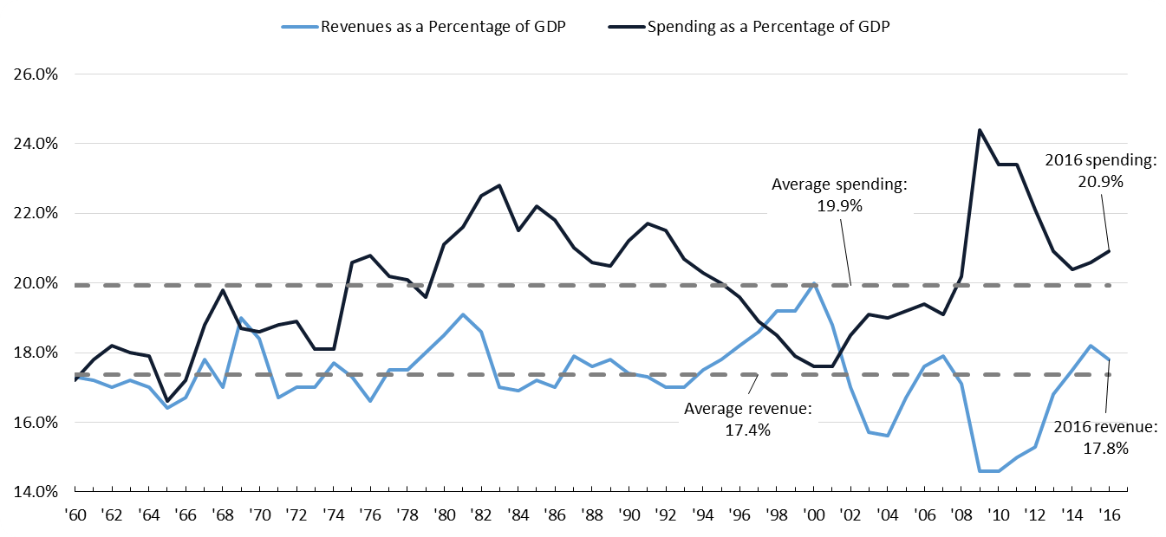
CHARLIE COOK’S TOUR OF POLITICS & ECONOMICS
As federal spending increases and tax revenues decrease, the deficit expands
Federal government taxes and spending
PERCENT OF GDP
Source: White House Office of Management and Budget, Historical Tables, 2016.
August 23, 2017 | Daniel Stublen

Slide 17
CHARLIE COOK’S TOUR OF POLITICS & ECONOMICS
The federal government has been running a deficit since 2001
U.S. taxing and spending as percentage of GDP
U.S. deficits and surplus
Source: White House Office of Management and Budget, Historical Tables, 2016.
August 23, 2017 | Daniel Stublen

Slide 18
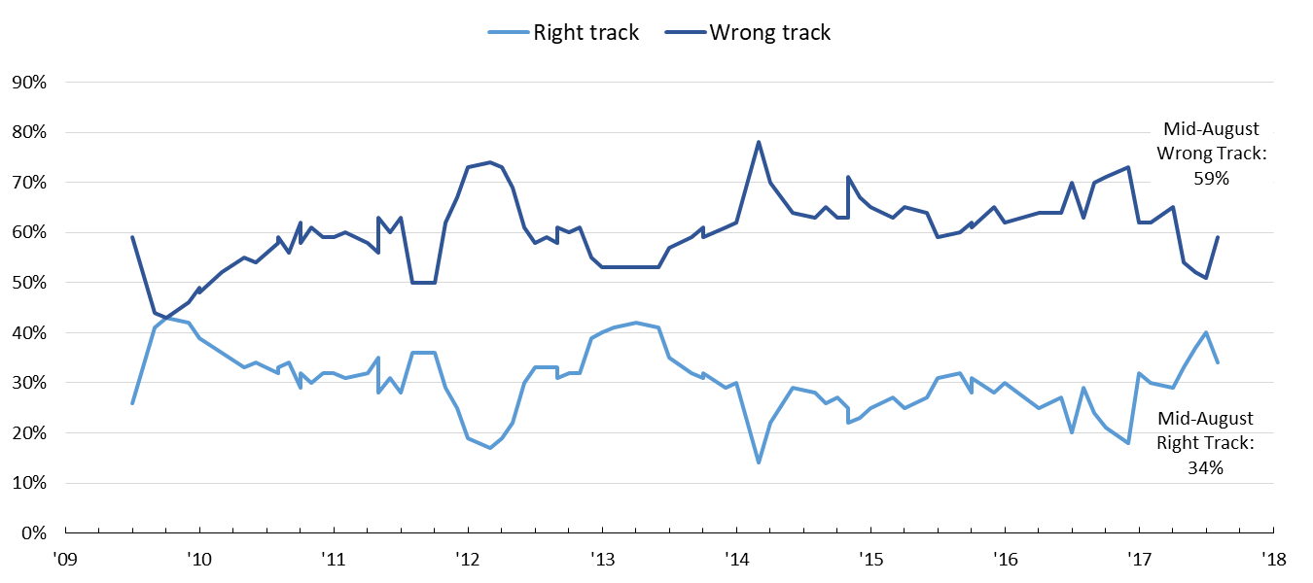
CHARLIE COOK’S TOUR OF POLITICS & ECONOMICS
The majority of Americans are pessimistic about the country’s outlook
Public opinion on the general direction of the nation
PERCENT RESPONDING TO THE QUESTION: “All in all, do you think things in the nation are generally headed in the right direction, or do you feel things are off on the wrong track?”
Source: Before April 2017: NBC/WSJ Poll. After April 2017: Reuters/Ipsos.
August 23, 2017 | Daniel Stublen

Slide 19
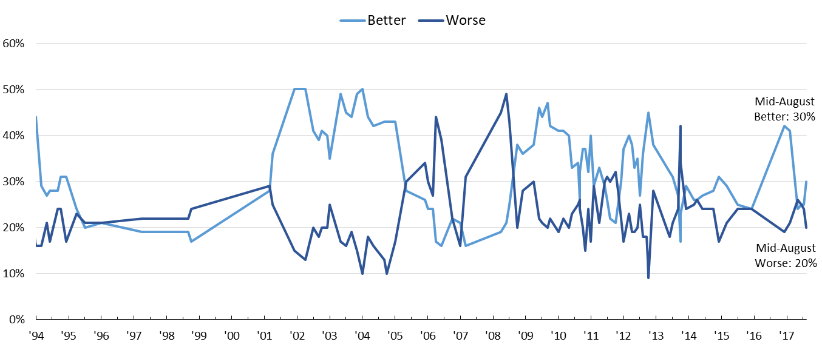
CHARLIE COOK’S TOUR OF POLITICS & ECONOMICS
The public’s outlook on the economy is trending positively
Public opinion on the direction of the US economy
PERCENT RESPONDING TO THE QUESTION: “During the next twelve months, do you think that the nation’s economy will get better or worse?”
Source: Before April 2017: NBC/WSJ Poll. After February 2017: YouGov/Economist
August 23, 2017 | Daniel Stublen

Slide 20
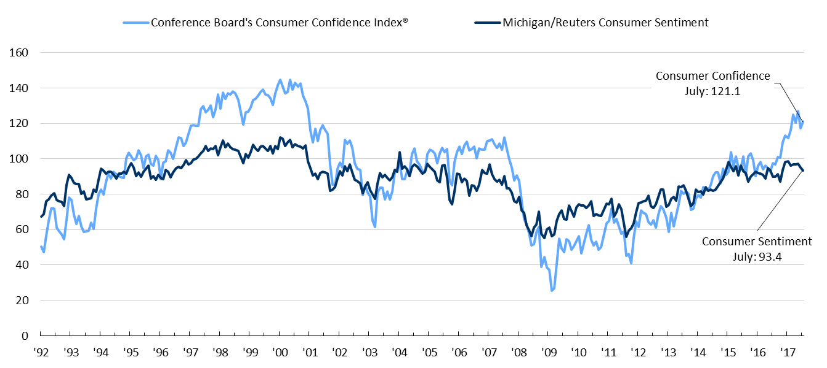
CHARLIE COOK’S TOUR OF POLITICS & ECONOMICS
Consumer confidence ticked up following Trump’s victory but has started to decline or plateau
Consumers Confidence Index ® and Consumer Sentiment
Source: Conference Board, July 2017; Thomson Reuters/University of Michigan Surveys of Consumers, July 2017.
August 23, 2017 | Daniel Stublen

Slide 21
CHARLIE COOK’S TOUR OF POLITICS & ECONOMICS
Roadmap for the presentation
Economic vital signs
American politics
August 23, 2017 | Daniel Stublen

Slide 22
CHARLIE COOK’S TOUR OF POLITICS & ECONOMICS
Congressional partisanship frames fiscal fights
Margin of House control after election
88TH-114TH CONGRESS
Margin of Senate control after election
88TH-114TH CONGRESS
Source: Senate.gov, 2017; Office of the Clerk of the House of Representatives, 2017.
August 23, 2017 | Daniel Stublen

Slide 23
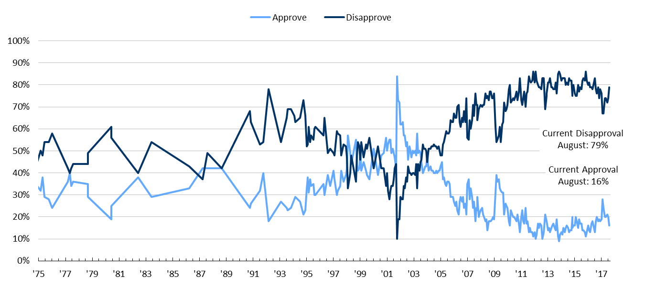
CHARLIE COOK’S TOUR OF POLITICS & ECONOMICS
Congressional approval ticked up at the beginning of 2017 but has fallen again to below 20%
Congressional approval rating
Source: Gallup.com, August 2017.
August 23, 2017 | Daniel Stublen

Slide 24
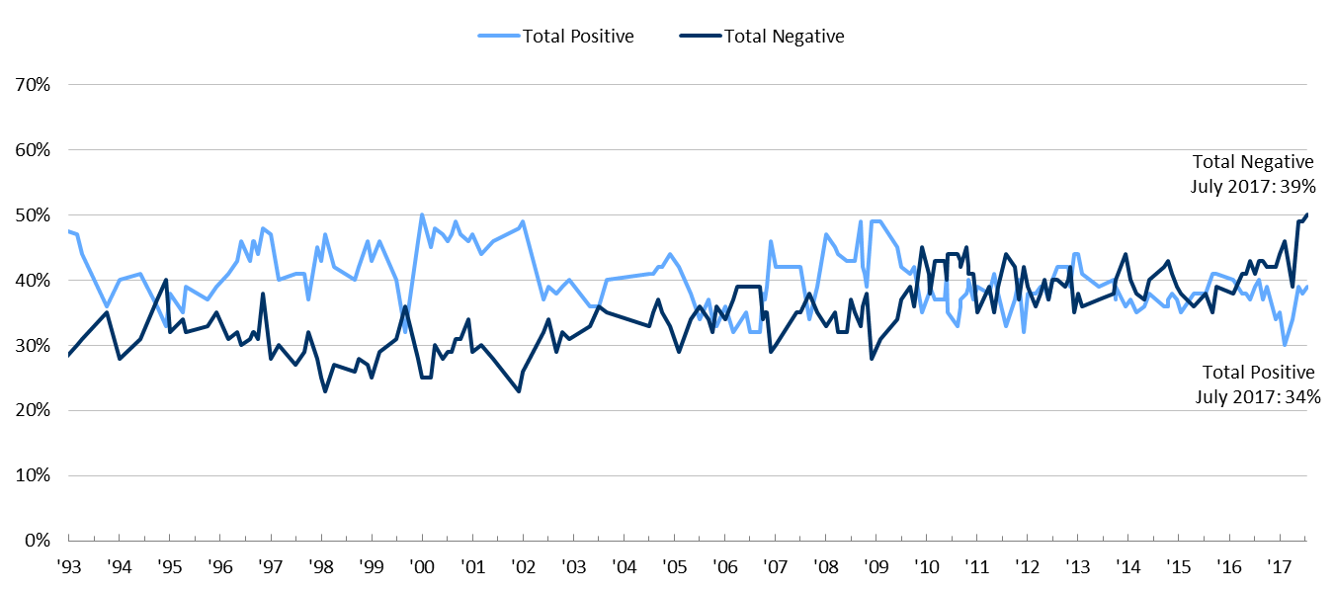
CHARLIE COOK’S TOUR OF POLITICS & ECONOMICS
The public holds negative opinion of the Democratic Party but it is trending up
American public view of the Democratic Party
Source: Until April 2017: NBC/WSJ Poll. After April 2017, YouGov/Economist
August 23, 2017 | Daniel Stublen

Slide 25
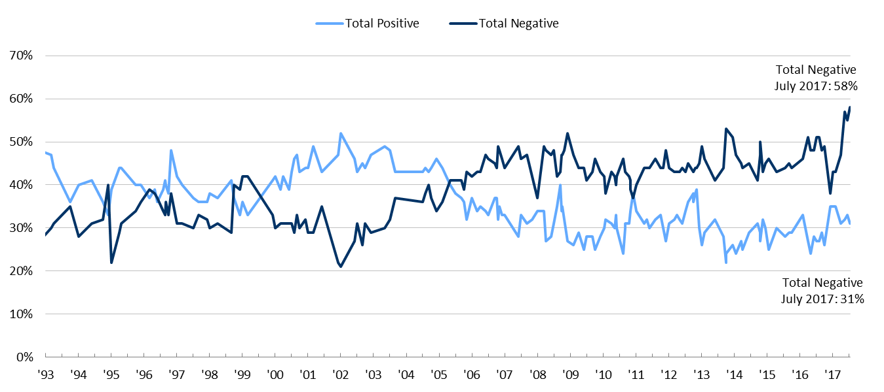
CHARLIE COOK’S TOUR OF POLITICS & ECONOMICS
The public holds an overall negative opinion of the GOP with a negative trend
American public view of the Republican Party
Source: Until April 2017: NBC/WSJ Poll. After April 2017, YouGov/Economist
August 23, 2017 | Daniel Stublen

Slide 26
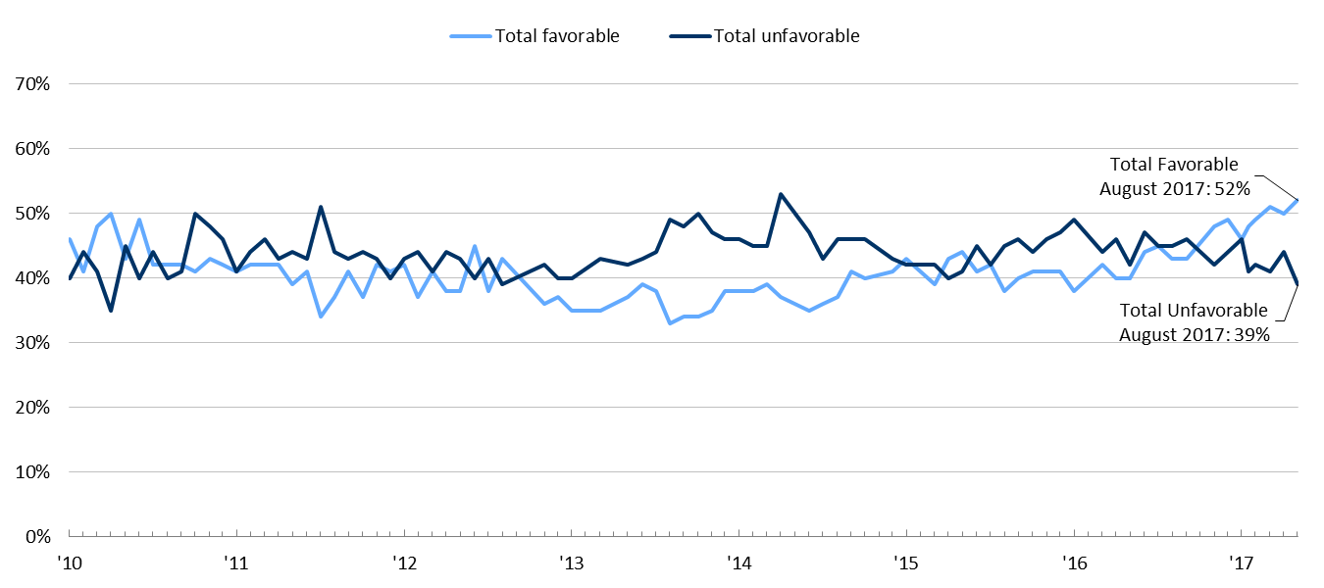
CHARLIE COOK’S TOUR OF POLITICS & ECONOMICS
The Affordable Care Act’s approval numbers have spiked as the GOP attempted to implement repeal
Kaiser Family Foundation Health Tracking Poll: ACA Favorability
Source: KFF Health Tracking Poll, August 22, 2017.
August 23, 2017 | Daniel Stublen

Slide 27
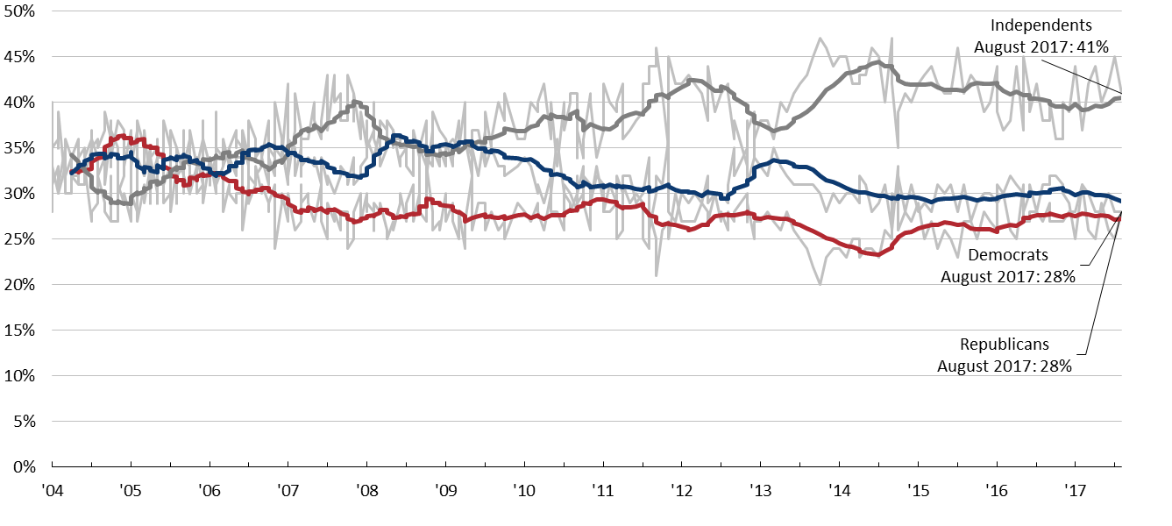
CHARLIE COOK’S TOUR OF POLITICS & ECONOMICS
The share of Independents trends upward as Democrats and Republicans hold equal numbers
Gallup’s party affiliation survey
PERCENT RESPONDING TO THE QUESTION: “In politics, as of today, do you consider yourself a Republican, Democratic, or an Independent?” (12-MONTH ROLLING AVERAGE)
Source: Gallup.com, August 2017.
August 23, 2017 | Daniel Stublen

Slide 28
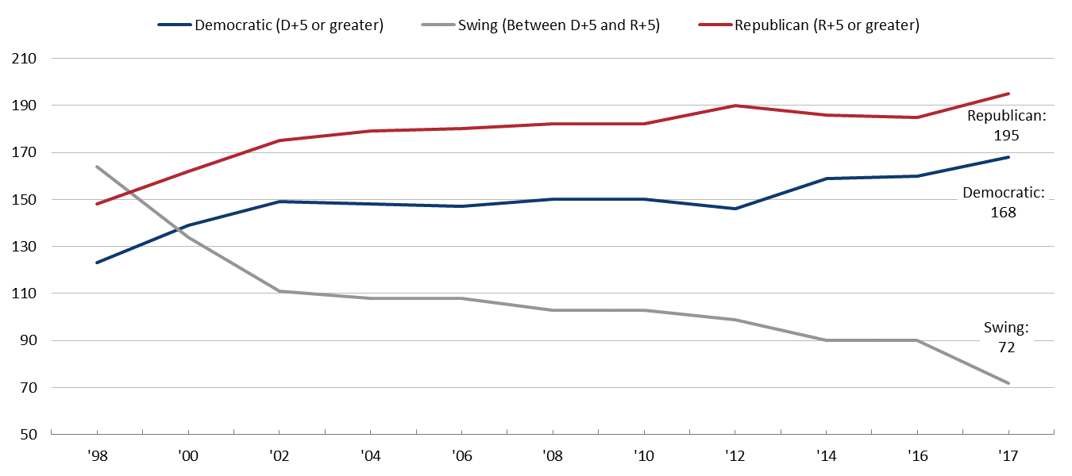
CHARLIE COOK’S TOUR OF POLITICS & ECONOMICS
In House, “fewer swing seats, more polarization”: as districts grow more partisan, incumbents fear primary challengers
Cook Political Report rates the districts
HOUSE MAKEUP BY COOK PARTISAN VOTE INDEX
Source: Cook Political Report, 2017.
August 23, 2017 | Daniel Stublen

Slide 29
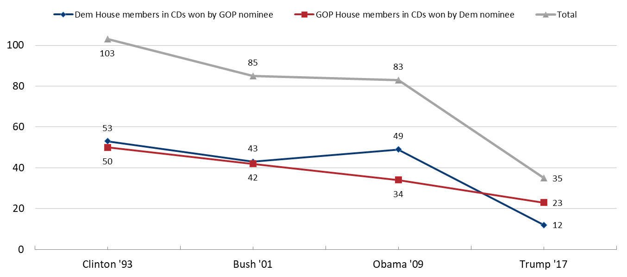
CHARLIE COOK’S TOUR OF POLITICS & ECONOMICS
In 2016, 35 House members were elected in districts where the opposing party’s presidential nominee won
House members in congressional districts won by opposite party's presidential nominee
Source: Cook Political Report, 2017.
August 23, 2017 | Daniel Stublen

Slide 30
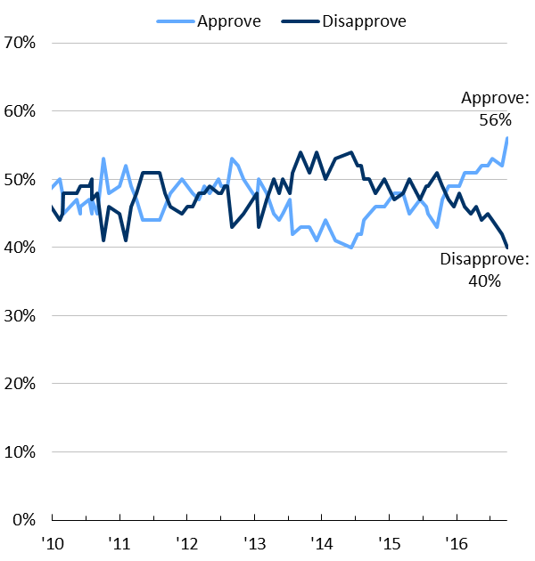
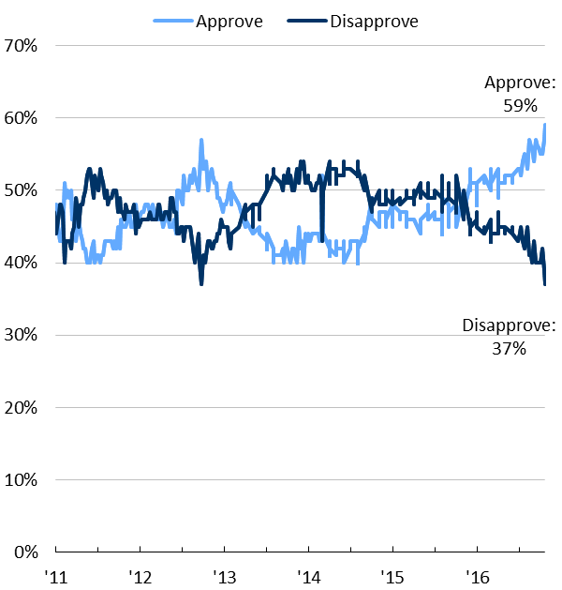
CHARLIE COOK’S TOUR OF POLITICS & ECONOMICS
At the end of his term, Obama’s job approval rating hovered at all-time highs
NBC/WSJ’s presidential job approval
Gallup’s presidential job approval
Source: NBC/WSJ Poll, January 2017; Gallup.com, January 2017.
August 23, 2017 | Daniel Stublen

Slide 31
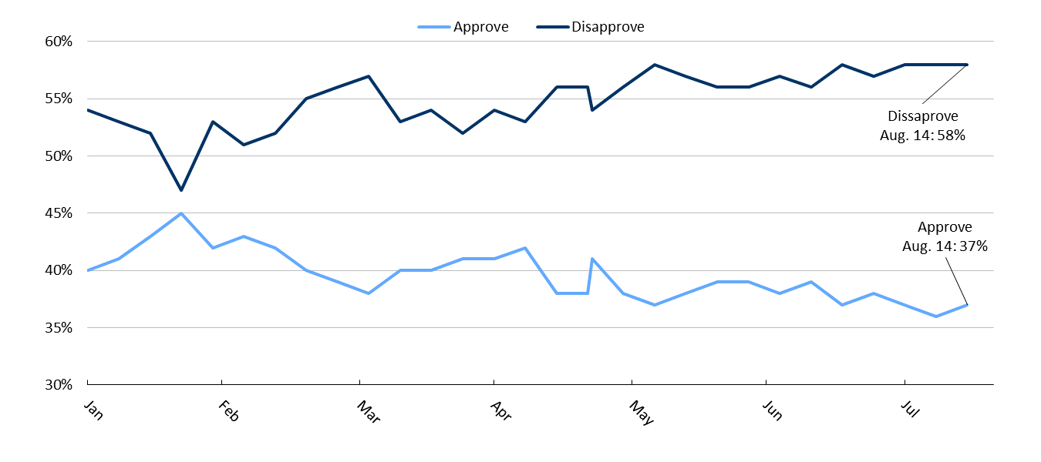
CHARLIE COOK’S TOUR OF POLITICS & ECONOMICS
President Trump’s low approval numbers have been stuck under 40% since late April
Gallup’s polling on President Trump’s approval
Source: Gallup, August 22, 2017.
August 23, 2017 | Daniel Stublen

Slide 32
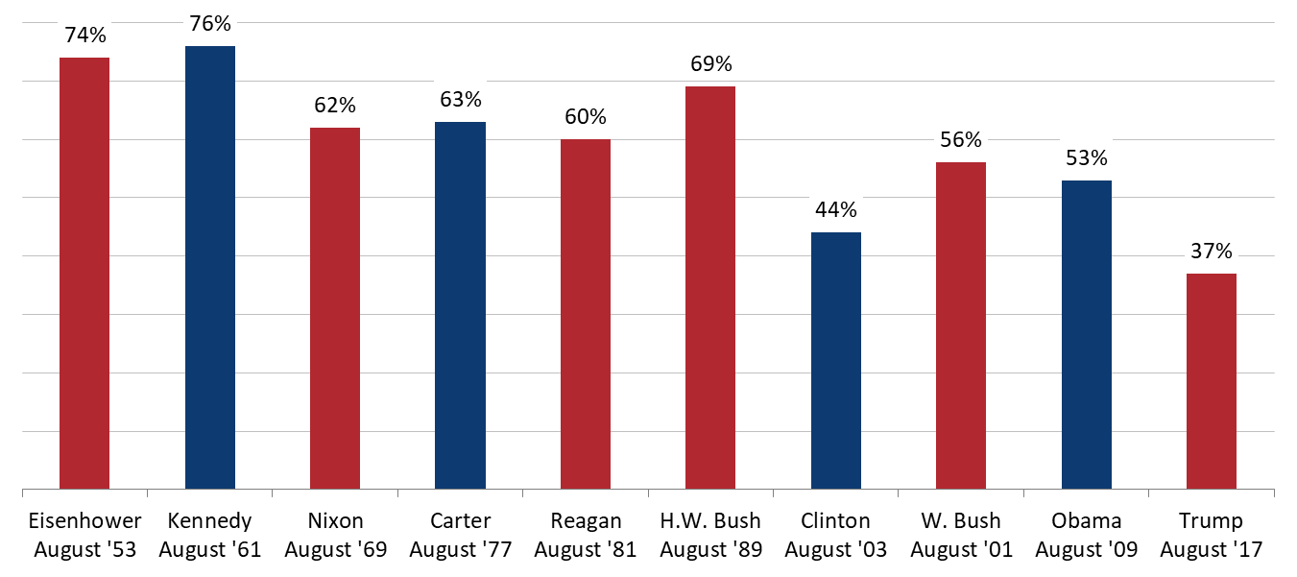
CHARLIE COOK’S TOUR OF POLITICS & ECONOMICS
Pres. Trump’s approval numbers are lower than any other modern presidents’ at this point in their respective terms
Gallup comparative presidential approval ratings
IN AUGUST OF EACH PRESIDENT’S FIRST TERM
Source: Gallup, August 22, 2017.
August 23, 2017 | Daniel Stublen

