Slide 1
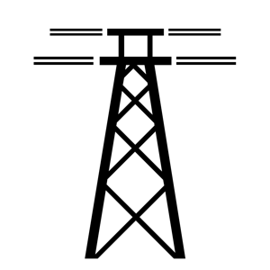
ELECTRIC GRID REPORT
New report finds US electric grid vulnerable to cyberattacks
Key points from the National Academies of Sciences, Engineering and Medicine report on the US electric grid
“Smart grids,” those utilizing digital communications technologies to detect and adapt to changes in usage, improve efficiency of energy systems. Increased automation of the US power grid introduces new threats to its physical and cyber components.
The North American Electric Reliability Corporation (NERC) has nine cyber security standards, but they do not apply to local distribution systems. Those that do not comply with standards are more vulnerable to attacks.
Damage to cyber components of the electric grid may result from natural disasters, direct cyber attacks, or a coordinated cyber and physical attack. In each of theses cases, the attack will disrupt or impede the ability to monitor and control the power system.
Trump’s budget proposal requests cuts of 27% decrease for the science and technology arm of the Department of Homeland Security and 33% for the Energy Department’s Office of Cybersecurity for energy delivery systems.
Findings
Because they are interconnected and interdependent bulk electric grids are susceptible to rapidly propagating disturbances
The power grid is vulnerable to a physical, cyber or combined attack by terrorists at the supply chain, corporate communications, global positioning system (GPS) or smart grid technologies levels
Some progress has been made in improving the resilience of the US power grid, but data analytics and prognostic techniques for new technologies is needed
Recommendations
Execute varied emergency preparedness exercises to maintain physical and cyber situational awareness of the grid
Expand the substantive areas of research and development, and commit funds to improve the grid’s physical components
Implement a joint program between the Departments of Energy and Homeland Security to predict potential threats to vital public infrastructure
Establish small system resilience groups to asses and mandate strategies to increase resilience of the US bulk electricity grid
Sources: The National Academies of Sciences, Engineering and Medicine, “Enhancing the Resilience of the Nation’s Electricity System” 2017; Iulia Gheorghiu, “New Grid Study Sees United States Vulnerable to Cyberattacks” July 20, 2017
July 24, 2017 | Kathryn Pentz

