Slide 1
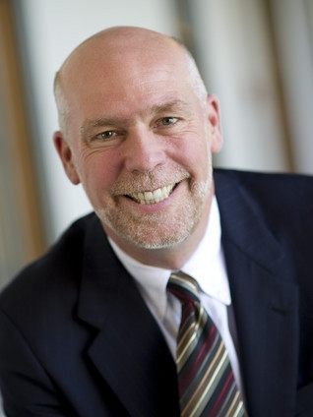
Rep. Greg Gianforte (R-MT-AL)
Background
Republican Greg Gianforte won the 2017 special election for representative after an unsuccessful attempt in the 2016 gubernatorial election. A native of San Diego, his family moved to Philadelphia, PA at an early age. He attended the Stevens Institute of Technology in Hoboken, NJ, where he received degrees in computer science. He started his career in software development in New Jersey, building a company that he sold to McAfee in 1994 for $10 million. He retired to Bozeman, MT, which he loved for its outdoor activities. He then developed a new business, RightNow Technologies, which focused on customer service software. It went public in 2004, and was bought by Oracle in 2011 for $1.5 billion. With his fortune, Gianforte established a family foundation with which he funds mostly religious charities. He ran for governor in 2016 on a platform of bringing more jobs to Montana, but lost by 4% to the Democratic incumbent Steve Bullock. Gianforte then ran to replace Ryan Zinke, who vacated his seat to become interior secretary, against Democrat Rob Quist, a musician. Both Donald Trump Jr. and Vice President Mike Pence stumped for him. A day before the election, Gianforte assaulted reporter Ben Jacobs, who was questioning him about the American Health Care Act. He still won the election by 6%, but was later convicted of assault.
Committees
Natural Resources Oversight and Government Reform
Biography
First Elected: 2017
Education: Stevens Institute of Tech., B.E, M.Sc. 1983
Religion: Christian - Non-Denominational
Family: Marital Status: Married, Spouse: Susan, 4 children
Contact Info: LHOB- Longworth House Office Building, 15 Independence Avenue, SE, Room 1419, Washington, DC, 20515-2601 (202) 225-3211
Election Results
2017 Special
Greg Gianforte (R) | 189,473 | 50%
Rob Quist (D) | 166,483 | 44%
Mark Wicks (L) | 21,509 | 6%
Online Info
Sources: National Journal Almanac, 2018
Slide updated: August 24, 2018

