Slide 1
The Russia investigations
Key people, agencies and events in the investigations into possible ties between Trump officials and Russia
May 22, 2017
Producer: National Journal Presentation Center
Director: Alistair Taylor

Slide 2
Roadmap for the presentation
RUSSIA INVESTIGATION
What are the investigations?
Key people involved
Key events

Slide 3
There are three separate Russia investigations
RUSSIA INVESTIGATION
Investigations of Russian interference in the 2016 US presidential election
Criminal investigations
Fact-finding investigations
Other potential investigations
Congress
Types of fact-finding bodies that have not been used for Russia inquiries
Special counsel
FBI
Select committee
Independent commission
Senate Intelligence Committee
House Intelligence Committee
Bipartisan committee made up of equal number of Democrats and Republicans
Example: House Benghazi committee
Nonpartisan, non-governmental experts
Established by bill signed by president
Example: 9/11 commission
Robert Mueller
Richard Burr (R)
Mike Conaway (R)*
Decide whether to bring indictment of suspects to grand jury
Decide whether to bring criminal charges
Produce report of findings
Produce report of findings
Produce report of findings
Republican control both the House and Senate and have leadership in both committees
GOP leaders have shown no interest in setting up a select committee or independent commission so far
*House Intelligence committee chair Devin Nunes has recused himself, so Conaway is chairing the investigation
Sources: Charlie Savage, Larry Buchanan, Troy Giggs and Karen Yourish, “Why it’s hard to have an independent Russia investigation,” May 17, 2017.
May 18, 2017 | Owen Minott

Slide 4
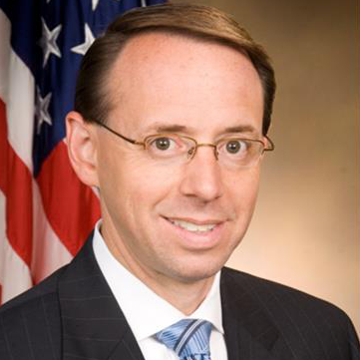
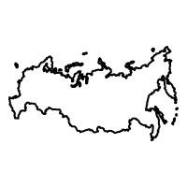
Deputy AG appoints special counsel for Russia probe
SPECIAL COUNSEL
What is a special counsel?
Special prosecutors are independent judges or attorneys appointed to conduct federal investigations; they serve to prevent officials from investigating their own superiors
Past investigations of the White House by special counsels:
Archibald Cox was appointed by Nixon’s AG to investigate President Nixon after the Watergate scandal
Ken Starr investigated President Bill Clinton through the now-extinct Office of Independent Counsel; his investigation led to Clinton’s impeachment trial
Robert Mueller
How was the special counsel appointed?
Only the attorney general or Congress can appoint a special counsel:
AG Jeff Sessions has recused himself from the investigation, so Sessions’ deputy is in charge of the decision
Rod Rosenstein, a former US attorney for Maryland with a reputation for being fair and non-partisan, was recently confirmed as deputy, and appointed former FBI director Robert Mueller to serve as special counsel for the Russia probe
Rosenstein can overrule any decisions made by Mueller in the investigation
Rod Rosenstein
What is the special counsel investigating?
Mueller will investigate whether there was any coordination between Trump campaign officials and the Russian government in an attempt to influence the election
Mueller will also investigate whether any crimes committed during the investigation, such as perjury, obstruction of justice, or witness intimidation
Mueller will keep his findings secret, and if he decides not to bring charges, his findings will not be aired; if Mueller uncovers actions that are inappropriate but not illegal, for example, he will not publicize them
Sources: Major Garrett, Emily Schultheis, Ellen Uchimiya, Will Rahn, “What you need to know about appointing a special prosecutor to investigate Trump,” CBS News, March 7, 2017; Dylan Scott, “Democratic leaders demand a special prosecutor after Comey firing,” May , 2017; Jennifer Williams, “The new special counsel investigating Trump: who he is, what he can do, what comes next,” Vox, May 17, 2017; National Journal research.
May 18, 2017 | Owen Minott

Slide 5
Congressional committees investigating Russia’s hacking in the 2016 election and potential connections to Trump
Cybersecurity vertical sample — for more details, please contact your DA about premium content access
The focus of various inquiries on the Hill
Primary
investigations
House Intelligence Committee
Senate Intelligence Committee
Recently-released parameters from chairman Devin Nunes (R-CA) and ranking member Adam Schiff (D-CA) reveal the investigation will focus in part on Russia’s cyber activity, connections between Russia and U.S. persons and related intelligence leaks
Chairman Richard Burr (R-NC) and ranking member Mark Warner (D-VA) are cooperating on an investigation that is similar in scope to its counterpart in the House. The committee is expected to hear testimony from Flynn as part of its probe
Subsidiary
investigations
House Oversight, Judiciary Committees
Senate Armed Services Committee
Senate Foreign Affairs Committee
Senate Judiciary Subcommittee
Oversight and Judiciary are primarily probing the leaks of Flynn’s communications (not Flynn himself), though the Oversight Committee may also look at Flynn’s speeches in Russia
The committee, and its newly formed cyber subcommittee, will examine the Russia issue as part of its broader assessment of cyber threats, policy and strategy
Senators on the Foreign Affairs Committee are focusing on Russian hacking and U.S.-Russia relations. A bill that would require congressional approval to lift sanctions on Moscow emanated from senators on this committee
The Subcommittee on Crime and Terrorism is examining the methods used by Russia to interfere in democracies across the globe and how to defend against foreign interference in future elections
Sources: Erin Kelly, “5 ways Congress is investigating Russia-Trump ties,” USA Today, February 17, 2017; Ali Rogin, “A closer look at congressional probes into Russia and alleged Trump associate contacts,” ABC News, February 27, 2017.
March 2, 2017 | Jessica Grischkan

Slide 6
Roadmap for the presentation
RUSSIA INVESTIGATION
What are the investigations?
Key people involved
Key events

Slide 7
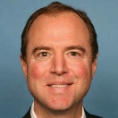
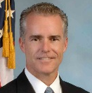
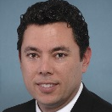
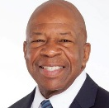
Key figures investigating Russia’s involvement in the 2016 election
RUSSIA INVESTIGATION KEY PLAYERS
All justice and intelligence officials can be fired by the president
Justice Department
House of Representatives
Senate
Rod Rosenstein
Deputy AG
Dana Boente
US Attorney-Eastern VA
Mike Conaway (R-TX11)
House Intelligence
Adam Schiff (D-CA28)
House Intelligence
Richard Burr (R-NC)
Senate Intelligence
Mark Warner (D-VA)
Senate Intelligence
Andrew McCabe
Deputy FBI director
Robert Mueller
Special counsel
Jason Chaffetz
(R-UT03)
House Oversight
Elijah Cummings
(R-UT03)
House Oversight
Lindsey Graham
(R-SC)
Senate Crime and Terrorism Subcom.
Sheldon Whitehouse
(D-RI)
Senate Crime and Terrorism Subcom.
Intelligence
Former government
Adm. Mike Rogers
NSA director
Mike Pompeo
CIA director
Dan Coats
DNI
Sally Yates
Fmr. acting AG
James Comey
Fmr. FBI director
Lt. Gen. James Clapper
Fmr. DNI
John Brennan
Fmr. CIA director
Sources: National Journal Research
May 18, 2017 | Daniel Stublen

Slide 8
DEPARTMENT OF JUSTICE
Department of Justice
Organizational chart
Attorney General
Not yet nominated Nominated Confirmed
Not yet appointed Appointed
Solicitor General
Associate Attorney General
Deputy Attorney General
Office of the Solicitor General
Office of Legal Policy
Office of Public Affairs
Office of Legislative Affairs
Office of Legal Counsel
Office of Tribal Justice
Office of Justice Programs
Executive Office for U.S. Trustees
Civil Rights Division
National Security Division
Office of Professional Responsibility
Federal Bureau of Investigation
Criminal Division
Community Oriented Policing Services (COPS)
Civil Division
Office of the Inspector General
Office of the Pardon Attorney
Antitrust Division
Drug Enforcement Administration
Bureau of Prisons
Office of Information Policy
Justice Management Div.
U.S. Parole Commission
Foreign Claims Settlement Commission
Tax Division
Executive Office for U.S. Attorneys
U.S. Marshals Services
Civil Rights Division
Exec. Office for Organized Crime Drug Enforcement Task Forces
Office for Access to Justice
Environment & Natural Resources Division
U.S. Attorneys
Interpol Washington
Office on Violence Against Women
Community Relations Service
Bureau of Alcohol, Tobacco, Firearms & Explosives
Professional Responsibility Advisory Office
Sources: Department of Justice
*Boxes corresponding to divisions, rather than positions, refer to the head of said division
May 12, 2017

Slide 9
Deputy AG Rosenstein appoints special counsel for Russia probe
JUSTICE DEPARTMENT SPECIAL COUNSEL
Former FBI Director Mueller to oversee Russia investigation
Previous positions | Bio
Director, FBI US deputy attorney general US attorney, northern California US assistant attorney general, criminal division US attorney, Massachusetts | Before joining a private firm, Mueller led the FBI for 12 years. He overhauled the agency to address the threat of terrorism, transferring thousands of agents from criminal to counterterrorism units. Mueller also notably threatened to resign from the FBI. In 2004, he told President Bush that he would leave office if the administration reauthorized a warrantless wiretapping program, and the president agreed to alter the program. Congress voted unanimously to extend Mueller’s term for two years at the request of President Obama. When Deputy Attorney General Rod Rosenstein appointed Mueller to serve as special counsel for the Russia investigation, Mueller received bipartisan praise. Some critics of Mueller’s appointment have noted that his current firm, WilmerHale, represents Paul Manafort, Ivanka Trump and Jared Kushner.
Special Counsel,
White House investigation
Robert Mueller III
Partner, WilmerHale LLP
Sources: Carrie Johnson, “Who is Robert Mueller, special counsel overseeing Russia investigation?” NPR, May 18, 2017; Derek Hawkins, “Twice Robert Mueller threatened to resign from the FBI. Twice he decided not to,” The Washington Post, May 18, 2017; Josh Gerstein, “Mueller’s law firm’s clients could cause ‘wrinkle; in appointment,” Josh Gerstein, May 17, 2017; National Journal research, 2017.
May 18, 2017 | Owen Minott

Slide 10
Deputy AG Rosenstein receives national attention after appointing special counsel
DEPUTY ATTORNEY GENERAL
Trump’s deputy attorney general
Previous positions | Bio
US attorney, district of Maryland Adjunct professor, University of Maryland School of Law Principal deputy assistant attorney general | Before his appointment as deputy attorney general, Rosenstein served for over 25 years between the US Attorney’s Fffice and the Department of jJstice. Rosenstein has a long reputation for being nonpartisan. His nomination as a US attorney was unanimously confirmed by the Senate in 2005, and only six senators later voted against his appointment to deputy attorney general. Rosenstein had maintained a relatively low profile during his time at the Justice Department until this year. In May, he received national attention when President Trump fired James Comey, the director of the FBI, citing a letter by Rosenstein that was critical of Comey as justification. Rosenstein then appointed Robert Mueller as special counsel for the Justice Department’s investigation of the White House’s ties to Russia.
Deputy Attorney General
Rod J. Rosenstein
Sources: National Journal research; Dan Merica, “Who is the DOJ official at te heart of Comey’s firing,” CNN, May 10, 2017.
May 22, 2017 | Owen Minott

Slide 11
Former Senator Lieberman is Trump’s top pick for FBI director
FEDERAL BUREAU OF INVESTIGATION
Potential candidates to replace Comey
The White House is reportedly considering the following people:
Person | Current position
Joe Lieberman | Former Independent senator from Connecticut
Mchael Anderson | Special agent, FBI’s Chicago field office
John Cornyn* | Republican senator from Texas
William Evanina | Counterintelligence adviser to the director of national intelligence
Alice Fisher* | Former assistant US attorney general
Michael J. Garcia* | Judge, New York Court of Appeals
Trey Gowdy | GOP representative from South Carolina
Henry Hudson* | Former judge, US district court for eastern Virginia
Adam Lee* | Special agent, FBI’s Richmond field office
J. Michael Luttig | Former judge, 4th circuit court of appeals
Andrew McCabe* | Deputy and acting director of the FBI
Mike Rogers* | Former GOP representative from Michigan
Fran Townsend* | Former White House homeland security advisor
On Thursday, President Trump announced that Sen. Joe Lieberman (I) was his top choice to replace James Comey as director of the FBI
Senate Democrats objected to Lieberman as a candidate, saying they preferred someone without a political background
Democrats also took issue with Lieberman’s position as a lawyer for a firm that represents Trump
Lieberman was originally a Democrat but switched parties after losing in a primary race to a more liberal Democrat
Sources: Laura Jarrett, “Sessions, Rosenstein interviewing potential interim FBI directors Wednesday,” CNN Politics, May 10, 2017; Josh Gerstein, “11 possible contenders to replace Comey,” Politico, May 10, 2017; Dan Merica, “The people Trump could pick to replace Comey,” CNN, May 10, 2017; Sadie Gurman and Darlene Superville, “Trump Administration interviews potential candidates for FBI director,” Time, May 14, 2017.
May 19, 2017 | Owen Minott

Slide 12
House Intelligence Committee Oversees the agencies and bureaus of the federal government that provide information for leaders in the government
COMMITTEE OVERVIEWS
13 Republicans nnnnnnnnnnnnn |  |  | 9 Democrats nnnnnnnnn
Devin Nunes (CA) Mike Conaway (TX) Peter King (NY) Frank LoBiondo (NJ) | Tom Rooney (FL) Ileana Ros-Lehtinen (FL) Mike Turner (OH) Brad Wenstrup (OH) Chris Stewart (UT) | Rick Crawford (AK) Trey Gowdy (SC) Elise Stefanik (NY) Will Hurd (TX) | Adam Schiff (CA) Luis Gutierrez (IL) Jim Himes (CT) Terri Sewell (AL) André Carson (IN) | Jackie Speier (CA) Mike Quigley (IL) Eric Swalwell (CA) Joaquin Castro (TX) Denny Heck (WA)
 |  |  | Committee chair (R) Committee ranking member (D) † Retiring after 2018 election
Subcommittees
CIA | Chair (R): Frank LoBiondo Ranking (D): Eric Swalwell
Department of Defense Intelligence and Overhead Architecture | Chair (R): Joe Heck Ranking (D): Terri Sewell
Emerging Threats | Chair (R): Tom Rooney Ranking (D): Mike Quigley
NSA and Cybersecurity | Chair (R): Lynn Westmoreland † Ranking (D): Jim Himes
January 30, 2017 | Madelaine Pisani

Slide 13
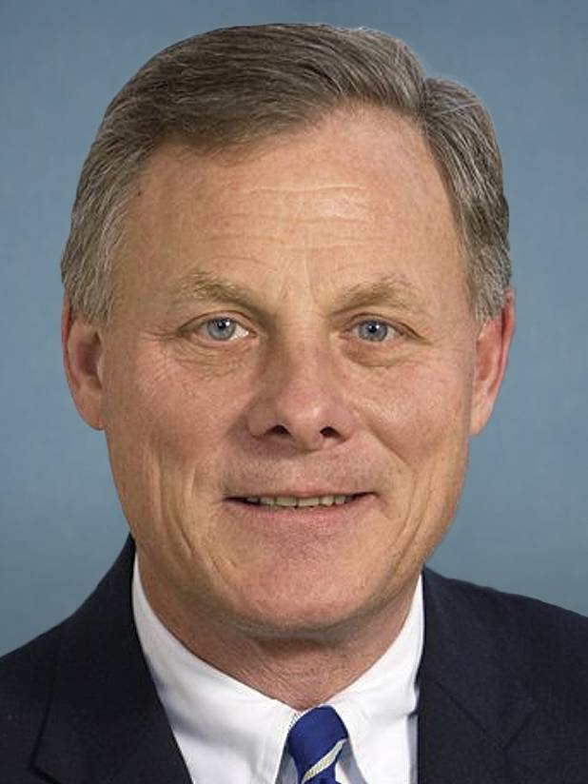
Senator Richard Burr
SEN. RICHARD BURR
Biography
Republican Richard Burr, North Carolina’s senior senator, was first elected to the Senate in 2004 after serving 10 years in the House. A hard-working and conscientious conservative, Burr has not built the national profile of other senators and has been stymied in his attempts to enter the Senate GOP leadership ranks. But his ascension to the chairmanship of the Senate Intelligence Committee in 2015 offered him a chance to prominently shape debates over surveillance and terrorism. In the House, Burr had a mostly conservative voting record. On the Energy and Commerce Committee, his early cause was streamlining the Food and Drug Administration’s drug and medical device approval process, which he argued would speed lifesaving products to the market. With broad bipartisan support, his FDA Modernization Act became law in 1997. He helped to set up the National Institute for Biomedical Imaging and Bioengineering at the NIH. After the September 11 attacks, he sponsored laws to improve defenses against bioterrorism. He sought a crackdown on illegal textile imports but backed President George W. Bush’s call for trade promotion authority after securing promises that the local textile industry would have a seat at the table. In the Senate, Burr has shown little interest in self-promotion. He has leaned conservative on cultural issues and initially toward the center on foreign policy, although he has moved further to the right in that area since Democrat Barack Obama became president.
Biography
Currently: Senator, North Carolina Elected: 2004
Education: Wake Forest U., B.A. 1978
Religion: Methodist
Family: Married (Brooke Fauth), 2 children
Contact: (202) 224-3154 RSOB room 217 Washington, DC 20510
Stance on Issues
Strong supporter of securing the border and takes a strong conservative stance on most issues of immigration Burr was part of a group of senators to keep down student loan interest rates by tying them to government’s cost of borrowing Supporter of rights for veterans including ensuring dignified burials for all veterans, Burr surprised conservatives voting in favor of repealing “Don’t Ask, Don’t Tell” Strongly favors gun ownership as an absolute right
Committees
Committee on Intelligence
Committee on Health, Education, Labor, and Pensions
Joint Committee on Security and Cooperation in Europe
Committee on Finance
Election Results
2016 General
Richard Burr (R) | Votes: 2,395,376 | Percent: 51.1%
Deborah Ross (D) | Votes: 2,128,165 | Percent: 45.4%
Sources: National Journal Almanac, 2017; Ballotpedia 2017.
May 9, 2017 | Claire Carter

Slide 14
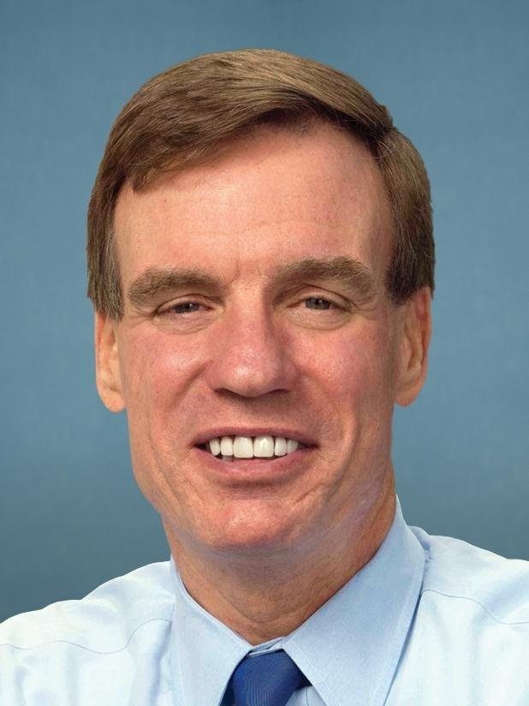
Senator Mark Warner
SEN. MARK WARNER PROFILE
Biography
Warner was born in Indianapolis, where his father was a safety evaluator for Aetna Life & Casualty Inc. and his mother stayed at home with their two children. The family moved to Vernon, Conn., when Warner was in the eighth grade. He later recalled that he was influenced by a social studies teacher who encouraged his students to pay attention to the turbulent social change unfolding in the late 1960s. He graduated from George Washington University, the first college graduate in his family, and from Harvard Law School. Although he has emphasized his business experience in his campaigns, his first love seems to have been politics. After law school, he worked in fundraising for the Democratic National Committee and in 1989, managed Douglas Wilder’s successful campaign to become Virginia’s first African-American governor. By 1999, he had an eye on running for governor in 2001 as an entrepreneur who could bring savvy business methods to government. Warner won, but not resoundingly, by 52%-47%, a reversal of the numbers in the 1996 Senate race. He carried all major regions of the state, albeit by narrow margins. Then, when Sen. John Warner announced in August 2007 that he would retire from the Senate after five terms, Mark Warner’s next career move seemed obvious. It turned out not to be a seriously contested campaign. Warner argued that the previous governor, Jim Gilmore, left the state in poor fiscal shape and that he had been able to turn things around. Warner won 65%-34%.
Biography
Currently: Senator, Virginia Elected: 2008
Education: George Washington U., B.A. 1977; Harvard U., J.D. 1980
Religion: Presbyterian
Family: Married (Lisa Collis), 3 children
Contact: (202) 224-2023 RSOB 475 Washington, DC 20510
Stance on Issues
Originally opposed new gun control laws but has since changed his stance in the wake of recent shootings Participated in bipartisan efforts to prevent financial institutions from becoming “too big to fail” Favors expanding and strengthening Obamacare
Committees
Senate Committee on Rules and Administration
Senate Committee on Banking, Housing and Urban Affairs
Senate Committee on the Budget
Senate Committee on Finance
Senate Intelligence Committee
Election Results
2014 General
Mark Warner (D) | Votes: 1,073,667 | Percent: 49.1%
Ed Gillespie (R) | Votes: 1,055,940 | Percent: 48.3%
Sources: National Journal Almanac, 2016; Ballotpedia, 2016.
May 6, 2017 | Justin C. Brown

Slide 15
Senate Intelligence Committee Oversees the agencies and bureaus of the federal intelligence community
COMMITTEE OVERVIEWS
8 Republicans nnnnnnnn |  |  | 6 Democrats + 1 Independent nnnnnnn
Richard Burr (NC) James “Jim” Risch (ID) Marco Rubio (FL) | Susan Collins (ME) Roy Blunt (MO) James Lankford (OK) | Tom Cotton (AR) John Cornyn (TX) | Mark Warner (VA) Dianne Feinstein (CA) * Ron Wyden (OR) Martin Heinrich (NM) * | Angus King (ME) * ** Joe Manchin (WV) * Kamala Harris (CA)
 |  |  | Committee chair (R) Committee ranking member (D) † Retiring after 2018 election * Up for reelection in 2018 **Independent that caucuses with the Democrats
Subcommittees
No subcommittees
January 19, 2017 | Christine Yan

Slide 16
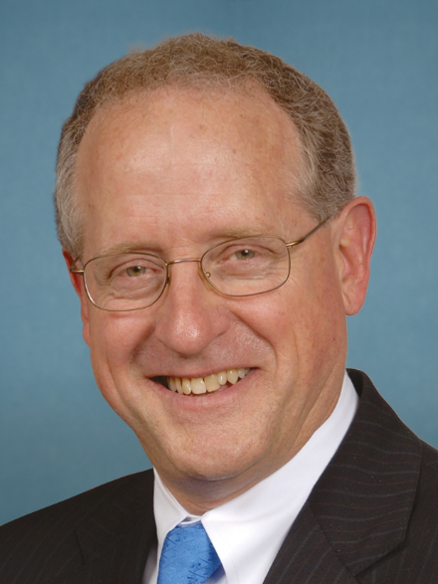
Rep. Michael Conaway
REP. MICHAEL CONAWAY
Biography
Mike Conaway, a Republican first elected in 2004, is a low-profile but well-regarded conservative who has taken on an assortment of tasks for his party, including generously fundraising for GOP colleagues and serving as chairman of the House Ethics Committee, and took the gavel of the Agriculture Committee in 2015. Conaway graduated from East Texas State University, now Texas A&M. He worked as a certified public accountant for, among others, George W. Bush, and was chief financial officer in Arbusto/Bush Exploration during the 1980s. After Bush became governor, he named Conaway to the state Board of Public Accountancy, and Conaway later chaired the National Association of State Boards of Accountancy. Conaway ran for the seat in the redrawn 11th District in 2004. He won 77%-22% and has been reelected with ease ever since. Through 2013, Conaway had a lifetime rating of nearly 93% from the American Conservative Union. He is known for requiring his staff to read and understand the Constitution. He favors state-based regulatory actions over federal ones, arguing that they are far more nimble and responsive. He has been critical of Obama administration efforts to promote renewable energy and sponsored legislation to limit the purchase of biofuels, which compete against his state’s oil and natural gas. Boehner personally asked Conaway to take the chairmanship of the Ethics Committee in 2013, and Conway was rewarded in 2015 with the chairmanship of the Agriculture Committee in 2015.
Biography
Currently: Rep., Texas (11) Elected: 2004
Education: East TX State U. B.B.A., ‘70
Religion: Baptist
Family: Married, 4 children; 7 grandchildren
Contact: (202) 225-3605 2430 Rayburn HOB Washington, DC 20515
Stance on Issues
Strongly opposes expanding the Affordable Care Act Strongly favors vouchers for school choice Strongly favors an absolute right to gun ownership Strongly opposes higher taxes on the wealthy Opposes green energy initiatives Opposes a stimulus in recession recovery Strongly opposes same-sex marriage
Committees
Committee on Agriculture, Chairman
Permanent Select Committee on Intelligence
Committee on the Armed Services
Election Results
2016 General
Mike Conaway (R) | Votes: 201,871 | Percent: 89.5%
Nicholas Landholt (L) | Votes: 23,677 | Percent: 10.5%
Sources: National Journal Almanac, 2016; Ballotpedia, 2016.
April 14, 2017 | Emilia Varrone, Claire Carter and Claire Garney

Slide 17
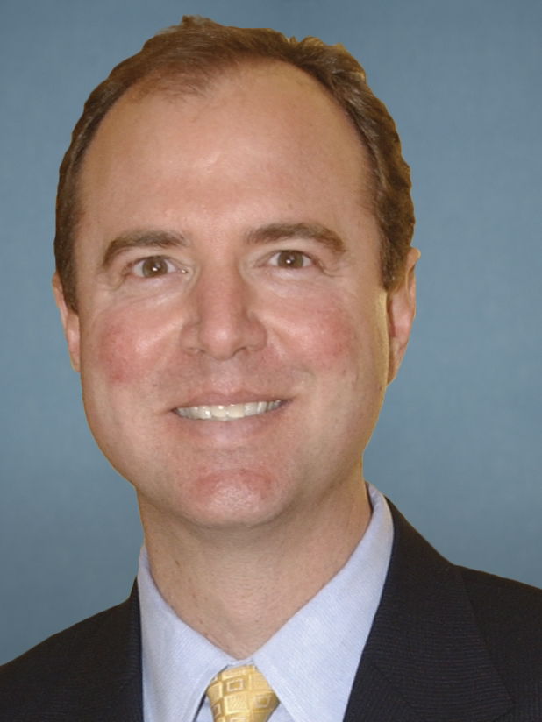
Rep. Adam Schiff
REP. ADAM SCHIFF
Biography
Adam Schiff, a Democrat elected in 2000, is an active legislator on defense, foreign policy and intellectual property issues. Schiff grew up throughout the country, eventually graduating from high school in Northern California. He went on to Stanford University and Harvard Law School. From 1987 to 1993, he worked in the U.S. attorney’s office in Los Angeles. He ran for the California Assembly and lost three times. But in 1996, he was elected to the state Senate. In his first two years, he authored dozens of measures that Republican Gov. Pete Wilson signed into law, including a bill guaranteeing up-to-date textbooks in classrooms and another reforming the child support system. Schiff also taught political science at Glendale Community College. Schiff ran for the House in the first election following the 1998 impeachment of President Bill Clinton, and the issue became a factor in a number of races in 2000. Schiff challenged incumbent Republican James Rogan. The Schiff-Rogan race became a fundraising marathon, and was then the most expensive House race on record. Schiff won by an unexpectedly large 53%-44% vote, and has been easily reelected since. In the House, Schiff joined the Blue Dog Coalition of moderate to conservative Democrats and has sometimes worked across party lines. But he also has been a party activist, contributing to the Democratic Congressional Campaign Committee’s efforts by co-chairing a mentoring program for prime candidates. Schiff is the co-founder of a Democratic study group on national security and serves on both the Intelligence and Appropriations committees. Schiff won reelection against Republican challenger Lenore Solis in November 2016, winning by 77.9% to 22.1%.
Biography
Currently: Representative, CA-28 Elected: 2000
Education: Stanford University, B.A. 1982; Harvard Law School, J.D. 1985
Religion: Jewish
Contact: (202) 225-4176 Rayburn House Office 2411 Washington, D.C. 20515
Stance on Issues
Strongly favors expanding Obamacare Strongly opposes vouchers for school choice Supports expanding free trade Favors prioritizing green energy Opposes privatizing Social Security
Committees
House Appropriations Committee
House Permanent Select Committee on Intelligence
Election Results
2016 General
Adam Schiff (D) | Votes: 156,172 | Percent: 77.9%
Lenore Solis (R) | Votes: 44,419 | Percent: 22.1%
Sources: National Journal Almanac; Ballotpedia, 2016.
December 7, 2016 | Jessica Grischkan

Slide 18
Roadmap for the presentation
RUSSIA INVESTIGATION
What are the investigations?
Key people involved
Key events

Slide 19
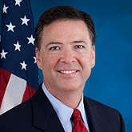
Trump fires FBI Director Comey
FEDERAL INVESTIGATION BUREAU
Details of letters written by Trump and Rosenstein dismissing Comey
May 8, 2017
fc
Trump said that he fired Comey based on the a letter by Deputy Attorney General Rod Rosenstein, who criticized Comey’s handling of the Clinton email investigation
This surprised many people, because Trump had previously praised Comey’s handling of that investigation; skeptics suggested that Trump may have used Rosenstein’s letter as a pretext
Just before he was fired, Comey reportedly requested more resources from the Justice Department for the FBI investigation into Trump’s ties to Russia
The Trump Administration announced that a search for the replacement head of the FBI begins immediately; no potential successors have been announced
Rosenstein’s letter:
Rosenstein, who is widely considered to be nonpartisan, harshly denounced Comey’s handling of the Clinton email investigation. Rosenstein cited Comey’s disclosures about Clinton’s conduct and his letter to Congress before the election as errors in judgment. He also argued that anger against Comey undermined the FBI’s ability to do its job.
James Comey
Former director,
Federal Bureau of Investigation
“
The FBI is one of our Nation’s most cherished and respected institutions and today will mark a new beginning for our crown jewel of law enforcement.”
—President Donald Trump, after firing Director Comey
Source: National Journal research.
May 9, 2017 | Owen Minott

Slide 20
Senate Intelligence Committee subpoenas Flynn and requests Trump-relevant financial data from Treasury
Cybersecurity vertical sample — for more detail, please contact your DA about premium content access
Five key developments in the ongoing Russia saga
April letter
Letters from the Senate Intel Committee were sent to at least four associates of the Trump campaign: Carter Page, Roger Stone, Paul Manafort and Michael Flynn. With May deadlines, Sens. Burr (R-NC) and Warner (D-VA) requested details on meetings, communications, financial and real estate holdings they or any other campaign officials had with Russian officials or representatives of Russian businesses
FinCEN request
In tandem with the Flynn subpoena, Burr and Warner asked the Treasury Department’s Financial Crimes Enforcement Network to submit to the committee any information it has gathered regarding financial connections between Russia (or any other country) and Trump or his associates
4
1
Lack of response
While Page and one of the other three reportedly provided responses to the committee, Flynn’s counsel issued a statement indicating that his client would not “submit to questioning in such a highly politicized, witch hunt environment without assurances against unfair prosecution”
Grand jury subpoenas
It was also revealed on Wednesday that former Flynn associates have recently been subpoenaed by the U.S. Attorney’s Office in Alexandria, Virginia. Federal prosecutors working on the FBI’s investigation into links and/or collusion between the Trump campaign and Russia are said to be seeking business records from individuals involved in Flynn’s activities and contracts following his 2014 dismissal from the Defense Intelligence Agency
2
5
Subpoena issued
Following the statement from Flynn’s lawyer, Sens. Burr and Warner took the step of issuing a subpoena on Wednesday, May 10. Flynn will now be compelled to provide the committee with information and documents relevant to the panel’s investigation into Russia’s election interference
3
Sources: Karoun Demirjian, “Senate Intelligence Committee subpoenas documents from Flynn in Russia probe,” May 10, 2017; Riley Beggin, Ali Rogin and Justin Fishel, “Senate Intelligence Committee subpoenas Michael Flynn for documents in Russia investigation,” ABC News, May 10, 2017; Tom LoBianco, “Senate Russia investigators ask Treasury for Trump team financial information,” CNN, May 10, 2017; Evan Perez, Shimon Prokupecz and Pamela Brown, “Grand jury subpoenas issued in FBI’s Russia investigation,” May 10, 2017.
May 11, 2017 | Jessica Grischkan

Slide 21
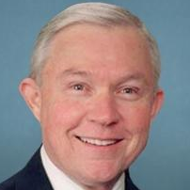
Attorney General Jeff Sessions spoke with the Russian ambassador to the US twice during the presidential election
SESSIONS RUSSIA CONTROVERSY
Timeline of the Jeff Sessions and Russia controversy
July 18th
Russian ambassador Sergey Kislyak approached Sessions at the Republican National Convention
The Heritage Foundation hosted an event attended by about 50 ambassadors during the Republican National Convention. Kislyak and a small group of ambassadors approached Sessions as he was leaving the podium after the event. Sessions spoke individually to a few of the ambassadors, including Kislyak.
Then-Senator Jeff Sessions met with Ambassador Kislyak in his Capitol Hill office
At the time, US intelligence officials were in the middle of an investigation regarding Russia’s cyber interference in the presidential election. Sessions holds he met with Kislyak in his capacity as a senior member of the Armed Services Committee. None of the other 26 members of the 2016 Senate Armed Services Committee met with the ambassador in 2016.
Sen. Al Franken (D-MN) asked Sessions during his confirmation hearing if he or anyone affiliated with the Trump campaign communicated with the Russian government during the campaign
Sessions said he was unaware of any communications with the Russians adding, “I have been called a surrogate at a time or two in that campaign and I did not have communications with the Russians."
Sessions released a statement saying, “I never met with any Russian officials to discuss the issues of the campaign.”
In response to resounding criticism, Sessions recused himself from any current or future investigation of Russia’s interference in the 2016 presidential election
Congressional Republicans and Democrats called for Sessions to recuse himself from the DOJ Russia probe. Some Democrats, including House minority leader Nancy Pelosi, have called for Sessions to step down as attorney general.
Attorney General
Sept. 8
Jan. 10
Jeff Sessions
Former Republican Senator from Alabama
March 1
March 2
Source: Adam Entous, Ellen Nakashima and Greg Miller, “Sessions met with Russian envoy twice last year, encounters he later did not disclose,” Washington Post, March 1, 2017; Eric Lichtblau, Michael Shear and Charlie Savage, “Jeff Sessions recuses himself from Russia inquiry,” NY Times, March 2, 107.
March 2, 2017 | Libbie Wilcox

Slide 22
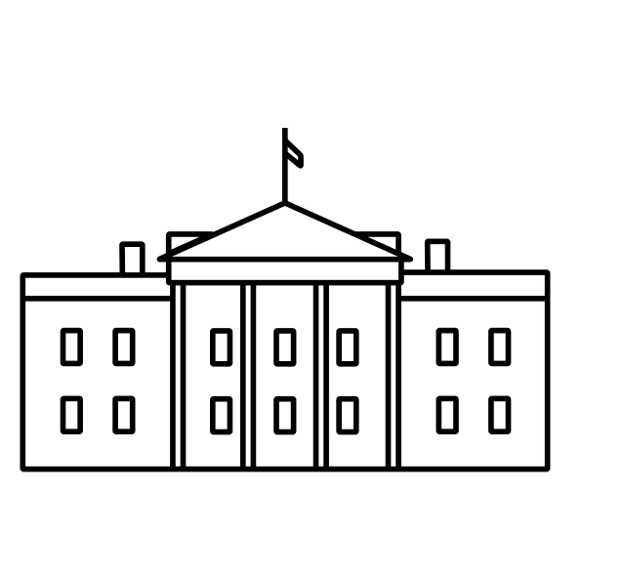
New Russia revelations: AG met with Russia’s ambassador, Obama officials traced path for investigators
RUSSIA DEVELOPMENTS
Details on the latest developments and controversies
AG under fire
Attorney General Jeff Sessions met with Russia’s ambassador to the U.S. on two occasions in 2016, first in July at an RNC event in Cleveland and again in September in the then-senator’s office on Capitol Hill. The communications were unearthed as part of an investigation conducted by the FBI, CIA, NSA and Treasury Department into links between Russia and President Trump’s campaign
Sessions, who was a foreign policy adviser to the Trump campaign, testified during his January confirmation hearing that he had not discussed matters related to the campaign or election with Russian officials. The attorney general’s spokesperson defended that response, differentiating between Sessions’ involvement with the Trump campaign and his role as a senior senator on the Armed Services Committee
Citing this latest revelation, Democrats are intensifying their calls for an independent investigation into Russia’s ties to the Trump campaign and for Sessions’ recusal from the probe. Several members of Congress, including Reps. Nancy Pelosi (D-CA) and Elijah Cummings (D-MD) and Sen. Claire McCaskill (D-MO), are urging Sessions to resign
The Russian ambassador with whom Sessions met is the same individual whose conversations with Michael Flynn led to the former national security adviser’s resignation
The Obama White House
In a separate development, the New York Times reported that in the final days of the Obama administration (and independently of the president), senior White House officials sought to “preserve and distribute” intelligence regarding Russia’s interference in the election and possible connections to Trump’s campaign. Their efforts, which included posing questions during intelligence briefings so the answers would be archived, were intended not only to raise the profile of the issue across the government but also to highlight leads for investigators to pursue after the change in administration
Intelligence agencies are also reported to have had a role, maximizing their processing of raw data and producing reports that could be read by those without top security clearances
Sources: Carol E. Lee, Christopher S. Stewart, Rob Barry and Shane Harris, “Investigators probed Jeff Sessions’ contacts with Russian officials,” WSJ, March 2, 2017; Adam Entous, Ellen Nakashima and Greg Miller, “Sessions met with Russian envoy twice last year, encounters he later did not disclose,” Washington Post, March 1, 2017; Mathew Rosenberg, Adam Goldman and Michael S. Schmidt, “Obama administration rushed to preserve intelligence of Russian election hacking,” NYT, March 1, 2017; Images by Edward Boatman and Dan Benyishay, Noun Project, March 2017.
March 2, 2017 | Jessica Grischkan

