Slide 1
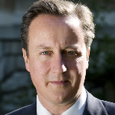
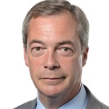
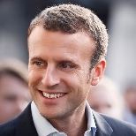
Nationalist segments tapped into anti-establishment momentum, but results were limited by electoral system
ANTI-ESTABLISHMENT ELECTIONS
■ Establishment ■ Anti-establishment
Stay: Led by Conservative PM David Cameron who had promised an EU referendum if elected; also backed by Labour leadership
Leave: Led by Nigel Farage of the United Kingdom Independence Party (UKIP) and supported by the former mayor of London, Boris Johnson
Result: Generally, rural and industrially depressed areas voted to leave while cities and most of Scotland voted to stay
Turnout: 72.2% (of registered voters)
Brexit
Stay in the EU
(establishment coalition)
Leave the EU
(nationalist)
Clinton: Former secretary of state, senator and first lady
Trump: Real estate billionaire and reality TV host
Result: Trump latched on to the frustration of white working class voters while maintaining the reluctant support of the establishment right whom he had vilified in the primary
Clinton won 2.8 million more votes, but lost in the electoral college
Turnout: 86.8% (of registered voters), 60.2% (of eligible voters)
US presidential election
Clinton
Democrat (centrist)
Trump
Republican (nationalist)
Macron: Former Socialist Party member, economy minister and banker
Le Pen: EU Parliament member, daughter to polemical party founder
Result: Macron won 24% of the vote in the 1st round and 66% in the 2nd round against Le Pen; all parties except the populist far-left party supported Macron in order to block Le Pen
Legislative elections occur later in the year
Turnout: 74.56% (of registered voters)
French presidential election
Le Pen
National Front
(nationalist)
Macron
En Marche!
(centrist)
Sources: National Journal Research, 2017. “EU Referendum Result,” BBC. “America goes to the polls,” Nonprofit VOTE. Constitutional Council of France.
May 16, 2017 | Daniel Stublen

